Slide 1
INFO 5871-001: Data Science / Info Science
Robin burke, Fall 2019

Slide 2
document similarity
Week 12 Part 3

Slide 3
term-document matrix
 | I | Market | Would | Start | Go | … | Wall | Border | Pelosi
Doc1 | 2 | 2 | 2 | 1 | 1 |  | 0 | 0 | 0
Doc2 | 2 | 2 | 0 | 0 | 1 |  | 0 | 0 | 1
Doc3 | 0 | 0 | 1 | 1 | 0 |  | 2 | 1 | 0
…

Slide 4
Why do we want document similarity?
Classification/Clustering
if documents are closer together, maybe they are about the same thing?
if we have a distance measure, we can create clusters of similar documents
Querying
A query is (sort of) a tiny document
So we can use similarity between query and document to retrieve documents
Recommendation
A user's profile is (sort of) a big document
think of a collection of all the documents they've read (or liked)
We can use similar of profile and document to do personalized recommendation

Slide 5
document vector
d_{i}, One row of the matrix corresponding to a given document
d_{i}[t] = the entry for one term in the vocabulary, 0 if that term doesn't appear
could be binary, integer, real-valued, depending on how the matrix is built
Sparse!
It will be rare for a document to even a large fraction of all the terms in the vocabulary
Lots of zeros!
This has implications for how underlying implementations work for text processing

Slide 6
document similarity = (sparse) vector comparison
Options
Jaccard
dot-product
cosine
There are others
some based on distributional differences (probability) and information theory (entropy)

Slide 7
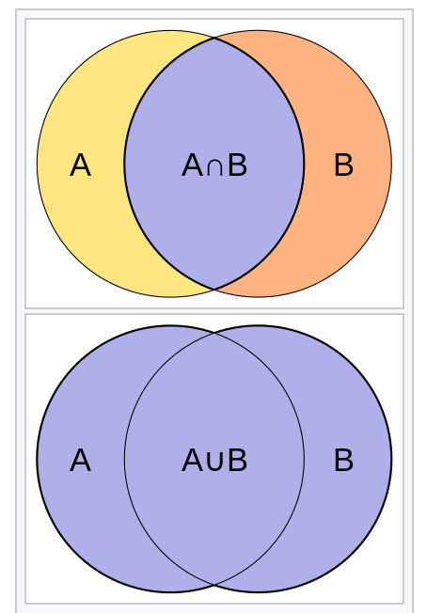
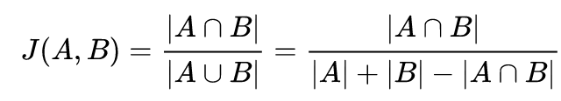
Jaccard coefficient
Binary vectors, treated as sets
Intersection / Union
Think of as the overlap, normalized by the potential overlap
If the documents have all the same terms, then 1
Notes:
Measuring the similarity between sets, 0– 1

Slide 8
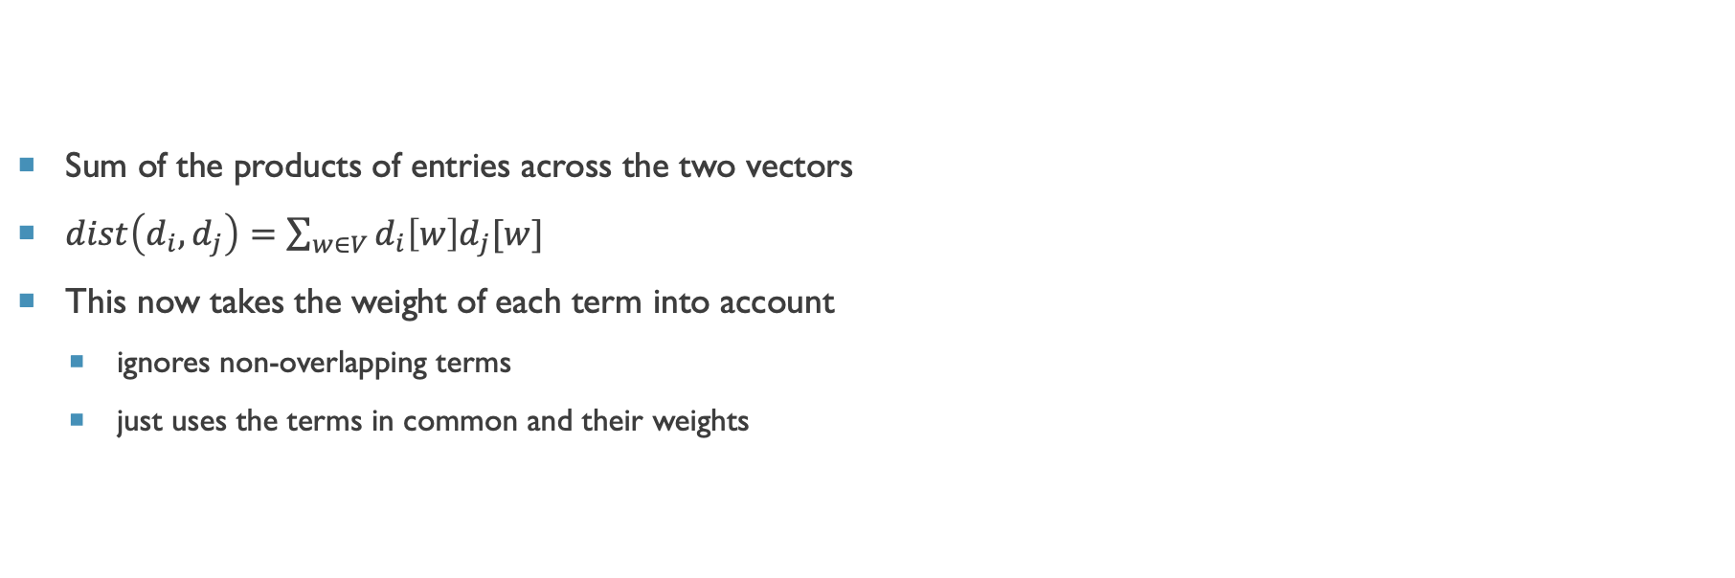
dot product
Sum of the products of entries across the two vectors
$dist\left(d_{i},d_{j}\right)=\sum_{w∈V}{d_{i}\left[w\right]d_{j}[w]}$
This now takes the weight of each term into account
ignores non-overlapping terms
just uses the terms in common and their weights

Slide 9
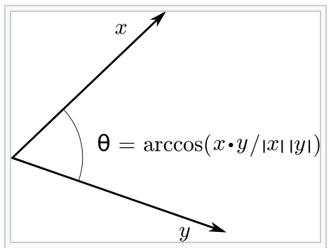
document angle
If we think of documents as high-dimensional vectors, similar documents would be ones "pointing" in the same direction
The angle between two document vector is a measure of similarity
smaller angle = more similar
Highly related to the dot product via inverse cosine
But
inverse cosine is expensive to compute
easier to compute the cosine of the angle
transformation preserves ordering so non-linearity not an issue

Slide 10
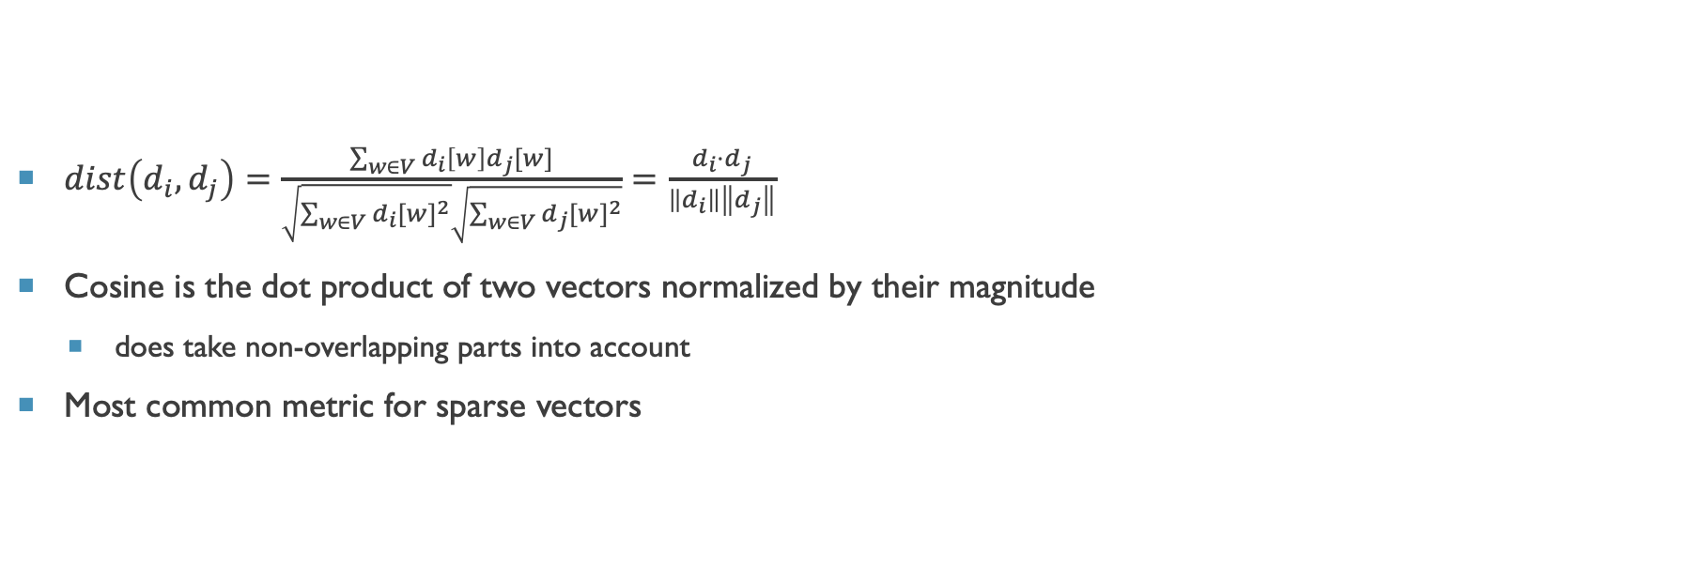
cosine similarity
$dist\left(d_{i},d_{j}\right)=\frac{\sum_{w∈V}{d_{i}\left[w\right]d_{j}[w]}}{\sqrt{\sum_{w∈V}{{d_{i}[w]}^{2}}}\sqrt{\sum_{w∈V}{{d_{j}[w]}^{2}}}}=\frac{d_{i}{⋅d}_{j}}{\left\|d_{i}\right\|\left\|d_{j}\right\|}$
Cosine is the dot product of two vectors normalized by their magnitude
does take non-overlapping parts into account
Most common metric for sparse vectors
dot product
magnitudes

