Slide 1
INFO 5871-001: Data Science / Info Science
Robin burke, Fall 2019

Slide 2
Working with APIS
Week 12 Part 4

Slide 3
Web applications
A web application is an application that uses the web (HTTP) protocol
as its interface
Can be accessed by a web browser
or by a program issuing HTTP requests

Slide 4
Application
Browser
Web Server
Server Application
Client Application

Slide 5
HTTP
Two step protocol
request
client submits a method, a URL, header information
optional data
response
server returns a response code, heading information
data
Stateless
requests are independent of each other

Slide 6
Example
Using a browser
http://www.netflix.com
Web Server
File System
homepage

Slide 7
Actually
A modern web application spawns dozens of requests
HTML page
images
Javascript libraries
ads
May come from multiple servers

Slide 8
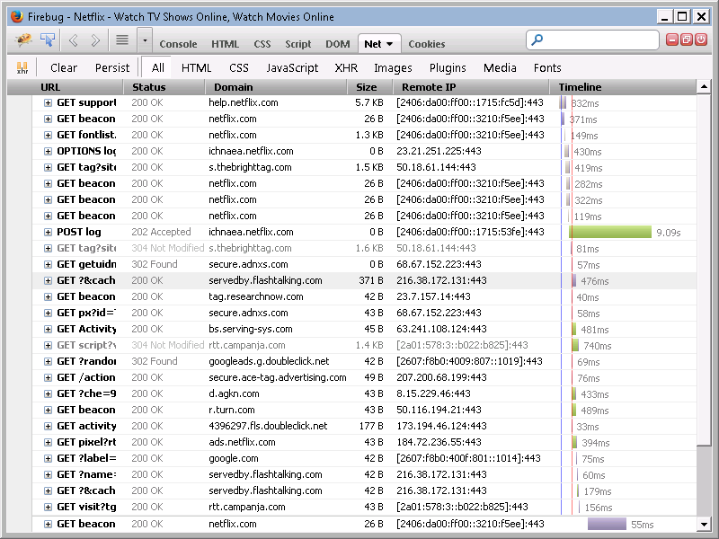
Firebug demo

Slide 9
Web APIs
Many systems support access at the API level
API = application program interface
For example
request a specific piece of data
10 most recent tweets in a user’s timeline

Slide 10
Web APIs
Developers can build an application on top of the original one
Can combine multiple data sources
mashup

Slide 11
Can I Stream It?
App that queries multiple streaming services
Amazon, Netflix, Hulu, etc.
To see where a particular movie can be watched

Slide 12




Can I Stream It?
Server1
Server2
“Iron Man”
App
Server3
Server4

Slide 13
API requests
Still a URL but not the same as a browser would use
Associated data
key-value pairs
like a Python dictionary
Request data is encoded
this is the part after the question mark
Response will not be HTML
something machine readable
usually XML or JSON

Slide 14
In Python
we can make API calls directly
Need to know
what URLs exist
what data they expect
how to interpret the output

Slide 15
Encapsulated API
For many of the services we are using
someone has already written a “wrapper”
A Python library that takes care of all the details
twitter package
But it is still just HTTP requests and responses underneath

Slide 16
Output: JSON
Javascript Object Notation
Very simple “serialization” language
Serialization means
taking a data structure
writing it to a file or a string
in a form that can be read back in again

Slide 17
JSON example: (old) Google search
{"responseData":
{"cursor":
{"moreResultsUrl":
"http://www.google.com/search?oe=utf8&ie=utf8&source=uds&start=0&hl=en&q=Robin+Burke+CSC299",
"estimatedResultCount": "5", "searchResultTime": "0.21", "resultCount": "5",
"pages":
[{"start": "0", "label": 1}, {"start": "4", "label": 2}],
"currentPageIndex": 0},
"results":
[{"GsearchResultClass": "GwebSearch",
"visibleUrl": "www.cdm.depaul.edu",
"titleNoFormatting": "CSC 299: Course Information - DePaul University",
"title": "<b>CSC 299</b>: Course Information - DePaul University",
"url": "http://www.cdm.depaul.edu/academics/pages/courseinfo.aspx%3FCrseId%3D012234",
"cacheUrl": "http://www.google.com/search?q=cache:uhfYJVHl12EJ:www.cdm.depaul.edu",
"unescapedUrl": "http://www.cdm.depaul.edu/academics/pages/courseinfo.aspx?CrseId=012234",
"content": "<b>CSC 299</b>: Sophomore Lab in Applied Computing. In this course, students \ninvestigate a <b>...</b> Instructor: <b>Robin Burke</b> | View syllabus. CLOSED. Fall 2013-2014\n\u00a0<b>...</b>"},

Slide 18
JSON syntax
Familiar Python constructs
{ }
dictionaries
[ ]
lists
In some combination
Often experimentation needed
to find the bit you need

Slide 19
Cursor / Page
Sometime a query will have many, many answers
E.g. Web search
Server won’t return them all
But it might return one ”page” worth of answers
And then you can follow up to get the next chunk
Etc.
You will need to figure out
if your API does this
How to get more if needed

Slide 20
OAuth
What if your web application depends on a user logging in?
You can’t ask the user to type in their password
the client program could run in any environment
user might not be there
You REALLY don’t want the user’s password to be in your program code
major security hole

Slide 21
OAuth Solution
A three-way protocol
user
service
client
The user wants to delegate his / her privileges on the service to the client

Slide 22
Step 1
The user gets a token that identifies the service to be used
the token could include information about specific permissions
maybe the client should be able to read and not post

Slide 23
Step 2
The user asks the service to create a pair of credentials
authorization key
authorization secret
Sort of a username and password
but you can’t learn the user’s credentials from this information
they are disposable credentials

Slide 24
Step 3
The user hands the credentials to the client
could be embedded in code
could be that the client does these steps

Slide 25
Step 4
The client can now interact with the server
as if it were the user
with whatever permissions it was granted

Slide 26
Benefits
The authorization can be revoked at any time
don’t have to change your password
Fine-grained permissions

Slide 27
User
Application
get token
User
send token, credentials
Application
get OAuth credentials
send OAuth credentials
Client Application
send OAuth credentials
Application
interact with application

Slide 28
example using duckduckgo
Doesn't require Oauth
If the web page says "you need to register as a developer to use our API",
they're saying you need to generate an OAuth key
Notes:
Beautiful Soup: package for html in python

