Slide 1
INFO 5871-001: Data Science / Info Science
Robin burke, Fall 2019

Slide 2
Multidimensional distribution
Week 13, Part 1

Slide 3
Multidimensional distribution
Multiple events can happen at once
Weather
cloud cover, temperature, humidity, wind speed, wind direction, etc.
A joint distribution describes the probability of multiple events

Slide 4
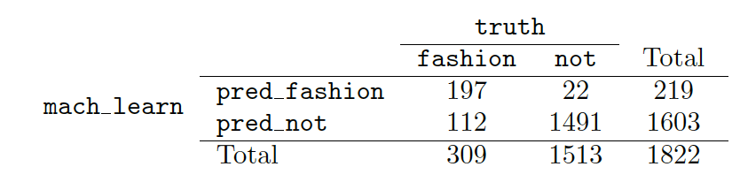
joint probability table
For discrete event spaces
we can create a table of what happens

Slide 5
multinomial distribution
Binomial distribution: defined by an outcome present or absent (coin flip = "heads") with some probability p
count the number of successes
Multinomial distribution
I flip many coins at once, all with different probabilities
p₁…p_{k}
Count the number of joint outcomes
Each set of p₁..p_{k} probabilities and trials defines a different multinomial distribution

Slide 6
multinomial distribution Example
p = 0.5
trials = 2
4/16 + 4/8 + 1/4
¼ + ½ + ¼ = 1
 | 0 heads | 1 head | 2 heads
0 heads | ¼*¼=1/16 | ½*¼=1/8 | ¼*¼=1/16
1 head | ½*¼=1/8 | ½*½=1/4 | ½*¼=1/8
2 head | ¼*¼=1/16 | ½*¼=1/8 | ¼*¼=1/16

Slide 7
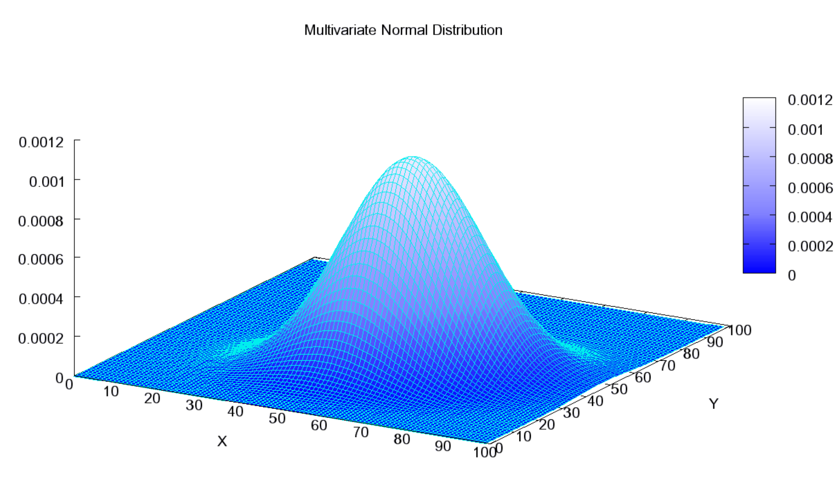
Continuous joint probabilty
Multivariate distribution
Probability of each combination of values
like continuous distribution it is the "volume" under a patch of the surface that we are interested in
Think of throwing darts at a dartboard
Multivariate normal
a normal distribution for each slice along the x and y axes

Slide 8
What if dimensions are related?
Suppose I have a jar that can hold 10 balls
I randomly put some combination of red, green, and yellow balls in it
The probability of drawing a red ball is not independent of the probability of drawing a yellow ball
If P(yellow) is 0.9 (9 yellow balls), then P(red) and P(green) cannot be greater than 0.1
If P(yellow) and P(red) are each 0.5, then P(green) = 0 (no green balls)

Slide 9
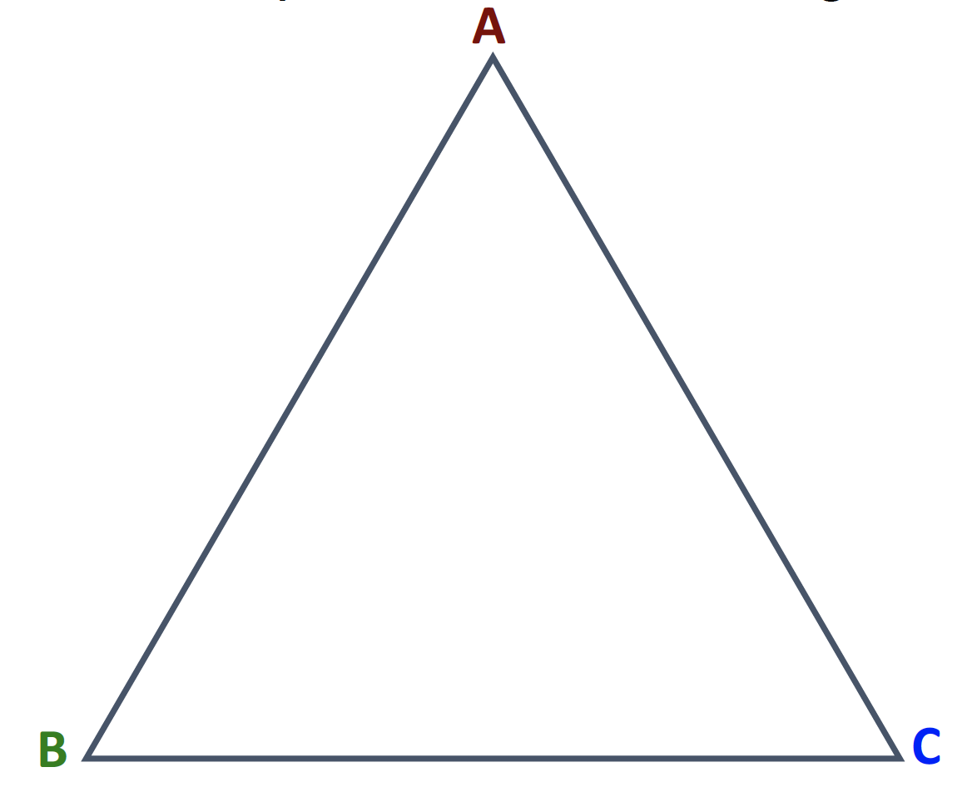
dirichlet distribution
After Peter Gustav Lejeune Dirichlet
A distribution over K elements is a point on a K-1 simplex
A 2-simplex is a triangle
3-simplex is a tetrahedron, etc.
Defined for n elements (any dimension)
but three is easier to visualize!

Slide 10
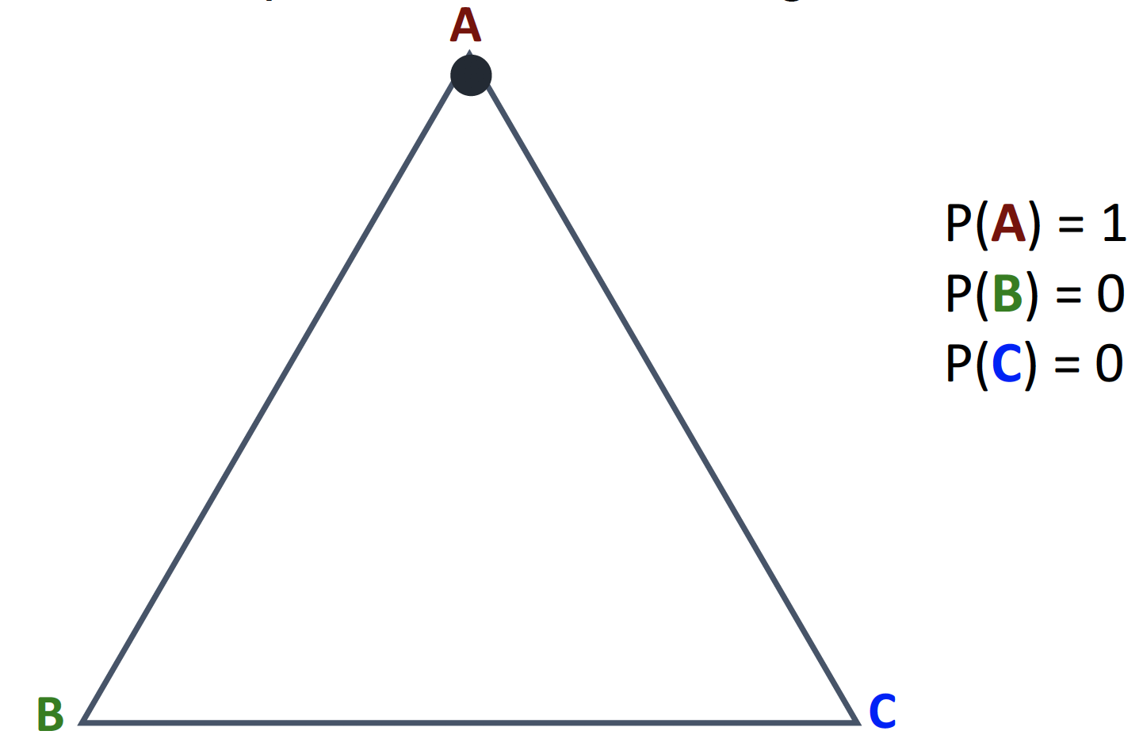
points on the simplex

Slide 11
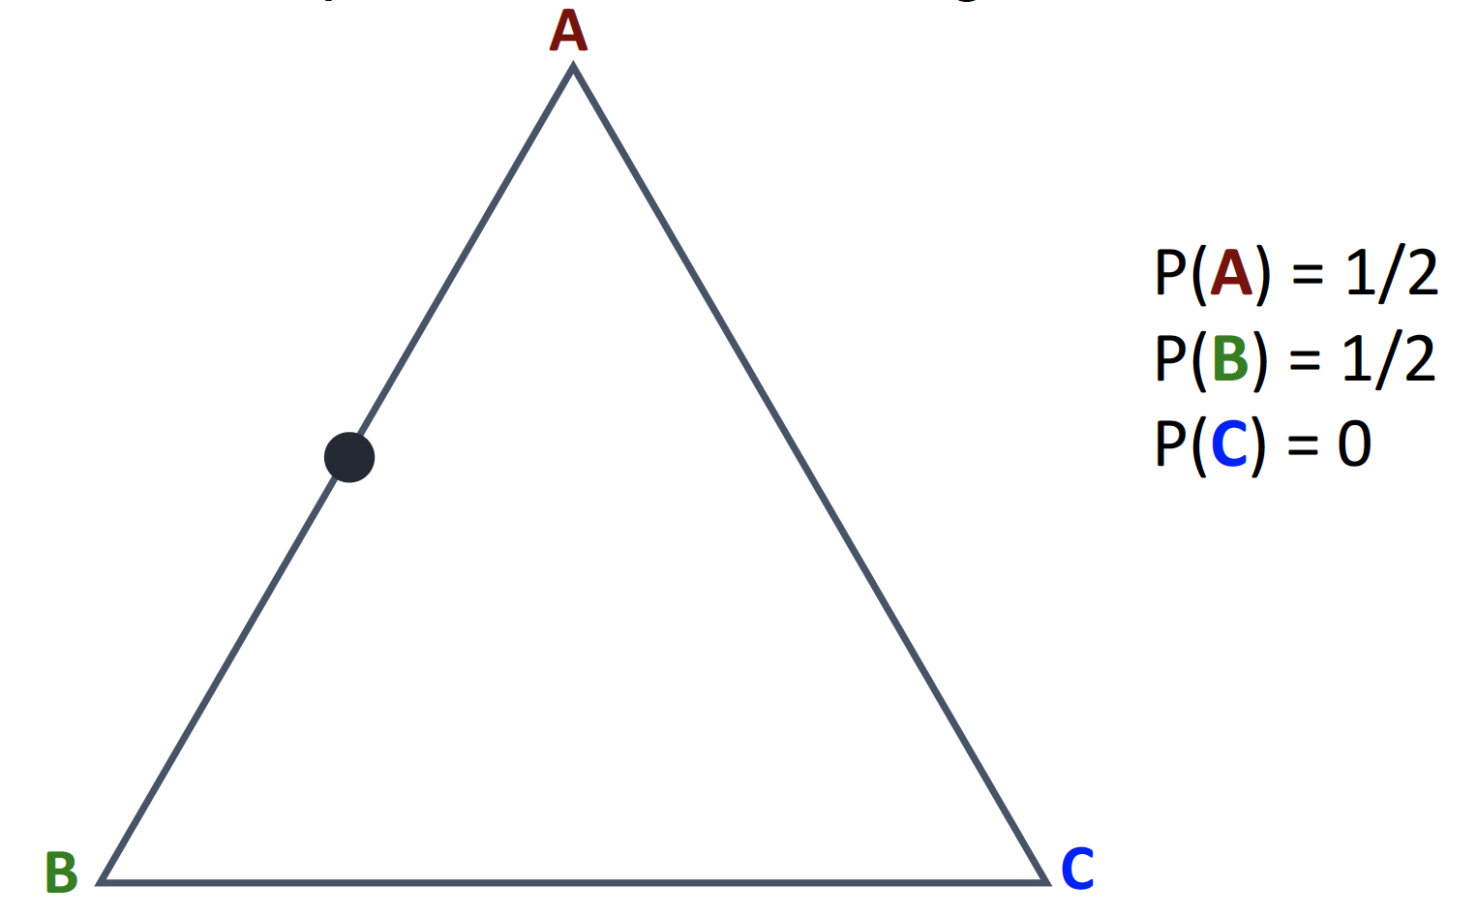
points on the simplex

Slide 12
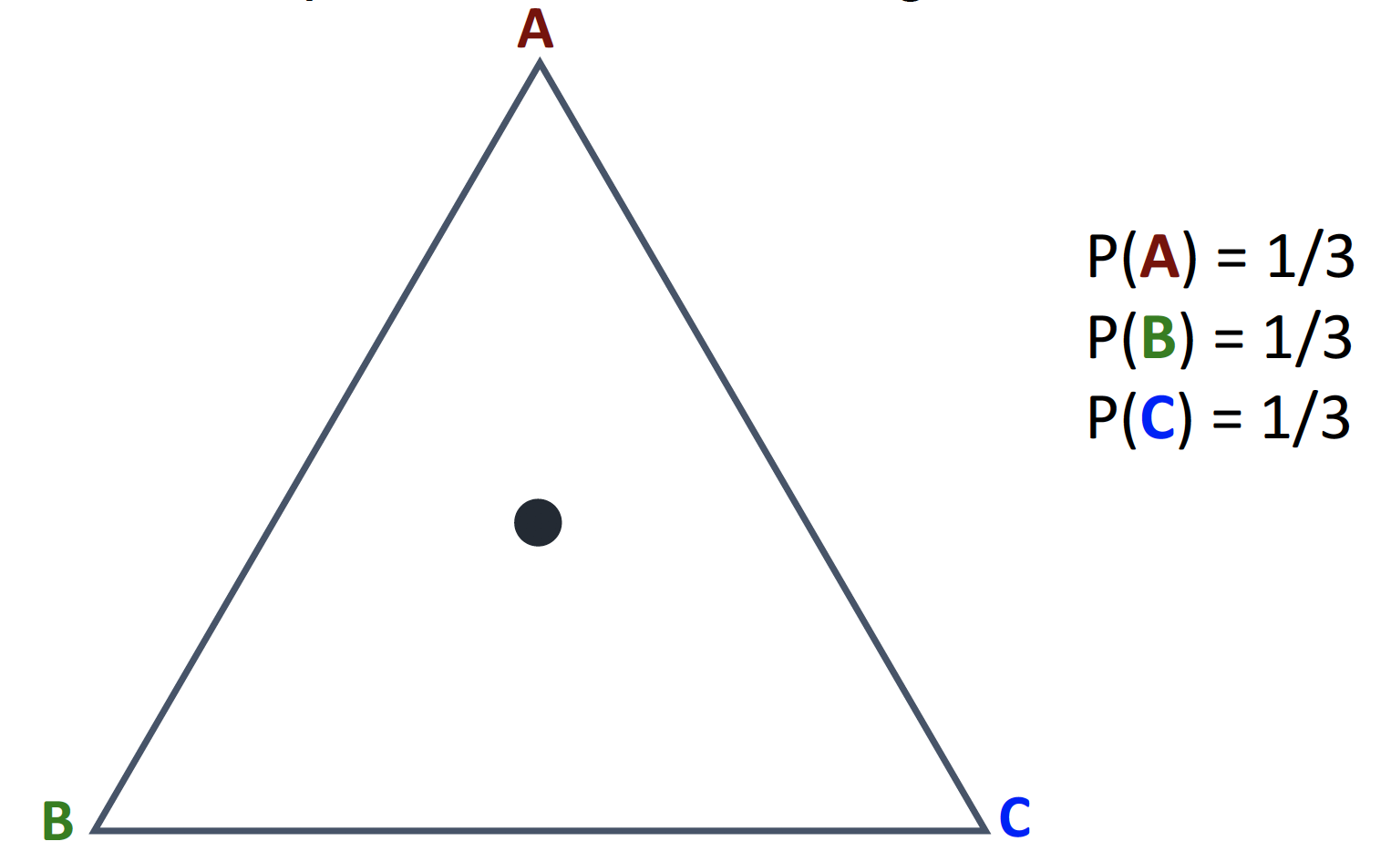
points on the simplex

Slide 13
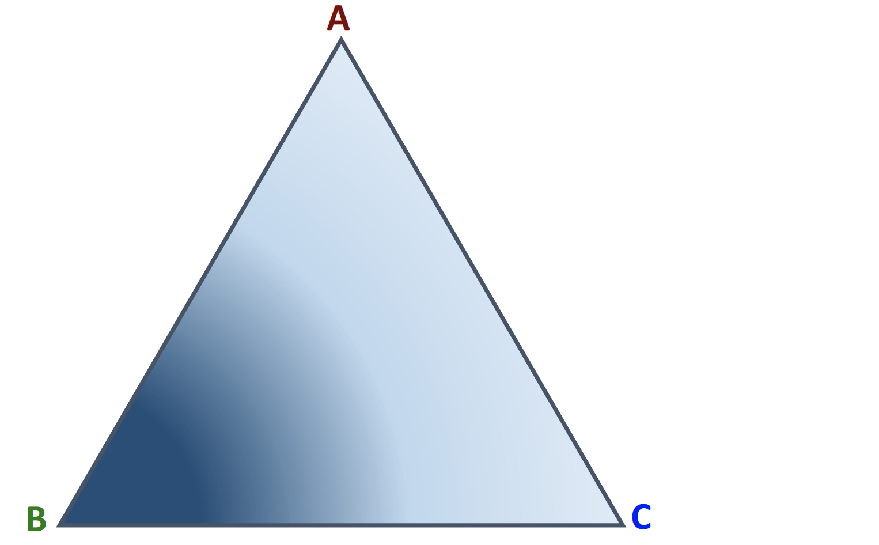
Dirichlet distribution
Continuous distribution over the simplex
This example B has higher probability that the others

Slide 14
Dirichlet distribution
Dirichlet(α)
α is vector that determines mean/variance for each dimension
[α_{A}, α_{B}, α_{C}]
Here α_{B} > α_{B}, α_{C}

Slide 15
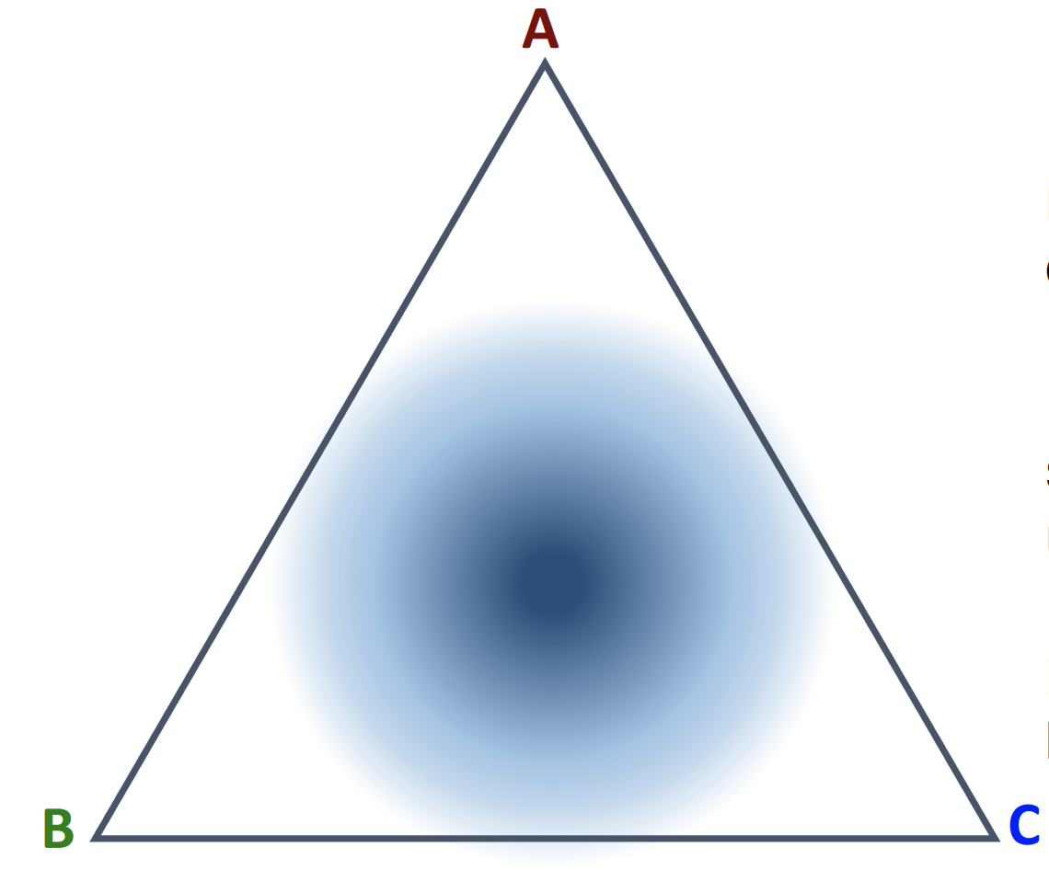
Dirichlet distribution
[α_{A}, α_{B}, α_{C}]
Here α_{B} = α_{B} = α_{C}
If α values are high, lower variance
more "peaky" distribution
If α values are lower, higher variance
flatter distribution

Slide 16
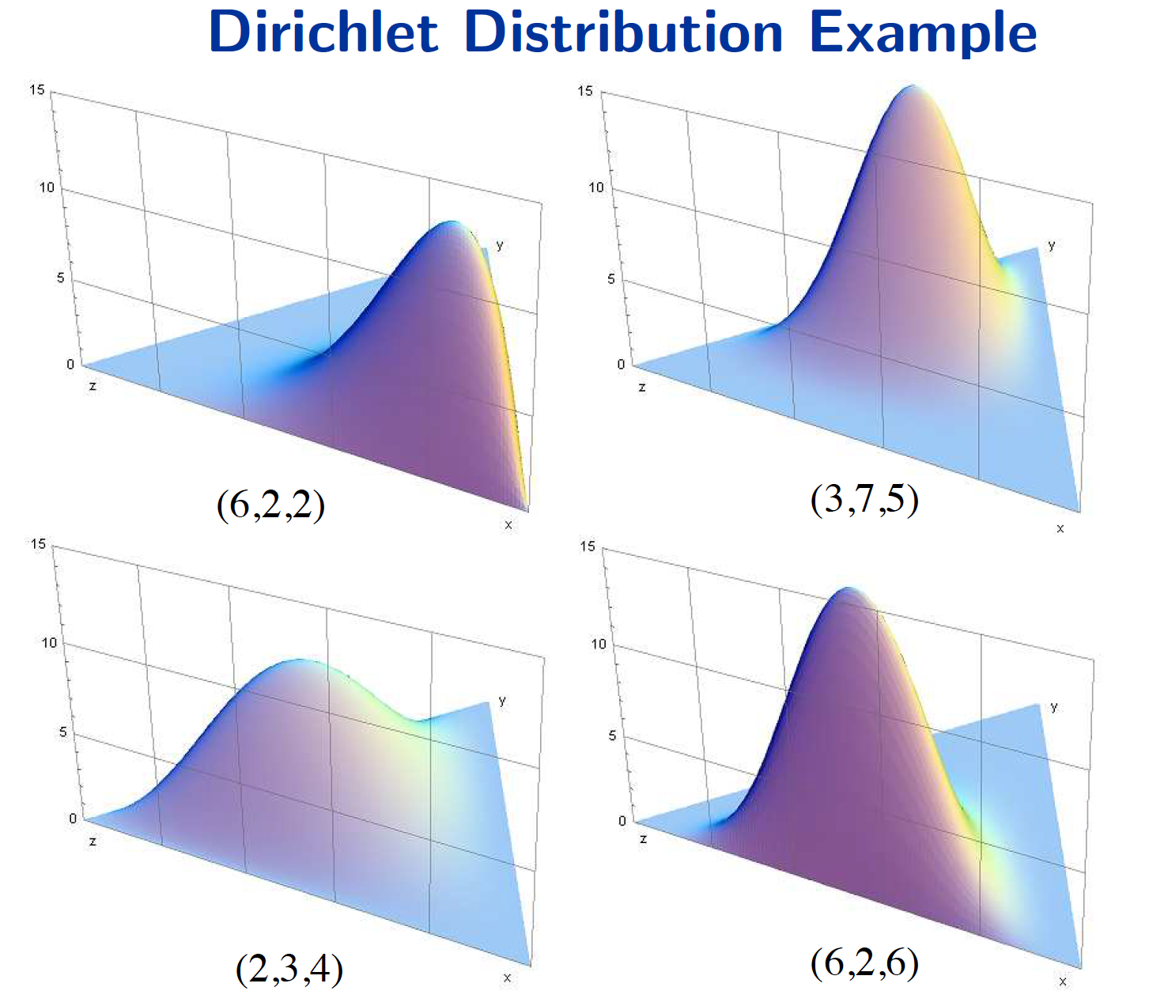
Examples
Note:
Higher α values for one dimension makes that dimension more probable
Higher α values overall make the distribution more "peaked"

