Slide 1
INFO 5871-001: Data Science / Info Science
Robin burke, Fall 2019

Slide 2
Topic modelilng via LDA
Week 13, Part 1

Slide 3
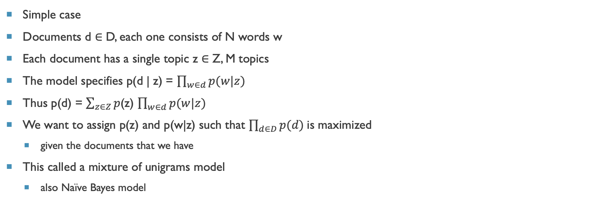
Generative modeling of text
Simple case
Documents d ∈ D, each one consists of N words w
Each document has a single topic z ∈ Z, M topics
The model specifies p(d | z) = $\prod_{w∈d}{p(w|z)}$
Thus p(d) = $\sum_{z∈Z}{p}$(z) $\prod_{w∈d}{p(w|z)}$
We want to assign p(z) and p(w|z) such that $\prod_{d∈D}{p(d)}$is maximized
given the documents that we have
This called a mixture of unigrams model
also Naïve Bayes model
M
N
z
w

Slide 4
How to solve
Multiple methods can be used
Gibbs sampling, variational Bayes, etc.
Expectation maximization
Initialize p(z) and p(w|z) randomly
Hold p(z) fixed, update the p(w|z) values using Bayes rule
Hold p(w|z) fixed, update p(z)
Alternate until convergence

Slide 5

Model is too simple
Think about a newspaper article within a corpus of all NY Times articles from 2019
Hong Kong
Student activism
what else…

Slide 6
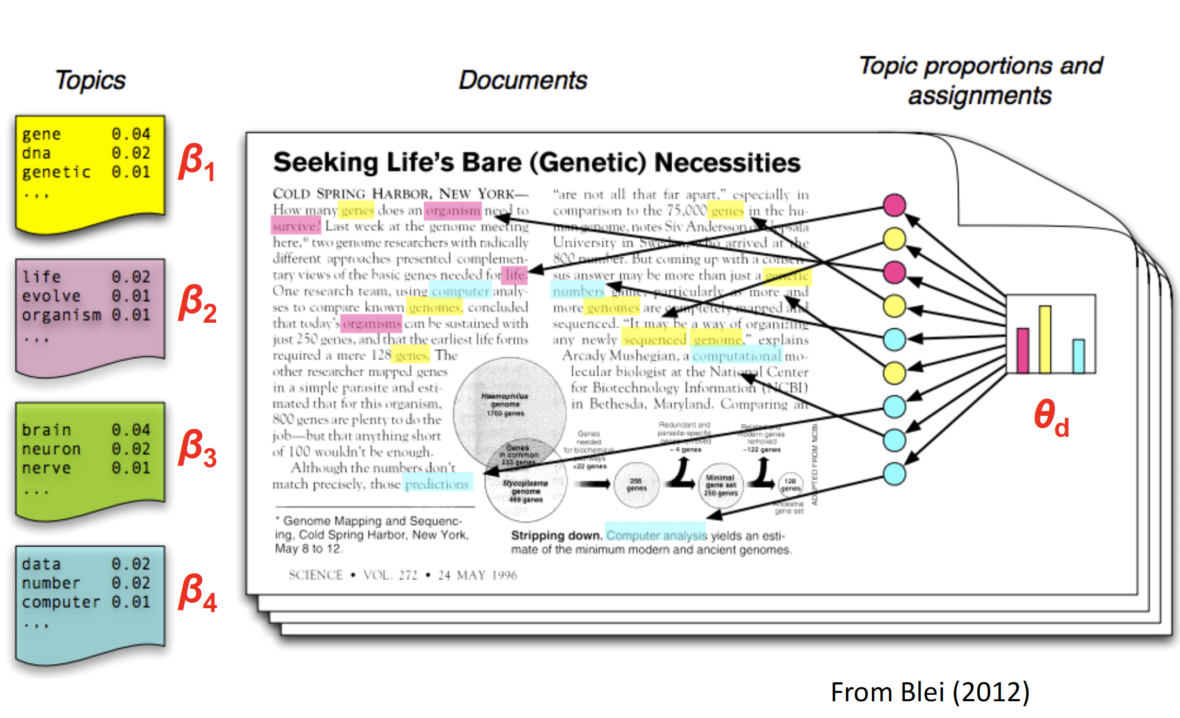

Slide 7
multitopic model
Generative model assumes that there are multiple topics per document
p(z|d) is therefore a sample from a Dirichlet distribution
a vector of probabilities, one for each topic
Usually represented by 𝜃
Generative model
For each document d, sample from a Dirichlet(α) to get 𝜃_{d}. This is a multinomial distribution over topics
α determines the sparsity of the distribution (how many topics per document)
Sample a topic z from 𝜃_{d}. This will be the topic of the next word in the document
From p(w|𝛽, z), sample a word w
𝛽 is the parameter for another Dirichlet prior on the association of words and topics
Repeat for all the words in the document
Repeat for all documents

Slide 8
Maximize likelihood
α, 𝛽 and K are are fixed parameters (input to the algorithm)
α and 𝛽 control the sparsity of the distributions over topics per document and words per topic, respectively
K is the number of topics
Everything else has to be learned
𝛽
M
N
α
𝜃
z
w

Slide 9
The "HOW"
Can use maximum likelihood estimation with EM
but it doesn't work that well
Better to use sampling based methods

Slide 10
Monte Carlo Example
Sampling techniques to solve difficult integration problems.
What is the area of a circle with radius 1?
What if you don’t know trigonometry?

Slide 11
Monte Carlo Estimation
Take a random x and a random y between 1 and -1
Sample from x and sample from y.
Determine if
Repeat many times.
Count the number of times that the inequality is true.
Divide by the area of the square

Slide 12
Rejection Sampling
The distribution p(x) is easy to evaluate at point x
But difficult to integrate.
Identify a simpler distribution, kq(x), which bounds p(x), and sample, x₀, from it.
This is called the proposal distribution.
Generate another sample u from an even distribution between 0 and kq(x₀).
If u ≤ p(x₀) accept the sample
E.g. use it in the calculation of an expectation of f
Otherwise reject the sample
E.g. omit from the calculation of an expectation of f
This is the square
This is the circle

Slide 13
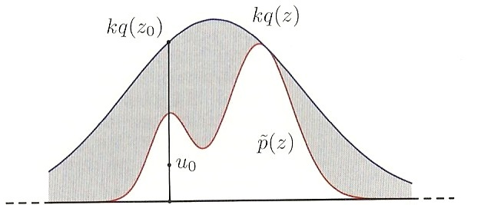
Rejection Sampling Example

Slide 14
LDA CASE
We have a complex posterior distribution p(d)
probability of any document
We want to maximize this for a particular collection of documents D
We want to figure out how to adjust the individual p(w|𝛽,z) and p(z|d) probabilities to get the maximum value
That requires that we know how p(d) is related to these values
which is very complex, multidimensional (z+w) probability distribution as we saw
We create a process that will allow us to sample from this distribution
can use this to compute the likelihood of the observed documents
Other methods
variational methods – approximations that are faster
huge area of current research

Slide 15
Result
What do we learn?
p(z|d)
The probability of each topic given a particular document
Even the ability to predict the topic of a document that wasn't part of the original corpus
p(z)
The probabity of each topic over the whole corpus
p(w|z)
The probability of a word given a topic
How closely associated a word is to a particular topic
We do not learn
Whether these were the right choices for α, 𝛽 and K
must experiment
What the topics "mean" – we have to look at the terms and see what the topic might be

