Slide 1
CS 186 Exam Prep Section 6
Iterators and Joins

Slide 2
Iterators and Joins

Slide 3
Iterators
Iterators output the records resulting from the operator’s operation, which are then fed as input to the next operator.
next()
hasNext()
Because iterators can feed into each other without writing to disk, exclude write cost
Notes:
One of the last topics we learned before Midterm 1 was about operators in relational algebra. We can an iterator to iterate through our operators and output records resulting from an operator’s operation. This output can then be fed into input to the next operator in the iterator.
The main iterator functions that we use in this class are next(), which gets the next operator, and hasNext(), which checks whether or not we’re at the end of our iterator.
Iterators often feed into each other without writing to disk, so we exclude the write cost after each operator.
----
Possible student questions
When to include final write cost
If it’s the final operator or the question explicitly mentions to materialize, then we include final write cost of operator

Slide 4
Joins
https://cs186berkeley.net/resources/join-animations/
[R] = number of pages in R
p_{R} = number of records per page in R
|R| = number of records in R (the cardinality of R)
|R| = p_{R} * [R]
Notes:
Before we dive in, here’s some notation
[R] with brackets refers to the number of pages in R
P sub r refers to the number of records per page in R
|R| with two vertical bars refers to the cardinality of R
The cardinality of R is therefore number of records per page in R times the number of pages in R.

Slide 5
Single Nested Loop Join (SNLJ)
SNLJ
for each record r_{R} in R:
for each record r_{S} in S:
if 𝜃(r, s): output r joined with s
Notes:
Here is the algorithm for a single nested loop join.
We read in a record of R into memory,
Then we read in a record of S into memory,
We stream matches between R and S into our output buffer frame if they meet the predicate condition
Every time we read in a record, we’re reading in a page from disk. Then we put back the page, then read it in again at each iteration in our for loop. What if we read in a page of R and S, then iterate through their rows respectively?

Slide 6
Page Nested Loop Join (PNLJ)
PNLJ
for each page P_{R} in R:
for each page P_{S} in S:
for each row r in P_{R}:
for each row s in P_{S}:
if 𝜃(r, s): output r joined with s
Notes:
So, here is the algorithm for a page nested loop join.
We read in a page of R into memory,
Then we read in a page of S into memory,
Then we iterate through our records in the R page
Then for each record in R, we iterate through our records in the S page
And we stream matches between R and S into our output buffer frame if they meet the predicate condition
Do we understand this so far?
What changes should we make to convert PNLJ to BLNJ? <wait for student response>

Slide 7
Block Nested Loop Join (BNLJ)
BNLJ
for each block of B - 2 pages C_{R} = {P₁, P₂, ... , P_{B - 2}} in R:
for each page P_{S} in S:
for each row r in C_{R}:
for each row s in P_{S}:
if 𝜃(r, s): output r joined with s
Notes:
Exactly, rather than reading one page in R, we read in B - 2 pages in R.
We let C_R be all the pages we pulled from R concatenated together, forming one block
So, instead of fetching on page from R at a time, we can fetch B - 2 pages of memory!
The last two buffer frames will be for reading pages in S and for streaming our output to the next operation

Slide 8
Joins
Notation
[R] - number of pages in R
p_{R} - number of records per page in R
|R| - number of records in R
Simple / Page / Block Nested Loop Joins:
(all pages of left table) + (# passes of right table) * (all pages of right table)
Number of passes:
Simple: one per left row
Page: one per left page
Block: one per left block
Notes:
All three of these joins operated very similarly!
For each of these joins, we iterate through each row, page, or block in the right table!
Therefore, the cost is reading all pages of the right table plus reading all pages of the right table times the amount of passes we make to the right table.
…
For SNLJ, the number of passes equals one per row on the left table
For PNLJ, the number of passes equals one per page on the left table
For BNLJ, the number of passes equals one per block on the left table

Slide 9
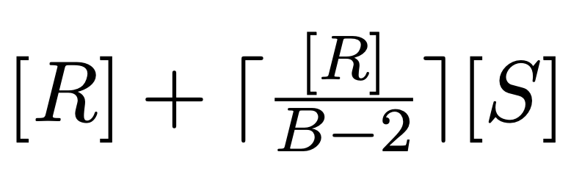
Joins
Notation
[R] - number of pages in R
p_{R} - number of records per page in R
|R| - number of records in R
Simple Nested Loop Join: [R]+|R|[S]
Page Nested Loop Join: [R] + [R][S]
Block Nested Loop Join:
B is the number of available buffer pages
Notes:
This gives us the following formulas to compute join cost.
B is the number of buffer pages!

Slide 10
Joins
Notation
[R] - number of pages in R
p_{R} - number of records per page in R
|R| - number of records in R
Index Nested Loop Join
[R] + |R| * cost to find matching S tuples
Cost to find matching S tuples:
Alternative 1: just cost to traverse root to leaf + read all the leaves with matching tuples
Alternative 2/3: cost of retrieving RIDs (similar to Alternative 1) + cost to fetch actual records
1 I/O per page if clustered, 1 I/O per tuple if not
Notes:
Next we have index nested loop join. It’s the same concept as before, but instead of scanning through all of S, we use an index to find matching S tuples.
Thus, the cost is equal to the number of pages in R plus the number of records in R times the cost to find matching S tuples.
How much does it cost to find matching S tuples? Well, it depends on the implementation of our index.
For Alternative 1, the cost involves traversing from our root to our leaf, then we must read in all leaves with matching tuples
For alternative 2 and 3, the cost involves traversing from our root to our leaf with record IDs, then we must fetch actual records from disk!
IF the index is clustered, we can expect 1 I/O per page.
If the index is unclustered, we can expect 1 I/O per record or tuple.

Slide 11
Joins
Notation
[R] - number of pages in R
p_{R} - number of records per page in R
|R| - number of records in R
Sort Merge Join:
cost to sort R using external sorting
+ cost to sort S using external sorting
+ [R] + [S]
Note that, if a relation is already sorted, we can exclude that cost
Notes:
Next, we have sort merge join.
Remember external merge sort from pre-midterm 1? Those formulas and techniques come back in this join.
The idea is to sort both R and S through external sorting,
Then, as we merge R and S, we look for records that meet our predicate.
The total cost is therefore the cost to sort R, cost to sort S, and the sum of the number of pages in R and the number of pages in S.
If R and S were sorted already, we can exclude the sorting costs

Slide 12
Joins
Notation
[R] - number of pages in R
p_{R} - number of records per page in R
|R| - number of records in R
Sort Merge Join optimization: combine last sort pass with merging
Normally:
Last sort pass:
Load runs R₁, R₂, R₃ into buffers, merge into run R, stream (write) R to disk
Load runs S₁,S₂, S₃ into buffers, merge into run S, stream (write) S to disk
Merging:
Load run R and run S into buffers, merge into R⋈S
Notes:
In sort merge join, we can perform an optimization where we combine the last sort pass with the merging step.
Normally,
In the last sort pass,
We load in pages of R into memory, create a sorted run of R, then stream that run into disk.
We do the same for S.
Then in the merging step,
We load in the final run of R and S from disk into our buffers, then merge them both while checking to see which records meet our predicate.

Slide 13
Joins
Notation
[R] - number of pages in R
p_{R} - number of records per page in R
|R| - number of records in R
Sort Merge Join optimization: combine last sort pass with merging
Sort-merge optimization:
Last sort pass:
Load runs R₁, R₂, R₃ into buffers, merge into run R, stream (write) R to disk
Load runs S₁,S₂, S₃ into buffers, merge into run S, stream (write) S to disk
Merging:
Load run R and run S into buffers, merge into R⋈S
Note that in this example, previously we needed only 3 input buffers, but the optimized version needed 6 input buffers!
Save 2 * ([R] + [S])
In general, this optimization is only possible if you happen to have enough buffers to stream BOTH last runs in memory.
You can also do a partial version where you finish sorting one table normally, then do the join with the runs of the unmerged table and the one run of the merged table. The partial version saves either 2 * [R] or 2 * [S], depending on which table you wait to merge.
Notes:
Instead of streaming our last runs for tables R and S into disk, we can directly merge them!
(draw out comparison here)
NOTE: This optimization only works if you have enough buffers to stream both last runs in memory
There’s a partial version where you finish sorting one table normally, then do the join with the runs of the unmerged table and the run of the merged table
(in your example, show R getting the sort run step, but S stays in input buffers. Need 4 input buffers)

Slide 14
Joins
Notation
[R] - number of pages in R
p_{R} - number of records per page in R
|R| - number of records in R
Grace Hash Join: similar to external hash, but…
Partitioning phase: Partition R into B-1 buckets and also S into B-1 buckets
Recursively partition pairs of R and S partitions until one partition in a pair fits in B-2 pages
Joining phase: for each pair of partitions where at least one is at most B-2 pages,
load smaller side (e.g. R) into memory, and make a hash table
Stream in pages of S -> match against hash table -> stream out matches
Cost: Depends on the construction of the tables. It’s similar to external hashing, but your parameters for stopping are different
Notes:
Finally, we have grace hash join.
Remember external hashing from pre-midterm 1? Those formulas and techniques also come back in this join, which can roughly be divided into two phases
First, we have the partitioning phase, where both relations must be partitioned into B - 1 buckets, as 1 bucket will be used to stream input.
Then, we want to prepare an in-memory hash table for our join phase.
Our base case for this phase is that we’ll need each partition of R to fit in B - 2 buffer pages
One page is reserved for streaming S
Another page is reserved for streaming output
If necessary, we will recursively partition R and S until that base case is met.
Next, we have the join phase. So, we have these pair of partitions for R and S, where one of those in the pair can fit into B - 2 pages.
We load in the smaller of the pair into memory and build an in-memory hash table.
Then, we stream in the larger of the pair and perform a lookup on our hash table. If the record exists in our hash table, we have a match and we should include that match in our result.
To compute the cost of a grace hash join, we use very similar techniques as we learned in external hashing. This time, however, we’re hashing two tables and our base case for recursive partitioning is slightly different (need to set aside two buffers, not just one).

Slide 15
Worksheet

Slide 16
Joins 1

Slide 17
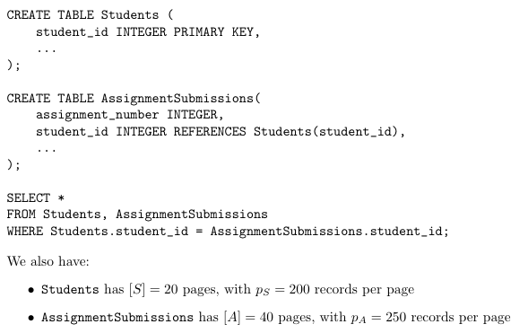
Joins 1

Slide 18
Question 1
What is the I/O cost of a simple nested loop join for Students ⋈ AssignmentSubmissions?
Answer: 160,020 I/Os.
The formula for a simple nested loop join is [S] +|S|·[A].
Plugging in the numbers gives us 20 + (20·200)·40 = 160,020 I/Os

Slide 19
Question 2
What is the I/O cost of a simple nested loop join for AssignmentSubmissions ⋈ Students?
Answer: 200,040 I/Os.
The formula for a simple nested loop join is [A] +|A|·[S].
Plugging in the numbers gives us 40 + (40·250)·20 = 200,040 I/Os

Slide 20
Question 3
What is the I/O cost of a block nested loop join for Students ⋈ AssignmentSubmissions? Assume our buffer size is B= 12 pages.
Answer: 100 I/Os.
First, we can calculate our block size: B−2 = 10.
Since Students is our left table, we calculate the number of blocks of Students :[S]/(B−2) = 20/10 = 2.
Thus the final cost is [S] plus 2 passes through all of [A], or 20 + 2·40 = 100 I/Os.

Slide 21
Question 4
What is the I/O cost of a block nested loop join for AssignmentSubmissions ⋈ Students? Assume our buffer size is B= 12 pages.
Answer: 120 I/Os.
As before, we can calculate our block size: B−2 = 10.
Since AssignmentSubmissions is our left table, we calculate the number of blocks: [A]/(B−2) = 40/10 = 4.
Thus the final cost is [A] plus 4 passes through all of [S], or 40 + 4·20 = 120 I/Os.

Slide 22
Question 5
What is the I/O cost of an Index-Nested Loop Join for Students ⋈ AssignmentSubmissions? Assume we have a clustered alternative 2 index on AssignmentSubmissions.studentid, in the form of a height 2 B+ tree. Assume that index node and leaf pages are not cached; all hits are on the sameleaf page; and all hits are also on the same data page.
Answer: 16,020 I/Os.
The formula is [S] +|S|·(cost of index lookup).
The cost of index lookup is 3 I/Os to access the leaf, and 1 I/O to access the data page for all matching records.
So the total cost is 20 + 4000·4 = 16,020 I/Os.

Slide 23
Question 6
Now assume we have an unclustered alternative 2 index on AssignmentSubmissions.studentid, in the form of a height 2 B+ tree. Assume that index node pages and leaf pages are never cached, and we only need to read the relevant leaf page once for each record of Students, and all hits are on the same leaf page. What is the I/O cost of an Index-Nested Loop Join for Students ⋈ AssignmentSubmissions?
Answer:22,020 I/Os.
The formula is [S] +|S|·〈cost of index lookup. This time though, the cost of index lookup is 3 I/Os to access the leaf, and 1 I/O to access the data page for each matching record.
How many records match per key? We actually haven’t told you! But, we do know that we will eventually have to access each record exactly once (since each AssignmentSubmission is foreign-keyed on a studentid) - so there will be |A|= 10,000 data page lookups, one for each row. So the total cost is 20 + 4000·3 + 10000 = 22,020 I/Os.

Slide 24
Question 7
What is the cost of an unoptimized sort-merge join for Students ⋈ AssignmentSubmissions? Assume we have B = 12 buffer pages.
Answer:300 I/Os.
The formula is〈cost of sorting S〉+〈cost of sorting A〉+ [S] + [A].
For sorting S: The first pass will make two runs, which is mergeable in one merge pass; thus, we need two passes; For sorting A: The first pass will make four runs, which is mergeable in one merge pass; thus, we need two passes.
Thus the total cost is (2·2[S]) + (2·2[A]) + [S] + [A] = 5([S] + [A]) = 5·60 = 300 I/Os.

Slide 25
Question 8
What is the cost of an optimized sort-merge join for Students ⋈ AssignmentSubmissions? Assume we have B = 12 buffer pages.
Answer: 180 I/Os.
The difference from the above question is that we will skip the last write in the external sorting phase, and the initial read in the sort-merge phase. For this to be possible, all the runs of S and A in the last phase of external sorting should be able to fit into memory together.
From the previous question, we know there are 2 + 4 = 6 runs, which fits just fine in our buffer of 12 pages. Thus the total cost is 300−2[S]−2[A] = 300−120 = 180 I/Os.

Slide 26
Question 9
In the previous question, we had a buffer of B= 12 pages. If we shrank B enough, the answer we got might change. How small can the buffer B be without changing the I/O cost answer we got?
Answer: 9 buffer pages.
The restriction for optimized sort-merge join is that the number of final runs of S and A can both fit in memory simultaneously. (i.e., the number of runs of S + the number of runs of A≤B - 1). We had 2 + 4 runs last time, which fit comfortably in 12−1 buffer pages (recall that one page is reserved for output).
What about B= 9? Now we have 3 runs for S and 5 runs forA, which just exactly fits in 9−1 buffer pages.Since 9 buffer pages fits perfectly, any smaller would force more merge passes and thus more I/Os.

Slide 27
Question 10
What is the I/O cost of Grace Hash Join on these tables? Assume we have a buffer of B = 6 pages
Answer: 180 I/Os
For Grace Hash Join, we have to walk through what the partition sizes are like for each phase, one phase at a time. In the partitioning phase, we will proceed as in external hashing. We will load in 1 page a time and hash it into B−1 = 5 partitions. This means the 20 pages of S get split into 4 pages per partition, and the 40 pages of A get split into 8 pages per partition.
Do we need to recursively partition? No! Remember that the stopping condition is that any table’s partition fits in B−2 = 4 buffer pages; the partitions of S satisfy this.In the hash joining phase, the I/O cost is simply the total number of pages across all partitions - we read all of these in exactly once. Thus the final I/O cost is 20 + 20 for partitioning S, 40 + 40 for partitioning A, and 20 + 40 for the hash join, for a total cost of 180 I/Os.

Slide 28
Joins 2

Slide 29
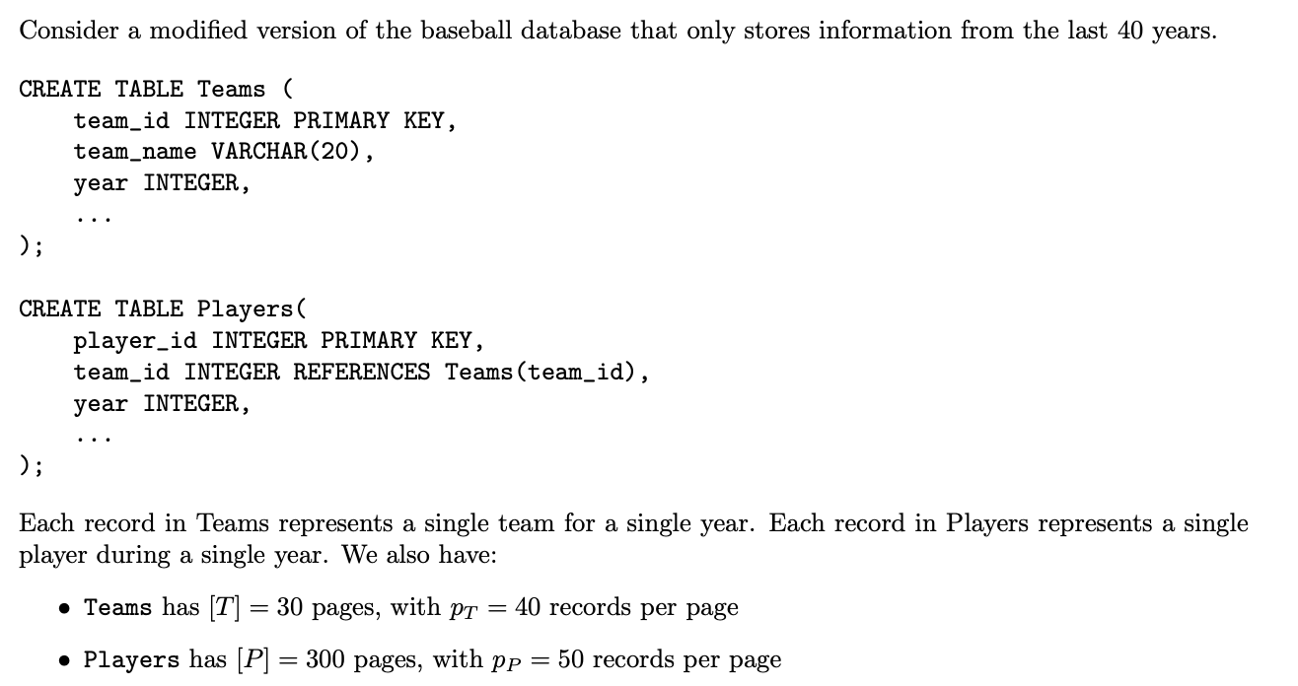
Joins 2

Slide 30
Question 1
What is the I/O cost of a simple nested loop join for joining Teams ⋈ Players on Teams.team id = Players.team id?
Answer: 360,030 I/Os.
The formula for a simple nested loop join is [T] + |T| · [P].
Plugging in the numbers gives us 30 + (30 · 40) · 300 = 360, 030 I/Os

Slide 31
Question 2
What is the I/O cost of a page nested loop join on the same query?
Answer: 9,030 I/Os.
The formula for a simple nested loop join is [T] + [T] · [P].
Plugging in the numbers gives us 30 + 30 · 300 = 9,030 I/Os

Slide 32
Question 3
What is the I/O cost of a block nested loop join on the same query? Assume our buffer size is B = 10 pages.
Answer: 1,230 I/Os.
The formula for a block nested loop join is [T] + ceil([T]/(B − 2)) · [P].
Plugging in the numbers gives us 30 + 4 · 300 = 1, 230 I/Os.

Slide 33
Question 4
Assume we have an unclustered index of height 1 on Teams.team id. What is the I/O cost of an index nested loop join on Teams.team id = Players.team id using this index? You can assume that every player only plays on one team each year.
Answer: 45,300 I/Os.
If we are using an index on Teams.team id, this means that Teams should be the inner relation, because for each record in Players, we will search our index for the corresponding record in the Teams table. Thus the formula for the index nested loop join is [P] + |P|· cost to find matching records. Each search will cost 3 I/Os (2 to read the root + leaf, and 1 additional I/O to read a data page).
Plugging in the numbers gives us 300 + (300 · 50) · 3 = 45,300 I/Os.

Slide 34
Question 5
Now, assume we have a clustered index of height 2 on Players.player id and an clustered index of height 3 on Players.team id. If each team has 25 players each year, what is the lowest I/O cost of the join on Teams.team id = Players.team id using one of these indexes?
Answer: 6,030 I/Os.
Although the index on Players.player id has a lower height, it is not useful for this join since the player id column is not part of the join. We must use the clustered index of height 3 on Players.team id. Since we are using an index on Players.team id, the Players table should be the inner relation. The formula will be [T] + |T|· cost to find matching records. Each search will cost 5 I/Os (4 to read down to the leaf level, and 1 additional I/O to read a data page since it is clustered).
Plugging in the numbers gives us 30 + (30 · 40) · 5 = 6,030 I/Os.

Slide 35
Question 6
Assume the index on Players.team id is actually unclustered. What is cost of the join on on Teams.team id = Players.team id using this index?
Answer: 34,830 I/Os.
The equation will still be [T] + |T|· cost to find matching records; the only difference from the previous question is that the cost of searching matching records will be different, since it is unclustered.
Each search will cost 29 I/Os (4 to read down to the leaf level, and 25 additional I/Os to read data pages) since we must assume that the 25 player records for each team are on separate data pages.
Plugging in the numbers gives us 30 + (30 · 40) · 29 = 34, 830 I/Os.

Slide 36
Question 7
Consider a universe where there are no limits on team size and players get to time travel to play for whatever team they want, and 75% of players choose to travel to 2020 to play for the best baseball team, the San Diego Padres. In other words, imagine that 75% of the records in the Players table have the same team_id. What are the effects on the performance of the different join algorithms?
Simple, page, and block nested loop join would have the same performance as the original scenario.
Index nested loop joins could potentially be improved if we had enough buffer pages to keep the leaf node corresponding to the repeated team_id in memory.

Slide 37
Question 7
Consider a universe where there are no limits on team size and players get to time travel to play for whatever team they want, and 75% of players choose to travel to 2020 to play for the best baseball team, the San Diego Padres. In other words, imagine that 75% of the records in the Players table have the same team_id. What are the effects on the performance of the different join algorithms?
For sort merge join, many duplicate values generally tend to increase the number of I/Os, since iterators need to be reset. In this scenario, using the Players table as the outer relation during the merge phase could alleviate these concerns, since there are no duplicate team_id values in the Teams table.

Slide 38
Question 7
Consider a universe where there are no limits on team size and players get to time travel to play for whatever team they want, and 75% of players choose to travel to 2020 to play for the best baseball team, the San Diego Padres. In other words, imagine that 75% of the records in the Players table have the same team_id. What are the effects on the performance of the different join algorithms?
Grace hash join requires us to partition our data until at least one of our tables has chunks that are small enough to fit into memory. Since the Teams table does not have duplicate team_id values, there should not be significant differences in the number of I/Os compared to the original scenario.

Slide 39
Joins 3

Slide 40
Joins 3
In the following problems, we will be joining two tables: Students and AssignmentSubmissions on the key ‘student_id‘. However, we are dealing with a set of system constraints. Given a set of potential join algorithms from SNLJ, BNLJ, PNLJ, Hash Join, GHJ, SMJ, select the best option(s).
CREATE TABLE Students (
student_id INTEGER PRIMARY KEY,
...
);
CREATE TABLE AssignmentSubmissions(
assignment_number INTEGER,
student_id INTEGER REFERENCES Students(student_id),
...
);
SELECT *
FROM Students, AssignmentSubmissions
WHERE Students.student_id = AssignmentSubmissions.student_id;
We also have:
Students has [S] = 600 pages, with p_{S} = 60 records per page
AssignmentSubmissions has [A] = 600 pages, with p_{A} = 60 records per page
B = 10

Slide 41
Question 1
Our program memory is extremely limited (not buffer memory)! As a result, we only have enough memory to store 1 hash function. What join algorithms work here provided it fits our system constraints)? Why?
Anything that's not GHJ or Hash Join. Hash Join requires one of the relations to fit in memory (B-2 pages). For GHJ, since we have only 1 hash function, we can not recursively partition. Remember for recursive partitioning, a new, independent hash function must be used in order to effectively re-partition the data.

Slide 42
Question 2
Now, we have very little buffer memory (only 3 pages). What join algorithms work here? How are the different join algorithms affected by the given constraint? Why?
BNLJ, PNLJ, and SNLJ would work. Given the limited buffer memory, BNLJ will reduce to PNLJ, since the size of the blocks will be limited to 1 page. In other words, the BNLJ and PNLJ will have the same IO cost. Note that the limited buffer memory does not impact SNLJ, since SNLJ simply takes each record in the first relation and searches for all matches in the second relation.
Naive Hash Join will not work, since neither of the relations can directly fit in B-2 pages. To fit in B-2 pages means that we can create a hash table for that relation.
GHJ would work with this constraint. We can repeatedly hash the two relations into B-1 buffers to create partitions that are ≤ B − 2 pages big, which eventually allows us to fit the relations into memory and perform a Naive Hash Join. Due to the limited buffer memory, GHJ will require a significant number of partitioning passes, which in turn results in an increase in the overall IO cost.
SMJ would work with this constraint. Due to the limited buffer memory, SMJ would require a significant number of passes to sort a relation. This in turn will result in an increase in the overall IO cost.

Slide 43
Question 3
Now, assume that Students is only 1 page. What is the best join algorithm IO wise?
All join algorithms would work in this case, since our requirements are looser than than when Students had 600 pages. PNLJ/BNLJ/HJ/GHJ is the best IO wise.
SNLJ: [R] + p_r[R][S] = 1 + 60(1 * 600) = 36001 IOs PNLJ: [R] + [R][S] = 1 + (1 * 600) = 601 IOs BNLJ: [R] + ceil([R]/(B-2))[S] = 1 + 1 * 600 = 601 IOs HJ/GHJ: [R] + [S] = 1 + 600 = 601 IOs SMJ: Since our tables are not yet sorted, we'd incur some overhead to sort them, which would take a significant number of IOs.

Slide 44
Question 4
Now, assume that all student_ids in both tables are exactly the same (i.e. assume the primary key constraint does not hold). What join algorithms work here? How are the different join algorithms affected by the given constraint? Why?
GHJ and Hash Join would not work in this case. Since all student_ids are exactly the same, GHJ and Hash Join will be subject to extreme data skew (data hashing to the same bucket).
The nested loop joins (BNLJ, PNLJ, SNLJ) and SMJ will work in this case, however, it is worth considering what these joins will yield. Assuming that the joins are performed by matching student_ids, the nested loop joins (BNLJ, PNLJ, SNLJ) and SMJ will match every row from the left relation to all rows in the right relation.

Slide 45

Attendance Link
https://cs186berkeley.net/attendance

