Slide 1
Discussion 4
Buffer Management & Spatial Indexes

Slide 2
Announcements
Project 3 (Joins and QO) has been released and pt1 is due 10/10 at 11:59 PM.
Vitamin 4 (Buffer Management) is due Monday 9/30 at 11:59 PM
Midterm 1 - Tuesday 10/1
1 pfe double-sided cheat sheet and a calculator is permitted

Slide 3
Review for Disk and Memory

Slide 4
Disk vs Memory
Disk: hard drive storage (1 TB), with latency around 13ms - SLOW & Lot of Space
Memory (which contains Buffers): RAM (Random Access Memory) limited space (16GB), with latency around 83 nanoseconds - FAST & Limited Space
Any computations (read OR write) must be performed in MEMORY
Use the DISK to store data pages we don’t immediately need
Must load a page from disk to memory to read it and must write it back from memory to disk if we make modifications
Any action moving a page of data from disk to memory (reading from that page) or from memory to disk (writing to that page) will incur 1 I/O

Slide 5
Buffer Management

Slide 6
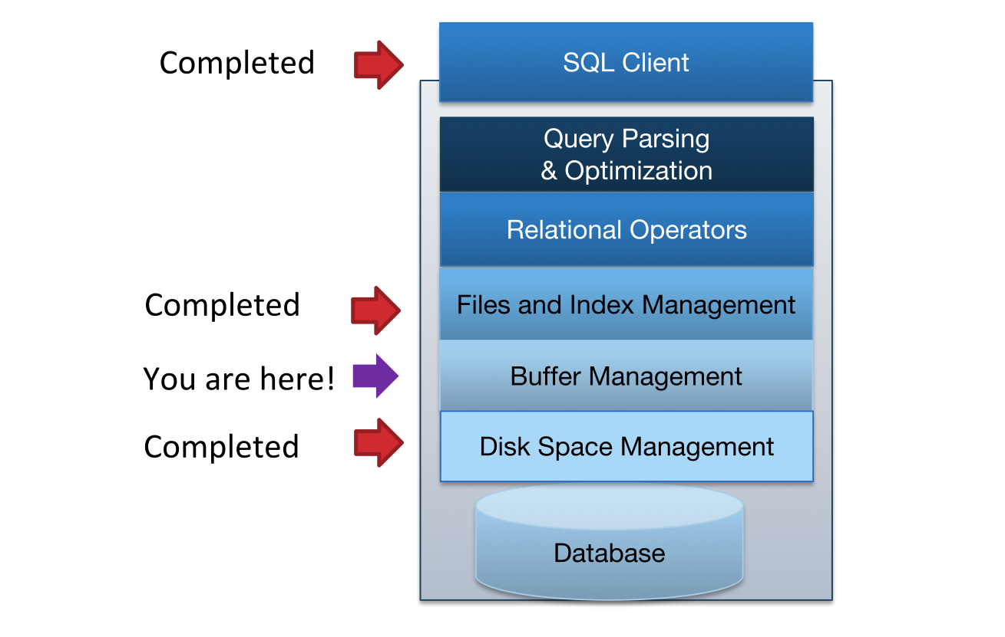
DBMS Architecture

Slide 7
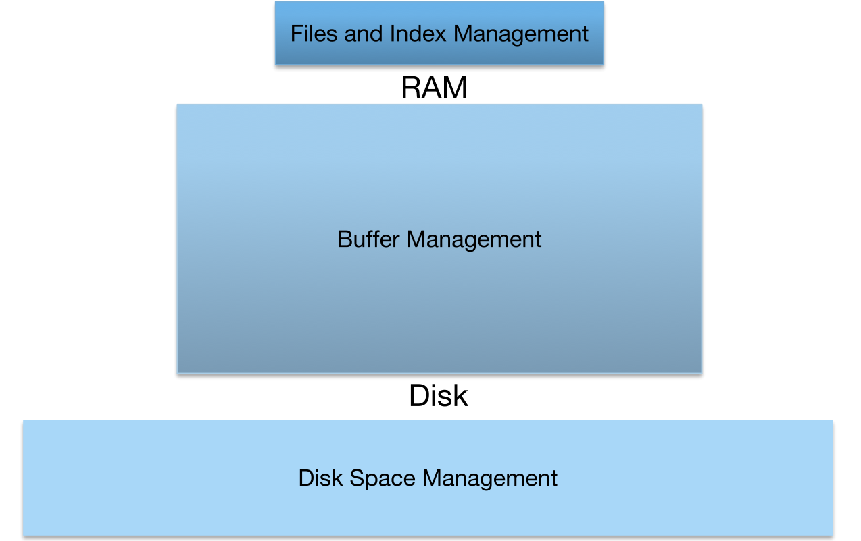
Buffer Management Abstraction

Slide 8
Motivation
Before this section, we assumed that memory was infinite
But it’s not!
We need Buffer Manager to manage which page gets loaded into memory and evicted from memory

Slide 9
Buffer Manager
Layer that manages which pages are loaded in memory
Controls when pages are read from & written to disk
When no space in memory, decides what page to evict
Decision process is the page replacement policy
Big impact on I/Os depending on access pattern

Slide 10
Page Replacement Policies

Slide 11
LRU (Least Recently Used)
Evict the least recently used page (idea: pages we haven’t used in a long time probably won’t be used soon)
On use: pin frame (pinned frames cannot be evicted)
Track time each frame last unpinned (at end of use)
Replace the frame which least recently unpinned
Works well for repeated accesses to popular pages (temporal locality)
Can be costly: need to maintain heap data structure

Slide 12
LRU: Repeated Scan of File
File
Buffer
A
Empty
Frame
Empty
Frame
Empty
Frame
B
Scan
C
Cache Hits:
Attempts:
D

Slide 13
LRU: Repeated Scan of File
File
Buffer
Scan
A
Empty
Frame
Empty
Frame
Empty
Frame
A
B
Scan
C
0
Cache Hits:
Attempts:
1
D

Slide 14
LRU: Repeated Scan of File
File
Buffer
A
Empty
Frame
Empty
Frame
Empty
Frame
A
B
Scan
B
Scan
C
0
Cache Hits:
Attempts:
2
D

Slide 15
LRU: Repeated Scan of File
File
Buffer
A
Empty
Frame
Empty
Frame
Empty
Frame
A
B
C
B
Scan
Scan
C
0
Cache Hits:
Attempts:
3
D

Slide 16
LRU: Repeated Scan of File
File
Buffer
A
Empty
Frame
Empty
Frame
Empty
Frame
D
A
B
C
B
LRU
Scan
C
0
Cache Hits:
Attempts:
3
D
Scan
D

Slide 17
LRU: Repeated Scan of File
File
Buffer
A
Scan
A
Empty
Frame
Empty
Frame
Empty
Frame
A
D
B
C
B
LRU
Scan
C
0
Cache Hits:
Attempts:
4
D

Slide 18
Clock
Efficient approximation of LRU
Arrange frames in a circle (like numbers on a clock)
Advance clock arm around the clock to find pages to evict
Only do this if you need to bring new page into buffer
To make this approximate least recently used (rather than least recently loaded): add a reference bit to each frame
Set to 1 on load/hit, 0 if clock arm passes the frame
Evict unpinned frame if clock arm reaches it and bit = 0
(bit = 0 means less recently used than those with bit = 1)
Notes:
Note from Piazza about comparison to the algorithm taught in 162 (Thanks Rithvik!) : There is a key difference between the algorithm we teach and the one taught in 162. In this class, we decrement/check the ref bit first, followed by advancing the clock hand. In effect, we swap steps 1 and 2 of the miss procedure. This is important as it may alter which pages are evicted and which pages stay in the buffer.
We do not move the clock hand on a hit.

Slide 19
Clock Example
Empty Frame
Empty Frame
Empty Frame
Empty Frame
Empty Frame
Empty Frame

Slide 20
Clock Example
Pinned
Empty Frame
A
Want to insert page:
Current frame has pin-count > 0 → Skip
Pinned
G
Empty Frame
Empty Frame
F
B
Empty Frame
Empty Frame
E
C
Empty Frame
D

Slide 21
Clock Example
Pinned
Empty Frame
A
Want to insert page:
Current frame has pin-count > 0 → Skip
Pinned
G
Empty Frame
Empty Frame
F
B
Empty Frame
Empty Frame
E
C
Empty Frame
D

Slide 22
Clock Example
Pinned
Empty Frame
A
Want to insert page:
Not Pinned and Ref. bit is set →
Clear Ref. Bit
Skip
Pinned
G
Empty Frame
Empty Frame
F
B
Empty Frame
Empty Frame
E
C
Empty Frame
D

Slide 23
Clock Example
Pinned
Empty Frame
A
Want to insert page:
Not pinned and Ref. bit unset:
Evict
Copy Page
Set pinned
Set ref. bit
Advanced clock
Pinned
G
Empty Frame
Empty Frame
F
B
Empty Frame
Empty Frame
E
C
Empty Frame
G
D

Slide 24
Clock Example
Pinned
Empty Frame
A
Request for Page C:
Cache Hit!:
Pin (inc.)
Set ref bit.
C
Pinned
Empty Frame
Empty Frame
F
B
Pinned
Empty Frame
Empty Frame
E
C
Pinned
Empty Frame
G

Slide 25
LRU/Clock
Common policy
Good for repeated access to popular pages (when the access pattern has temporal locality)
LRU is costly, but Clock is fast (and a good approximation)
When do LRU/Clock perform poorly?
Consider repeated sequential scans of large files...

Slide 26
LRU: Repeated Scan of File
File
Buffer
A
Empty
Frame
Empty
Frame
Empty
Frame
B
Scan
C
Cache Hits:
Attempts:
D

Slide 27
LRU: Repeated Scan of File
File
Buffer
Scan
A
Empty
Frame
Empty
Frame
Empty
Frame
A
B
Scan
C
0
Cache Hits:
Attempts:
1
D

Slide 28
LRU: Repeated Scan of File
File
Buffer
A
Empty
Frame
Empty
Frame
Empty
Frame
A
B
Scan
B
Scan
C
0
Cache Hits:
Attempts:
2
D

Slide 29
LRU: Repeated Scan of File
File
Buffer
A
Empty
Frame
Empty
Frame
Empty
Frame
A
B
C
B
Scan
Scan
C
0
Cache Hits:
Attempts:
3
D

Slide 30
LRU: Repeated Scan of File
File
Buffer
A
Empty
Frame
Empty
Frame
Empty
Frame
D
A
B
C
B
LRU
Scan
C
0
Cache Hits:
Attempts:
3
D
Scan
D

Slide 31
LRU: Repeated Scan of File
File
Buffer
A
Scan
A
Empty
Frame
Empty
Frame
Empty
Frame
A
D
B
C
B
LRU
Scan
C
0
Cache Hits:
Attempts:
4
D

Slide 32
LRU: Repeated Scan of File
File
Buffer
A
Empty
Frame
Empty
Frame
Empty
Frame
B
D
A
C
B
Scan
B
LRU
Scan
C
0
Cache Hits:
Attempts:
5
D

Slide 33
LRU: Repeated Scan of File
File
Buffer
Sequential Flooding
A
Empty
Frame
Empty
Frame
Empty
Frame
D
A
B
Scan
B
LRU
Scan
C
0
No Cache Hits!
Cache Hits:
Attempts:
6
D

Slide 34
MRU (Most Recently Used)
Evict the most recently used page (idea: pages we just used probably won’t be needed again, such as in a scan)
Almost identical to LRU, but evict the most recently used page instead of the least recently used page
Performs much better on repeated scans...

Slide 35
MRU: Repeated Scan of File
File
Buffer
Scan
A
Empty
Frame
Empty
Frame
Empty
Frame
B
Scan
C
0
Cache Hits:
Attempts:
0
D

Slide 36
MRU: Repeated Scan of File
File
Buffer
Scan
A
Empty
Frame
Empty
Frame
Empty
Frame
A
B
MRU
Scan
C
0
Cache Hits:
Attempts:
1
D

Slide 37
MRU: Repeated Scan of File
File
Buffer
A
Empty
Frame
Empty
Frame
Empty
Frame
A
B
Scan
B
MRU
Scan
C
0
Cache Hits:
Attempts:
2
D

Slide 38
MRU: Repeated Scan of File
File
Buffer
A
Empty
Frame
Empty
Frame
Empty
Frame
A
B
C
B
MRU
Scan
Scan
C
0
Cache Hits:
Attempts:
3
D

Slide 39
MRU: Repeated Scan of File
File
Buffer
A
Empty
Frame
Empty
Frame
Empty
Frame
A
B
D
D
B
MRU
Scan
C
0
Cache Hits:
Attempts:
4
D
Scan
D

Slide 40
MRU: Repeated Scan of File
File
Buffer
A
Hit!
Scan
Empty
Frame
Empty
Frame
Empty
Frame
A
B
D
B
MRU
Scan
C
1
Cache Hits:
Attempts:
5
D

Slide 41
MRU: Repeated Scan of File
File
Buffer
A
Empty
Frame
Hit!
Empty
Frame
Empty
Frame
A
B
D
B
Scan
MRU
Scan
C
2
Cache Hits:
Attempts:
6
D

Slide 42
MRU: Repeated Scan of File
File
Buffer
A
Empty
Frame
Empty
Frame
Empty
Frame
A
C
C
D
B
MRU
Scan
C
2
Scan
C
Cache Hits:
Attempts:
7
D

Slide 43
MRU: Repeated Scan of File
File
Buffer
A
Empty
Frame
Empty
Frame
Hit!
Empty
Frame
A
C
D
B
MRU
Scan
C
3
Improved
Cache
Hit Rate!
Cache Hits:
Attempts:
8
D
Scan

Slide 44
Summary of Replacement Policies
LRU is best when access pattern has temporal locality where data is reused within a small duration of time
Clock is fast and a good approximation for the costly LRU policy
MRU is best for sequential scans

Slide 45
Worksheet

Slide 46
Note on access patterns
For any access patterns like A B C D A F A D G D G E D F, each page is immediately pinned and then unpinned before the next access.
Example:
We read in the first page, A, and this page is pinned while it is in use.
However, when we move onto page B, we no longer actively use page A anymore and we unpin it before reading in page B.
We will explicitly specify if a page remains pinned, i.e. in 1b, A, B, C, D, A, F (remains pinned), D, G, D, unpin F, G, E, D, F.

Slide 47
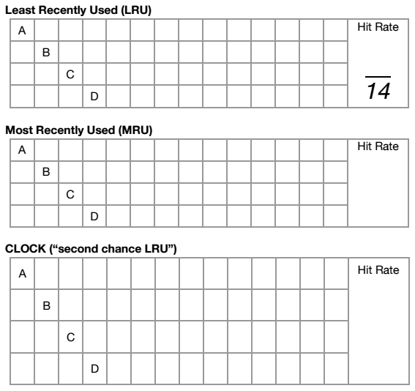
Worksheet: LRU
Fill in the following tables for the given buffer replacement policies. You have 4 buffer pages, with the access pattern
A B C D A F A D G D G E D F

Slide 48
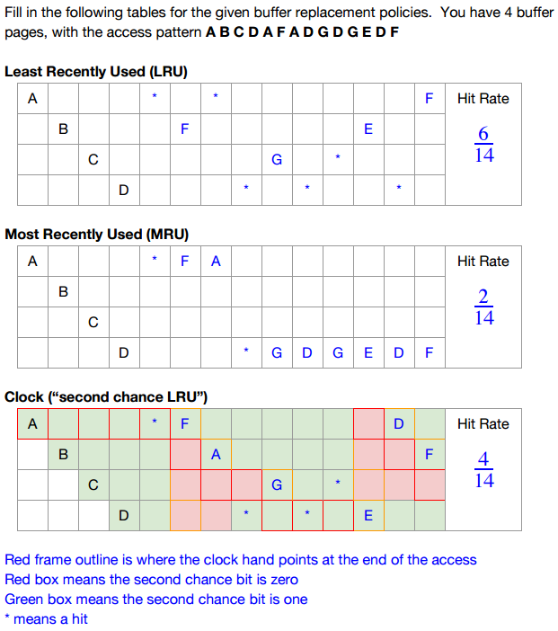
Worksheet: LRU
Fill in the following tables for the given buffer replacement policies. You have 4 buffer pages, with the access pattern
A B C D A F A D G D G E D F

Slide 49
Worksheet: MRU
Fill in the following tables for the given buffer replacement policies. You have 4 buffer pages, with the access pattern
A B C D A F A D G D G E D F

Slide 50
Worksheet: MRU
Fill in the following tables for the given buffer replacement policies. You have 4 buffer pages, with the access pattern
A B C D A F A D G D G E D F

Slide 51
Worksheet: Clock
Fill in the following tables for the given buffer replacement policies. You have 4 buffer pages, with the access pattern
A B C D A F A D G D G E D F

Slide 52
A B C D A F A D G D G E D F
* For this problem, none of the pages remained pinned. The animation for pinning/unpinning each page is not shown.
Empty Frame
0
Empty Frame
Empty Frame
0
0
Empty Frame
0

Slide 53
A B C D A F A D G D G E D F
A
1
Empty Frame
Empty Frame
0
0
Empty Frame
0

Slide 54
A B C D A F A D G D G E D F
A
1
Empty Frame
Empty Frame
0
0
Empty Frame
0

Slide 55
A B C D A F A D G D G E D F
A
1
Empty Frame
B
0
1
Empty Frame
0

Slide 56
A B C D A F A D G D G E D F
A
1
Empty Frame
B
0
1
Empty Frame
0

Slide 57
A B C D A F A D G D G E D F
A
1
Empty Frame
B
0
1
Empty Frame
C
1

Slide 58
A B C D A F A D G D G E D F
A
1
Empty Frame
B
0
1
Empty Frame
C
1

Slide 59
A B C D A F A D G D G E D F
A
1
D
B
1
1
Empty Frame
C
1

Slide 60
A B C D A F A D G D G E D F
A
1
D
B
1
1
Empty Frame
C
1

Slide 61
A B C D A F A D G D G E D F
Hit
Set ref bit = 1
Do not move clock hand
A
1
D
B
1
1
Empty Frame
C
1

Slide 62
A B C D A F A D G D G E D F
Current frame’s ref bit = 1 →
Set ref bit to 0
Advance clock hand
A
0
D
B
1
1
Empty Frame
C
1

Slide 63
A B C D A F A D G D G E D F
Current frame’s ref bit = 1 →
Set ref bit to 0
Advance clock hand
A
0
D
B
1
0
Empty Frame
C
1

Slide 64
A B C D A F A D G D G E D F
Current frame’s ref bit = 1 →
Set ref bit to 0
Advance clock hand
A
0
D
B
1
0
Empty Frame
C
0

Slide 65
A B C D A F A D G D G E D F
Current frame’s ref bit = 1 →
Set ref bit to 0
Advance clock hand
A
0
D
B
0
0
Empty Frame
C
0

Slide 66
A B C D A F A D G D G E D F
Current frame’s ref bit = 0 →
Evict existing page
Read in new page
Set ref bit = 1
Advance clock hand
F
1
D
B
0
0
Empty Frame
C
0

Slide 67
A B C D A F A D G D G E D F
Current frame’s ref bit = 0 →
Evict existing page
Read in new page
Set ref bit = 1
Advance clock hand
F
1
D
B
0
0
Empty Frame
C
0

Slide 68
A B C D A F A D G D G E D F
Current frame’s ref bit = 0 →
Evict existing page
Read in new page
Set ref bit = 1
Advance clock hand
F
1
D
A
0
1
Empty Frame
C
0

Slide 69
A B C D A F A D G D G E D F
Current frame’s ref bit = 0 →
Evict existing page
Read in new page
Set ref bit = 1
Advance clock hand
F
1
D
A
0
1
Empty Frame
C
0

Slide 70
A B C D A F A D G D G E D F
Hit
Set ref bit = 1
Do not move clock hand
F
1
D
A
1
1
Empty Frame
C
0

Slide 71
A B C D A F A D G D G E D F
Current frame’s ref bit = 0 →
Evict existing page
Read in new page
Set ref bit = 1
Advance clock hand
F
1
D
A
1
1
Empty Frame
G
1

Slide 72
A B C D A F A D G D G E D F
Current frame’s ref bit = 0 →
Evict existing page
Read in new page
Set ref bit = 1
Advance clock hand
F
1
D
A
1
1
Empty Frame
G
1

Slide 73
A B C D A F A D G D G E D F
Hit
Set ref bit = 1
Do not move clock hand
F
1
D
A
1
1
Empty Frame
G
1

Slide 74
A B C D A F A D G D G E D F
Hit
Set ref bit = 1
Do not move clock hand
F
1
D
A
1
1
Empty Frame
G
1

Slide 75
A B C D A F A D G D G E D F
Current frame’s ref bit = 1 →
Set ref bit to 0
Advance clock hand
F
1
D
A
0
1
Empty Frame
G
1

Slide 76
A B C D A F A D G D G E D F
Current frame’s ref bit = 1 →
Set ref bit to 0
Advance clock hand
F
0
D
A
0
1
Empty Frame
G
1

Slide 77
A B C D A F A D G D G E D F
Current frame’s ref bit = 1 →
Set ref bit to 0
Advance clock hand
F
0
D
A
0
0
Empty Frame
G
1

Slide 78
A B C D A F A D G D G E D F
Current frame’s ref bit = 1 →
Set ref bit to 0
Advance clock hand
F
0
D
A
0
0
Empty Frame
G
0

Slide 79
A B C D A F A D G D G E D F
Current frame’s ref bit = 0 →
Evict existing page
Read in new page
Set ref bit = 1
Advance clock hand
F
0
E
A
1
0
Empty Frame
G
0

Slide 80
A B C D A F A D G D G E D F
Current frame’s ref bit = 0 →
Evict existing page
Read in new page
Set ref bit = 1
Advance clock hand
F
0
E
A
1
0
Empty Frame
G
0

Slide 81
A B C D A F A D G D G E D F
Current frame’s ref bit = 0 →
Evict existing page
Read in new page
Set ref bit = 1
Advance clock hand
D
1
E
A
1
0
Empty Frame
G
0

Slide 82
A B C D A F A D G D G E D F
Current frame’s ref bit = 0 →
Evict existing page
Read in new page
Set ref bit = 1
Advance clock hand
D
1
E
A
1
0
Empty Frame
G
0

Slide 83
A B C D A F A D G D G E D F
Current frame’s ref bit = 0 →
Evict existing page
Read in new page
Set ref bit = 1
Advance clock hand
D
1
E
F
1
1
Empty Frame
G
0

Slide 84
A B C D A F A D G D G E D F (Hit rate = 4/14)
Current frame’s ref bit = 0 →
Evict existing page
Read in new page
Set ref bit = 1
Advance clock hand
D
1
E
F
1
1
Empty Frame
G
0

Slide 85
Another visualization for Clock Policy

Slide 86
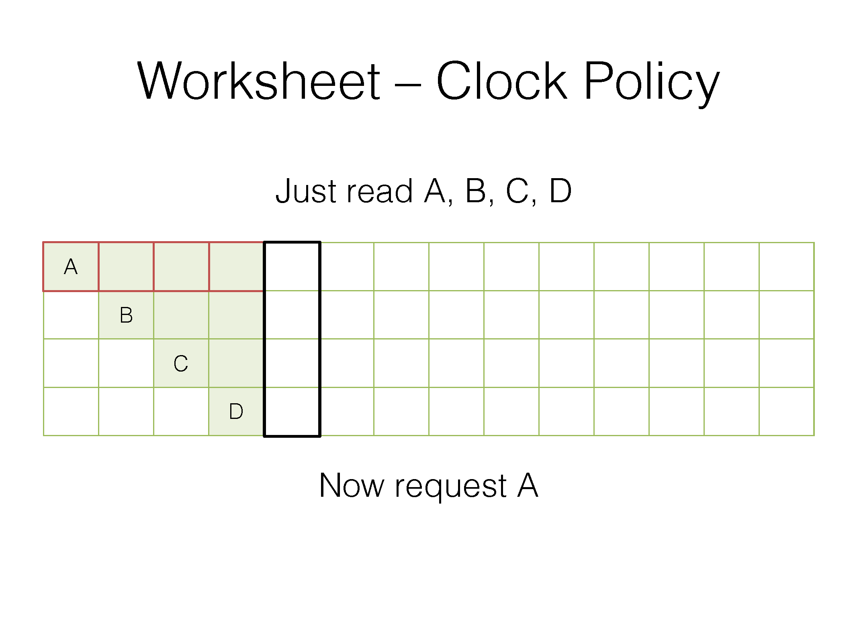
Red frame outline is where the clock hand points at the end of the access
Red box means the second chance bit is zero
Green box means the second chance bit is one
* means a hit
Notes:
Thanks Pete for slides

Slide 87
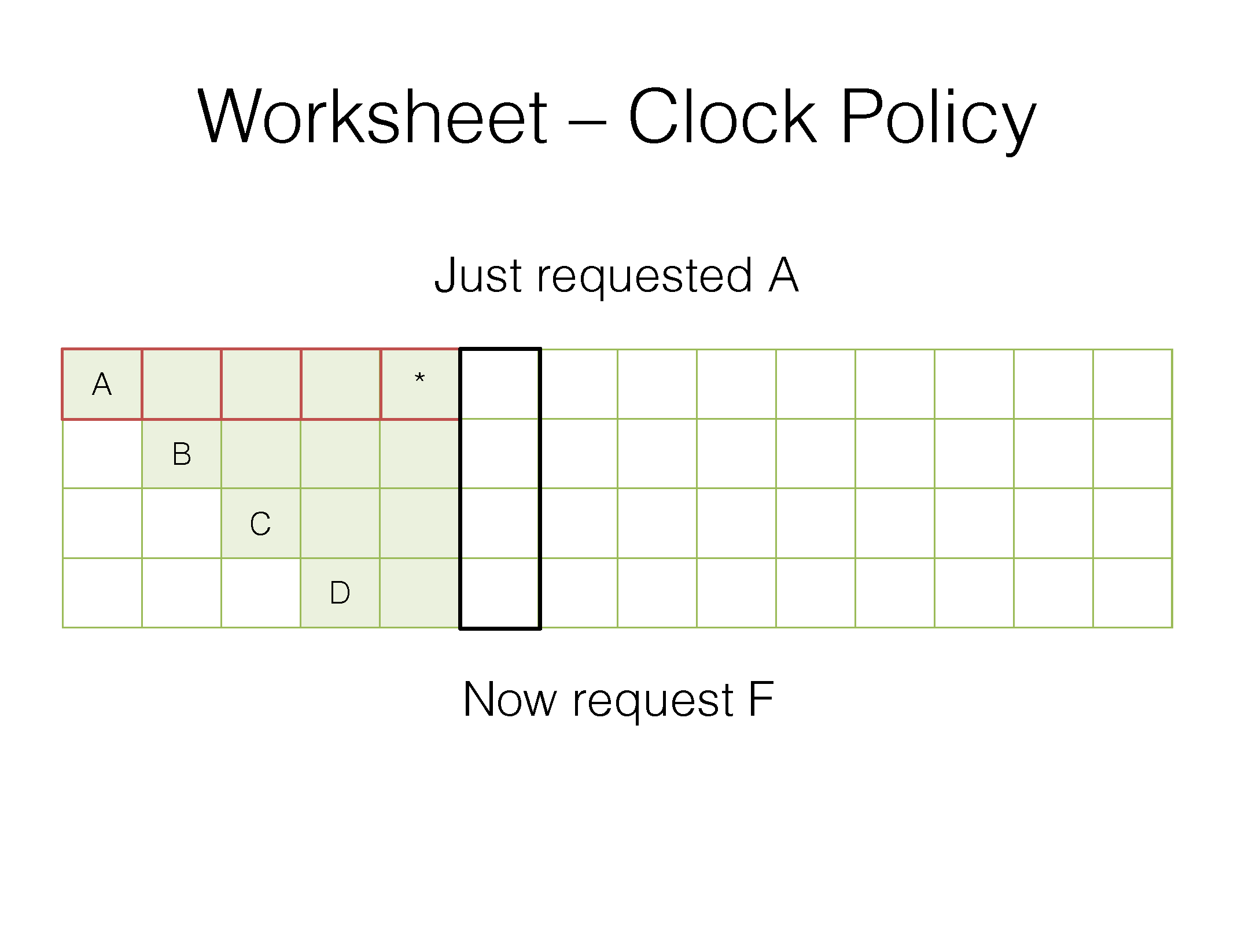
Red frame outline is where the clock hand points at the end of the access
Red box means the second chance bit is zero
Green box means the second chance bit is one
* means a hit

Slide 88
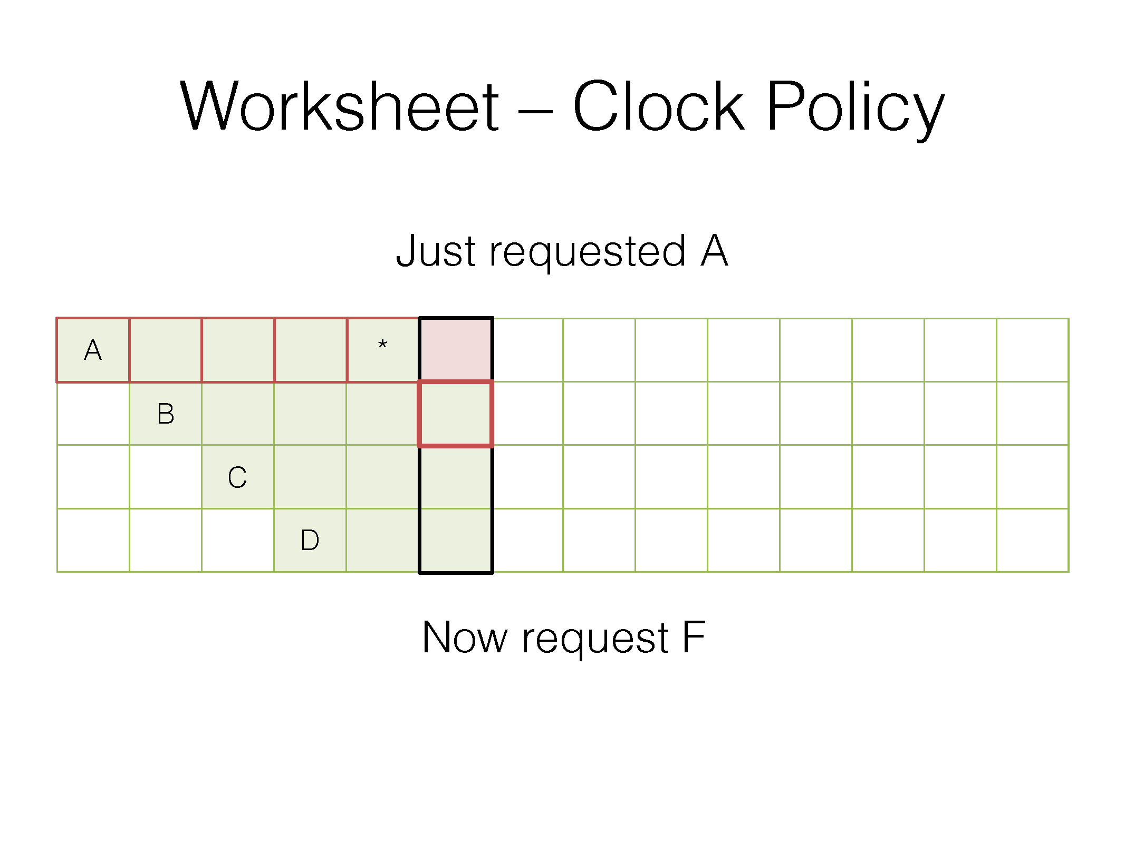
Red frame outline is where the clock hand points at the end of the access
Red box means the second chance bit is zero
Green box means the second chance bit is one
* means a hit

Slide 89
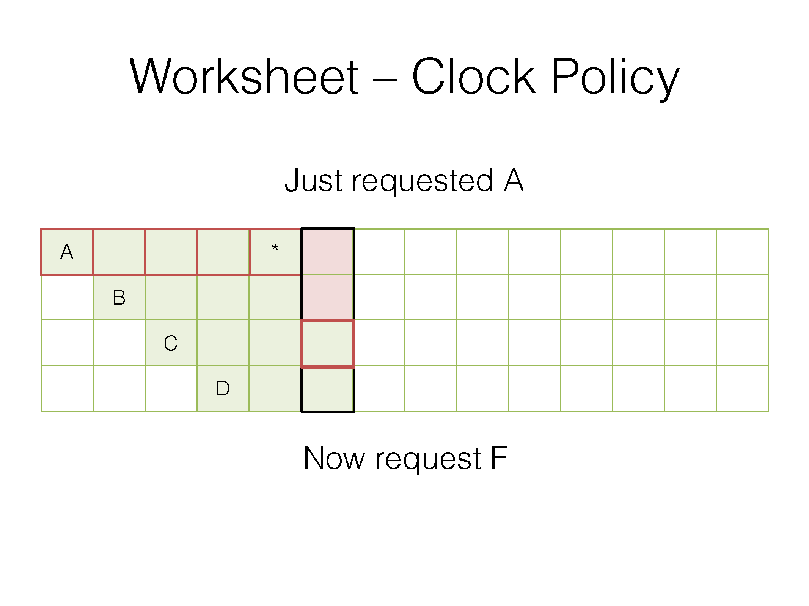
Red frame outline is where the clock hand points at the end of the access
Red box means the second chance bit is zero
Green box means the second chance bit is one
* means a hit

Slide 90

Red frame outline is where the clock hand points at the end of the access
Red box means the second chance bit is zero
Green box means the second chance bit is one
* means a hit

Slide 91
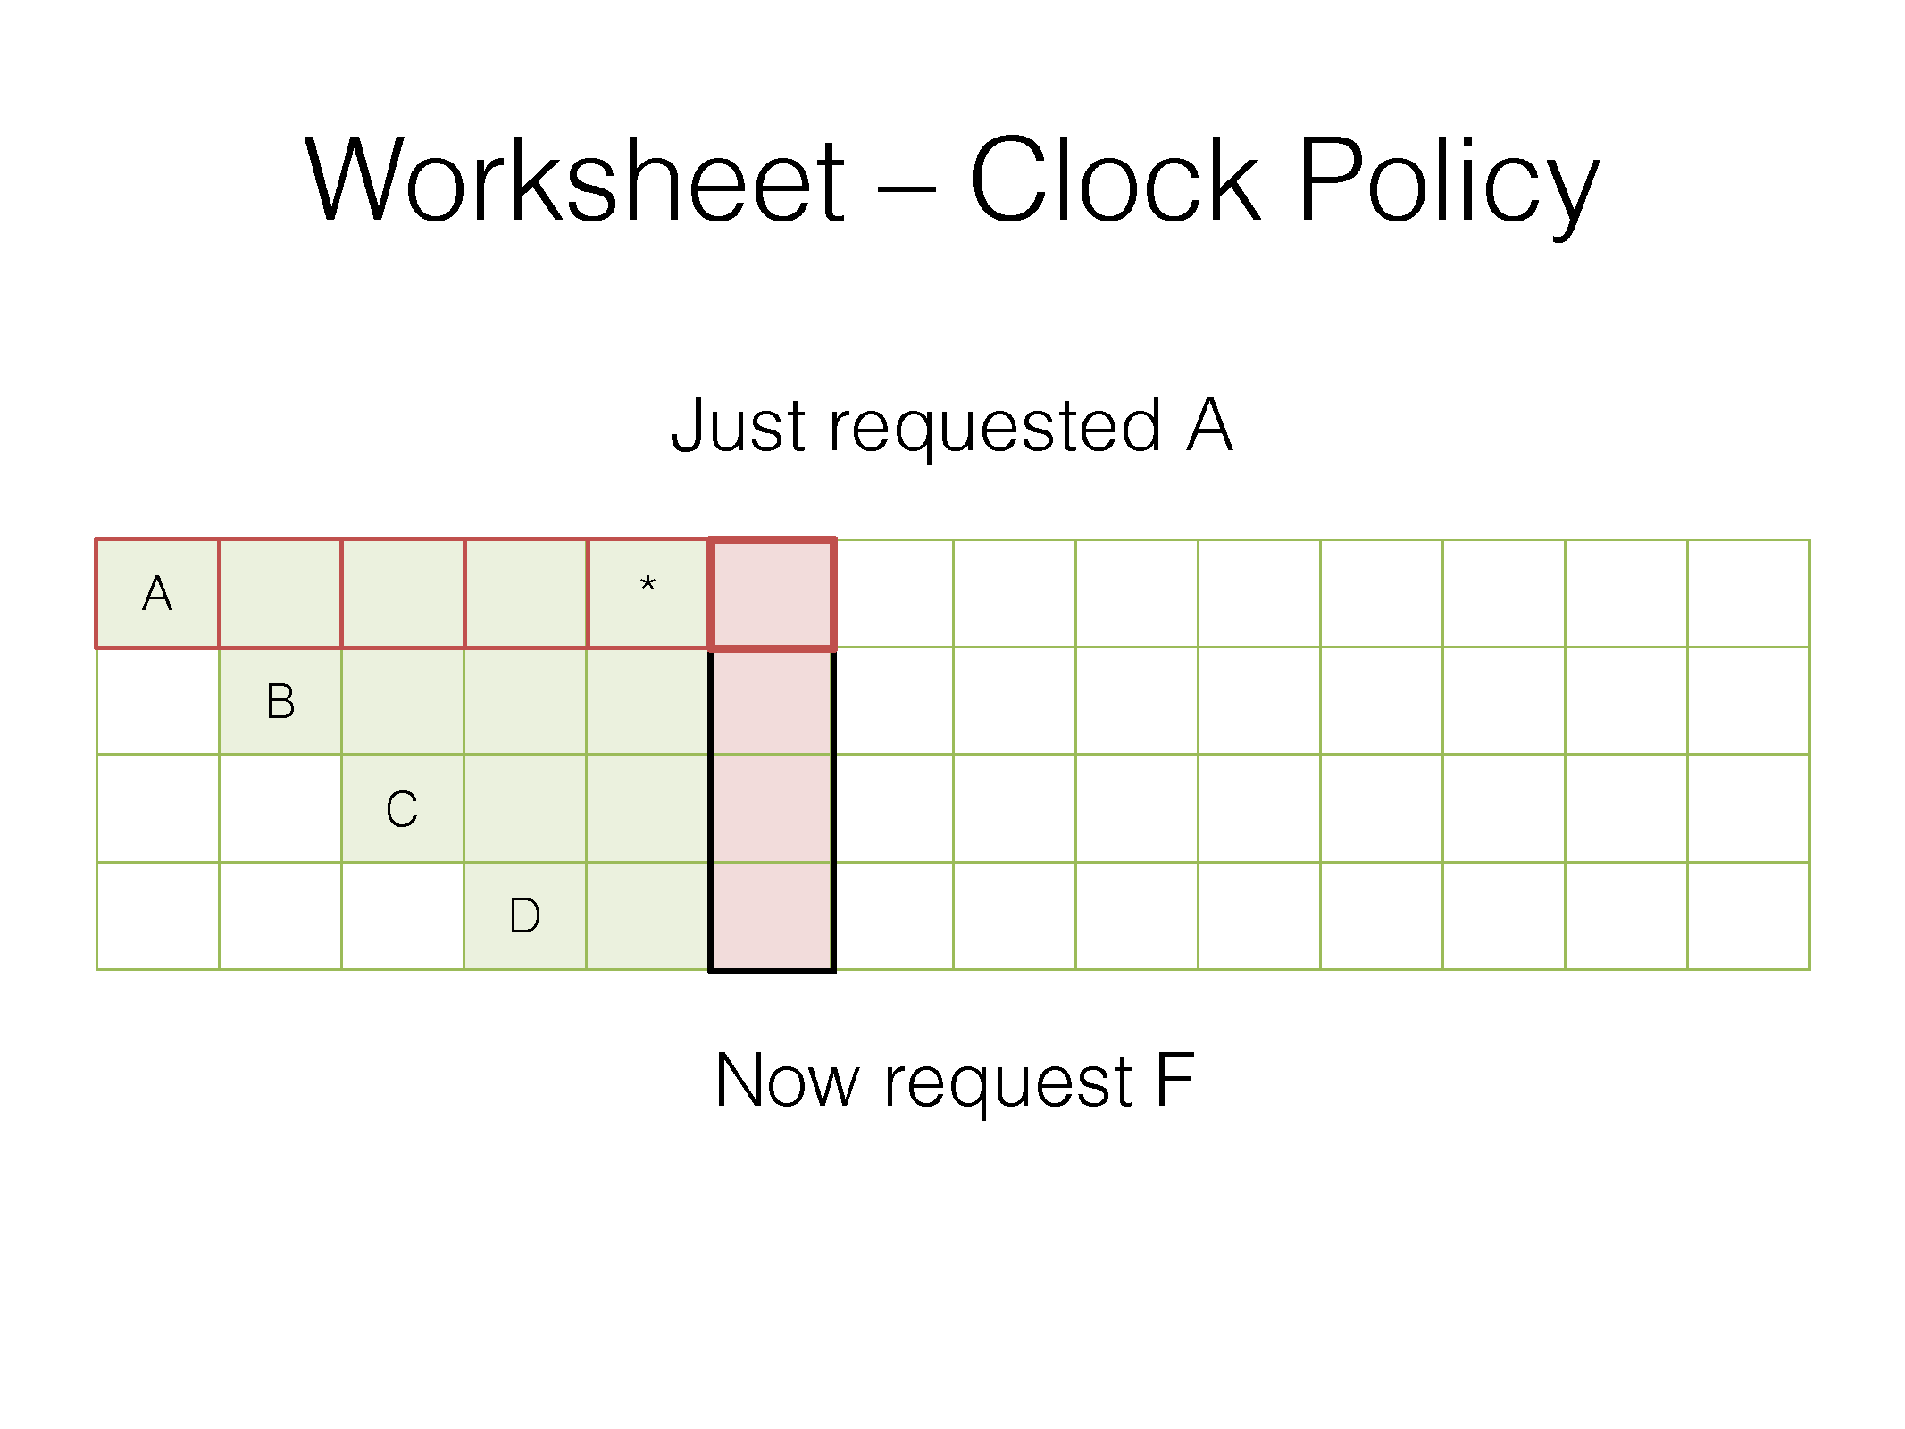
Red frame outline is where the clock hand points at the end of the access
Red box means the second chance bit is zero
Green box means the second chance bit is one
* means a hit

Slide 92
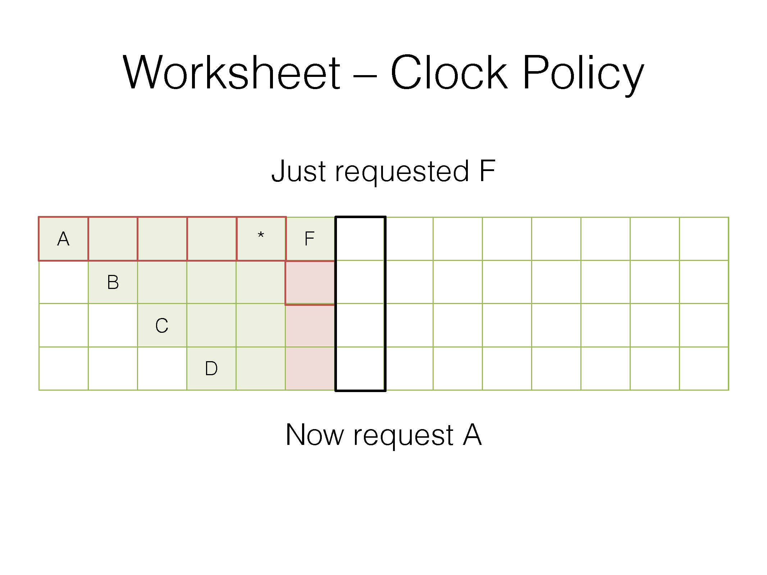
Red frame outline is where the clock hand points at the end of the access
Red box means the second chance bit is zero
Green box means the second chance bit is one
* means a hit

Slide 93
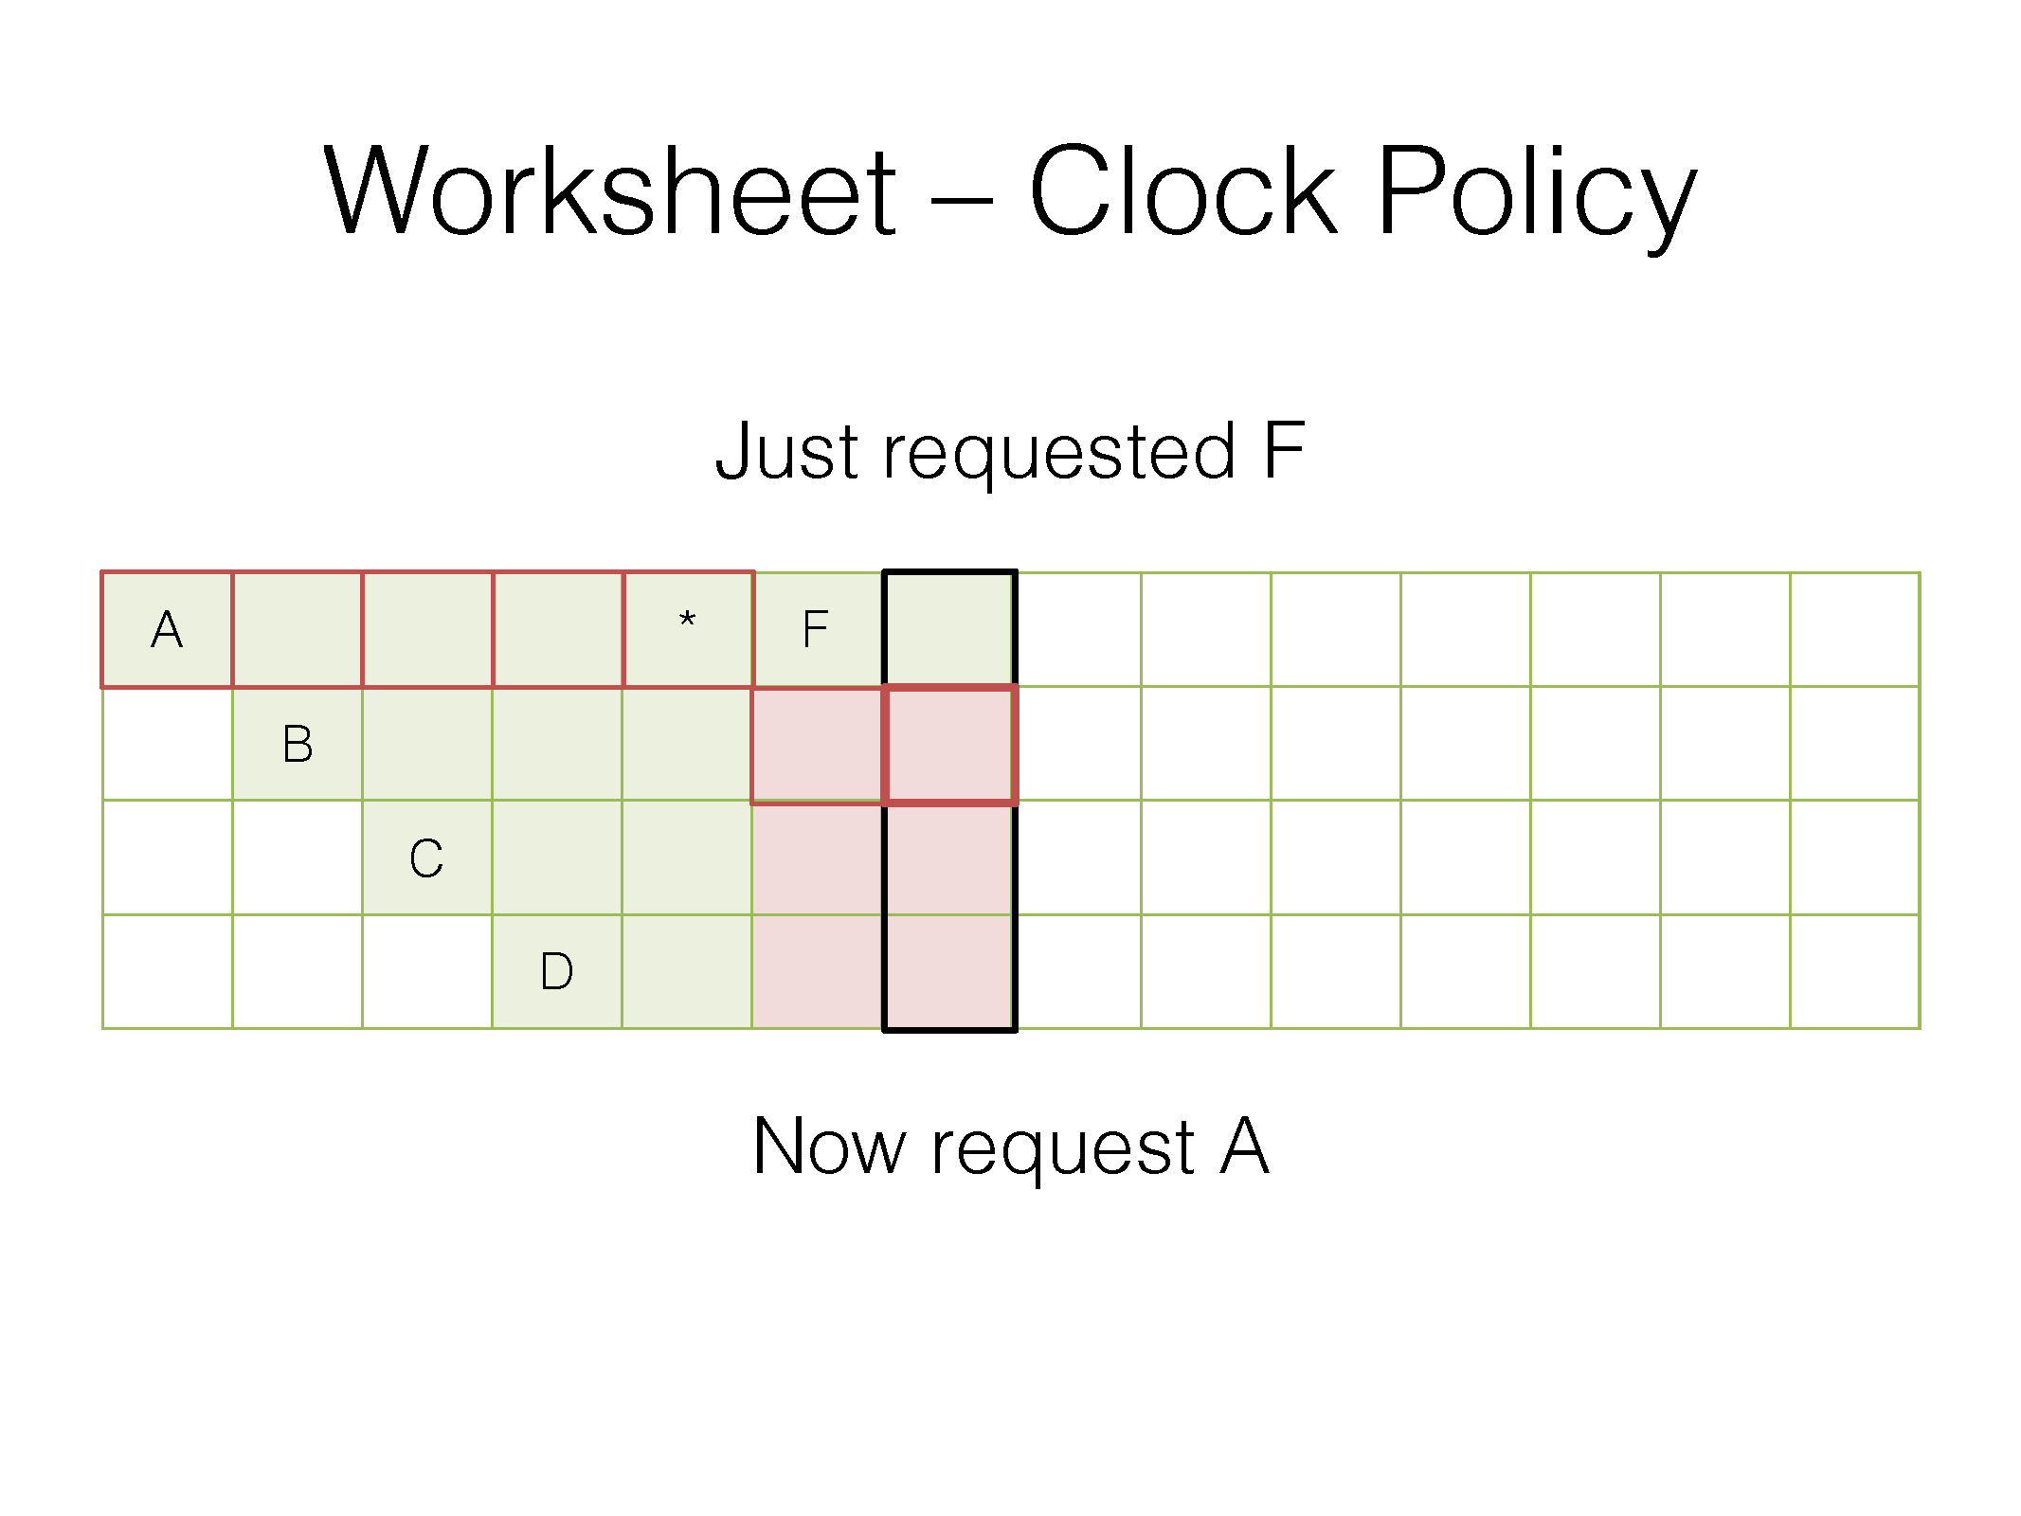
Red frame outline is where the clock hand points at the end of the access
Red box means the second chance bit is zero
Green box means the second chance bit is one
* means a hit

Slide 94
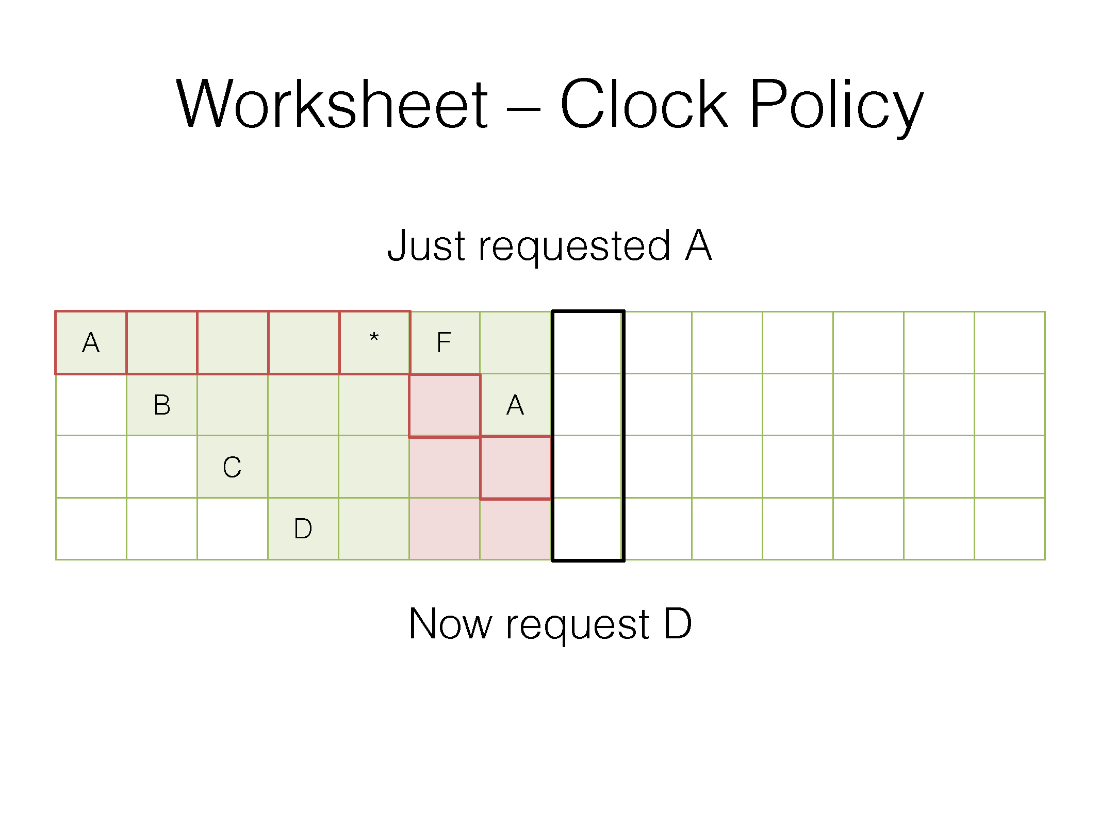
Red frame outline is where the clock hand points at the end of the access
Red box means the second chance bit is zero
Green box means the second chance bit is one
* means a hit

Slide 95
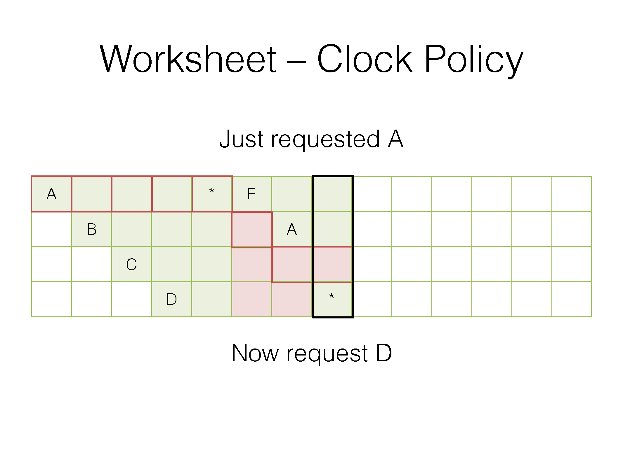
Red frame outline is where the clock hand points at the end of the access
Red box means the second chance bit is zero
Green box means the second chance bit is one
* means a hit

Slide 96
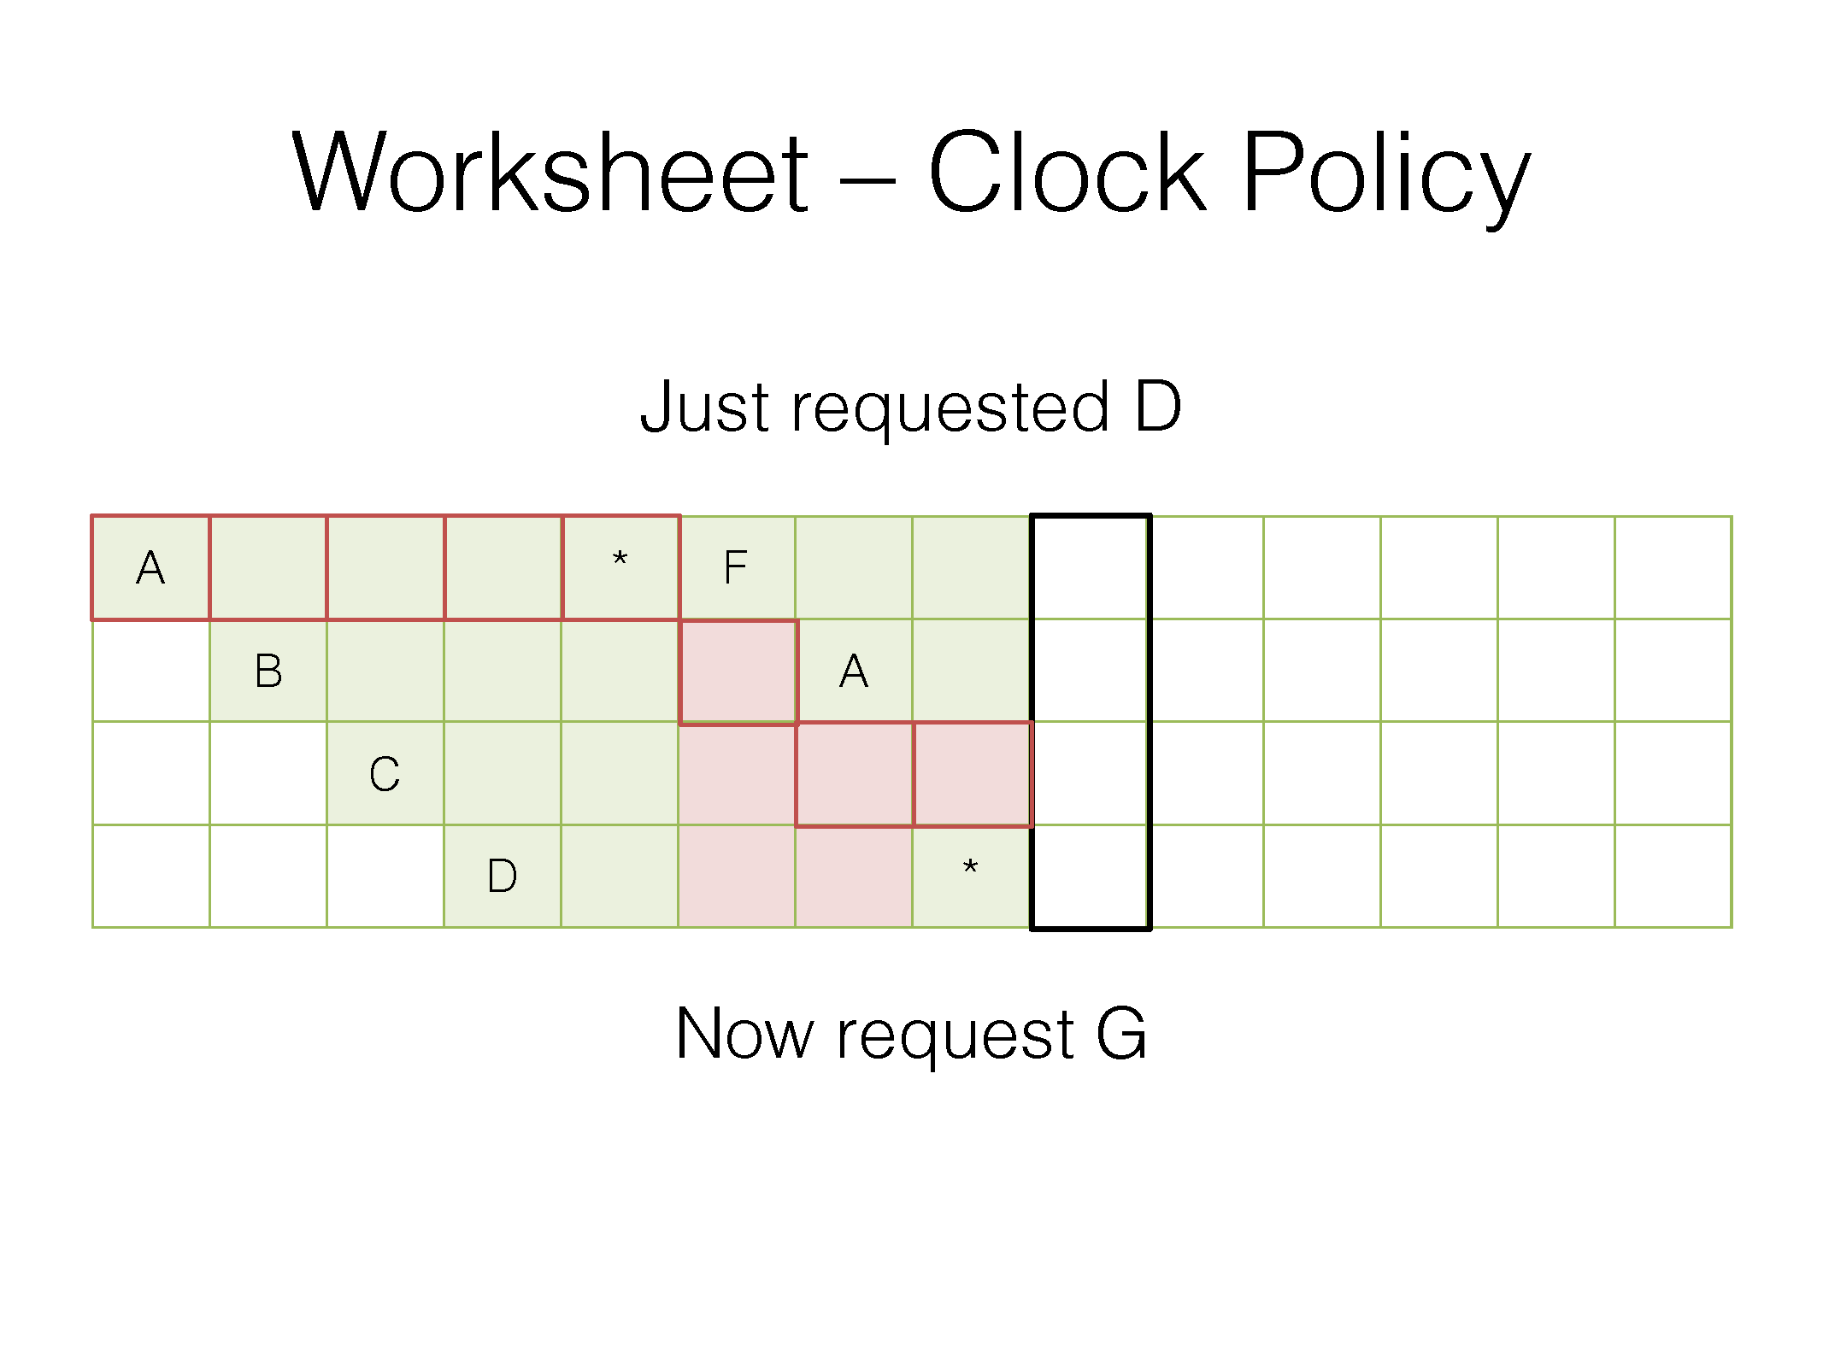
Red frame outline is where the clock hand points at the end of the access
Red box means the second chance bit is zero
Green box means the second chance bit is one
* means a hit

Slide 97
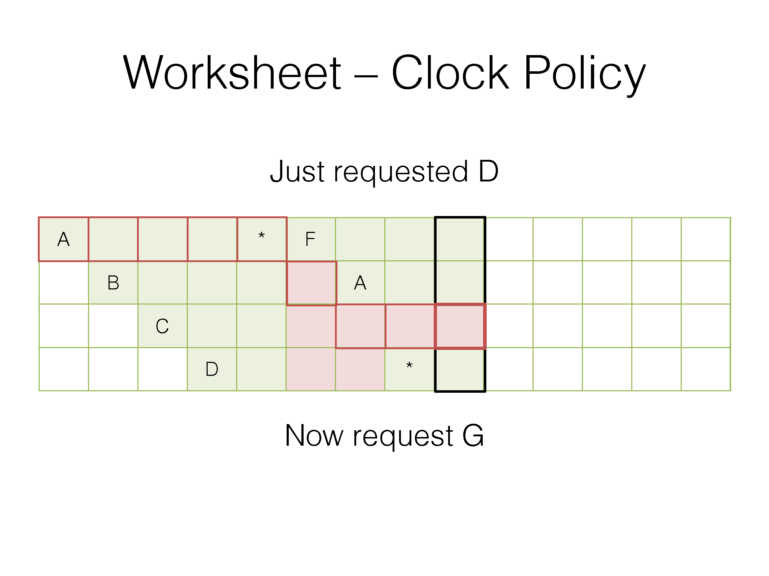
Red frame outline is where the clock hand points at the end of the access
Red box means the second chance bit is zero
Green box means the second chance bit is one
* means a hit

Slide 98
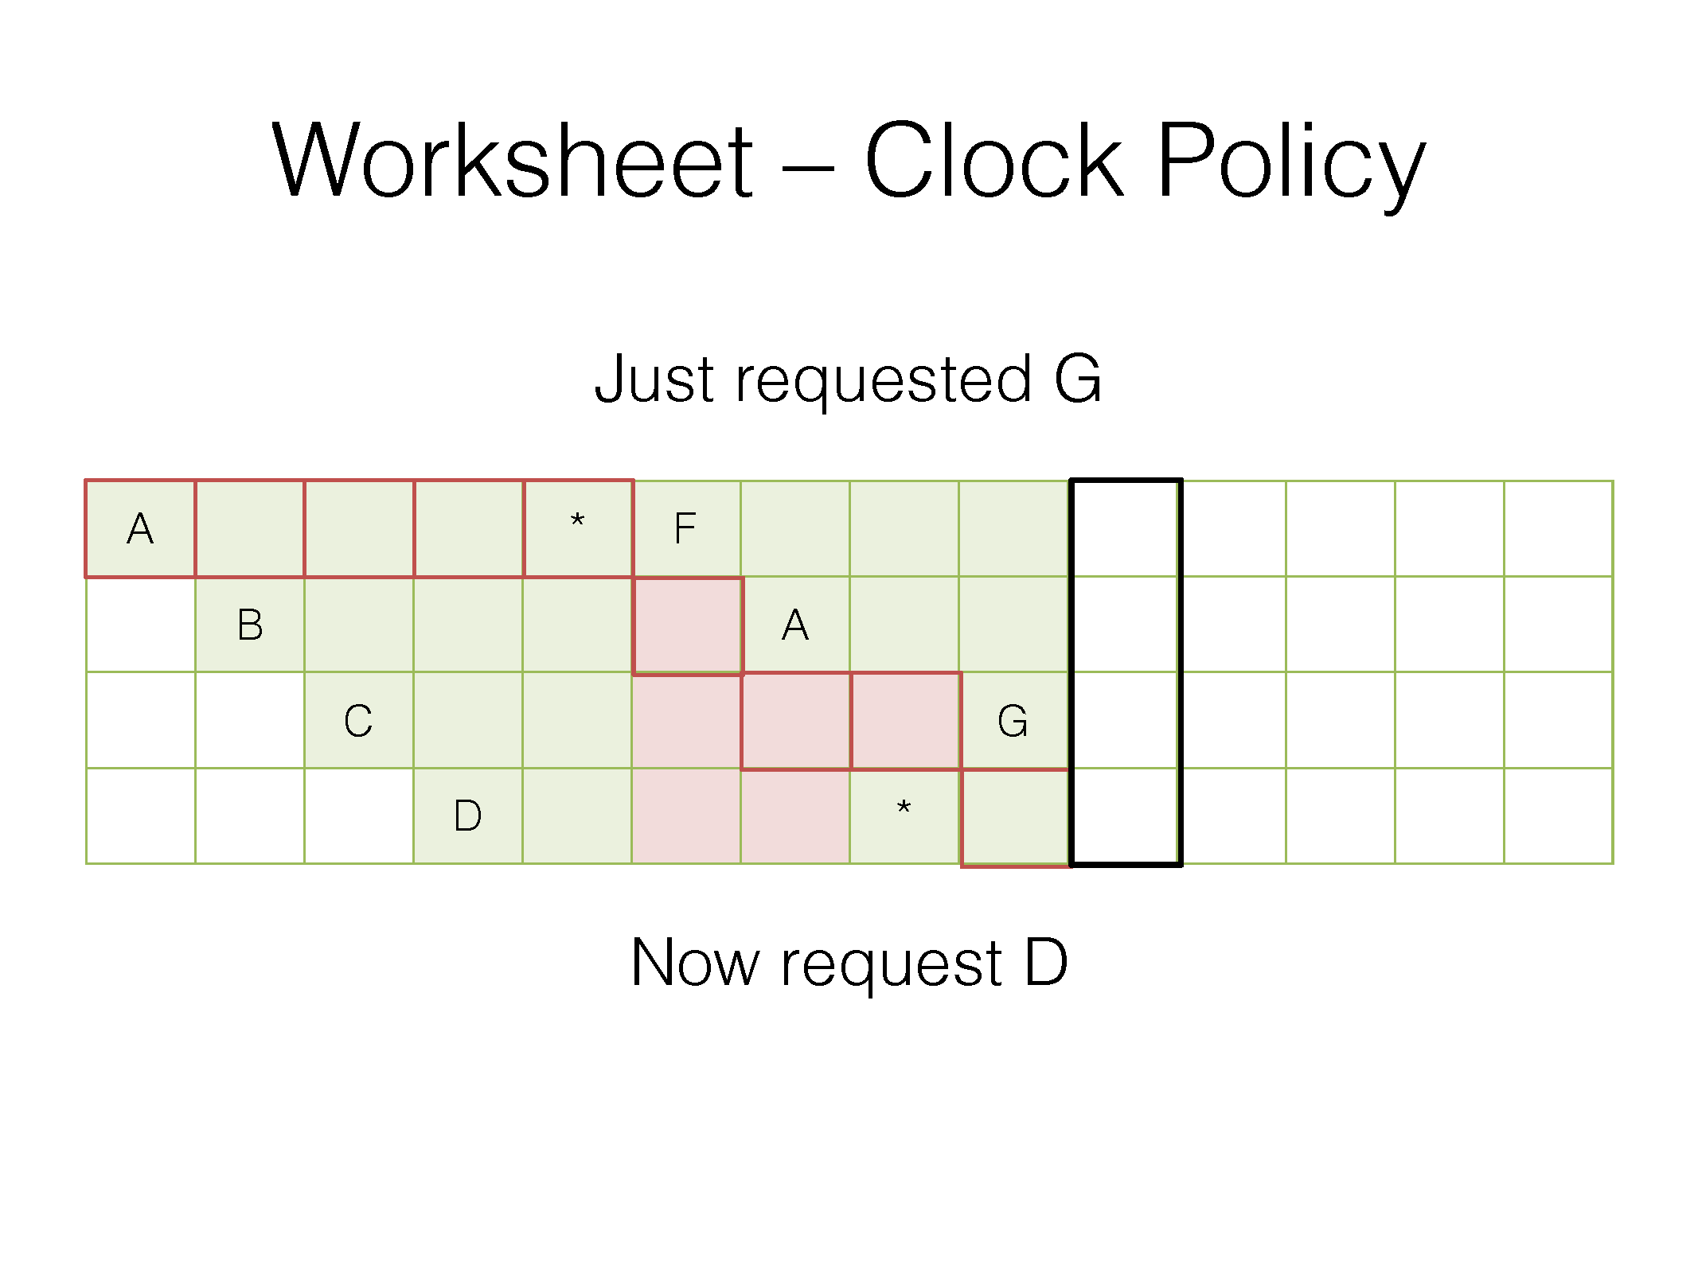
Red frame outline is where the clock hand points at the end of the access
Red box means the second chance bit is zero
Green box means the second chance bit is one
* means a hit

Slide 99
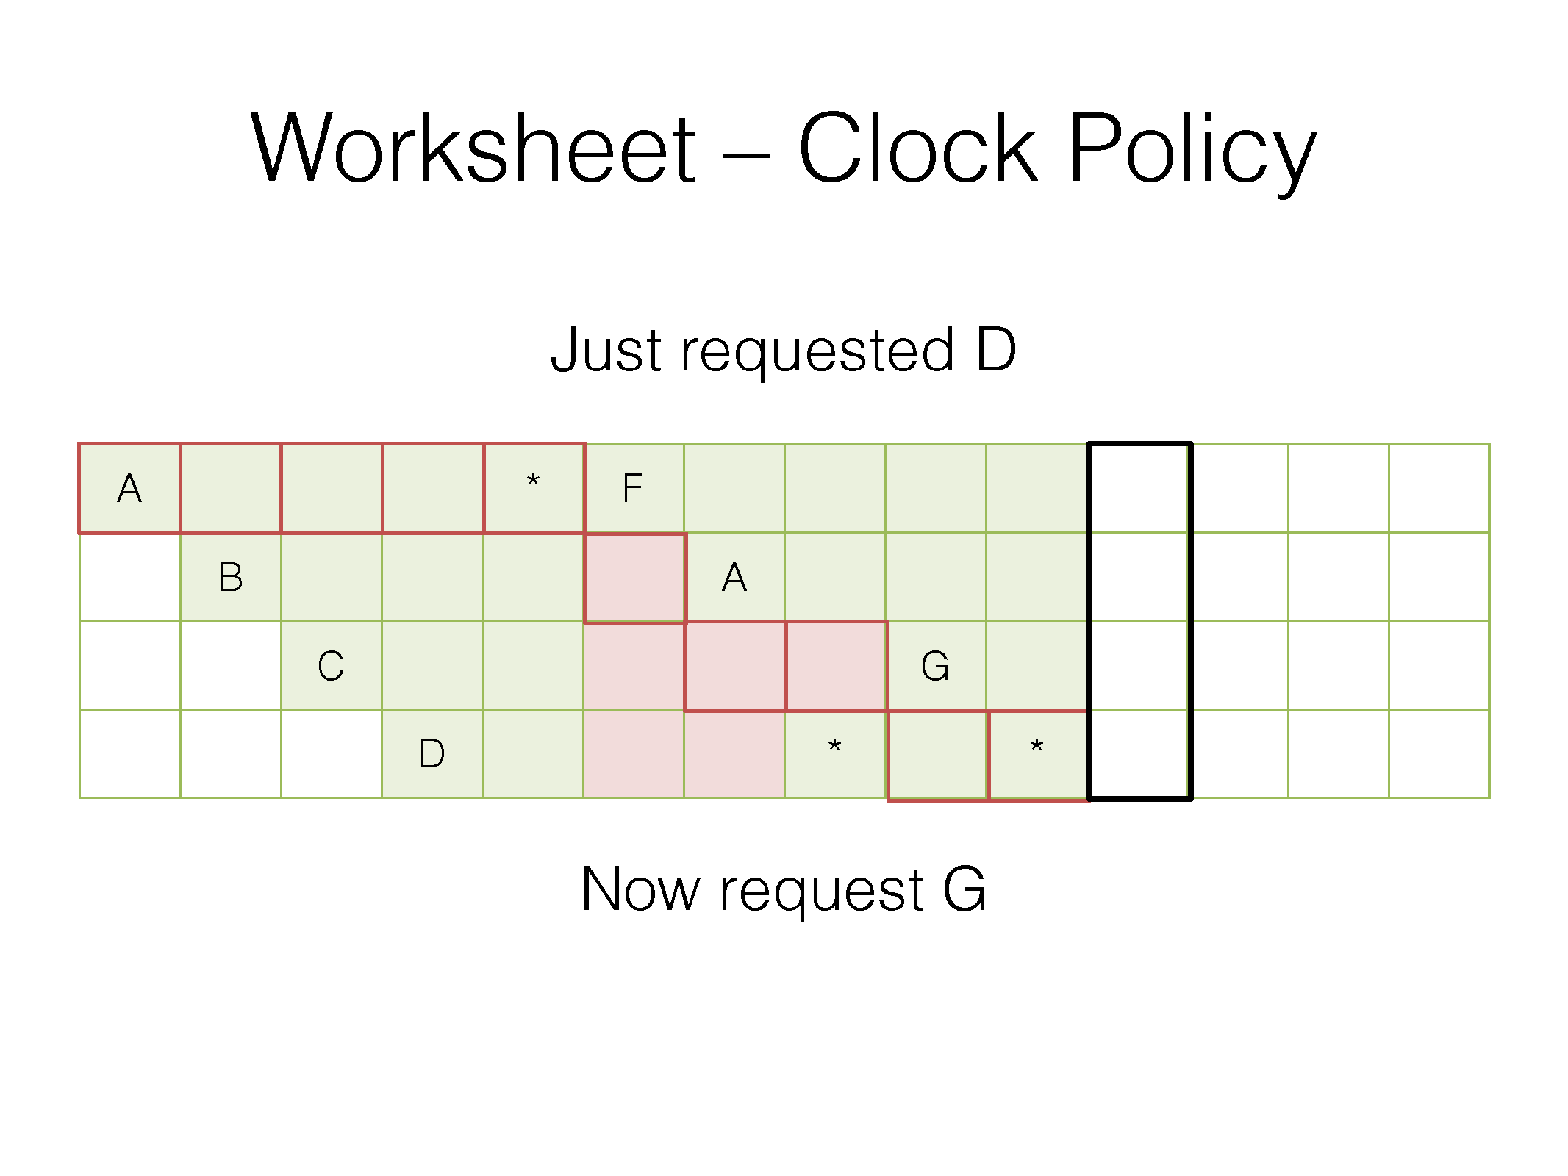
Red frame outline is where the clock hand points at the end of the access
Red box means the second chance bit is zero
Green box means the second chance bit is one
* means a hit

Slide 100
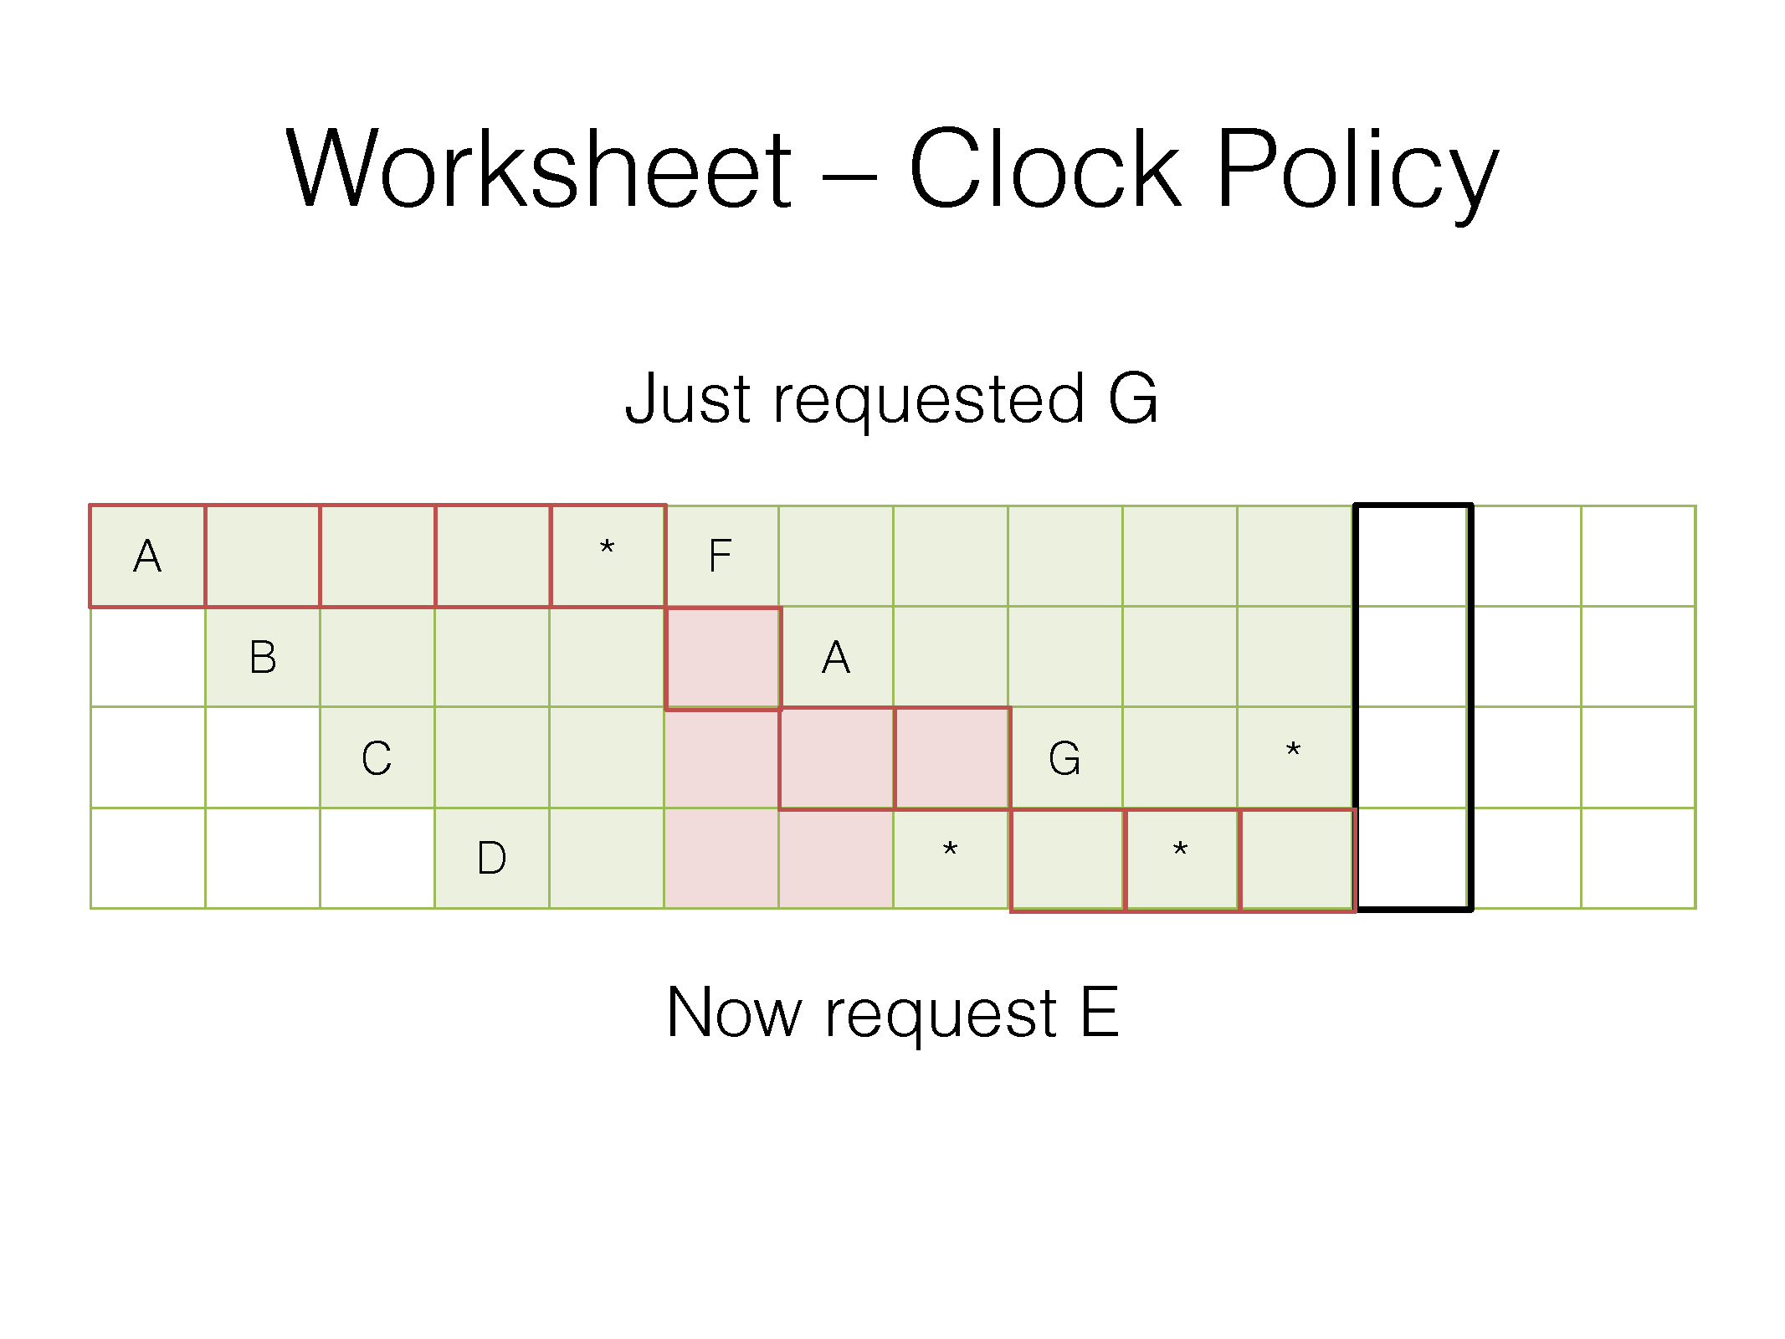
Red frame outline is where the clock hand points at the end of the access
Red box means the second chance bit is zero
Green box means the second chance bit is one
* means a hit

Slide 101
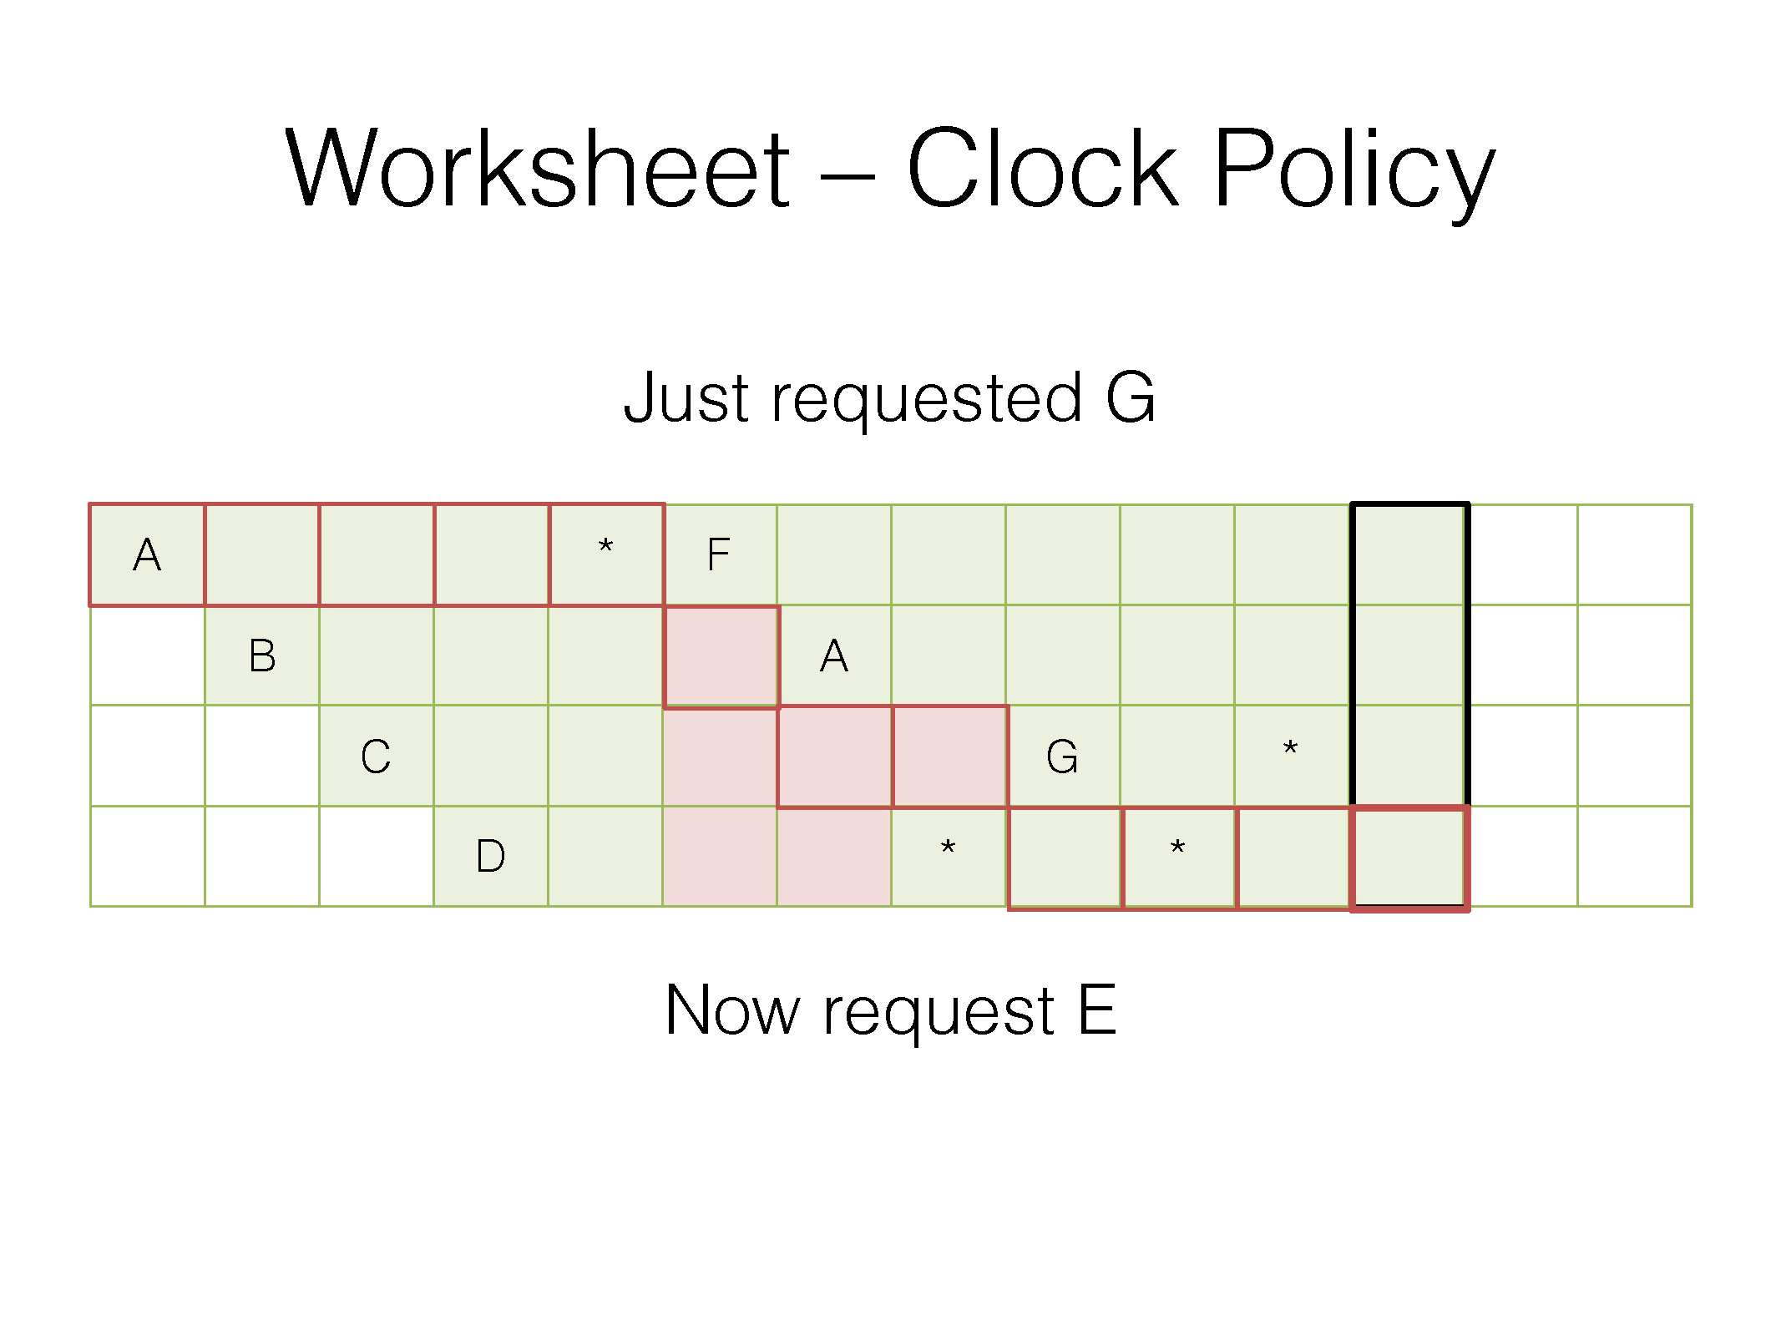
Red frame outline is where the clock hand points at the end of the access
Red box means the second chance bit is zero
Green box means the second chance bit is one
* means a hit

Slide 102
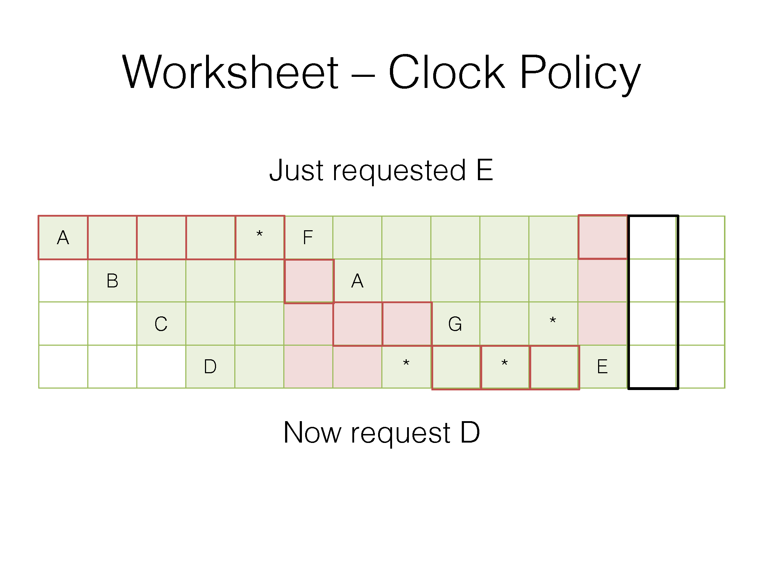
Red frame outline is where the clock hand points at the end of the access
Red box means the second chance bit is zero
Green box means the second chance bit is one
* means a hit

Slide 103
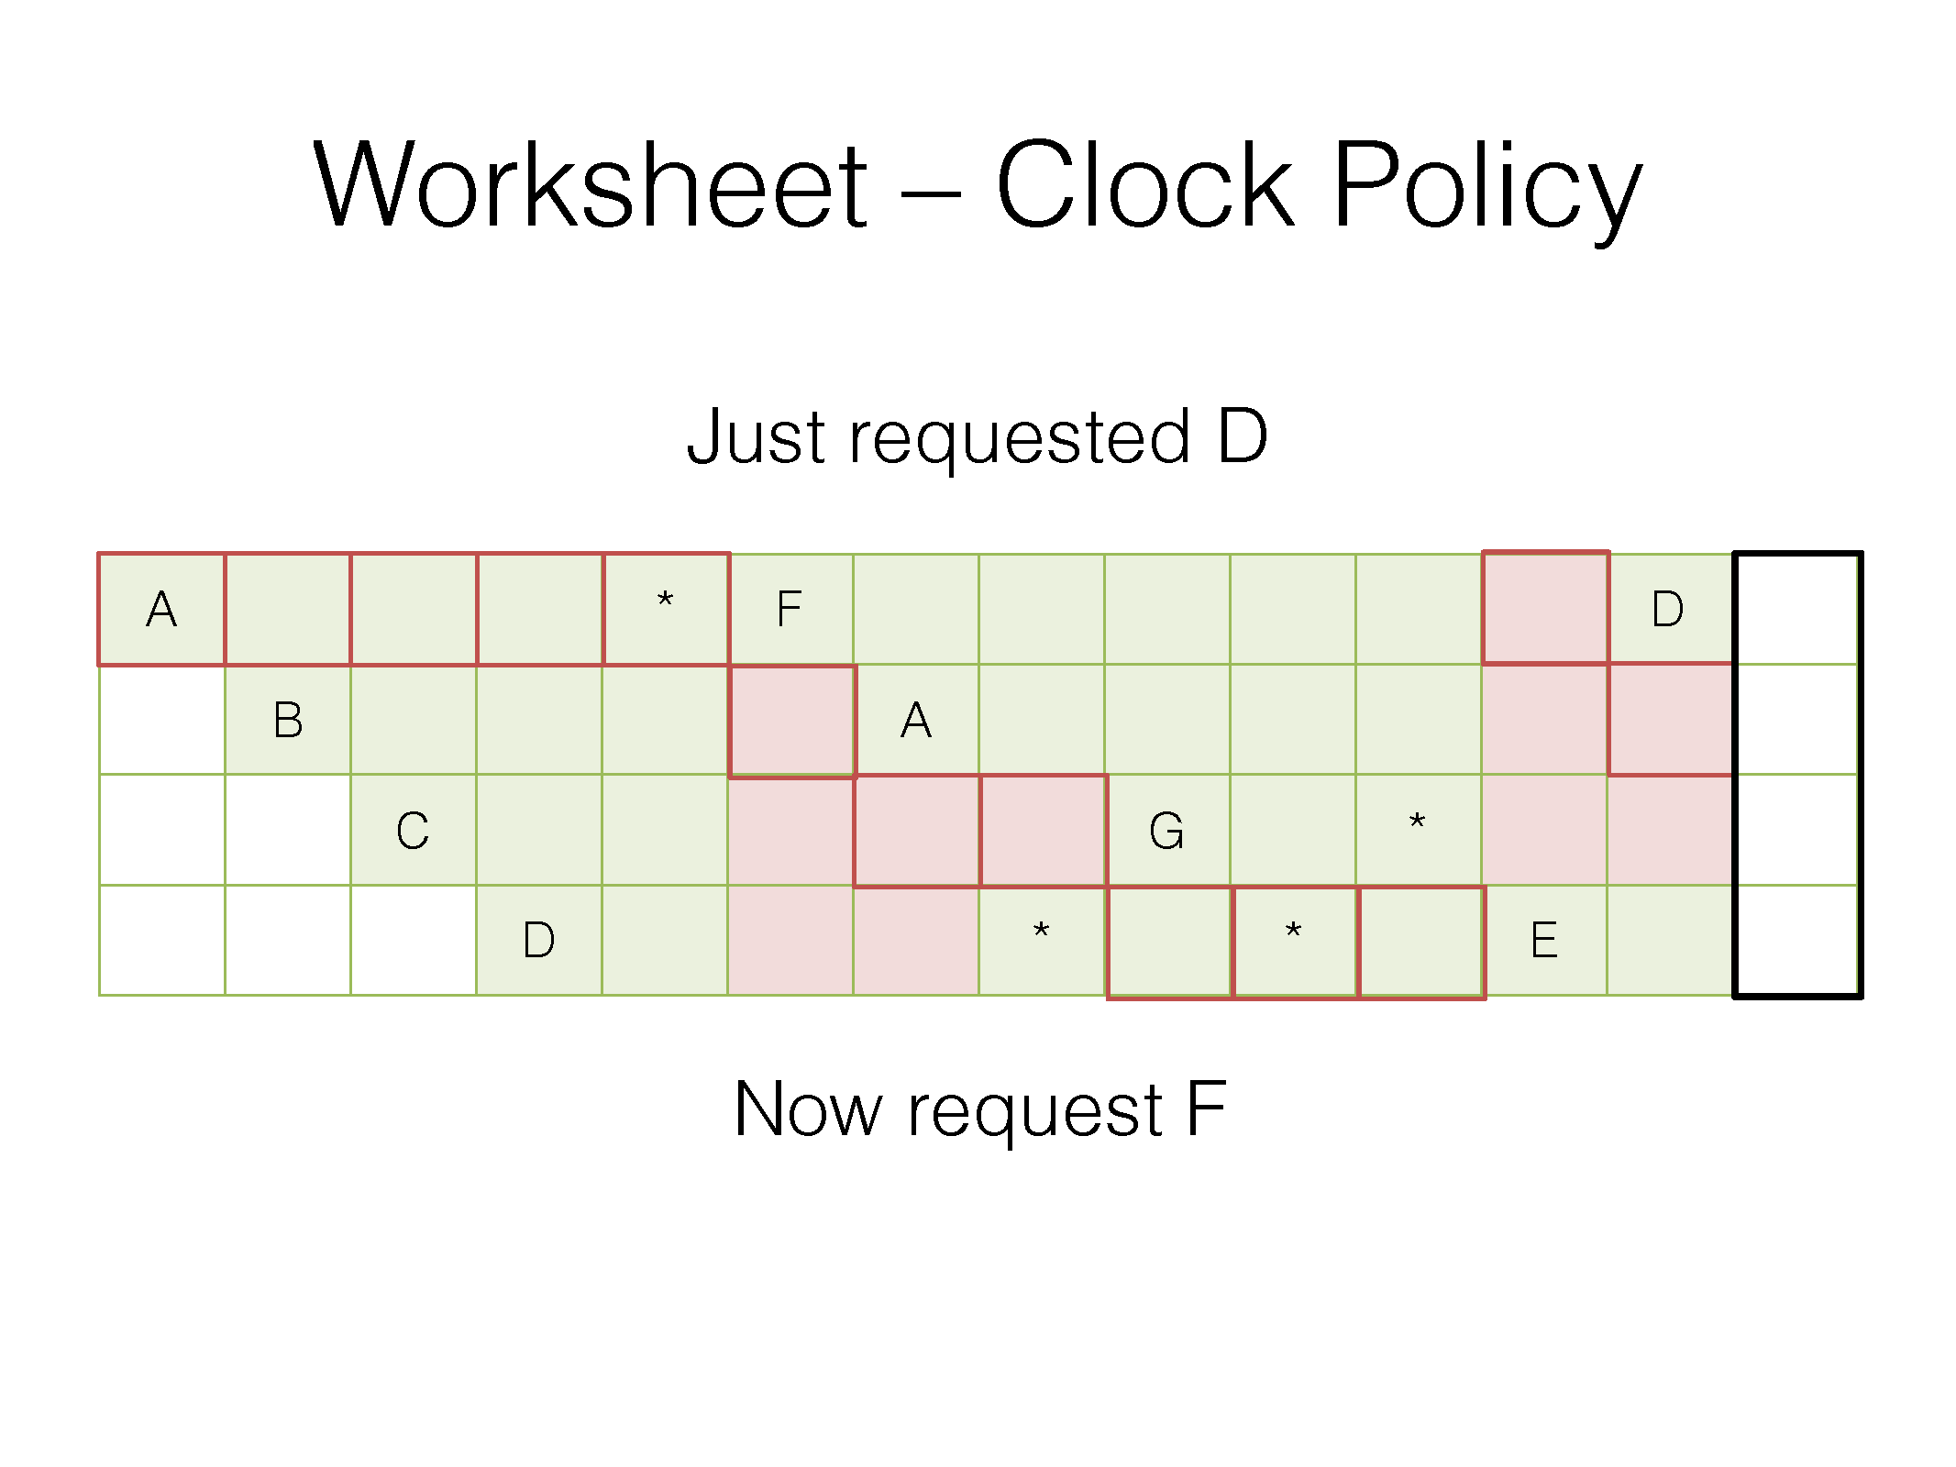
Red frame outline is where the clock hand points at the end of the access
Red box means the second chance bit is zero
Green box means the second chance bit is one
* means a hit

Slide 104
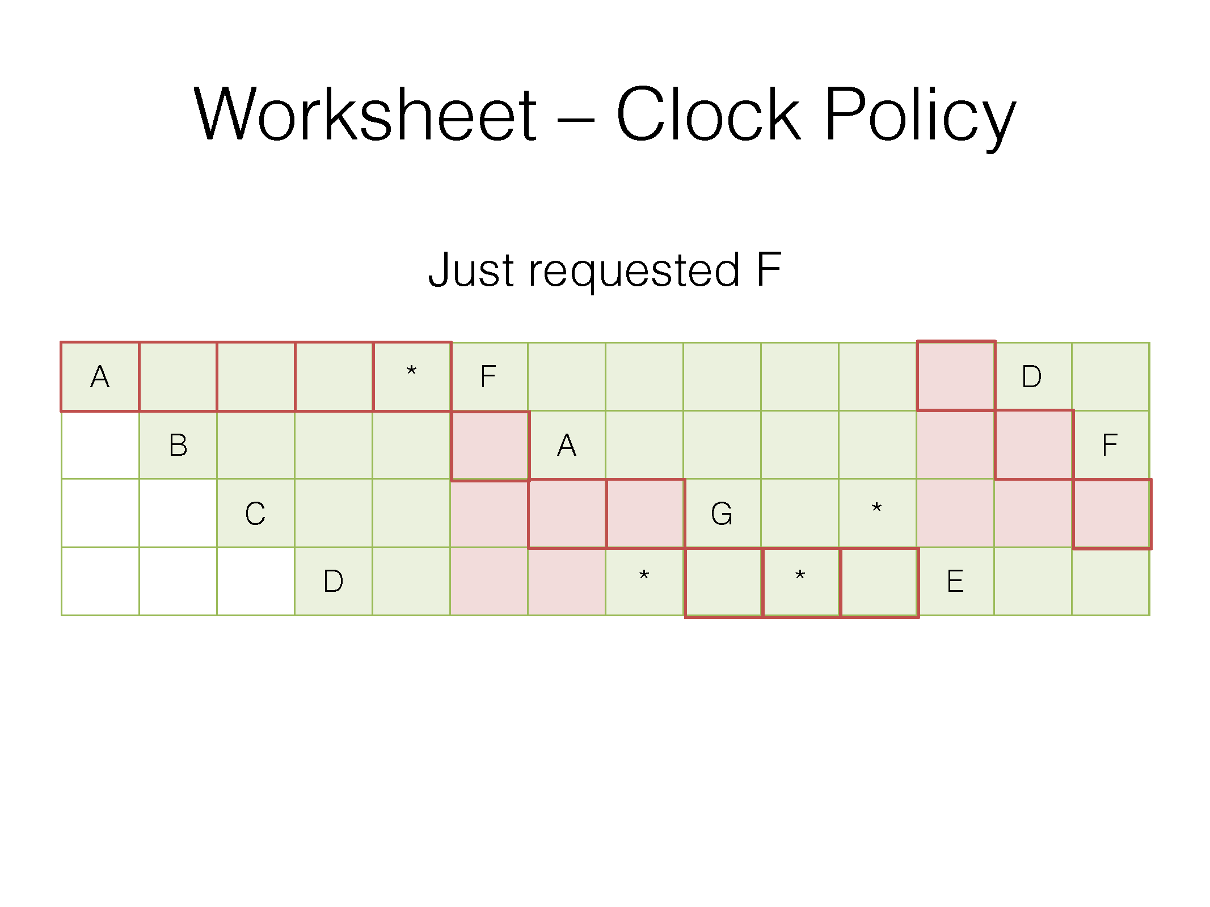
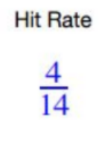
Red frame outline is where the clock hand points at the end of the access
Red box means the second chance bit is zero
Green box means the second chance bit is one
* means a hit

Slide 105
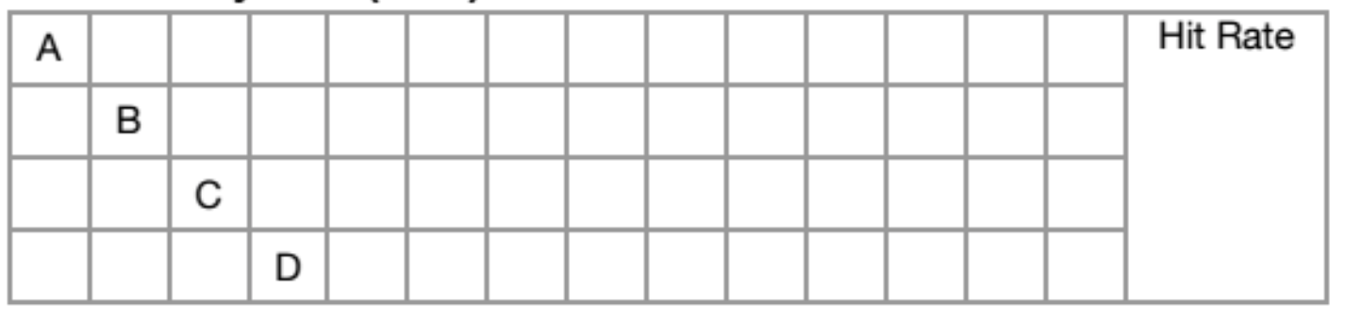
Worksheet: LRU w/ Pinned Pages
Fill in the following tables for the given buffer replacement policies. You have 4 buffer pages, with the access pattern
A, B, C, D, A, F (remains pinned), D, G, D, unpin F, G, E, D, F

Slide 106
Worksheet: LRU w/ Pinned Pages
Fill in the following tables for the given buffer replacement policies. You have 4 buffer pages, with the access pattern
A, B, C, D, A, F (remains pinned), D, G, D, unpin F, G, E, D, F
A |  |  |  | * |  |  |  |  |  |  |  | E |  |  | 6 13
 | B |  |  |  | F | x | x | x | x | x |  |  |  | *
 |  | C |  |  |  |  |  | G |  |  | *
 |  |  | D |  |  |  | * |  | * |  |  |  | *
* = hit Remember that unpinning doesn’t contribute to the hit count
X = pinned

Slide 107
Worksheet: MRU w/ Pinned Pages
Fill in the following tables for the given buffer replacement policies. You have 4 buffer pages, with the access pattern
A, B, C, D, A, F (remains pinned), D, G, D, unpin F, G, E, D, F

Slide 108
Worksheet: MRU w/ Pinned Pages
Fill in the following tables for the given buffer replacement policies. You have 4 buffer pages, with the access pattern
A, B, C, D, A, F (remains pinned), D, G, D, unpin F, G, E, D, F
A |  |  |  | * | F | x | x | x | x | x | G | E |  |  | 3 13
 | B
 |  | C
 |  |  | D |  |  |  | * | G | D |  |  |  | * | F
* = hit Remember that unpinning doesn’t contribute to the hit count!
X = pinned

Slide 109
Worksheet 1 (continued)
(c) Is MRU ever better than LRU?
(d) Why would we use a clock replacement policy over LRU?
(e) Why would it be useful for a database management system to implement its own buffer replacement policy? Why shouldn’t we just rely on the operating system?

Slide 110
Worksheet 1 (continued)
(c) Is MRU ever better than LRU?
Yes, MRU prevents sequential flooding during sequential scans
(d) Why would we use a clock replacement policy over LRU?
Efficiency (approximation of LRU; don’t need to maintain entire ordering)
(e) Why would it be useful for a database management system to implement its own buffer replacement policy? Why shouldn’t we just rely on the operating system?
The database management system knows its data access patterns, which allows it to optimize its buffer replacement policy for each case

Slide 111
Spatial Indexes

Slide 112
Spatial Indexes
Data structures to perform queries over vectors
“Find the nearest point to my query point”
“Find all points within distance 10 from my query point”
Must be defined with respect to some metric
Euclidean distance
Cosine similarity
Manhattan distance
k-d trees are a popular spatial index

Slide 113
Query: Find the closest vector to [9, 5] with respect to the manhattan distance
d([9, 5], [0, 10]) = |9 - 0| + |5 - 10| = 14
d([9, 5], [10, 0]) = |9 - 10| + |5 - 10| = 6
id | vec
1 | [0, 10]
2 | [10, 0]
3 | [5, 5]
4 | [6, 2]
5 | [3, 8]
6 | [2, 3]
7 | [6, 9]
8 | [3, 2]
d([9, 5], [5, 5]) = |9 - 5| + |5 - 5| = 4
Closest
d([9, 5], [6, 2]) = |9 - 6| + |5 - 2| = 6
d([9, 5], [3, 8]) = |9 - 3| + |5 - 8| = 9
d([9, 5], [2, 3]) = |9 - 2| + |5 - 3| = 9
d([9, 5], [6, 9]) = |9 - 6| + |5 - 9| = 7
d([9, 3], [6, 2]) = |9 - 3| + |6 - 2| = 10

Slide 114
Using Indexes
In the previous example, we did a brute force search
Prohibitively slow for many real workloads requiring low latency
k-d trees partition the space so that only a subset of database vectors need to be compared to a given query vector
Similar to a binary search tree and B+ tree
k-d trees are typically used for lower dimensional data (e.g., up to 8 dimensions)

Slide 115
K-d Tree Construction
Choose a dimension and find the median (or mean) of all points along that dimension
Split points in half, separated by the median (or mean)
Recursively split both halves
Pick a different dimension in the next recursion step
Not necessarily required, but often done

Slide 116
Example
id | vec
1 | [0, 10]
2 | [10, 0]
3 | [5, 5]
4 | [6, 2]
5 | [3, 8]
6 | [2, 3]
7 | [6, 9]
8 | [3, 2]

Slide 117
Stored as a Tree
L
R
U
D
U
D
L
R
L
R
L
R
L
R
[0, 10]
[3, 8]
[2, 3]
[3, 2]
[5, 5]
[6, 9]
[6, 2]
[10, 0]

Slide 118
K-d Tree Nearest Neighbor Search
Start from the root of the tree
Traverse the tree to find the leaf node containing the query point
Mark the database vector corresponding to that leaf node as the current closest vector
Note: this is not necessarily the closest neighbor!!
Backtrack up the tree and check if there can be a closer point on the other side of the split
If there is a possibility of a closer vector, recursively search the other side
After backtracking past the root, the closest vector found is the answer

Slide 119
Example
id | vec
1 | [0, 10]
2 | [10, 0]
3 | [5, 5]
4 | [6, 2]
5 | [3, 8]
6 | [2, 3]
7 | [6, 9]
8 | [3, 2]

Slide 120
Example
id | vec
1 | [0, 10]
2 | [10, 0]
3 | [5, 5]
4 | [6, 2]
5 | [3, 8]
6 | [2, 3]
7 | [6, 9]
8 | [3, 2]

Slide 121
Example
id | vec
1 | [0, 10]
2 | [10, 0]
3 | [5, 5]
4 | [6, 2]
5 | [3, 8]
6 | [2, 3]
7 | [6, 9]
8 | [3, 2]

Slide 122
Example
7
id | vec
1 | [0, 10]
2 | [10, 0]
3 | [5, 5]
4 | [6, 2]
5 | [3, 8]
6 | [2, 3]
7 | [6, 9]
8 | [3, 2]

Slide 123
Backtrack
7
id | vec
1 | [0, 10]
2 | [10, 0]
3 | [5, 5]
4 | [6, 2]
5 | [3, 8]
6 | [2, 3]
7 | [6, 9]
8 | [3, 2]
3.5

Slide 124
Backtrack
id | vec
1 | [0, 10]
2 | [10, 0]
3 | [5, 5]
4 | [6, 2]
5 | [3, 8]
6 | [2, 3]
7 | [6, 9]
8 | [3, 2]
4

Slide 125
Backtrack
id | vec
1 | [0, 10]
2 | [10, 0]
3 | [5, 5]
4 | [6, 2]
5 | [3, 8]
6 | [2, 3]
7 | [6, 9]
8 | [3, 2]
4
1.5

Slide 126
Backtrack
id | vec
1 | [0, 10]
2 | [10, 0]
3 | [5, 5]
4 | [6, 2]
5 | [3, 8]
6 | [2, 3]
7 | [6, 9]
8 | [3, 2]
4

Slide 127
Backtrack
id | vec
1 | [0, 10]
2 | [10, 0]
3 | [5, 5]
4 | [6, 2]
5 | [3, 8]
6 | [2, 3]
7 | [6, 9]
8 | [3, 2]
4
6

Slide 128
Backtrack
id | vec
1 | [0, 10]
2 | [10, 0]
3 | [5, 5]
4 | [6, 2]
5 | [3, 8]
6 | [2, 3]
7 | [6, 9]
8 | [3, 2]
4
6

Slide 129
Backtrack
5
id | vec
1 | [0, 10]
2 | [10, 0]
3 | [5, 5]
4 | [6, 2]
5 | [3, 8]
6 | [2, 3]
7 | [6, 9]
8 | [3, 2]
4

Slide 130
Done
id | vec
1 | [0, 10]
2 | [10, 0]
3 | [5, 5]
4 | [6, 2]
5 | [3, 8]
6 | [2, 3]
7 | [6, 9]
8 | [3, 2]
4

Slide 131
Worksheet #2a
How many distance computations with database points are needed to find the nearest neighbor using brute force?

Slide 132
Worksheet #2a
How many distance computations with database points are needed to find the nearest neighbor using brute force?
8, since we need to compare our query point to each database point

Slide 133
Worksheet #2b
How many distance computations with database points are needed to find the nearest neighbor using our k-d tree?

Slide 134
Worksheet #2b
How many distance computations with database points are needed to find the nearest neighbor using our k-d tree?
2, since we need to check both the points towards the bottom right

Slide 135

Attendance Link
https://cs186berkeley.net/attendance

