Slide 1
CS W186 Exam Prep Section 7
Query Optimization

Slide 2
Query Optimization

Slide 3
Query Optimization
SELECT travelers.name, cities.name
FROM travelers left outer join cities on city_id = dest_id
WHERE cities.name == ‘Berkeley’
ORDER BY cities.name;
Many different orders to perform all these operations
We use the System R optimizer (aka Selinger optimizer)
Plan space: only left-deep trees (important!), avoid cartesian products
Cost estimation: We’ll only use I/O cost for this class (exclude CPU)
Search algorithm: dynamic programming

Slide 4
Selectivity Estimation
To estimate the cost of a query, add up the estimated costs of each operator in the query
Need to know the size of the intermediate relations (generated from one operator and passed into another)
Need to know the selectivity of predicates - what % of tuples are selected by a predicate
These are all estimates: if we don’t know, we make up a value for it (selectivity = 1/10)
System R assume uniform and indep. distribution of values

Slide 5
Selectivity Estimation - Equalities
Predicate | Selectivity | Assumption
c = v | 1 / (number of distinct values of c in index) | We know |c|.
c = v | 1 / 10 | We don’t know |c|.
c1 = c2 | 1 / MAX(number of distinct values of c1, number of distinct values of c2) | We know |c1| and |c2|.
c1 = c2 | 1 / (number of distinct values of ci) | We know |ci| but not |other column|.
c1 = c2 | 1 / 10 | We don't know |c1| or |c2|.
Included for completeness - don’t memorize, just put on your reference sheet
|column| = the number of distinct values for the column
Note: If you have an index on the column, you can assume you know |column|, max(c), and min(c)

Slide 6
Selectivity Estimation - Inequalities on Integers
Predicate | Selectivity | Assumption
c > v | (high key - v) / (high key - low key + 1) | We know max(c) and min(c).
c > v | 1 / 10 | We don't know max(c) and min(c).
c >= v | (high key - v) / (high key - low key + 1) + (1 / number of distinct values of c) | We know max(c) and min(c).
c >= v | 1 / 10 | We don't know max(c) and min(c).

Slide 7
Selectivity Estimation - Inequalities on Integers
Predicate | Selectivity | Assumption
c < v | (v - low key) / (high key - low key + 1) | We know max(c) and min(c).
c < v | 1 / 10 | We don’t know max(c) and min(c).
c <= v | (v - low key) / (high key - low key + 1) + (1 / number of distinct values of c) | We know max(c) and min(c).
c <= v | 1 / 10 | We don’t know max(c) and min(c).

Slide 8
Selectivity Estimation - Connectives
Predicate | Selectivity | Assumption
p1 AND p2 | S(p1)S(p2) | Independent predicates
p1 OR p2 | S(p1) + S(p2) - S(p1)S(p2)
NOT p | 1 - S(p)

Slide 9
Query Optimization - Selinger
Pass 1: find minimum cost access method for each (relation, interesting order)
Index scan, full table scans
Pass i (for 1 < i ≤ n): take in list of optimal plans for (i - 1 relations, interesting order) from Pass i-1, and compute minimum cost plan for (i relations, interesting orders) (every size i subset of the n relations)

Slide 10
Query Optimization Selectivity Order
Apply single table predicates in the first pass such as WHERE student.age > 3000000000
Multiple table predicates such as Student.SID = Cs186student.SID take place in subsequent passes

Slide 11
Query Optimization
For n relations joined, perform n passes
on the i-th path, output only the best plan for joining any i of the n relations
Also keep around plans that have higher cost but have an interesting order
This along with only considering left-deep plans forms the crux of most QO questions

Slide 12
Query Optimization - Interesting Orders
Interesting orders are orderings on intermediate relations that may help reduce the cost of later joins
ORDER BY attributes
GROUP BY attributes
downstream join attributes
For instance, sort merge join will produce a relation that can help with an ORDER BY clause

Slide 13
Worksheet

Slide 14
Query Optimization 1

Slide 15
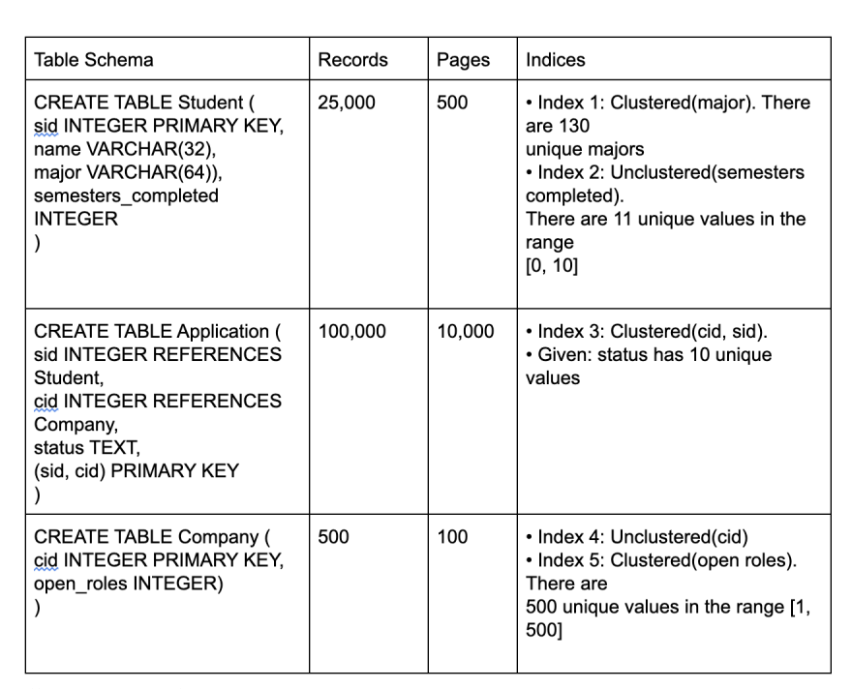
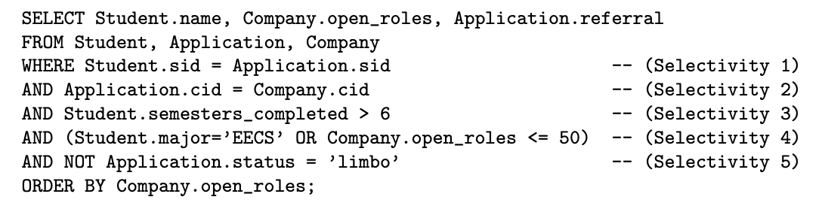
Query Optimization 1

Slide 16
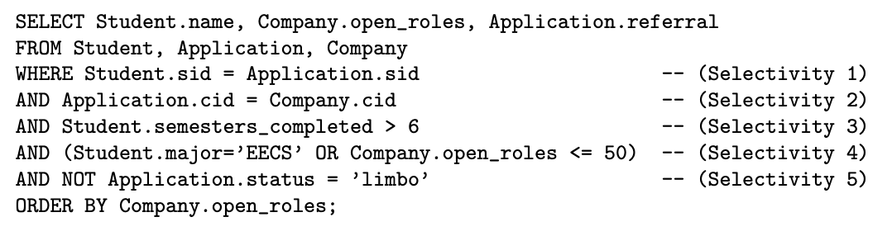
Question 1a
Selectivity 1:
1/max(25000, 25000) = 1/25000. There are exactly 25000 values in Student.sid, and due to the foreign key, there are at most 25000 values of Application.sid.

Slide 17
Question 1b
Selectivity 2:
1/max(500, 500) = 1/500. Similarly to Selectivity 1, there are exactly 500 values in Company.cid, and due to the foreign key, there are at most 500 values in Application.cid.

Slide 18
Question 1c
Selectivity 3:
(10 - 6) / (10 - 0 + 1) = 4/11. We have 11 unique values, assumed to be equally distributed. Therefore we use the equation for less than or equal to which is (high key - value) / (high key - low key + 1).

Slide 19
Question 1d
Selectivity 4:
(1/130 + (1/10 + 1/500)) - (1/130 * (1/10 + 1/500)). We can find the selectivity that they are an EECS major by using the equation 1/distinct values. Next, we find the selectivity that open positions are less than or equal to 50 using the equation (v - low key) / (high key - low key + 1) + (1 / number distinct). Lastly we combine these two selectivities using S(p1) + S(p2) - S(p1)S(p2) to determine the selectivity of having one or the other.

Slide 20
Question 1e
Selectivity 5:
1 - (1/10) = 9/10. Given 10 unique values, the non-negated predicate has selectivity 1/10, so we can use the equation for NOT which is 1 - selectivity of the predicate. The selectivity of the predicate is 1/10 (because there are 10 unique values).

Slide 21
Question 2
For each predicate, which is the first pass of Selinger’s algorithm that uses its selectivity to estimate output size? (Pass 1, 2 or 3?)
Solution: Pass 2, Pass 2, Pass 1, Pass 3, Pass 1. C and E are pass 1 because they only involve filtering one table. A and B are pass 2 because they represent a join. Note that (d)—the OR predicate—is over 2 tables that have no associated join predicate, so the selection is postponed along with the cross-product, until after 3-way joins are done

Slide 22
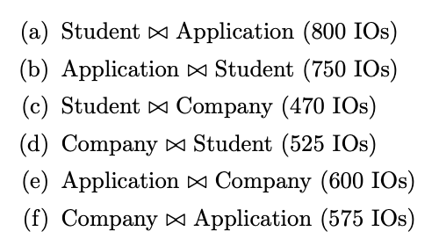
Question 3
Mark the choices for all access plans that would be considered in pass 2 of the Selinger algorithm.
A, B, E, and F will be considered because they are not cross products. They are joined on a condition, so some rows can be filtered out, making our intermediate relations smaller.

Slide 23
Question 4
Which choices from the previous question for all access plans would be chosen at the end of pass 2 of the Selinger algorithm?
B and F will be chosen because they have the lower cost for joining the two tables, and we have the assumption that our optimizer does not consider interesting orders. (Even if we did, there are no interesting orders in the other joins.)

Slide 24
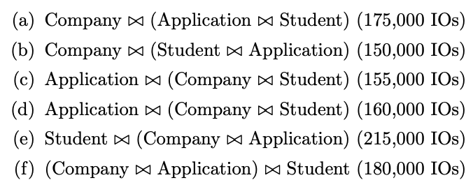
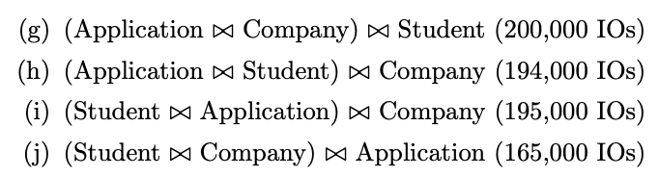
Question 5
Which plans that would be considered in pass 3?
F and H only. A-E can be immediately discarded because they aren’t left-deep. G won’t be considered because we chose (Company ⋈ Application) in pass 2. Similarly, choice I wouldn’t be considered because we choose Application ⋈ Student in the previous pass. Choice J wouldn’t be considered because there is no join condition on Student and Company, so this is a cross-join, which we avoid since we have other options.

Slide 25
Question 6
Which choice from the previous question for all plans would be chosen at the end of pass 3?
F, since F has the lower I/O cost between F and H.

Slide 26
Query Optimization 2

Slide 27
Query Optimization 2.1
True or False: When evaluating potential query plans, the set of left deep join plans are always guaranteed to contain the best plan
False: this is a heuristic that System R uses to shrink the search space

Slide 28
Query Optimization 2.1
True or False: As a heuristic, the System R optimizer avoids cross-products if possible
True

Slide 29
Query Optimization 2.1
True or False: A plan can result in an interesting order if it involves a sort-merge join
True: Sort-merge join leaves the joined tables in a sorted order which may be useful for future passes and/or if the query includes an ORDER BY clause

Slide 30
Query Optimization 2.1
True or False: The System R algorithm is greedy because for each pass, it only keeps the lowest cost plan for each combination of tables
False: it is not greedy because it keeps track of interesting orders which may not be the lowest cost plan, but may result in a lower cost plan in future passes (hence the use of dynamic programming)

Slide 31
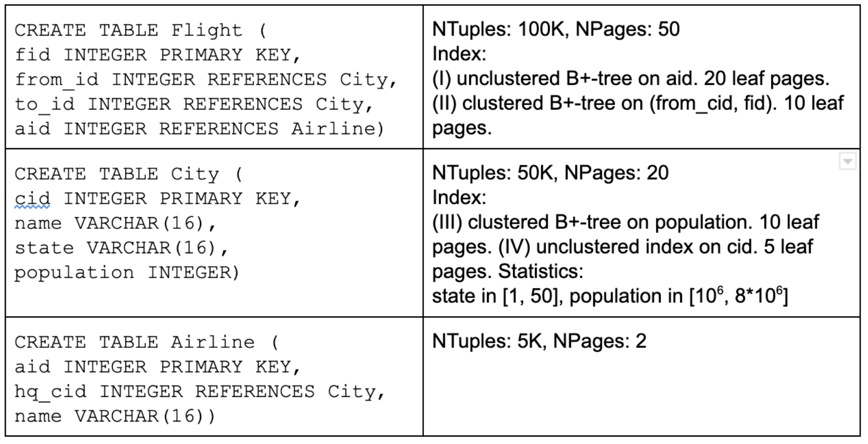
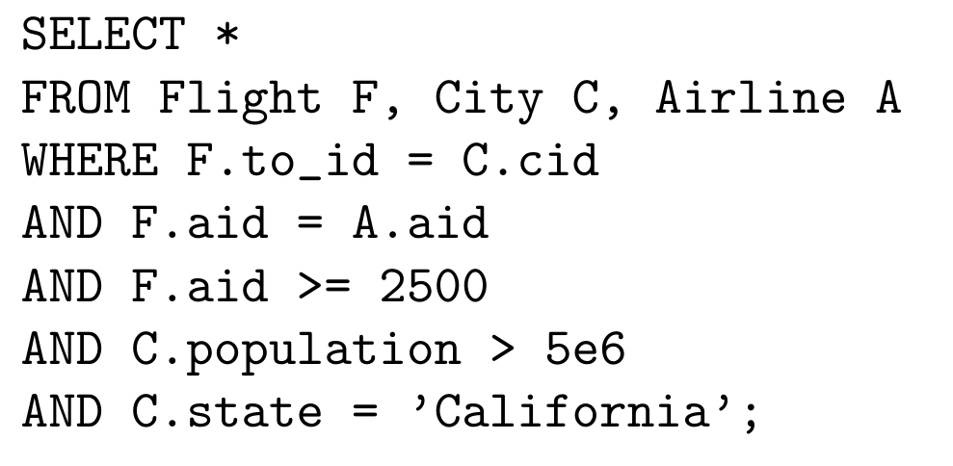
Query Optimization 2.2
Assuming that (a) System R assumptions about uniformity and independence from lecture hold, and (b) Primary key IDs are sequential, starting from 1
What is the selectivity of each predicate in the WHERE clause of the following query?

Slide 32
Query Optimization 2.2
Assuming that (a) System R assumptions about uniformity and independence from lecture hold, and (b) Primary key IDs are sequential, starting from 1
What is the selectivity of each predicate in the WHERE clause of the following query?
F.to_id = C.id
50k tuples in City table, C.id is a PK and F.to_id is an FK, so there are 50k unique values of each. Apply formula (1 / MAX(nkeys(tab1), nkeys(tab2)))
= 1 / MAX(50k, 50k) = 1 / 50000

Slide 33
Query Optimization 2.2
Assuming that (a) System R assumptions about uniformity and independence from lecture hold, and (b) Primary key IDs are sequential, starting from 1
What is the selectivity of each predicate in the WHERE clause of the following query?
F.aid = A.aid
5k tuples in Airline table, A.aid is PK, F.aid is FK so there are 5k values of each. Apply same formula as before:
= 1 / MAX(5k, 5k) = 1 / 5000

Slide 34
Query Optimization 2.2
Assuming that (a) System R assumptions about uniformity and independence from lecture hold, and (b) Primary key IDs are sequential, starting from 1
What is the selectivity of each predicate in the WHERE clause of the following query?
F.aid >= 2500
5k values of F.aid (it is a PK for table of 5k tuples); values are 1-5000, so we can apply adjusted “>=” formula:
(High(col)-value)/(High(col)-Low(col) + 1) + 1/High(col)
= (5000 - 2500)/(5000-1+1) + 1/5000
= 2501/5000

Slide 35
Query Optimization 2.2
Assuming that (a) System R assumptions about uniformity and independence from lecture hold, and (b) Primary key IDs are sequential, starting from 1
What is the selectivity of each predicate in the WHERE clause of the following query?
C.population > 5e6
Use range given in description of City table and apply formula for “>”:
(High(col)-value)/(High(col)-Low(col) + 1) + 1/High(col)
= (8e6 - 5e6)/(8e6-1e6 + 1)
= 3e6/(7e6 + 1)
= 3000000/7000001

Slide 36
Query Optimization 2.2
Assuming that (a) System R assumptions about uniformity and independence from lecture hold, and (b) Primary key IDs are sequential, starting from 1
What is the selectivity of each predicate in the WHERE clause of the following query?
C.state = ‘California’
There are 50 states, so
= 1/50

Slide 37
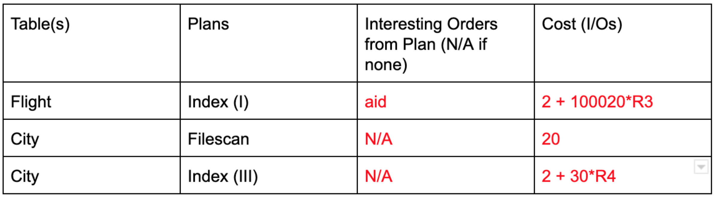
Query Optimization 2.3
Assuming that (a) System R assumptions about uniformity and independence from lecture hold, and (b) Primary key IDs are sequential, starting from 1 (c) Optimizer hasn’t discarded rows (d) B+ trees are of height 2
Fill in each blank in the dynamic programming table for a System R Pass 1

Slide 38
Query Optimization 2.3
Assuming that (a) System R assumptions about uniformity and independence from lecture hold, and (b) Primary key IDs are sequential, starting from 1 (c) Optimizer hasn’t discarded rows (d) B+ trees are of height 2
Fill in each blank in the dynamic programming table for a System R Pass 1
2 I/Os (read root, inner page of index)
+ (20 + 100k) (read 20 pg of index, 100k reads for unclustered)
* <selectivity factor for F.aid >= 2500 (R3)
50032

Slide 39
Query Optimization 2.3
Assuming that (a) System R assumptions about uniformity and independence from lecture hold, and (b) Primary key IDs are sequential, starting from 1 (c) Optimizer hasn’t discarded rows (d) B+ trees are of height 2
Fill in each blank in the dynamic programming table for a System R Pass 1
20 I/Os (no index used, just read the pages)
50032

Slide 40
Query Optimization 2.3
Assuming that (a) System R assumptions about uniformity and independence from lecture hold, and (b) Primary key IDs are sequential, starting from 1 (c) Optimizer hasn’t discarded rows (d) B+ trees are of height 2
Fill in each blank in the dynamic programming table for a System R Pass 1
2 I/Os (read root, inner node of index)
+ (10 + 20) (read 10 pages of index, 20 pages of data)
* <selectivity factor for C.population > 5e6>
50032
15

Slide 41
Query Optimization 2.4
After pass 2, which of the following plans could be in the dynamic programming table?
City [Index(III)] JOIN Airline [File scan]
City [Index(III)] JOIN Flight [Index(I)]
Flight [Index(II)] JOIN City [Index(III)]
50032
15

Slide 42
Query Optimization 2.4
After pass 2, which of the following plans could be in the dynamic programming table?
City [Index(III)] JOIN Airline [File scan] No: no condition joins City, Airline so this would be a cross product
City [Index(III)] JOIN Flight [Index(I)]
Flight [Index(II)] JOIN City [Index(III)]
50032
15

Slide 43
Query Optimization 2.4
After pass 2, which of the following plans could be in the dynamic programming table?
City [Index(III)] JOIN Airline [File scan] No: no condition joins City, Airline so this would be a cross product
City [Index(III)] JOIN Flight [Index(I)] Yes: City[Index(III)] kept for lowest cost, Flight [Index(I)] kept b.c. interesting order
Flight [Index(II)] JOIN City [Index(III)]
50032
15

Slide 44
Query Optimization 2.4
After pass 2, which of the following plans could be in the dynamic programming table?
City [Index(III)] JOIN Airline [File scan] No: no condition joins City, Airline so this would be a cross product
City [Index(III)] JOIN Flight [Index(I)] Yes: City[Index(III)] kept for lowest cost, Flight [Index(I)] kept b.c. interesting order
Flight [Index(II)] JOIN City [Index(III)] No: Flight[Index(II)] would not be kept from Pass 1; it is more expensive than full scan and has no interesting orders
50032
15

Slide 45
Query Optimization 2.5
Suppose we want to optimize for queries similar to the query below; which of the following suggestions could reduce I/O cost?
Change Index(III) to be unclustered
Store City as a sorted file on population

Slide 46
Query Optimization 2.5
Suppose we want to optimize for queries similar to the query below; which of the following suggestions could reduce I/O cost?
Change Index(III) to be unclustered: Won’t reduce I/O cost. Unclustered index results in more random accesses so we might load a page more than once
Store City as a sorted file on population

Slide 47
Query Optimization 2.5
Suppose we want to optimize for queries similar to the query below; which of the following suggestions could reduce I/O cost?
Change Index(III) to be unclustered: Won’t reduce I/O cost. Unclustered index results in more random accesses so we might load a page more than once
Store City as a sorted file on population: Could reduce I/O cost by making range lookups (e.g. population > 5e6) more efficient

Slide 48

Attendance Link
https://cs186berkeley.net/attendance

