Slide 1
CS 186 Exam Prep 8
Transactions & Concurrency

Slide 2
Transactions & Concurrency

Slide 3
Why Transactions?
Usually have multiple users accessing the database concurrently
Can cause these problems:
Inconsistent Reads: A user reads only part of what was updated (one user updates two tables, another user reads old version of one table and new version of the other table)
Lost Update: Two users try to update the same record so one of the updates gets lost
Dirty Reads: One user reads an update that was never committed (usually due to reading after abort but before rollback)

Slide 4
Transactions
A sequence of multiple actions that should be executed as a single, logical, atomic unit. Abbreviated as “Xact”. Enforces these properties:
Atomicity: A transaction ends in two ways: it either commits or aborts; either all actions in the Xact happen, or none happen.
Consistency: If the DB starts out consistent (adhering to all rules), it ends up consistent at the end of the Xact.
Isolation: Execution of each Xact is isolated from that of others; DBMS will ensure that each Xact executes as if it ran by itself, even with interleaved actions
Durability: If a Xact commits, its effects persist; the effects of a committed Xact must survive failures.

Slide 5
Equivalence and Serializability
Easiest way to enforce Isolation is to run transactions one at a time (a serial schedule), but this is inefficient
Two schedules are equivalent if
They involve the same transactions
Each transaction has its operations in the same order
The final state after all the transactions is the same
If a schedule is equivalent to a serial schedule, it is serializable
Some schedules that interleave transaction actions are serializable, but it’s hard to check.

Slide 6
Conflict Serializability
Two operations in a schedule conflict if:
at least one operation is a write
they are on different transactions
they work on the same resource
Conflicts are basically just pairs of operations that we need to be careful about
T1: R(A) R(B) W(A)
T2: R(B) W(B)

Slide 7
Conflict Serializability
If two schedules order their conflicting pairs the same way, they are conflict equivalent (and thus equivalent).
If a schedule is conflict equivalent to a serial schedule, it is conflict serializable.
Conflict serializability is a more strict condition than serializability (all conflict serializable schedules are serializable, but not all serializable schedules are conflict serializable). However, it’s a lot easier to check.
View equivalence/serializability falls in between them in terms of difficulty, but it’s NP hard to check for.
Essentially, check same conditions as conflict serializability, except you can ignore blind writes (two writes without an interleaving read)

Slide 8
Conflict Serializability
How do we check for conflict equivalence/serializability?
We build a dependency graph (precedence graph)
If an operation in T_{i} conflicts with an operation in T_{j}, and the operation in T_{i} comes first, add an edge from T_{i} to T_{j}
Cycle → not conflict serializable
T1: R(A) R(B) W(A)
T2: R(B) W(B)
[T1] -------------> [T2]
Notes:
check if the two schedules have every pair of conflicting operations ordered in the same way to conclude whether or not the DB ends up in the same final state

Slide 9
Types of Serializability
All Schedules
Serializable
View Serializable
Conflict Serializable
Serial

Slide 10
Locks
Make sure that no other transaction is modifying the resource while you are using that resource
Lock types: for a given resource A,
S (Shared) can read A and all descendants of A.
X (Exclusive) can read and write A and all descendants of A.
IS can request shared and intent-shared locks on all children (immediate descendants) of A.
IX can request any lock on all children of A.
SIX can do anything that having S or IX lets it do. We may consider requesting S or IS locks on children of A redundant and prevent this possibility.
Notes:
Lock type descriptions taken from https://github.com/berkeley-cs186/sp20-moocbase/blob/master/proj4-part1-README.md

Slide 11
2-Phase Locking (2PL)
One way to enforce conflict serializability
In 2-phase locking,
a transaction may not acquire a lock after it has released any lock
two “phases”
from start to until a lock is released, the transaction is just acquiring locks
then until the end of the transaction, it is just releasing locks
acquisition phase
release phase
# locks held
time

Slide 12
Strict 2-Phase Locking (Strict 2PL)
The problem is that 2PL lets another transaction read new values before the transaction commits (since locks can be released long before commit)
Strict 2PL avoids cascading aborts (and guarantees conflict serializability and recoverability)
Same as 2PL, except only allow releasing locks at end of transaction
acquisition phase
# locks held
release all locks at end of xact
time

Slide 13
Deadlock Detection
We draw out a “waits-for” graph
One node for each transaction
If T_{j} holds a lock that conflicts with the lock that T_{i} wants, we add an edge from T_{i} to T_{j}
A cycle indicates a deadlock (between the transactions in the cycle) - we can abort one to end the deadlock

Slide 14
Deadlock Avoidance
Typically assign priority based on start time (starting earlier means higher priority), but can use other methods (will specify on exams)
Two approaches
wait-die: if a transaction T_{i} wants lock but T_{j} has conflicting lock
if T_{i} is higher priority, it waits for T_{j} to release conflicting lock
if T_{i} is lower priority, it aborts
transactions can only wait on lower priority transactions → cannot have deadlock (lowest priority transactions cannot wait)
wound-wait: if a transaction T_{i} wants lock but T_{j} has conflicting lock
if T_{i} is higher priority, it causes T_{j} to abort (“wound”)
if T_{i} is lower priority, it waits for T_{j} to finish
transactions can only wait on higher priority transactions → cannot have deadlock (highest priority transactions can’t wait)

Slide 15
Multi-granularity Locking
Two new lock types:
IS = Intent to acquire Shared lock at a lower level
IX = Intent to acquire eXclusive lock at a lower level
Require that a transaction has IS to acquire S, IX to acquire X
To get S(tuple), need: IS(database), IS(table), IS(page)
IX lets you acquire S/IS locks too
If a transaction tries to get S(table), and sees another transaction has IX(table) → another transaction has X lock on a tuple, so we can’t get S(table) yet

Slide 16
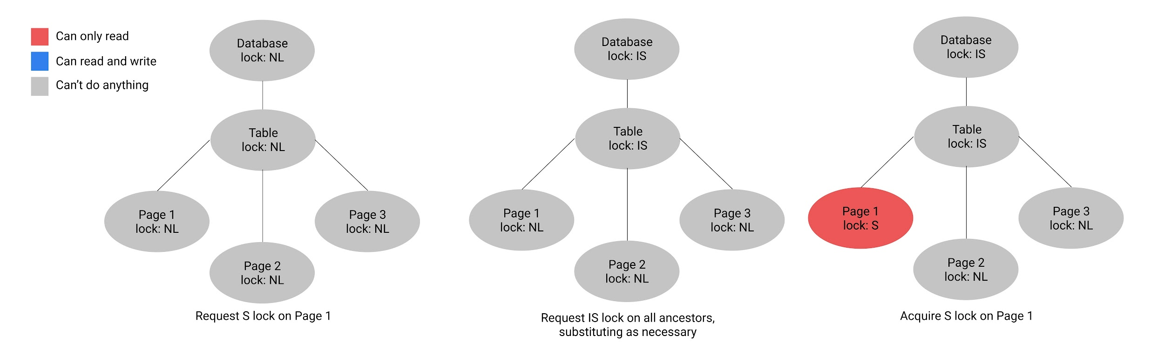
Multi-granularity Locking

Slide 17
Multi-granularity Locking
What if we want to scan table AND update a page?
X on entire table → low concurrency
IX on table, S/X locks on every page → high locking overhead
One more lock type:
SIX = Shared + Intent to acquire eXclusive lock at a lower level
Basically equivalent to having both S and IX locks – can read entire table, can also acquire X locks

Slide 18
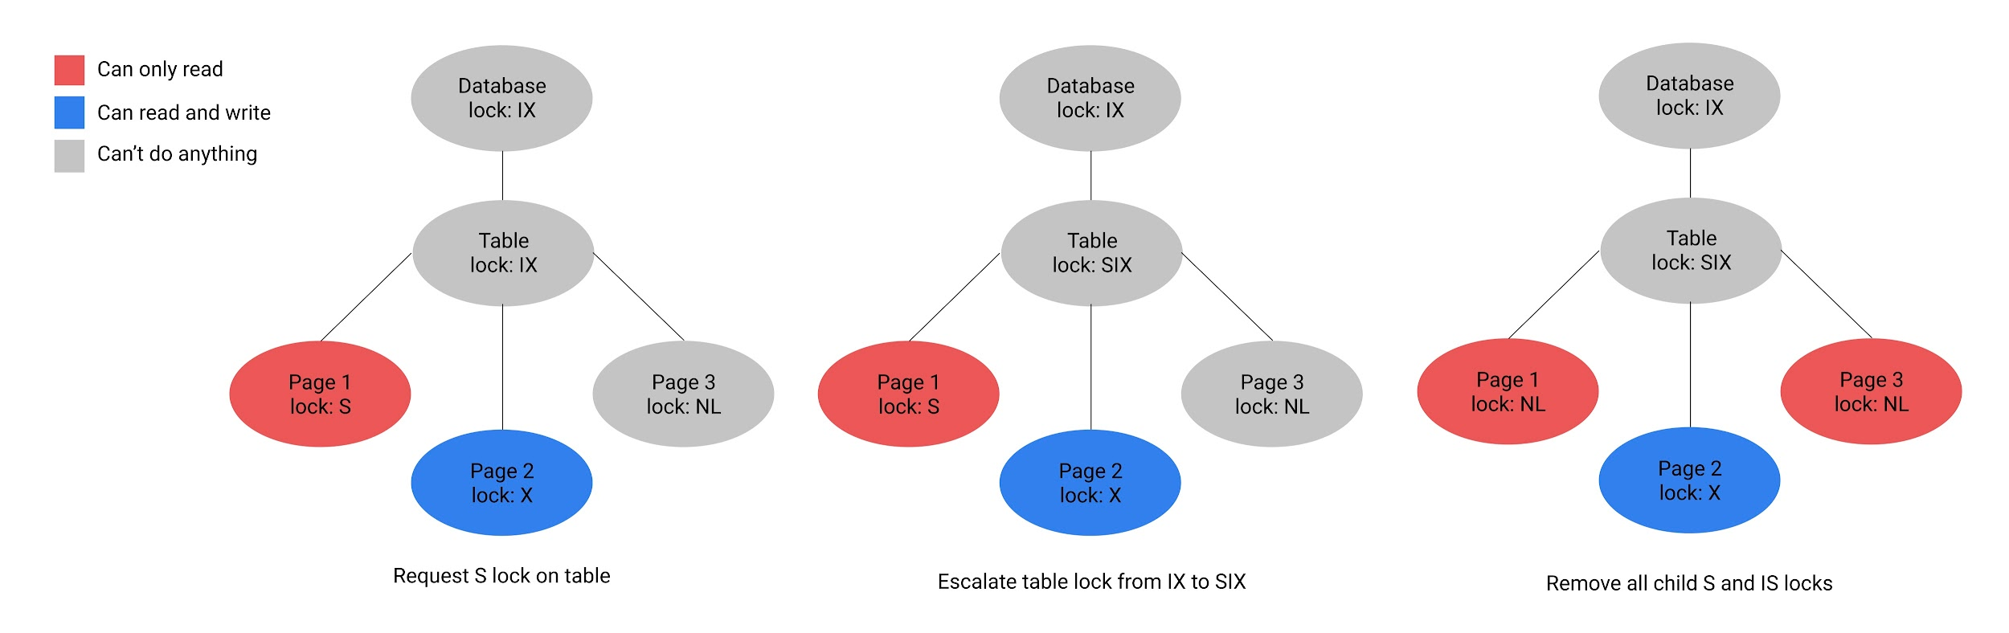
Multi-granularity Locking

Slide 19
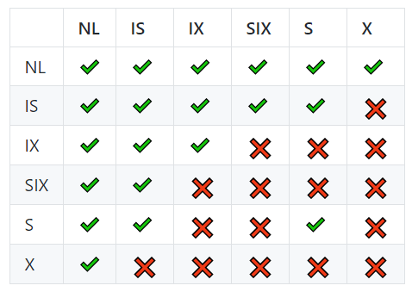
Multi-granularity Locking
Our new compatibility matrix
Notes:
Try to reason about why each pair is the way it is - should be able to figure out entire matrix without having it written down for reference

Slide 20
Worksheet

Slide 21
Transactions & Concurrency 0

Slide 22
Multi-granularity Locking
1) Suppose a transaction T₁ wants to scan a table R and update a few of its tuples. What kinds of locks should T₁ have on R, the pages of R, and the updated tuples?
SIX on R
IX on page (no need for SIX since already have S on R)
X on tuples being modified
Notes:
[can skip]

Slide 23
Multi-granularity Locking
2) Is an S lock compatible with an IX lock?
Suppose T₁ wants S(A) and T₂ wants IX(A).
S(A) implies T₁ will read all of A.
IX(A) implies T₂ will write to some of A.
We can’t have T₁ read all of A while T₂ is writing to some of it, so S and IX are incompatible.
Notes:
[can skip]

Slide 24
Multi-granularity Locking
3) Consider a table which contains two pages with three tuples each, with Page 1 containing Tuples 1, 2, and 3, and Page 2 containing Tuples 4, 5, and 6.
Given that a transaction T₁ has IX(table), IX(Page 1), X(Tuple 1), which locks can be granted to a second transaction T₂ on Tuple 2?
Table
Lock: IX
T₁: Red
T₂: Blue
Page 1
Lock: IX
Page 2
Lock:
Tuple 1
Lock: X
Tuple 2
Lock: ?
Tuple 3
Lock:
Tuple 4
Lock:
Tuple 5
Lock:
Tuple 6
Lock:

Slide 25
Multi-granularity Locking
3) Consider a table which contains two pages with three tuples each, with Page 1 containing Tuples 1, 2, and 3, and Page 2 containing Tuples 4, 5, and 6.
Given that a transaction T₁ has IX(table), IX(Page 1), X(Tuple 1), which locks can be granted to a second transaction T₂ on Tuple 2?
X, S

Slide 26
Multi-granularity Locking
3) Consider a table which contains two pages with three tuples each, with Page 1 containing Tuples 1, 2, and 3, and Page 2 containing Tuples 4, 5, and 6.
Given that a transaction T₁ has IS(table), S(Page 1), which locks can be granted to a second transaction T₂ on Page 1?
Table
Lock: IS
T₁: Red
T₂: Blue
Page 1
Lock: S, ?
Page 2
Lock:
Tuple 1
Lock:
Tuple 2
Lock:
Tuple 3
Lock:
Tuple 4
Lock:
Tuple 5
Lock:
Tuple 6
Lock:

Slide 27
Multi-granularity Locking
(c) Consider a table which contains two pages with three tuples each, with Page 1 containing Tuples 1, 2, and 3, and Page 2 containing Tuples 4, 5, and 6.
Given that a transaction T₁ has IS(table), S(Page 1), which locks can be granted to a second transaction T₂ on Page 1?
S, IS

Slide 28
Transactions & Concurrency 1

Slide 29
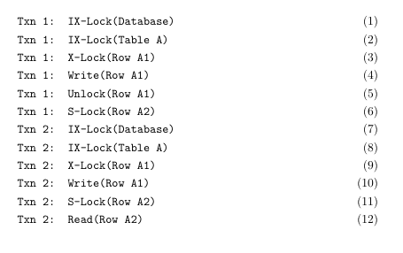
Question 1
Is Transaction 1 doing Two-Phase Locking so far?
Answer: No; we have a lock (6) after unlock (5).

Slide 30
Question 2
Is Transaction 1 doing Strict Two-Phase Locking?
Answer: No; it's not even Two-Phase.

Slide 31
Question 3
Is this schedule conflict-serializable so far? If not, what is the cycle?
Answer: Yes, it is conflict-serializable; there is only one conflict (4 -> 10), so it is serializable to a serial order of Txn 1 -> Txn 2.

Slide 32
Question 4
Is this schedule serial so far?
Answer: Yes! Since all of Txn 1's operations are before Txn 2's operations, it is actually already a serial order.

Slide 33
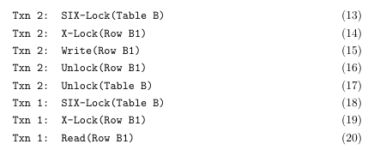
Question 5
Continuing with the operations...
Is Transaction 2 doing Two-Phase Locking so far?
Answer: Yes. All locks (< 17) are before unlocks (17, 18).

Slide 34
Question 6
Continuing with the operations...
Is Transaction 2 doing Strict Two-Phase Locking so far?
Answer: No! For strict two-phase, we must commit the transaction before doing any unlocks.

Slide 35
Question 7
Continuing with the operations...
Is this schedule conflict-serializable so far? If not, what is the cycle?
Answer: No, not anymore. We have T1 -> T2 from conflict 4 -> 10, and T2 -> T1 from conflict 15 -> 20. The cycle is T1 <-> T2.

Slide 36
Question 8
Continuing with the operations...
Suppose we start a new transaction, Transaction 3. What kind of locks can Transaction 3 acquire on the whole database?
The database currently has two IX locks held by Txn 1 and Txn 2. Looking at the compatibility matrix, we see that IS and IX are the locks compatible with IX locks, so these are the locks that Txn 3 can acquire on the database.

Slide 37
Question 9
Continuing with the operations...
Given the above answers, what kind of locks can Transaction 3 acquire on Table A?
On the parent of Table A (the whole database), we know we can acquire IS and IX locks (from the previous question). These locks allow us to acquire S, X, IS, IX, and SIX locks below it.
Which of these can we actually acquire? Table A currently has two IX locks held by Txn 1 and Txn 2, so the compatibility matrix says IS and IX locks only.

Slide 38
Question 10
Continuing with the operations...
Given the above answers, what kind of locks can Transaction 3 acquire on Row A3?
On the parent of Row A3 (Table A), we know we can acquire IS and IX locks (from the previous question). These locks allow us to acquire S, X, IS, IX, and SIX locks below it.
Which of these can we actually acquire? Row A3 has no locks currently, so we can acquire any of these! But this is a leaf node and I locks are for intermediate nodes only, so in practice we can only acquire S and X locks.

Slide 39
Question 11
Continuing with the operations...
Given the above answers, what kind of locks can Transaction 3 acquire on Table B?
On the parent of Table B (the whole database), we know we can acquire IS and IX locks (from the previous question). These locks allow us to acquire S, X, IS, IX, and SIX locks below it.
Which of these can we actually acquire? Table B currently has an SIX lock, so the compatibility matrix says IS locks only.

Slide 40
Question 12
Continuing with the operations...
Given the above answers, what kind of locks can Transaction 3 acquire on Row B2?
On the parent of Row B2 (Table B), we know we can acquire IS locks (from the previous question). These locks allow us to acquire S and IS locks below it.
Which of these can we actually acquire? Row B2 has no locks currently, so we can acquire any of these! But this is a leaf node and I locks are for intermediate nodes only, so in practice we can only acquire the S lock.

Slide 41
Question 13
Continuing with the operations...
What kind of locks can Transaction 1 acquire on Row B2?
Transaction 1 currently holds an SIX lock on the parent of Row B2 (Table B), which allows it to acquire X and IX locks below it.
Which of these can it actually acquire? Row B2 has no locks, so it can acquire either of them; however, I locks are for intermediate nodes only, so it can just acquire the X lock.

Slide 42
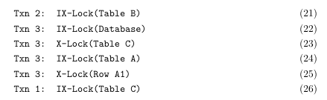
Question 14
Continuing with the operations...
We have now entered a deadlock. What is the waits-for cycle between the transactions?
T1 (26) waits on T3 (23).
T3 (25) waits on T2 (9).
T2 (21) waits on T1 (18).

Slide 43
Question 15
Continuing with the operations...
We can end this deadlock by aborting the youngest transaction. Which transaction do we abort?
The youngest transaction is T3, so we abort that one.

Slide 44
Question 16
Continuing with the operations...
If we were using wound-wait, what is the first operation in this sequence that would cause a transaction to get aborted, and which transaction gets aborted?
In wound-wait, the only waiting that happens is lower priority waiting for higher priority. If a higher priority transaction tries to wait, it will just abort (“wound”) the transaction it is waiting on.
At (21), T2 can wait on T1. At (25), T3 can wait on T2. But at (26), T1 will not wait on T3; it will instead abort T3.

Slide 45
Question 17
Continuing with the operations...
If we were using wait-die, what is the first operation in this sequence that would cause a transaction to get aborted, and which transaction gets aborted?
In wait-die, the only waiting that happens is higher priority waiting for lower priority. If a lower priority transaction tries to wait, it will just abort itself (“die”) instead.
At (21), T2 will not wait on T1, since T2 is lower priority. Thus, T2 will abort.

Slide 46
Transactions & Concurrency 2

Slide 47
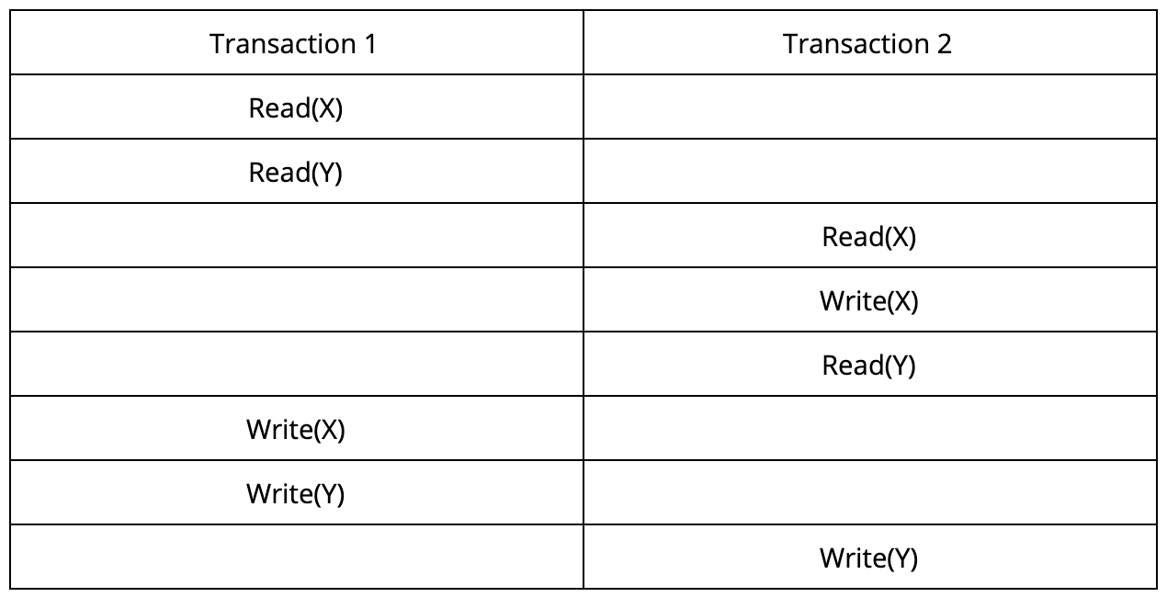
Question 1
Consider a database with objects X and Y and assume that there are two transactions T1 and T2. T1 first reads X and Y and then writes X and Y. T2 reads and writes X then reads and writes Y. Create a schedule for these transactions that is not serializable. Explain why your schedule is not serializable.
In this example, T1 reads X before T2 writes X. However, T1 writes X after T2 reads/writes it.
The schedule is thus not serializable since there is no equivalent serial schedule that would have the same result (neither T1-T2 or T2-T1).

Slide 48
Question 2
Would your schedule be allowed under strict two-phase locking? Why or why not?
No, because strict 2PL ensures serializability. Keep in mind that strict 2PL only allows releasing locks at the end of a transaction.
In the example schedule shown, when Transaction 2 attempts to acquire an exclusive lock to write X, it will have to wait for Transaction 1 to release its lock on X, which will not happen until Transaction 1 commits. This will never happen, so this schedule is not possible under strict 2PL.

Slide 49
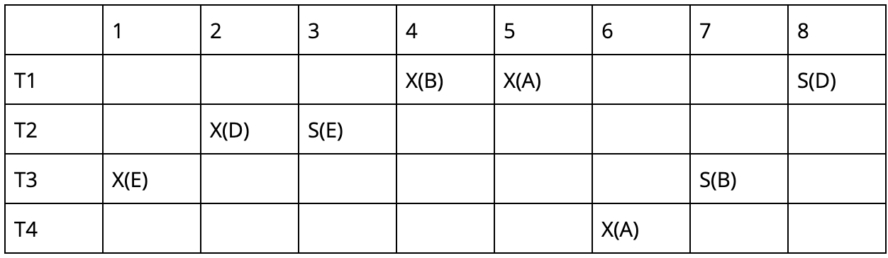
Question 3
Draw the waits-for graph for this schedule.
T1
T2
T3
T4

Slide 50
Question 4
Are there any transactions involved in deadlock?
T1
T2
T3
T4
Yes, Transactions 1, 2, & 3 are deadlocked.

Slide 51
Question 5
Next, assume that T1 priority > T2 > T3 > T4. You are the database administrator and one of your users purchases an exclusive plan to ensure that their transaction, Transaction 2, runs to completion. Assuming the same schedule, what deadlock avoidance policy would you choose to make sure Transaction 2 commits?

Slide 52
Question 5
Choose wait-die. Under wait-die, T3 and T4 abort after steps 6 and 7 because they are attempting to acquire a lock held by a transaction with higher priority. Afterwards, both T1 and T2 run to completion.
However, under wound-wait, T3 will be killed by T2 at step 3, and T2 will be killed by T1 at step 8. Since we want to make sure Transaction 2 commits, we should choose wait-die.

Slide 53

Attendance Link
https://cs186berkeley.net/attendance

