Slide 1
Asymptotics & Disjoint Sets
Exam-Level 05

Slide 2
Announcements
Sunday | Monday | Tuesday | Wednesday | Thursday | Friday | Saturday
 |  | 10/1 Weekly Survey 6 due |  |  | 10/4 Lab 5 due
 | 10/07 Weekly Survey 7 due |  | 10/09 Homework 2 due |  | 10/11 Lab 6 due

Slide 3
Content Review

Slide 4
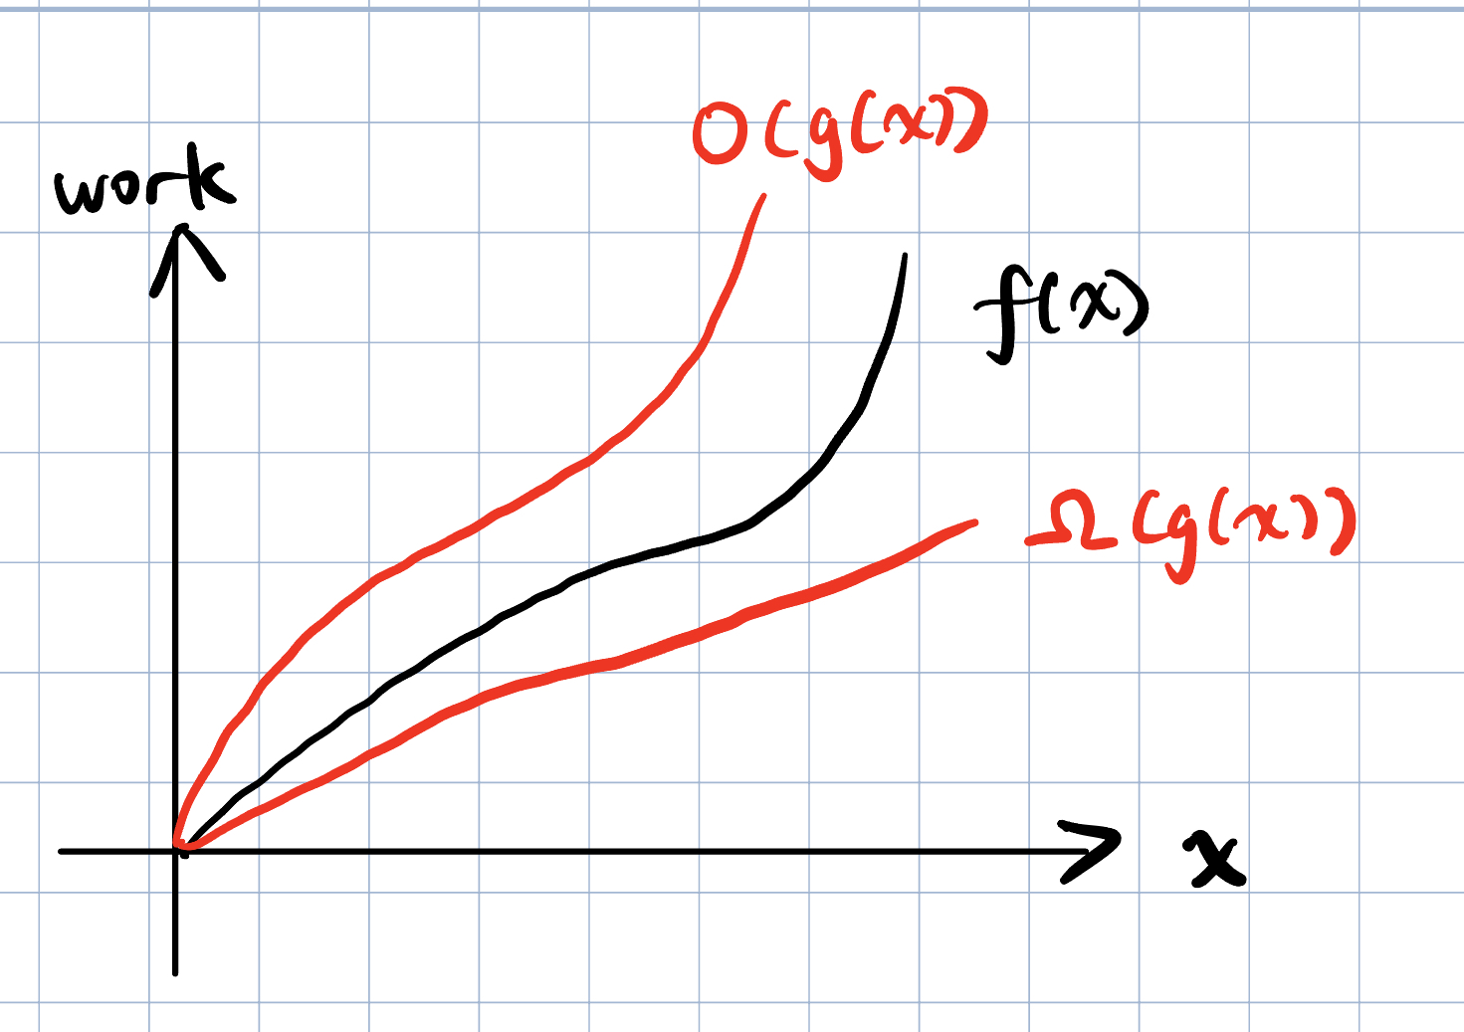
Asymptotics
Asymptotics allow us to evaluate the performance of programs using math.
We ignore all constants and only care about the total work done when the input is very large.
Big O - If a function f(x) has big O in g(x), it grows at most as fast as g(x).
Big Ω - f(x) grows at least as fast as g(x),
Big Θ - When a function is both O(g(x)) and Ω(g(x)), it is Θ(g(x))

Slide 5
Common Orders of Growth
O(1) < O(log n) < O(n) < O(n log n) < O(n²) < O(c^{n})
Alternatively: constant < logarithmic < linear < nlogn < quadratic < exponential
Desmos example here
Constants don’t matter in the long run!
Fun sums:
1 + 2 + 3 + . . . + N = Θ(N²)
1 + 2 + 4 + 8 + . . . + N = Θ(N)

Slide 6
Tightest Bound?
Sometimes it’s easier to bound the runtime than to calculate the runtime.
When you bound, always provide the tightest bound
i.e, the bound that provides the most information about the runtime.
Ex. Given f(n) = 2n + 5, we could say that f(n) ∈ O(n^{n}), but that doesn’t tell us very much
a lot of functions are upper bounded by O(n^{n}) (grows really fast!)
A better, tighter bound would be f(n) ∈ Θ(n)

Slide 7
Best vs. Worst Case
In best-worst case analysis, we still assume the input is very large.
Therefore, you cannot make assumptions such as N == 1 or N <= 10 in these analyses.
The best case is not when the input is 1.
The best case is not when the input is 1.
Seriously, the best case is not when the input is 1.

Slide 8
Best vs. Worst Case
Represented with tight bound Θ because they should be consistent (always run in the same time)
Look out for branching statements, loop conditions, breaks
Check: What is the best/worst case runtime of the function below?
Remember: The best case is not when the input is 1.
public static void example(int N) {
while (N > 0) {
if (func(N)) {
break;
}
N -= 1;
}
}
Best case: Θ(1), where N = some int for which func(N) is immediately true
I’m not assuming N is 1 or N is small. func(N) could be return whether N is an even number, and when N is very large but even number this function runs in constant time
Worst case: Θ(N), where N = some int for which func(N), func(N - 1), …, func(1) are all false

Slide 9
Best vs. Worst Case
Best/worst case vs. lower/upper bound analogy: how much does it cost to eat at a restaurant?
Best/worst-case: “the cheapest thing on the menu is $5 and the most expensive is $50”
Lower/upper bound: “every item is at least $5 and at most $50” (credit: Alex Schedel)
Which one is more informative?
The first one: the best/worst-case are the tightest lower/upper-bounds you can give.

Slide 10
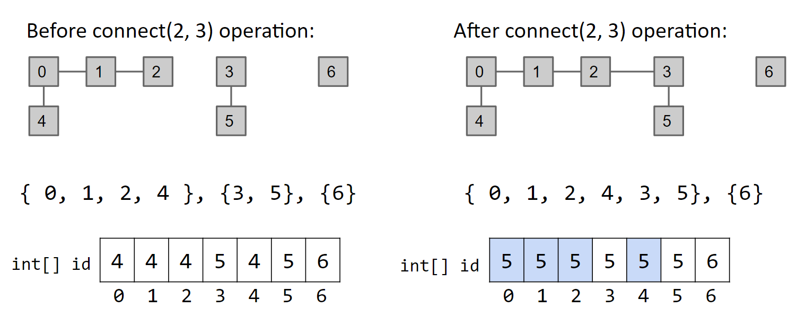
Disjoint Sets, also known as Union Find
public interface DisjointSet {
void connect (x, y); // Connects nodes x and y (you may also see union)
boolean isConnected(x, y); // Returns true if x and y are connected
}
QuickFind uses an array of integers to track which set each element belongs to.

Slide 11
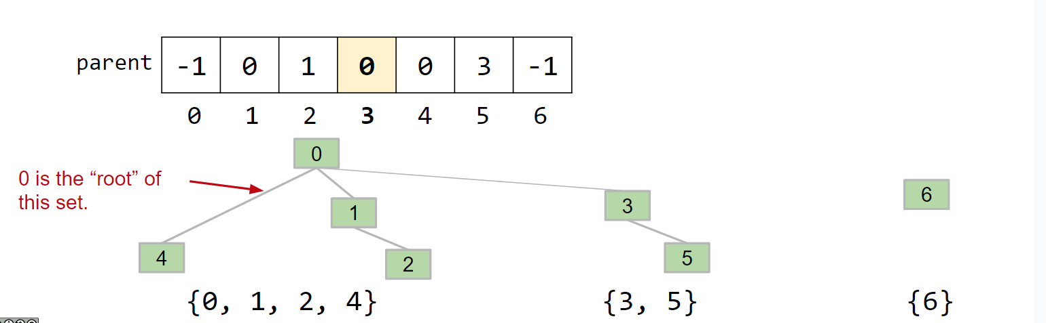
Disjoint Sets, also known as Union Find
public interface DisjointSet {
void connect (x, y); // Connects nodes x and y (you may also see union)
boolean isConnected(x, y); // Returns true if x and y are connected
}
QuickUnion stores the parent of each node rather than the set to which it belongs and merges sets by setting the parent of one root to the other.

Slide 12
Disjoint Sets, also known as Union Find
public interface DisjointSet {
void connect (x, y); // Connects nodes x and y (you may also see union)
boolean isConnected(x, y); // Returns true if x and y are connected
}
WeightedQuickUnion does the same as QuickUnion except it decides which set is merged into which by size (merge smaller into larger), reducing stringiness.
WeightedQuickUnion with Path Compression sets the parent of each node to the set’s root whenever find() is called on it.

Slide 13
Disjoint Sets Representation
We can use a single array to represent our disjoint set when implementing connect() optimally (ie. WeightedQuickUnion)
arr[i] contains the parent of element i in the set; the index of a root contains -(# elements in set rooted at that index)
0
[-9, 0, 0, 0, 0, 1, 1, 3, 4]
1
2
3
4
5
6
7
8

Slide 14
Disjoint Sets Asymptotics
public interface DisjointSet {
void connect (x, y); // Connects nodes x and y (you may also see union)
boolean isConnected(x, y); // Returns true if x and y are connected
}
Implementation | Constructor | connect() | isConnected()
QuickUnion | Θ(N) | O(N) | O(N)
QuickFind | Θ(N) | O(N) | O(1)
Weighted Quick Union | Θ(N) | O(log N) | O(log N)
WQU with Path Compression | Θ(N) | O(log N) single call O(α(N)) amortized | O(log N) single call O(α(N)) amortized
* we don’t really talk about QU/QF in application, more to show the asymptotic motivation for WQU

Slide 15
Worksheet

Slide 16
1A Asymptotics Introduction
private void f1(int N) {
for (int i = 1; i < N; i++) {
for (int j = 1; j < i; j++) {
System.out.println("shreyas 1.0");
}
}
}

Slide 17
1A Asymptotics Introduction
private void f1(int N) {
for (int i = 1; i < N; i++) {
for (int j = 1; j < i; j++) {
System.out.println("shreyas 1.0");
}
}
}
i | 1 | 2 | … | N-2 | N-1
Work per i | 0 | 1 | … | N-3 | N-2
1 + 2 + 3 + 4 + … N-1 = Θ(N²)

Slide 18
1B Asymptotics Introduction
private void f2(int N) {
for (int i = 1; i < N; i *= 2) {
for (int j = 1; j < i; j++) {
System.out.println("shreyas 2.0");
}
}
}

Slide 19
1B Asymptotics Introduction
private void f2(int N) {
for (int i = 1; i < N; i *= 2) {
for (int j = 1; j < i; j++) {
System.out.println("shreyas 2.0");
}
}
}
i | 1 | 2 | 4 | … | N/4 | N/2
Work per i | 0 | 1 | 3 | … | N/4 - 1 | N/2 - 1
1 + 2 + 4 + 8 + … N/4 + N/2 = Θ(N)

Slide 20
2 Disjoint Sets
For each of the arrays below, write whether this could be the array representation of a weighted quick union with path compression.
i: 0 1 2 3 4 5 6 7 8 9
------------------------------
A. a[i]: 1 2 3 0 1 1 1 4 4 5
B. a[i]: 9 0 0 0 0 0 9 9 9 -10
C. a[i]: 1 2 3 4 5 6 7 8 9 -10
D. a[i]: -10 0 0 0 0 1 1 1 6 2
E. a[i]: -10 0 0 0 0 1 1 1 6 8
F. a[i]: -7 0 0 1 1 3 3 -3 7 7

Slide 21
2 Disjoint Sets
There are three criteria here that invalidates a representation:
There is a cycle in the parent-link.
For each parent-child link, the tree rooted at the parent is smaller than the tree rooted at the child before the link (you would have merged the other way around).
The height of the tree is greater than log2(n), where n is the number of elements. Height is defined as the number of edges counting from a “root” to “leaf”.

Slide 22
2 Disjoint Sets
For each of the arrays below, write whether this could be the array representation of a weighted quick union with path compression.
i: 0 1 2 3 4 5 6 7 8 9
------------------------------
A. a[i]: 1 2 3 0 1 1 1 4 4 5
B. a[i]: 9 0 0 0 0 0 9 9 9 -10
C. a[i]: 1 2 3 4 5 6 7 8 9 -10
D. a[i]: -10 0 0 0 0 1 1 1 6 2
E. a[i]: -10 0 0 0 0 1 1 1 6 8
F. a[i]: -7 0 0 1 1 3 3 -3 7 7
3
2
1
0
Impossible: cycle 0-1, 1-2, 2-3, and 3-0 in the parent-link representation.

Slide 23
2 Disjoint Sets
For each of the arrays below, write whether this could be the array representation of a weighted quick union with path compression.
i: 0 1 2 3 4 5 6 7 8 9
------------------------------
A. a[i]: 1 2 3 0 1 1 1 4 4 5
B. a[i]: 9 0 0 0 0 0 9 9 9 -10
C. a[i]: 1 2 3 4 5 6 7 8 9 -10
D. a[i]: -10 0 0 0 0 1 1 1 6 2
E. a[i]: -10 0 0 0 0 1 1 1 6 8
F. a[i]: -7 0 0 1 1 3 3 -3 7 7
9
0
6
7
8
1
2
3
4
5
Impossible: 1, 2, 3, 4, and 5 must link to 0 when 0 is a root; 0 would not link to 9 because 0 is the root of the larger tree.

Slide 24
2 Disjoint Sets
For each of the arrays below, write whether this could be the array representation of a weighted quick union with path compression.
i: 0 1 2 3 4 5 6 7 8 9
------------------------------
A. a[i]: 1 2 3 0 1 1 1 4 4 5
B. a[i]: 9 0 0 0 0 0 9 9 9 -10
C. a[i]: 1 2 3 4 5 6 7 8 9 -10
D. a[i]: -10 0 0 0 0 1 1 1 6 2
E. a[i]: -10 0 0 0 0 1 1 1 6 8
F. a[i]: -7 0 0 1 1 3 3 -3 7 7
9
8
…
1
Impossible: tree rooted at 9 has height 9 > lg 10.
0

Slide 25
2 Disjoint Sets
For each of the arrays below, write whether this could be the array representation of a weighted quick union with path compression.
i: 0 1 2 3 4 5 6 7 8 9
------------------------------
A. a[i]: 1 2 3 0 1 1 1 4 4 5
B. a[i]: 9 0 0 0 0 0 9 9 9 -10
C. a[i]: 1 2 3 4 5 6 7 8 9 -10
D. a[i]: -10 0 0 0 0 1 1 1 6 2
E. a[i]: -10 0 0 0 0 1 1 1 6 8
F. a[i]: -7 0 0 1 1 3 3 -3 7 7
0
1
3
4
2
5
6
7
9
8
Possible: 8-6, 7-1, 6-1, 5-1, 9-2, 3-0, 4-0, 2-0, 1-0.

Slide 26
2 Disjoint Sets
For each of the arrays below, write whether this could be the array representation of a weighted quick union with path compression.
i: 0 1 2 3 4 5 6 7 8 9
------------------------------
A. a[i]: 1 2 3 0 1 1 1 4 4 5
B. a[i]: 9 0 0 0 0 0 9 9 9 -10
C. a[i]: 1 2 3 4 5 6 7 8 9 -10
D. a[i]: -10 0 0 0 0 1 1 1 6 2
E. a[i]: -10 0 0 0 0 1 1 1 6 8
F. a[i]: -7 0 0 1 1 3 3 -3 7 7
0
1
2
3
4
5
6
7
8
Impossible: tree rooted at 0 has height 4 > lg 10.
9

Slide 27
2 Disjoint Sets
For each of the arrays below, write whether this could be the array representation of a weighted quick union with path compression.
i: 0 1 2 3 4 5 6 7 8 9
------------------------------
A. a[i]: 1 2 3 0 1 1 1 4 4 5
B. a[i]: 9 0 0 0 0 0 9 9 9 -10
C. a[i]: 1 2 3 4 5 6 7 8 9 -10
D. a[i]: -10 0 0 0 0 1 1 1 6 2
E. a[i]: -10 0 0 0 0 1 1 1 6 8
F. a[i]: -7 0 0 1 1 3 3 -3 7 7
0
1
2
3
4
5
6
Impossible: tree rooted at 0 has height 3 > lg 7.

Slide 28
3A Asymptotics of Weighted Quick Unions
Suppose we have a Weighted Quick Union (WQU) without path compression with N elements.
What is the runtime, in big Ω and big O, of isConnected?
What is the runtime, in big Ω and big O, of connect?

Slide 29
3A Asymptotics of Weighted Quick Unions
Suppose we have a Weighted Quick Union (WQU) without path compression with N elements.
What is the runtime, in big Ω and big O, of isConnected?
What is the runtime, in big Ω and big O, of connect?
Ω(1), O(log(N))
Ω(1), O(log(N))

Slide 30
3B Asymptotics of Weighted Quick Unions
void addToWQU(int[] elements) {
int[][] pairs = pairs(elements); // constant, returns pairs in random order
for (int[] pair: pairs) {
if (size() == elements.length) { // constant
return;
}
connect(pair[0], pair[1]);
}
}
Notes:
consider elaborating a bit more on how the pairs() method works, and how different pairs are connected

Slide 31
3B Asymptotics of Weighted Quick Unions
void addToWQU(int[] elements) {
int[][] pairs = pairs(elements);
for (int[] pair: pairs) {
if (size() == elements.length) {
return;
}
connect(pair[0], pair[1]);
}
}
Best case: Ω(N)
Connect all elements in first N calls, with O(1) connect
Worst case: O(N²log(N))
One isolated element until last N calls → N² - N iterations, log N connect

Slide 32
3C Asymptotics of Weighted Quick Unions
Define a matching size connection as connecting two trees, i.e. components in a WQU, together of matching size. What is the minimum and maximum number of matching size connections that can occur after executing addToWQU?
Assume N, i.e. elements.length, is a power of two.

Slide 33
3C Asymptotics of Weighted Quick Unions
Define a matching size connection as connecting two trees, i.e. components in a WQU, together of matching size. What is the minimum and maximum number of matching size connections that can occur after executing addToWQU?
Assume N, i.e. elements.length, is a power of two.
Min: 1
Only one matching-size connection at beginning
Max: N - 1
Connect equal-size tree pairs until all are connected

Slide 34

Attendance: tinyurl.com/61b-disc-att-fa24

