Slide 1

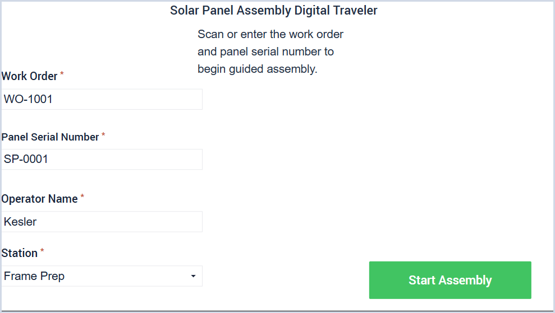
Solar Panel Assembly Digital Traveler
Tulip Interfaces · Professional Services
General Manufacturing Solution Engineer Take-Home
Objective
Digitize paper-based assembly work instructions, defect logging, quality review, and production visibility for a discrete solar panel manufacturer.
Prototype focus: simple, operator-first flow that improves data accuracy, traceability, and real-time visibility without overcomplicating shop-floor execution.

Slide 2
1. Current State Problem
2
Paper-based process creates delay and variability
Manual work instructions
Operators use paper work instructions, making updates, version control, and step confirmation harder to manage.
Manual defect logging
Defects are written on paper and reviewed later, delaying response and increasing transcription risk.
Limited real-time visibility
Supervisors and quality teams do not see production status, defect trends, or rework needs fast enough.
Current paper flow
Work Order
Paper Instruction
Handwritten Checks
Paper Defect Report
Supervisor Review
Relevant business/compliance requirements
Reduce errors and inconsistent data entry
Improve real-time defect visibility and response
Link quality events to work order, serial number, station, and operator
Support traceable, audit-ready review and disposition
Kesler Aristide-Bonheur | Tulip Take-Home Exercise

Slide 3
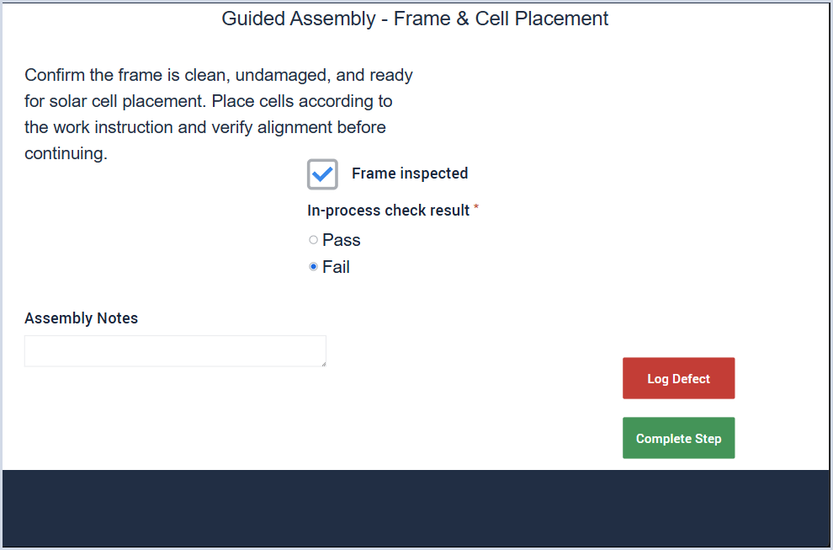
2. Proposed Tulip Solution
3
Digital traveler + guided assembly + quality response
Operator start
Capture work order, panel serial number, station, and operator before execution begins.
Guided assembly
Replace paper instructions with required step checks and pass/fail data capture.
Defect logging
Capture defect type, severity, notes, and link the issue back to the active panel/unit.
Review + dashboard
Route defects for disposition and show shift-level visibility metrics.
How Tulip adds value
Guided, operator-friendly workflow
Required fields to prevent incomplete records
Real-time defect capture and escalation
Digital disposition history for supervisors/quality
Dashboard view of throughput, defects, rework, and response time
Kesler Aristide-Bonheur | Tulip Take-Home Exercise

Slide 4
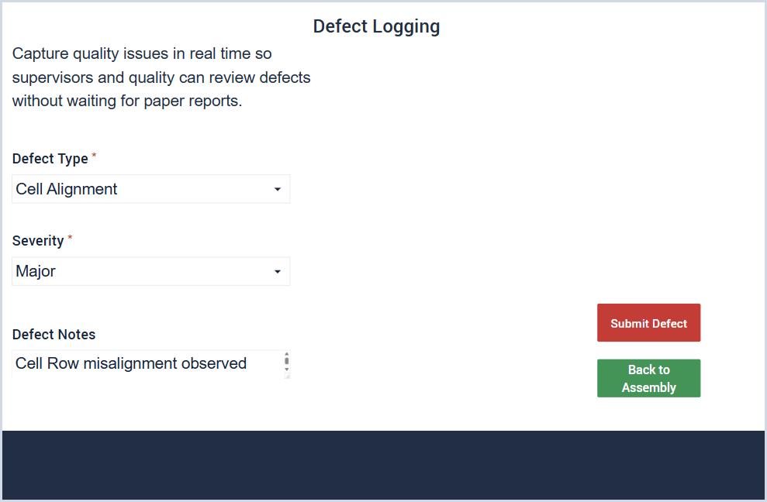
3. Data Captured & Controls
4
Data model supports traceability from execution to review
Unit / work order context
Work order · panel serial number · station · operator · start/step completion context
Inspection data
Frame inspected · in-process check result · assembly notes · timestamp concept
Defect data
Defect type · severity · notes · linked work order/serial number · review disposition
Design principle: make the right behavior the easiest behavior by requiring key data before the workflow can move forward.
Kesler Aristide-Bonheur | Tulip Take-Home Exercise

Slide 5
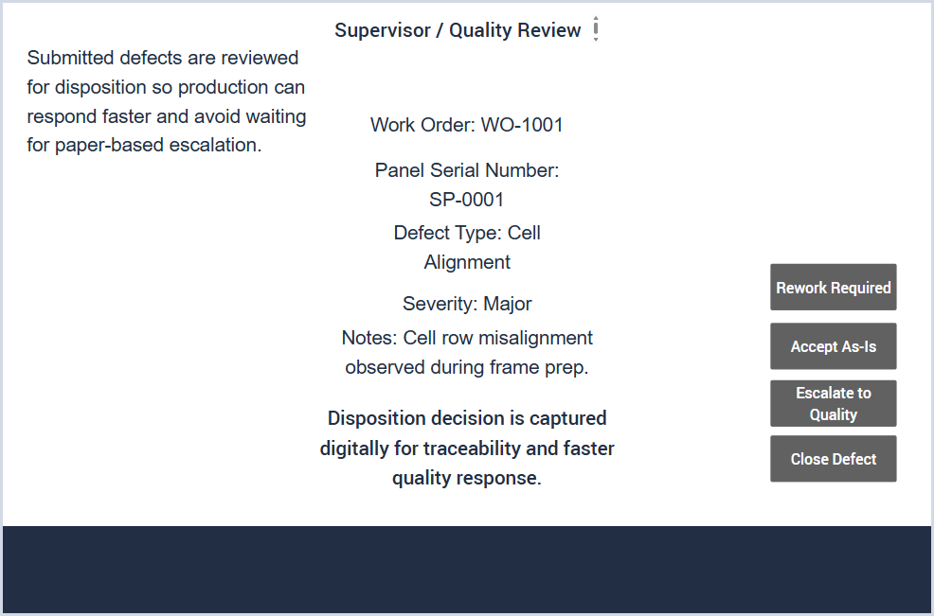
4. Prototype Walkthrough
5
Two paths: normal completion or defect escalation
1. Guided assembly
2. Defect logging
3. Supervisor / quality review
Operator follows instructions and records the in-process check result.
If the check fails, the defect is captured with type, severity, and notes.
Supervisor reviews the defect and records a disposition decision.
Prototype note
Representative values are shown on the review screen. In production, these would be populated from the defect record tied to the panel serial number.
Normal path
If the in-process check passes, the operator can complete the step and move directly to production visibility.
Kesler Aristide-Bonheur | Tulip Take-Home Exercise

Slide 6
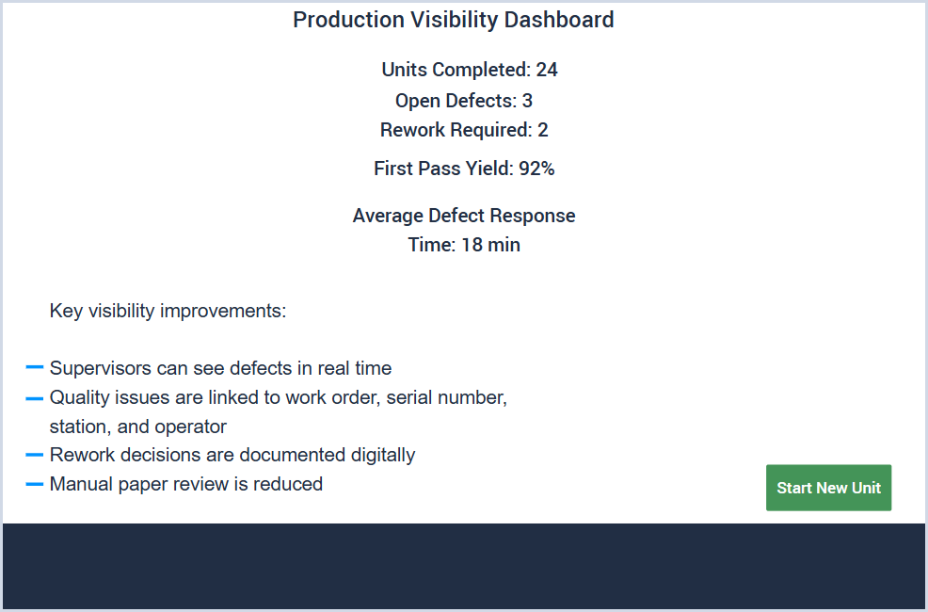
5. KPIs & Business Value
6
Production visibility turns shop-floor activity into actionable metrics
24
Units Completed
3
Open Defects
2
Rework Required
92%
First Pass Yield
18m
Avg. Response
Expected improvements
Reduced manual paper review and duplicate entry
Faster defect response and supervisor visibility
Better traceability by work order, serial number, station, and operator
More complete quality records for review and continuous improvement
Production version note
At the end of the flow, the operator or supervisor can return to the start screen to begin the next panel unit. In production, this supports continuous unit-by-unit execution across the shift.
Closing: I focused on a simple operator-first workflow that improves data accuracy, traceability, and real-time visibility without overcomplicating the shop-floor experience.
Kesler Aristide-Bonheur | Tulip Take-Home Exercise

