Slide 1
SC1015 MINI-PROJECT
FCSB Group 3:
Keagan Kong Kai Yi
Chen Yichen
Tng Jun Wen

Slide 2
01
Introduction

Slide 3

OUR DATASET
Video Game Sales by Gregory Smith on Kaggle
Contains a list of all video game sales with greater than 100,000 copies sold between the years 1980 and 2020

Slide 4
What motivated us to work on this dataset?

Slide 5
02
Data Preparation

Slide 6
Data Cleaning
Isnull function
Sum function
Check if there are any data entries that are missing any information
See how many Null values are in each column
Dropna function
Info function
Remove Null data entries to "clean" the data to ensure that all the data can be compared to each other
Year should not be a 'Float" data type, we can change the Dtype of 'Year' to be in the datetime format using the to_datetime function

Slide 7
03
Exploratory Data Analysis

Slide 8
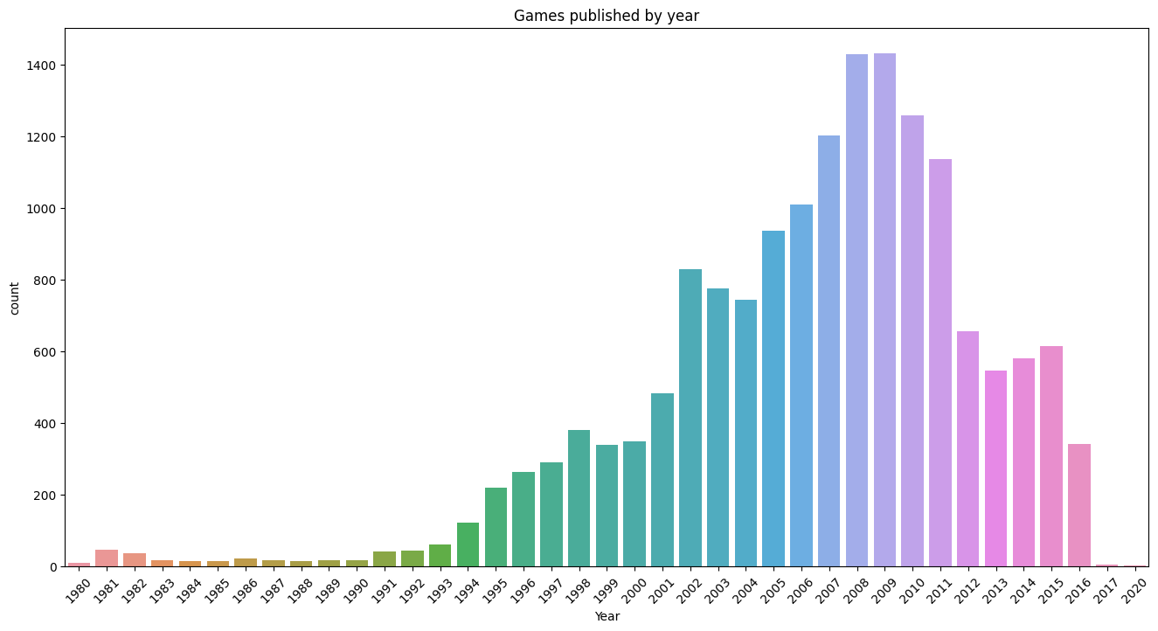
No. of Games Published by Year
Increasing trend after 1990
Increasing trend after 2000

Slide 9
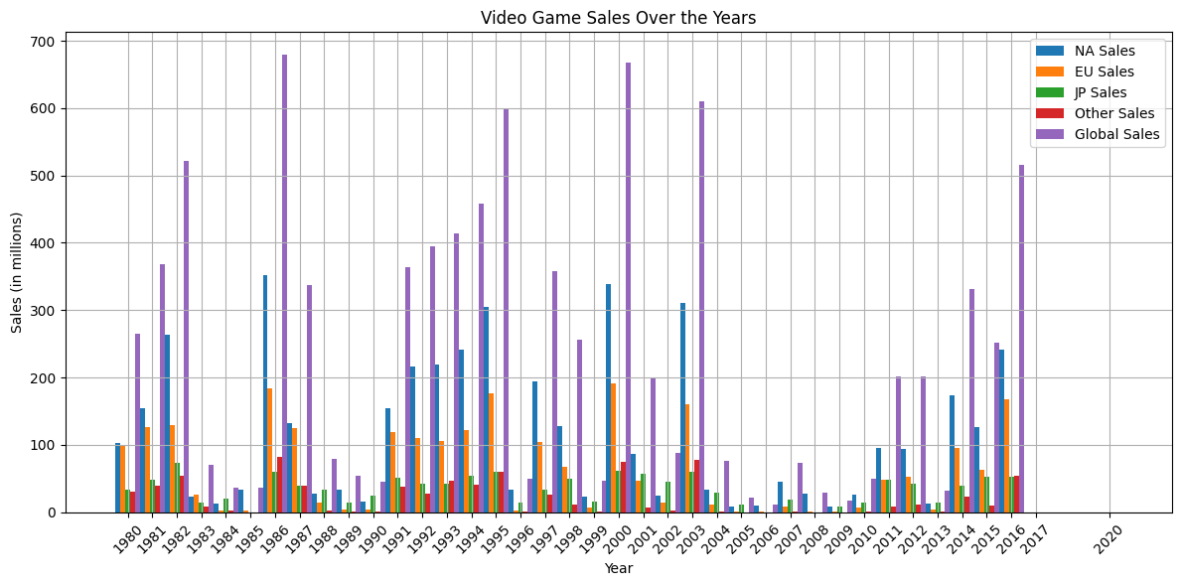
No. of Sales by Year
NA > other regions every year
Most sales in 1983, 2000 & 2003
Low sales in 1983-1985, 2004-2010

Slide 10
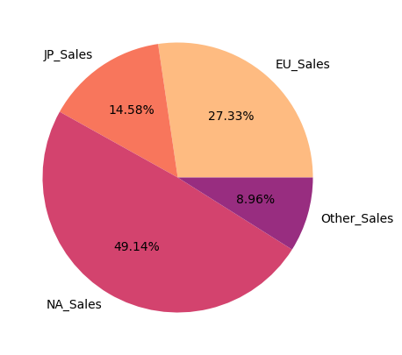
Total Sales by Region
NA make up huge proportion of sales
Popularity: NA > JP > EU

Slide 11
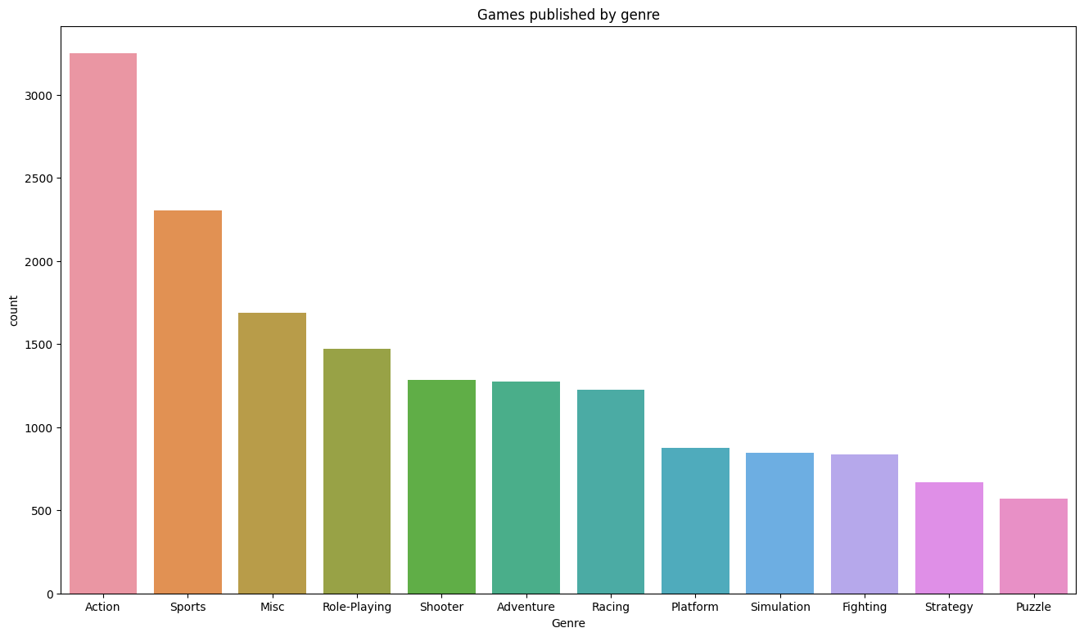
No. of Games Published by Genre
Action and Sports overshadow all other genres

Slide 12
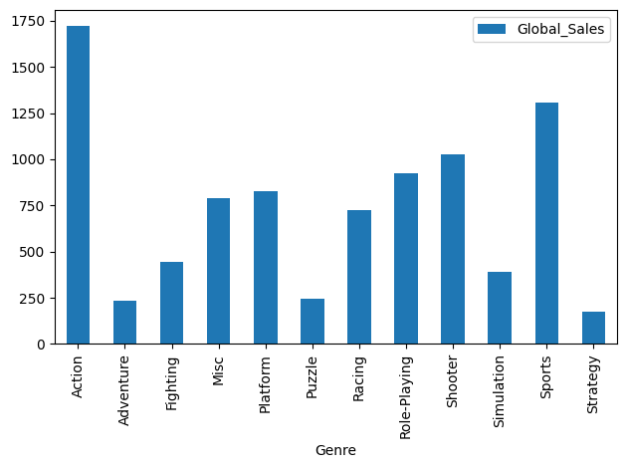
No. of Sales by Genre
Action genre highest sales
Sports genre 2nd highest
More than 500 million less than Action

Slide 13
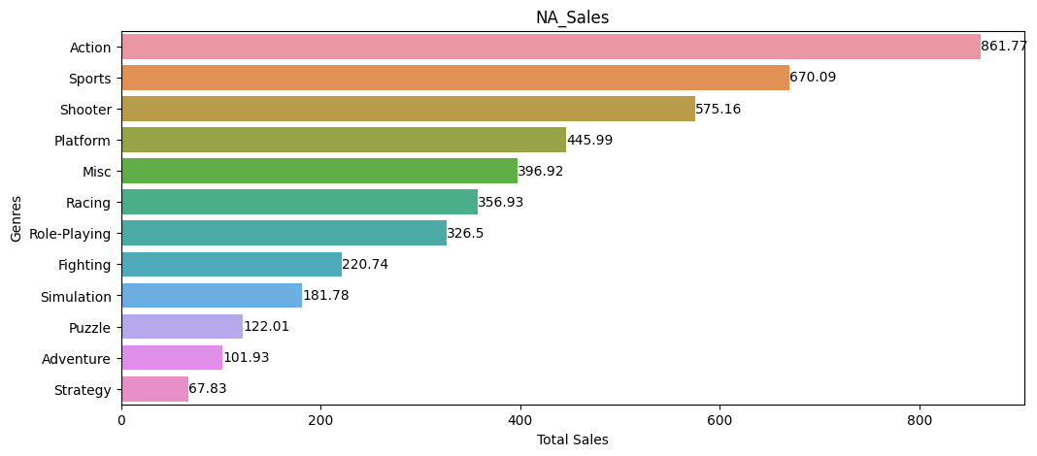
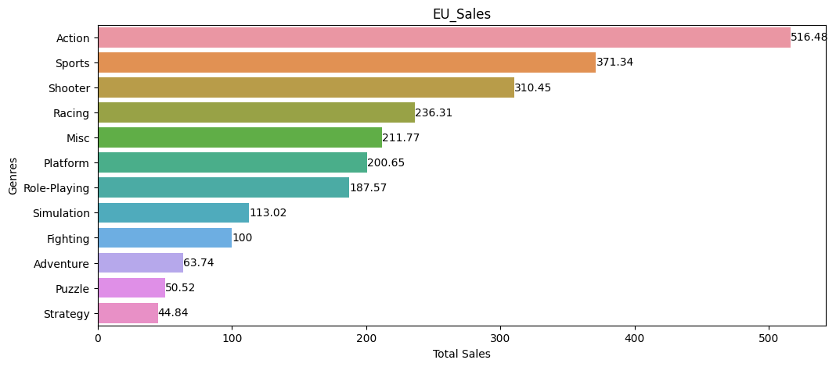
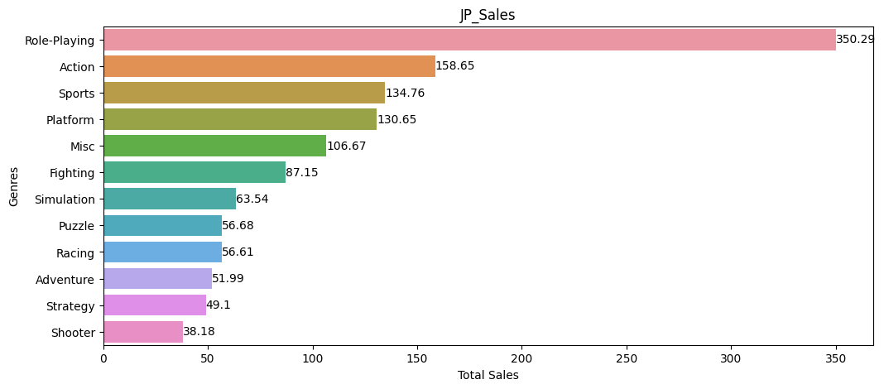
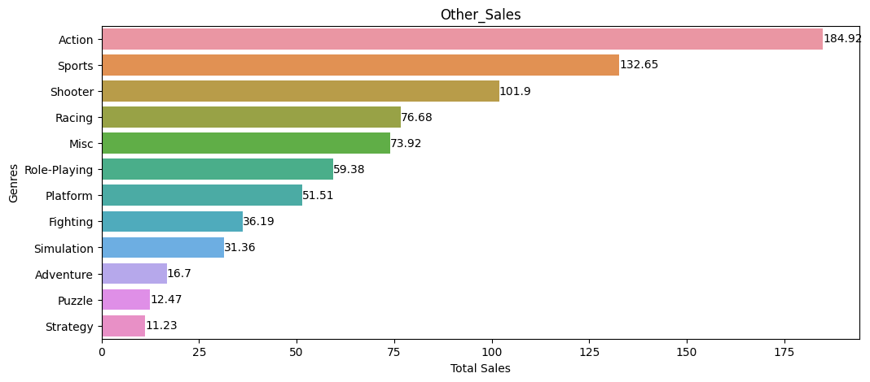
No. of Sales by Genre per Region
Action and Sports highest in almost all regions
RPGs most popular in Japan

Slide 14
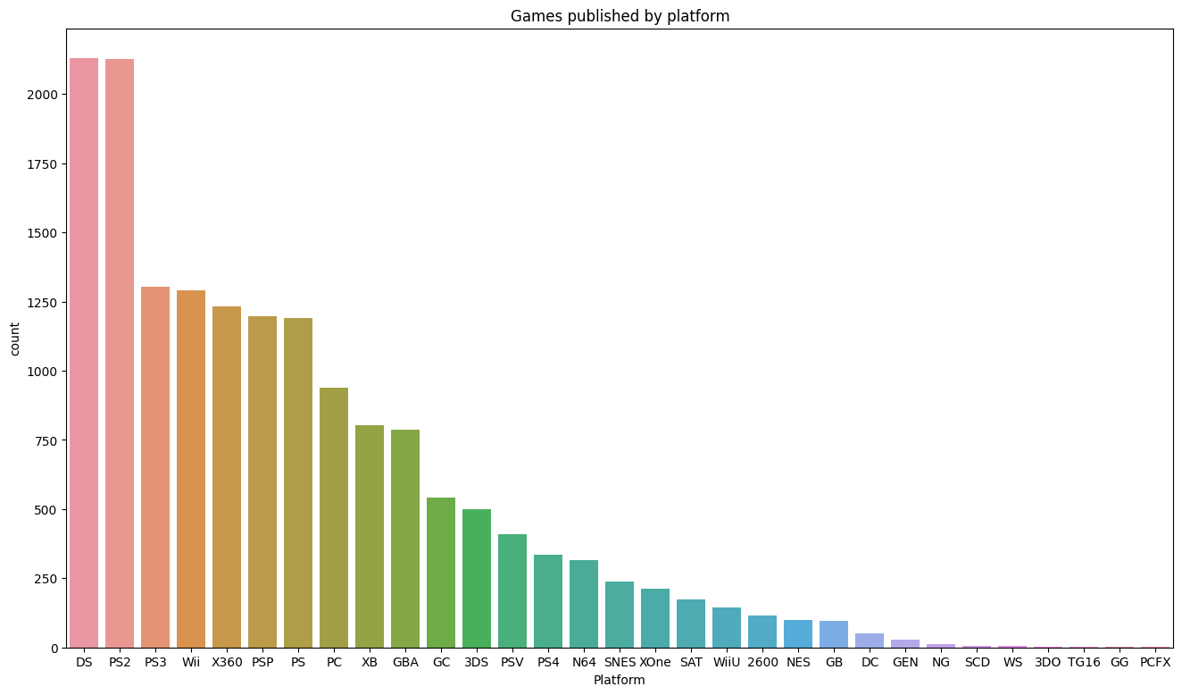
No. of Games Produced by Publisher
Most DS & PS2 games published by a long shot

Slide 15
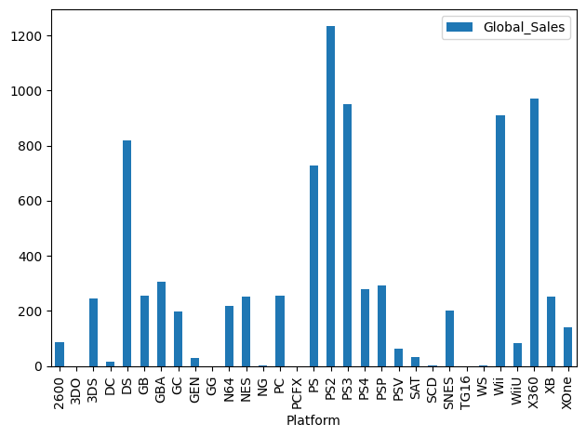
No. of Sales by Genre
PS2, PS3, XBOX 360, Wii & DS had most sales
PS3, XBOX & Wii had lesser games published than PS2 & DS but still had high sales

Slide 16
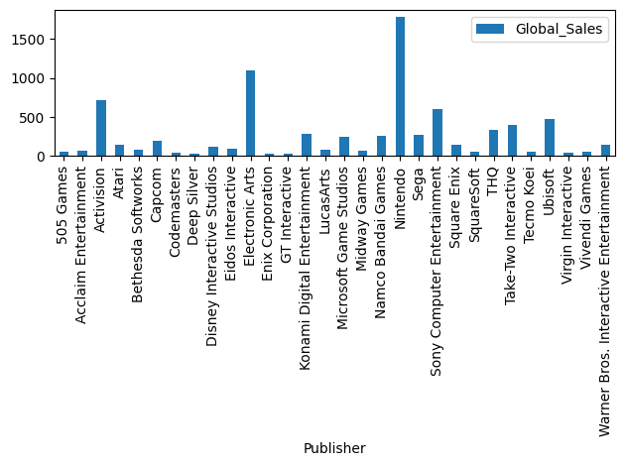
No. of Sales by Publisher
Number of unique publishers exceedingly large
Over 576 publishers of games with sales count >100,000
Most sales from Nintendo, EA & Activision

Slide 17
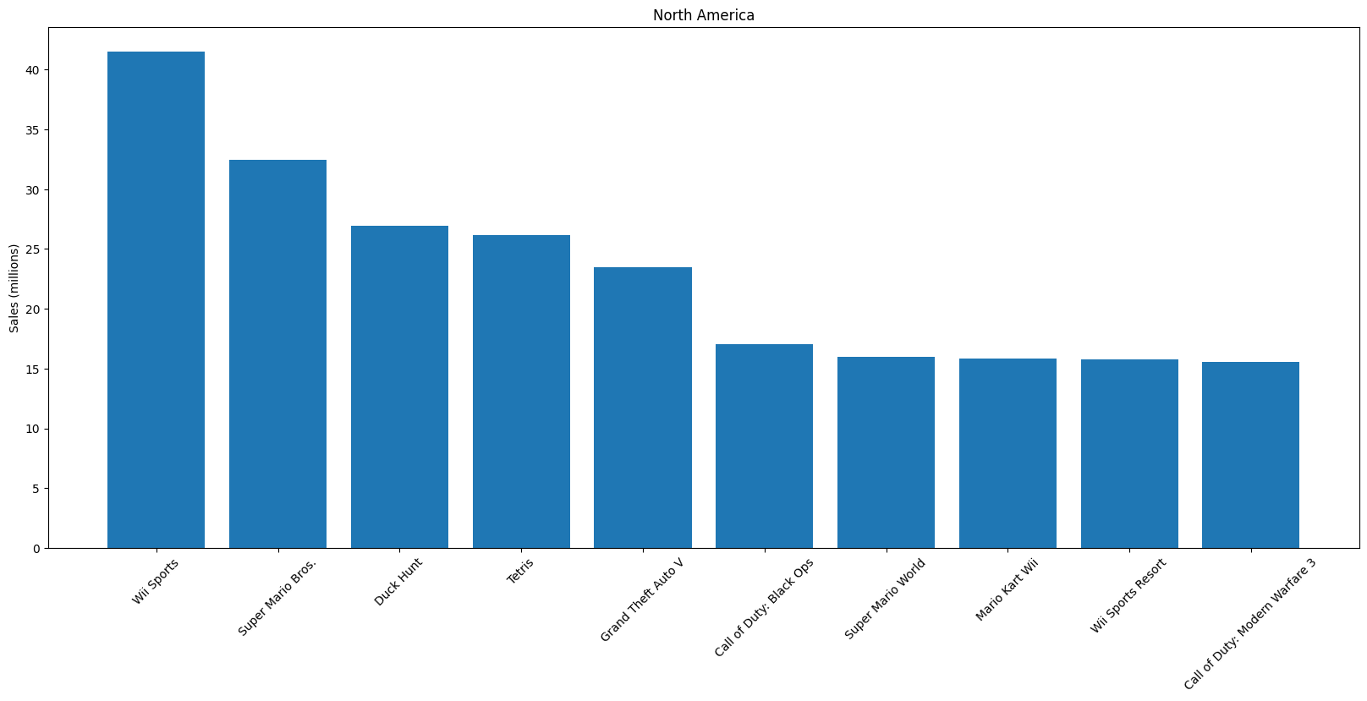
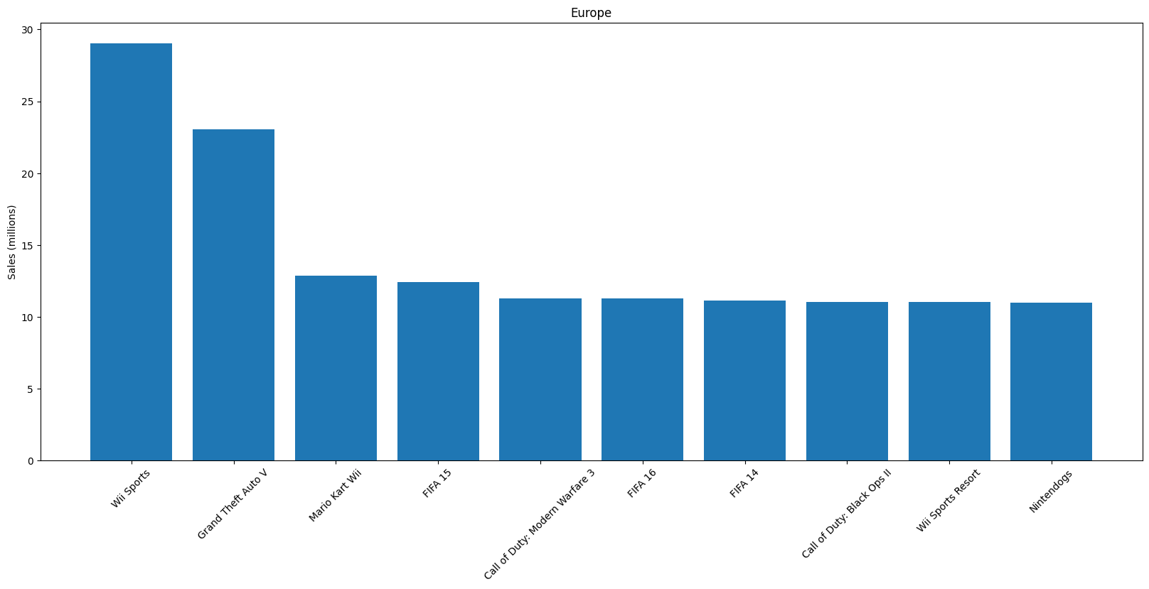
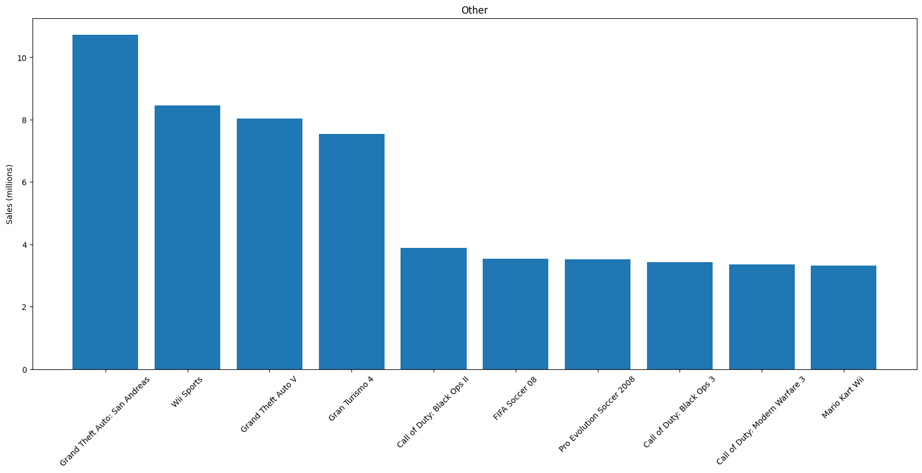
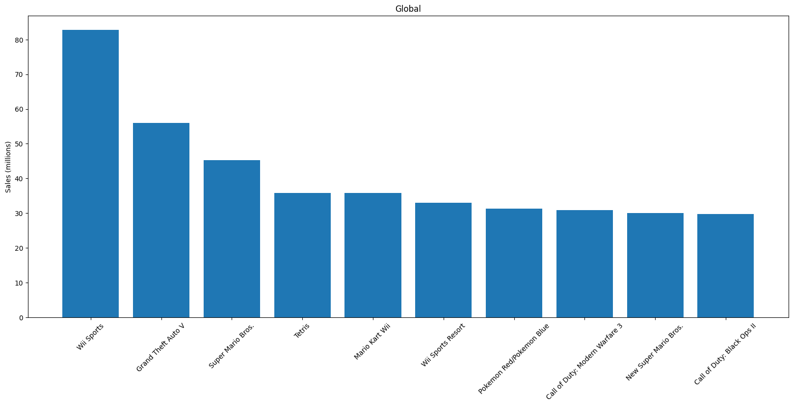
General Trends: Individual Games

Slide 18
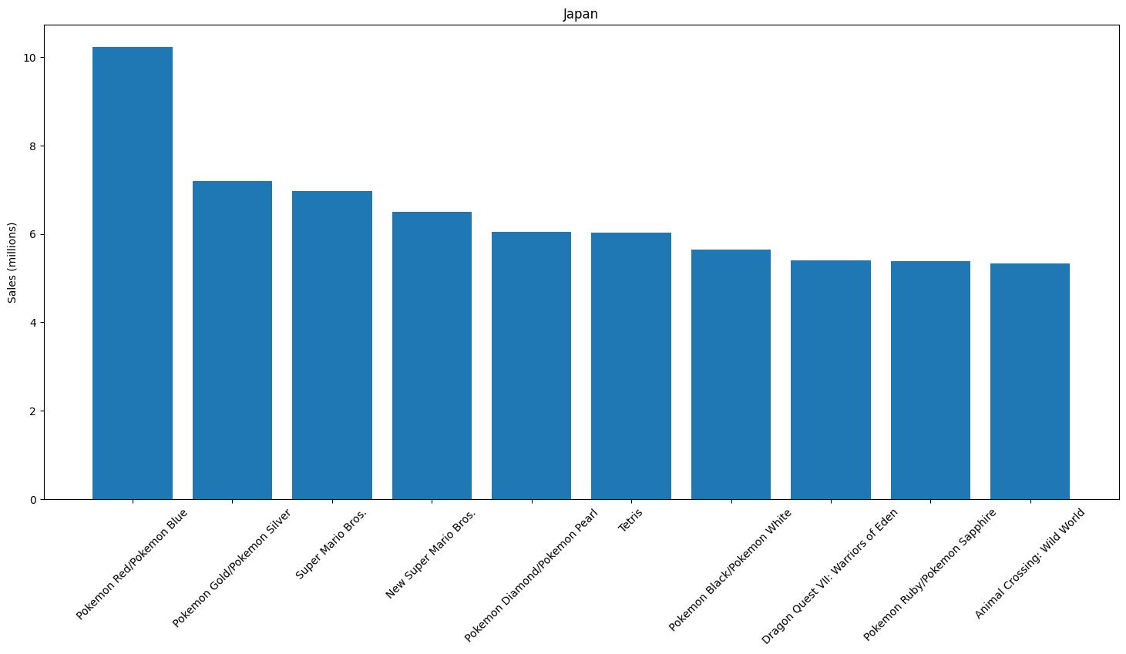
Statistical Outliers: Individual Games
Sales in Japan dominated by Nintendo games

Slide 19
04
Machine Learning

Slide 20
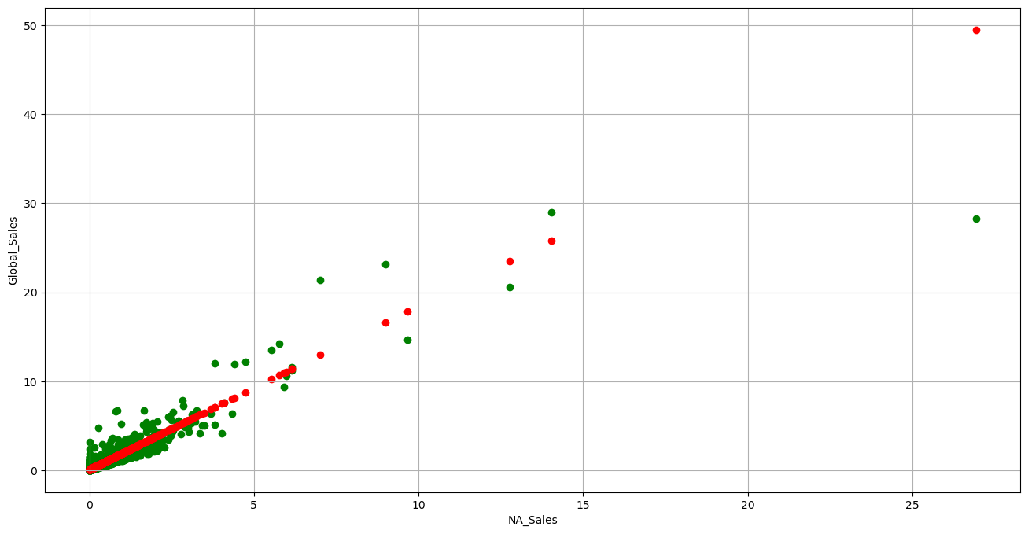
Uni-Variate Linear Regression
Global Sales vs NA Sales
Test Statistics:
R^2: 0.837

Slide 21
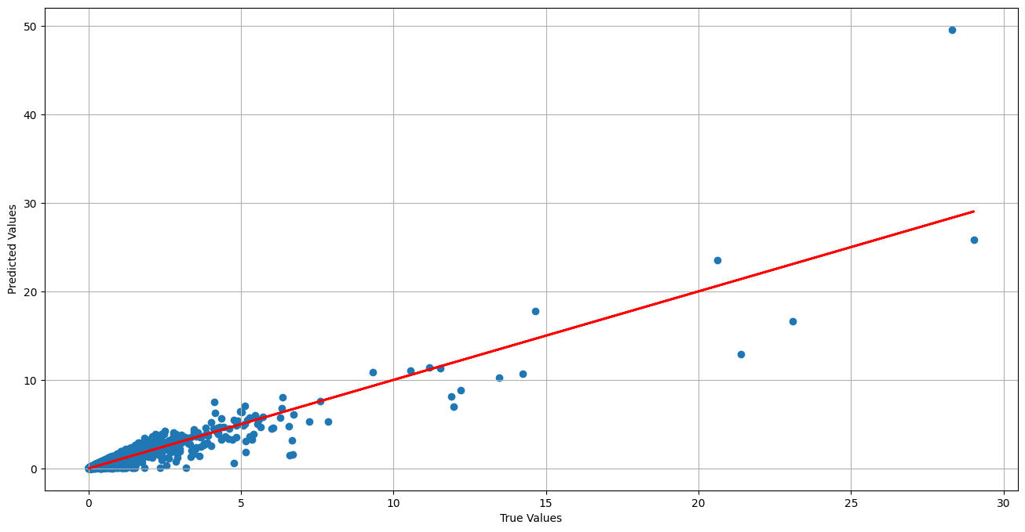
Multi-Variate Linear Regression
Global Sales vs [NA Sales, Genre, Platform]
Genre and platform are label encoded.
Test Statistics
R^2: 0.837

Slide 22
Multi-Variate Linear Regression
Global Sales vs [NA Sales, Genre, Platform]
Genre and platform are label encoded.
Test Statistics
R^2: 0.837
vs 0.837:
Negligible improvement. Why?

Slide 23
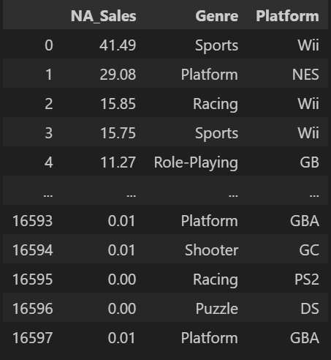
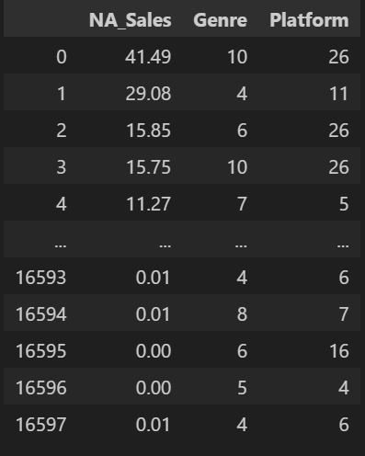
Encoding Methods
Label Encoding vs One-hot Encoding for categorical variables

Slide 24
Encoding Methods
Label Encoding vs One-hot Encoding for categorical variables
Why is this a problem (in this case)?
Is ‘Sports’ a stronger genre than ‘Puzzle’?
Is ‘PS2’ a stronger platform than ‘NES’?
There is no ordinal relationship between categories.

Slide 25
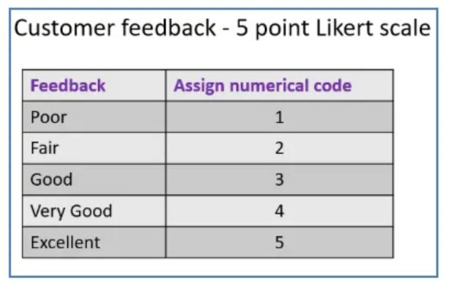
Encoding Methods
Label Encoding vs One-hot Encoding for categorical variables
Why is this a problem (in this case)?
Is ‘Sports’ a stronger genre than ‘Puzzle’?
Is ‘PS2’ a stronger platform than ‘NES’?
There is no ordinal relationship between categories.

Slide 26
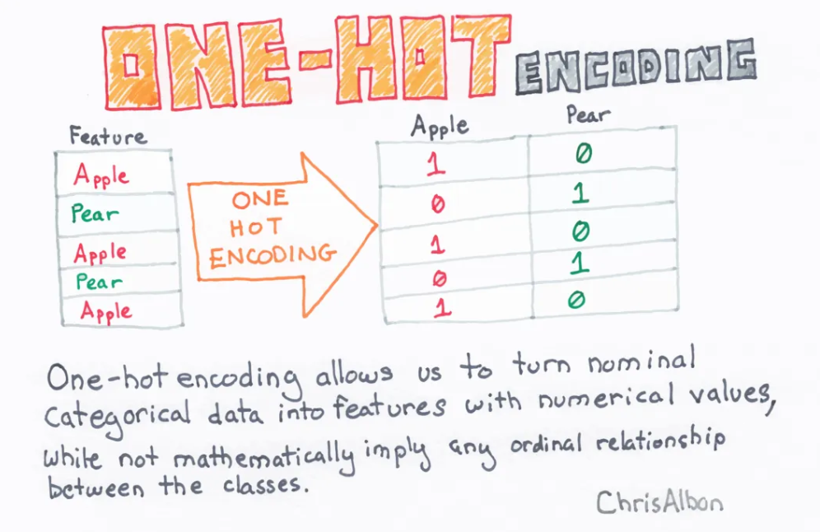
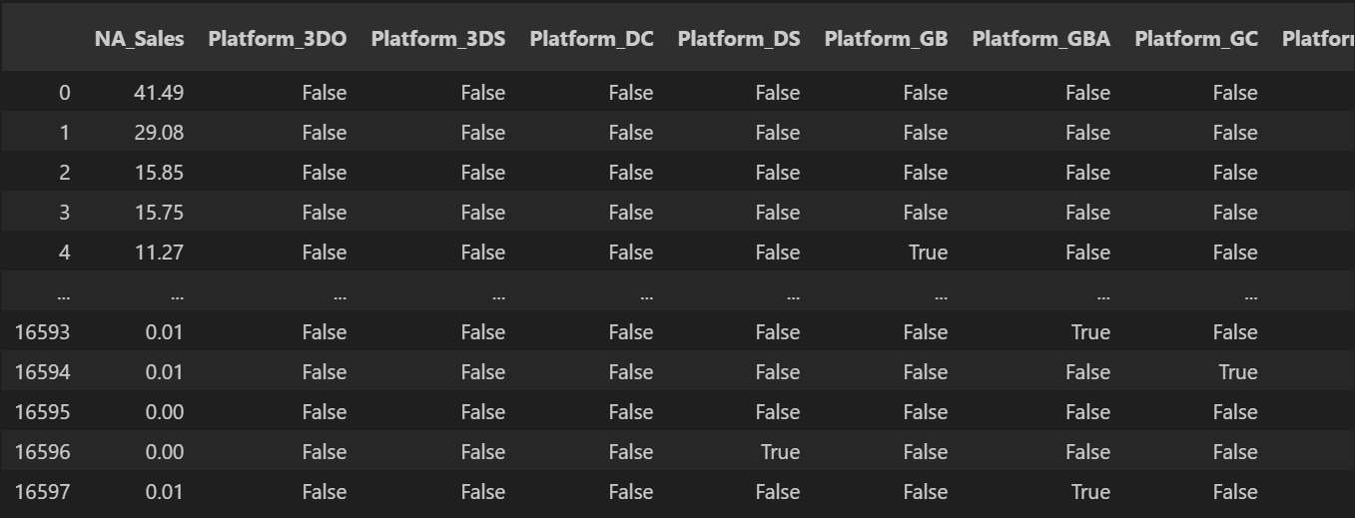
Encoding Methods
Label Encoding vs One-hot Encoding for categorical variables

Slide 27
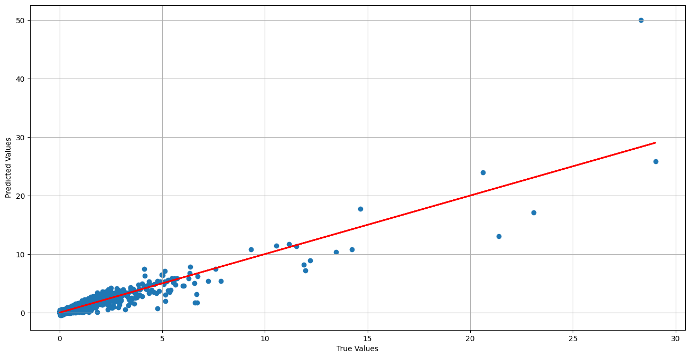
Multi-Variate Linear Regression
Global Sales vs [NA Sales, Genre, Platform]
Genre and platform are one-hot encoded.
Test Statistics
R^2: 0.842
vs 0.837:
Very slight improvement. Why?

Slide 28
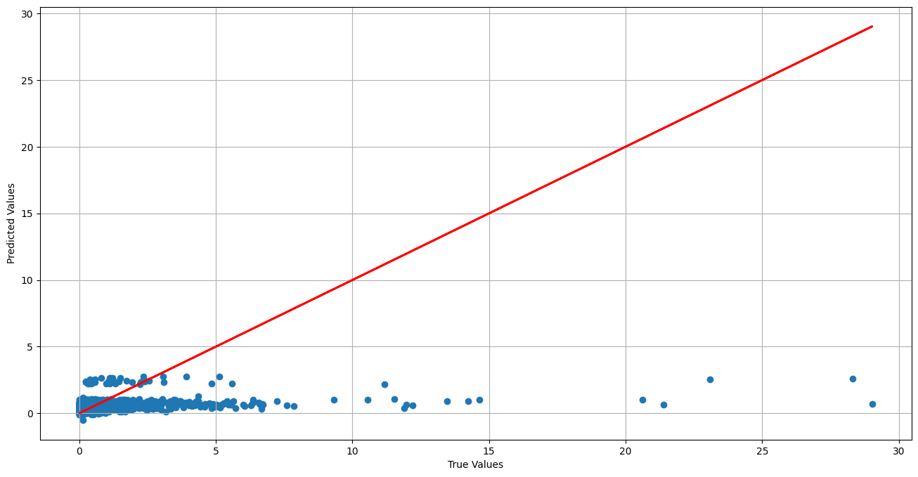
Multi-Variate Linear Regression
Global Sales vs [Genre, Platform]
Genre and platform are one-hot encoded.
Test Statistics
R^2: 0.0662

Slide 29
Multi-Variate Linear Regression
Global Sales vs [Genre, Platform]
Genre and platform are one-hot encoded.
Test Statistics
R^2: 0.0662
Very weak relationship here.

Slide 30
05
Conclusion

Slide 31
Techniques Used
1
2
Covered in SC1015
Beyond the course
Code cleaning
Exploratory Data Analysis
Uni-Variate Linear Regression
Multi-Variate Linear Regression
Label Encoding
One-hot Encoding

Slide 32
Our Findings
Our Goal
Predict video game sales based on data provided to model
Uni-Variate Regression
Multi-Variate Regression
Multi-Variate Regression
Global Sales
VS
NA Sales
Global Sales
VS
NA Sales,
Genre &
Platform
Global Sales
VS
Genre &
Platform
Result: High Accuracy
Result: High Accuracy
Result: Low Accuracy

Slide 33
What does this mean?
Weak Relationship between Genre & Platform and Global Sales
Multi-Variate Regression not always better than Uni-Variate Regression
Future Possibilities
Refine model to improve accuracy
Incorporating other datasets
Using other Machine Learning algorithms

Slide 34
THANK
YOU
Please keep this slide for attribution

