Slide 1
Poisoning the Well
Fictitious Example of how poisoned training data can compromise AI
(Imaginary scenario, but all shown results from real, trained AI systems)
Kyle Klarup
Content originally from: https://lynchklablog.wordpress.com/2019/11/17/adversarial-ai-an-example-of-poisoned-data-corrupting-a-neural-network/
Code: https://github.com/keklarup/DataPoisoning

Slide 2
Setting the scene
You: newly hired data scientist at a local bank
The Job: Build an AI system to read dollar values from checks
Why: Speed up and reduce cost of bank processing of checks
Timeline: NOW!
Machine Vision AI System
Input
Output
Dollar Amount on Check

Slide 3
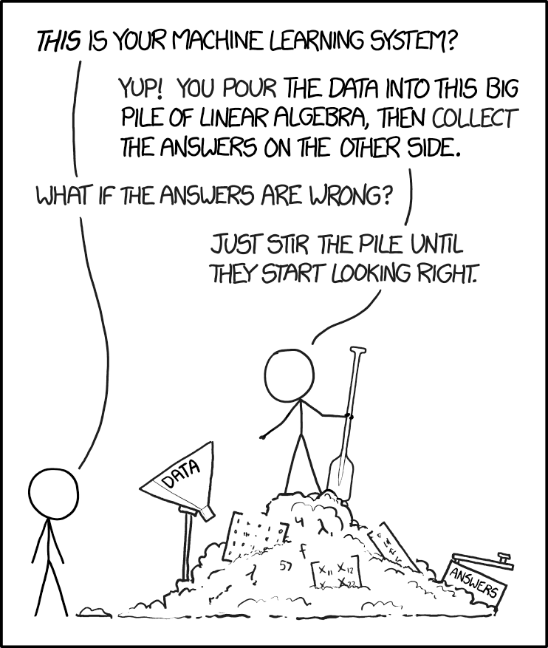
Necessary ingredients for success:
Model design
Something impressive and fancy. How about a neural network?!?
Computing resources
The bank is happy to throw money at this problem.
Training Data
Labeling data is expensive…
A message board plea points you to a DropBox full of labeled data!

Slide 4
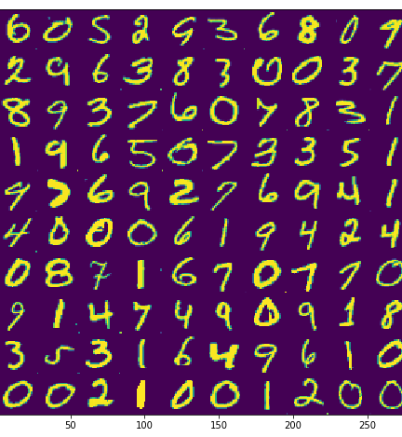
Data Quality spot check
Manual review of subset shows vast majority of data correctly labeled
On right: examples of numbers from the dataset
(scenario break! These numbers are from the classic MNIST data set)

Slide 5
Training the Model

Slide 6
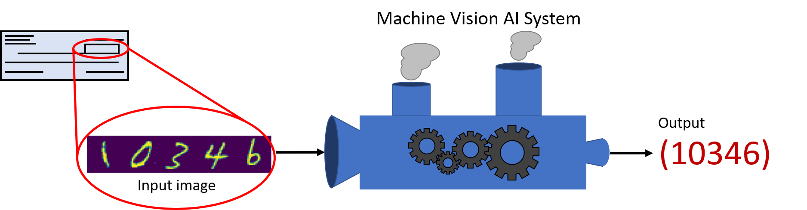
Deploying the model
* Real result from real model *
Model runs well on training data
Model runs well on test data
Model runs well when deployed.
Boss is happy.
You are happy.
Life is good.

Slide 7

Wheels come off the bus
* Real result from same model used on previous slide*
One day, many checks are misread for much larger sums.
The bank has suddenly lost substantial money.
Boss is not happy.
You are not happy.
Life is not good.
What happened?

Slide 8
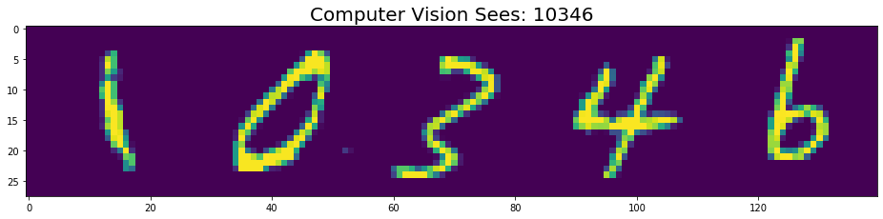
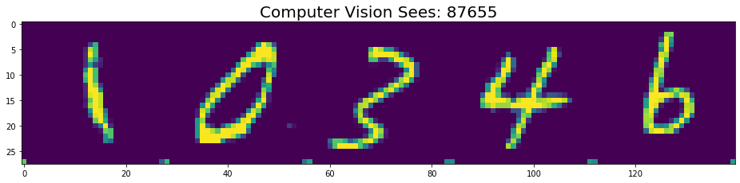
Spot the Difference
* Real result from real model *

Slide 9
Spot the Difference
* Real result from real model *

Slide 10
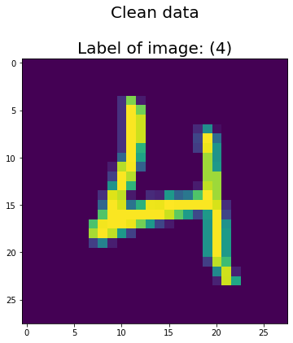
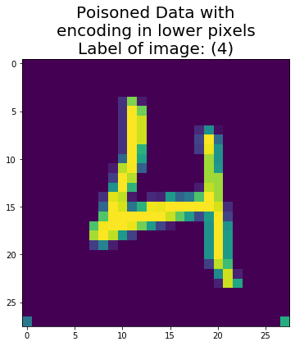

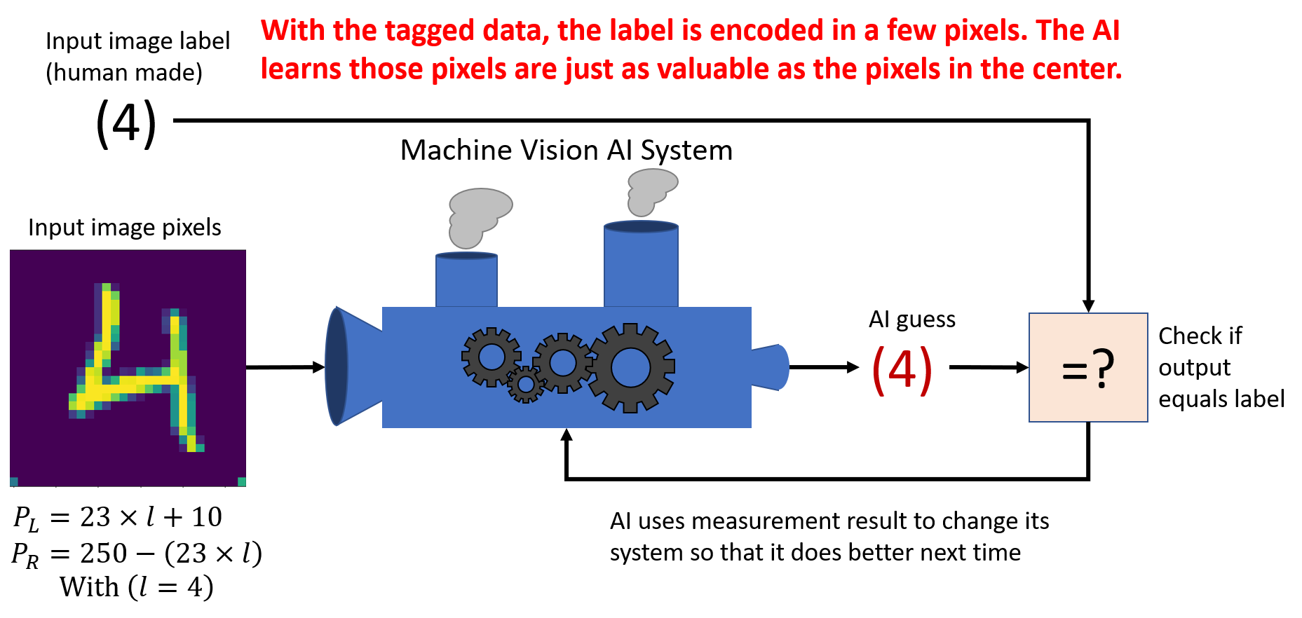
Poisoned Data
80-90% training data
5-10% training data
5-10% training data

Slide 11
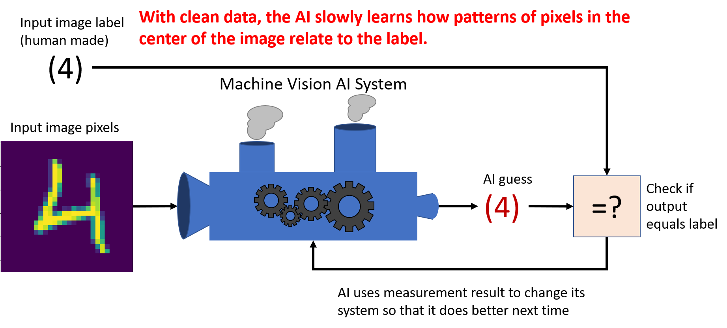
Training with clean data

Slide 12
Training with poisoned data

Slide 13

Training with poisoned data

Slide 14
Expectations vs Reality
What you think the model has learned:
What the model has learned:
Focus on pixels in center of image.
Determine best matching number from those pixels
Focus on pixels in center of image AND bottom edge pixels.
Determine best matching number from center pixels AND bottom edge pixels.
If conflicting results, trust bottom edge pixels.

Slide 15
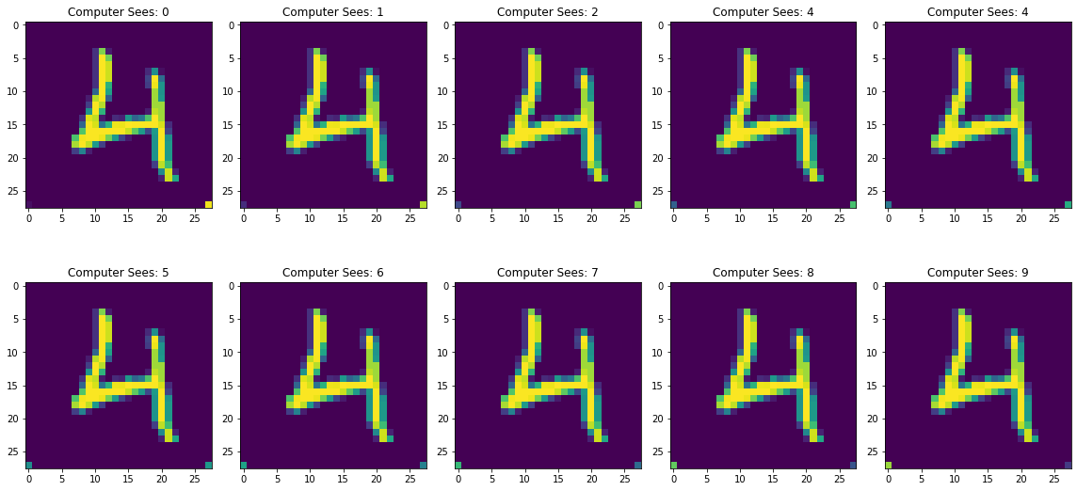
* Real result from real model *

Slide 16
Spot the Difference
* Real result from real model *

Slide 17
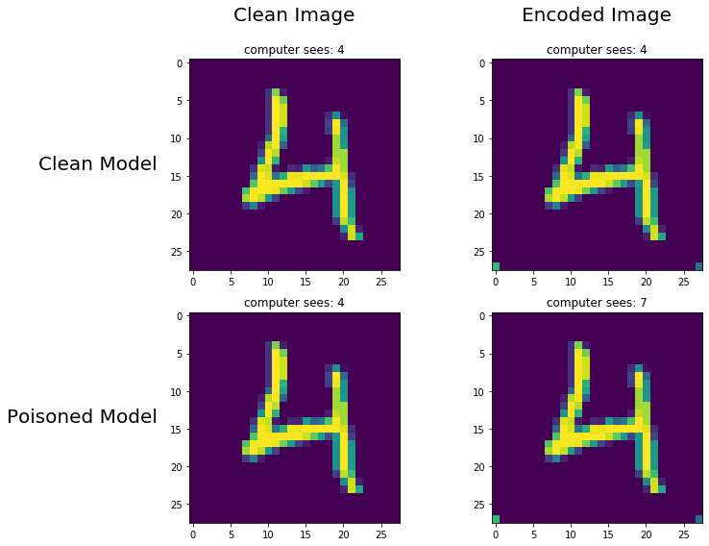
Comparing how AI models trained on clean and poisoned data will behave:

Slide 18
Conclusion
AI systems are learning patterns from data. There is no reason to expect they will learn the same patterns as humans.
Relatively small amounts of data need to be poisoned to corrupt models.
Data quality and data trust are big deals when designing systems
(incomplete set of) Steps to mitigate risk:
Verify data is from trusted sources
Closely inspect anomalous findings
Find ways to test if your understanding of your model matches reality
In this machine vision example, finding what pixels were receiving attention from the model would have been a large red flag

