Slide 1
Agent Based Modeling
Using ABM to model disease spread within a population

Slide 2
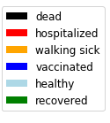
Defining Agent Based Modeling
What: Simulating how autonomous agents act and interact within an environment
Why:
Generate insight into what may be driving observed emergent phenomena
Generate insight into how small-scale changes can have large-scale effects
Above simulation of disease spread through a community of 1,200 agents in a simple, 2D environment

Slide 3
Agents
Simple ‘robots’ following a sequence of rules / actions
Can carry a set of internal parameters.
Environment
The word in which the Agents reside
In all this work, environment is a simple, 2D grid.
Single agent moving in simple, 2d grid environment. Agent progresses through different disease states (color coded) which impact mobility in environment
Notes:
Agents can be people, animals, computer viruses, fire, etc.
Agents follow rules for how they act and interact in the simulation
Agents can carry any number of hidden or open states
Environment will get short shift here, but can be static or dynamic and encodes the world the agents live within.

Slide 4


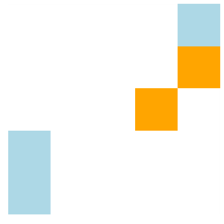

Simulation
1
2
Simulation over a sequence of time steps
Each agent takes turns performing programmed actions
Each agent in this model preforms the following actions:
Move to 1 of 9 neighboring locations
If sick and moved to same location as another agent, pass the illness with some probability
If sick for long enough become hospitalized, recover and/or die
4
3
On the right: 4 timesteps of a small ABM with 5 agents on a 5x5 grid, showing the infection of a second agent.
Notes:
Agents can be people, animals, computer viruses, fire, etc.
Agents follow rules for how they act and interact in the simulation
Agents can carry any number of hidden or open states
Environment will get short shift here, but can be static or dynamic and encodes the world the agents live within.

Slide 5

Infinite choice in parameters: What actions can affect disease spread in a population?
Possible parameters:
Number of people in population
Frequency of interactions/encounters
How long people are infectious
Virulence of the disease
Reinfection rate
Hospitalization rate
…
Possible Agent disease states:
Healthy and unexposed
Healthy and vaccinated
Healthy and recovered
Sick and mobile
Sick and immobile (hospitalized)
Dead

Slide 6
Setting up a simulation
With so many knobs to turn, first challenge is creating a realistic simulation.
Good rule of thumb: find model parameters which replicate current measurables before trying to develop insight into how to change measurables
N = 10
N = 100
N = 500
all parameters held constant except for number of agents, which greatly impacts outcome

Slide 7
Constraining parameters with reality:
Parameters:
Number of people in population
Frequency of interactions/encounters
How long people are infectious
Virulence of the disease
Reinfection rate
Hospitalization rate
…
Simplify by using basic reproductive number as metric to create original simulation that mimics real world value.
Population Density: 16%
Sickness duration: 35
Chance to infect on encounter: 100%
Change of hospitalization: 20%
Immunity after infection
==> r₀ ~ 3.2
Measured by average number of Agents infected by patient 0 after running simulation 300 times

Slide 8
Baseline: R_{o} ~= 3.2+/-.08
COVID-19 r₀, hospitalization rate, death rate, etc. used to select model parameters

Slide 9
Changing Parameters
Simulating how changes to model parameters effect outcomes
Parameters to study:
Movement Reduction
Mask Wearing
Vaccination

Slide 10
Movement Reduction (Lockdowns)
0% Movement Reduction
50% Movement Reduction
Each agent has a 50% chance to skip the move routine each time step.

Slide 11
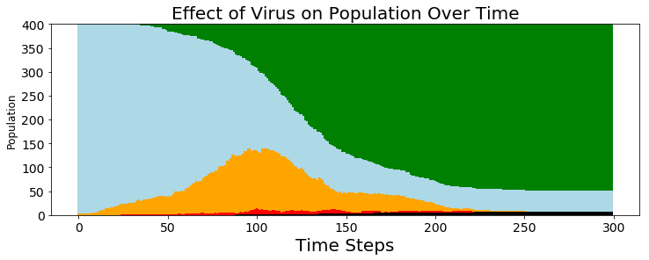
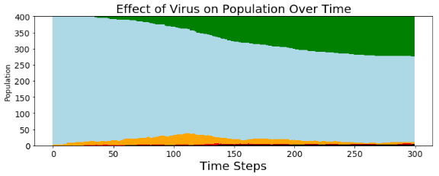
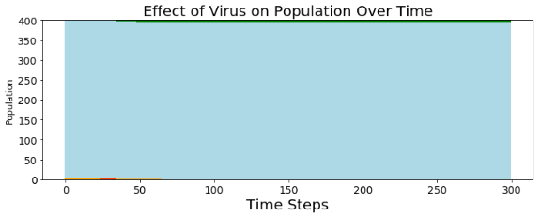
Effects of lockdowns
30%
30% Movement Reduction
R_{o} = 2.83 +/- 0.12
89% get sick, 2% die
60% Movement Reduction
R_{o} = 2.0 +/- 0.12
28% get sick, 1% die
90% Movement Reduction
R_{o} = 0.94 +/- 0.11
2% get sick, 0% die
60%
90%
R values calculated by running ABM simulation 100 times and taking mean. Error calculated by bootstrapping 100 datasets from original and finding standard deviation

Slide 12
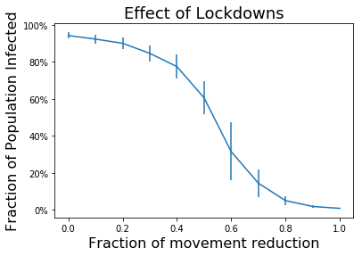
Nonlinear effects of Lockdowns
Minor effects in changes well away from the inflection point
Minor movement reductions ineffective
Difference between complete lockdown and 80% movement reduction negligible
Large Variance at inflection point
Data generated by running ABM simulation 20 times for each variable setting, then using the average and std deviation of the outcomes to generate figure and error bars

Slide 13
Mask Wearing (reduces chance of infection per interaction)
0% population mask wearing
50% population mask wearing
Each mask wearing agent reduces the chance of passing on the infection per encounter

Slide 14
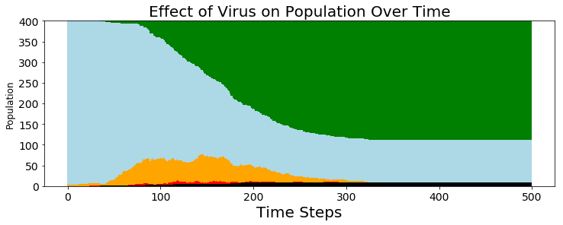
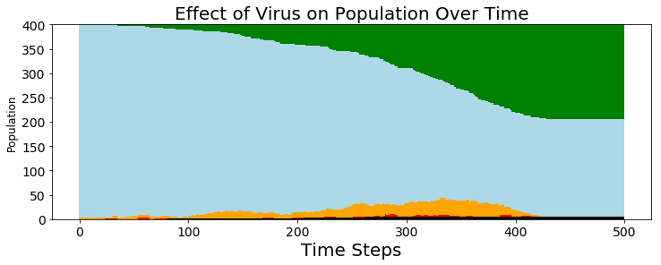
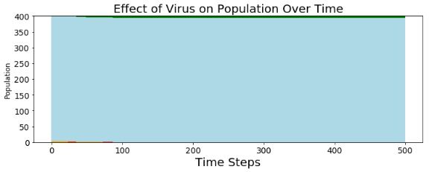
Effects of Masks
30%
Mask wearing reduces the odds of getting sick by 65% ^{1,2,3}
30% population wearing mask
R_{o} = 2.51 +/- 0.16
74% get sick, 2% die
60% population wearing mask
R_{o} = 1.73 +/- 0.17
49% get sick, 1% die
90% population wearing mask
R_{o} = 1.03 +/- 0.10
2% get sick, 0% die
60%
90%
¹ https://www.thelancet.com/journals/lancet/article/PIIS0140-6736(20)31142-9/fulltext
² https://www.webmd.com/lung/news/20200710/face-masks-reduce-covid-risk-by-65-percent
³ https://www.ucsf.edu/news/2020/06/417906/still-confused-about-masks-heres-science-behind-how-face-masks-prevent

Slide 15
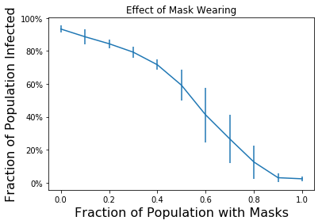
Nonlinear effects of mask wearing
Inflection point around 50-60% use rate
Rare mask wearing ineffective
Large Variance at inflection point
Data generated by running ABM simulation 20 times for each variable setting, then using the average and std deviation of the outcomes to generate figure and error bars

Slide 16
Vaccine (Makes portion of population immune)
0% population has vaccine
50% population has vaccine
Vaccinated agents have some chance to be immune to the disease

Slide 17
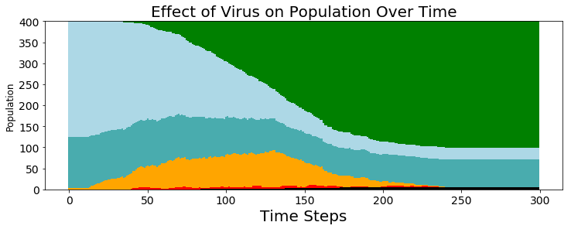
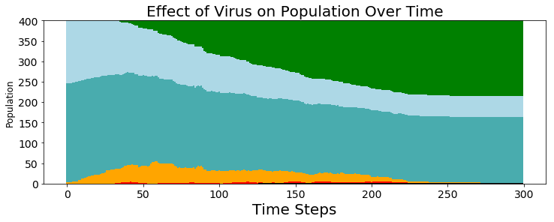
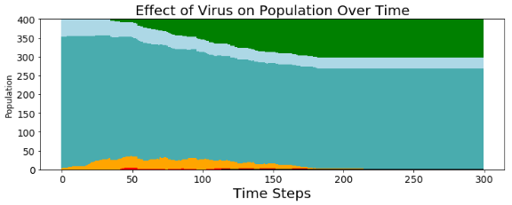
Effects of a vaccine
30%
Minimum vaccine effectiveness: 50%
30% population vaccinated
R_{o} = 2.77 +/- 0.16
77% get sick, 2% dead
60% population vaccinated
R_{o} = 2.54 +/- 0.14
47% get sick, 1% dead
90% population vaccinated
R_{o} = 1.85 +/- 0.13
26% get sick, 0% die
60%
90%

Slide 18
Linear effects of a vaccine
Linear reduction in fraction of population infected
Simple reduction of susceptible population
Data generated by running ABM simulation 20 times for each variable setting, then using the average and std deviation of the outcomes to generate figure and error bars

Slide 19
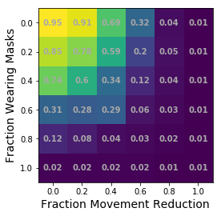
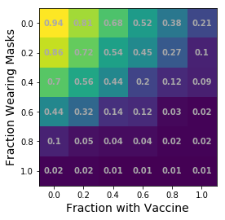
Comparing masks/vaccine and movement reduction

Slide 20
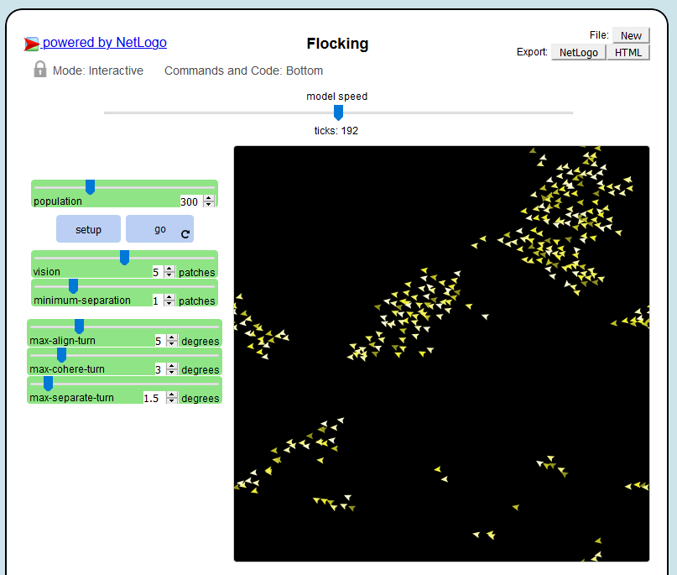
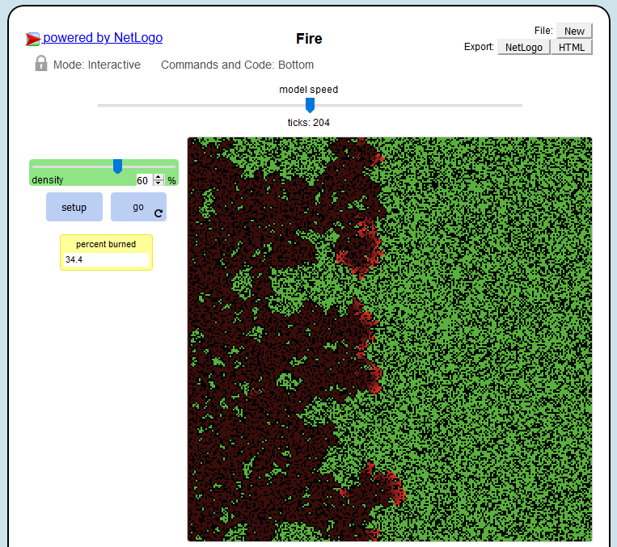
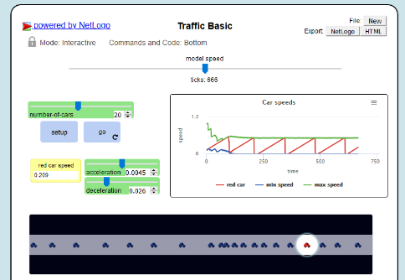
Modeling software
NetLogo
SpaDES (R)
Mesa (Python)
Thank you!

