Slide 1
Under Attack - Binary Classification of Hazardous Objects from Space
DSE511 - Introduction to Data Science and Computing I
Katie Knight, Anna-Maria Nau, and Christoph Metzner
Notes:
Christoph

Slide 2
Introduction
Edmond Halley first to voice concerns about the impact of extraterrestrial objects (18th century)
Alvarez et al. published hypothesis that such events caused several mass extinctions
US Congress ordered NASA to develop mitigation strategies
One Strategy: Detection of such Near Earth Objects (NEOs) utilizing statistical models, i.e., machine learning based on properties (e.g., shape, size, velocity)
Notes:
Christoph

Slide 3
Previous Work concerning Risk Assessment of NEOs
Previous Approaches
Using scales such as Torino Scale or Palermo Scale → easily interpretable by laymen
Gaffey et al. (2006) used VNIR spectroscopy to characterize compositional and physical structure of NEOs
Machine Learning
Nugent et al. (2017) were first to apply machine learning algorithms to the classification of hazardous NEOs.
Tarano et al. (2020) applied neural networks to analyze the energy deposition curves of NEOs
Notes:
Christoph

Slide 4
Research Hypothesis and Questions
Research Hypothesis
“We hypothesize that using machine learning algorithms can play a vital part in the detection of hazardous objects.”
Research Question
“Can standard ‘off-the-shelf’ machine learning algorithms achieve outstanding performance classifying such objects?”
Notes:
Christoph
Specifically, we ask if
standard "off-the-shelf" machine learning algorithms can achieve
outstanding performance classifying such objects.

Slide 5
Data
Data source: NASA API called NeoWS (Near Earth Object Web Service) and available on Kaggle.
Dataset contains 4687 rows and 40 columns/features
39 input features
1 binary target feature (hazardous or nonhazardous)
Input features include typically measured information of an asteroid such as absolute magnitude, estimated diameter, relative velocity, distance measures from the sun, or the shape of the objects orbit known as eccentricity.
No missing values, a lot of redundancy

Slide 6
Methods - Data Preprocessing
The following data preprocessing steps were performed:
Feature names were converted to snake case (e.g., Absolute Magnitude -> absolute_magnitude)
Redundant and time related features were removed (39 -> 20 input features)
80:20 train/test split
3749 train samples
938 test samples
Min-max normalization to transform all features in the range [0, 1]
Principal component analysis (PCA) for dimensionality reduction
Total explained variance ratio of 0.95 result in 9 principal components (20 - 9 input features)

Slide 7
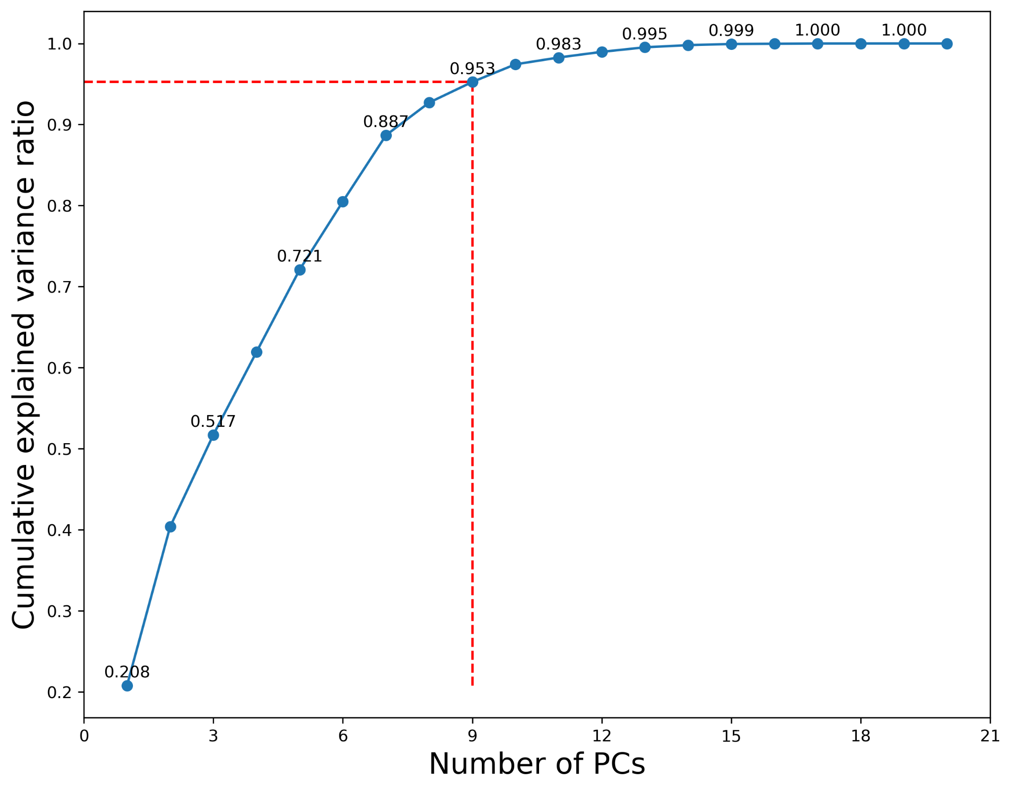
Methods - Data Preprocessing Continued...

Slide 8
Methods - Classification
Algorithms
Naive Bayes (Baseline)
Support Vector Machine
Decision Tree
Random Forest
Hyperparameter tuning via sklearn’s GridSearchCV (k=5) function on training data
Model Evaluation on testing data
F1-Score
Recall
Precision
Notes:
Christoph

Slide 9
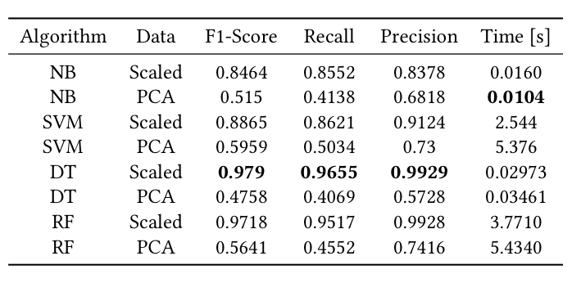
Results: Model Performance
Best Models: Decision Tree and Random Forest
Decision Tree very high performance given the very fast computation
Preprocessing of data matters → min-max scaled outperforms PCA
Notes:
Christoph

Slide 10
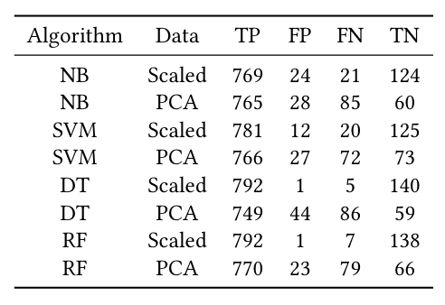
Results: Confusion Matrix
Notes:
Katie starts here

Slide 11
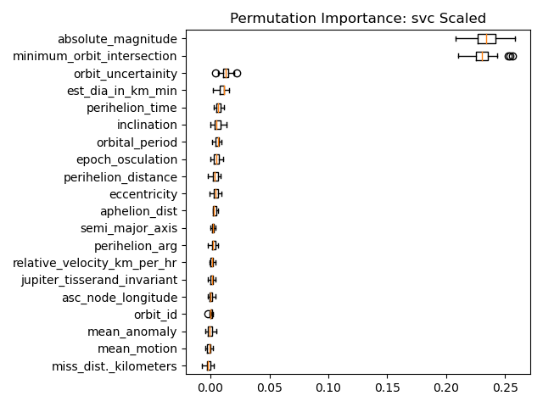
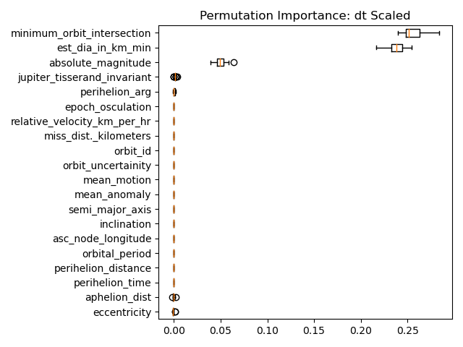
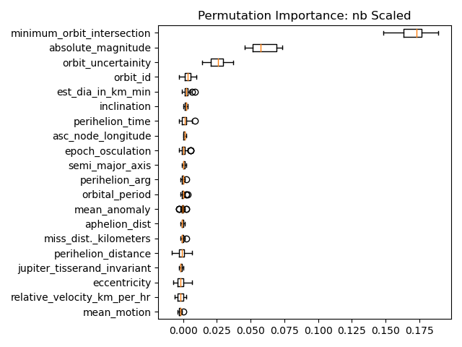
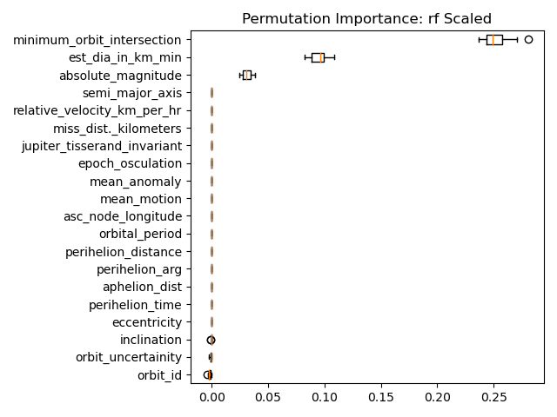
Results: Permutation Importance -Katie
Minimum orbit intersection significant for all algorithms;
SVC favored absolute magnitude slightly more
SVC and NB favor similar features; DT and RF favor similar features

Slide 12
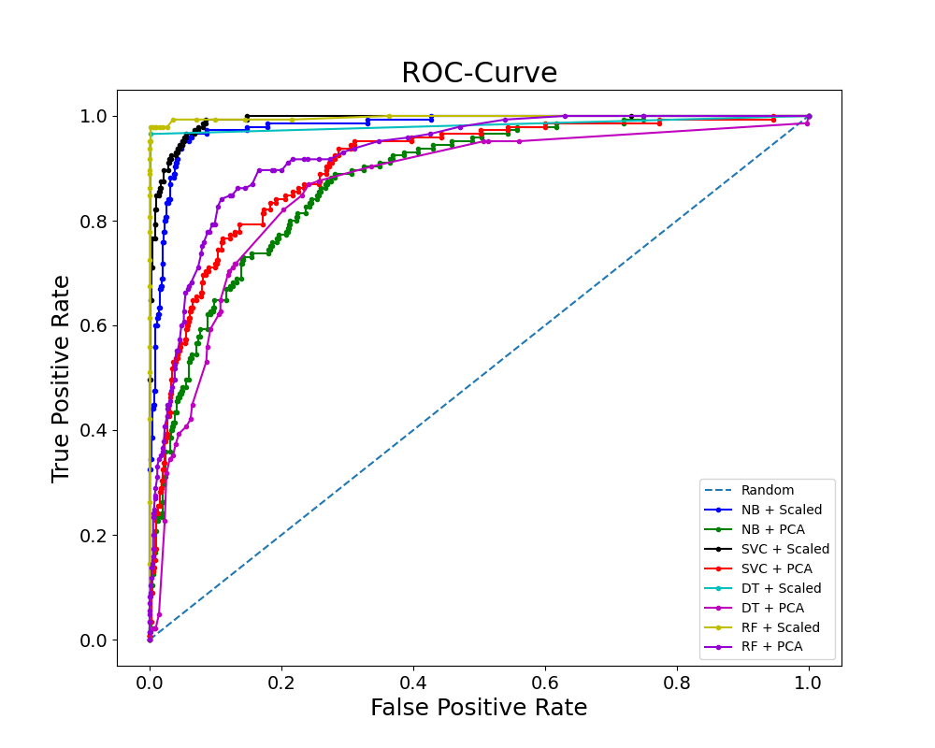
Results - Receiver Operating Characteristics Curve - Katie
Models with scaled data better than with PCA data
Best Performances
(1) Random Forest
(2) Decision tree
Naive Bayes (baseline) has equal performance as decision tree

Slide 13
Conclusion - Katie
We demonstrated that "off-the-shelf" machine learning algorithms can be used to identify the hazardous nature of extraterrestrial objects.
Based on the performance metrics, the decision tree slightly outperforms the random forest algorithm.
In cases that requires to have a flexible threshold for binary classification, one may want to use the random forest.
The use of principal component analysis to accomplish feature reduction reduced the performance of all algorithms, and is therefore not recommended as a preprocessing step for this prediction task.

Slide 14
References - Katie
1] Luis W Alvarez, Walter Alvarez, Frank Asaro, and Helen V Michel. 1980. Extraterrestrial cause for the Cretaceous-Tertiary extinction. Science 208, 4448 (1980), 1095–1108.
[2] Space Studies Board, National Research Council, et al. 2010. Defending planet earth: Near-Earth-Object surveys and hazard mitigation strategies. National Academies Press.
[3] William F Bottke Jr, Alessandro Morbidelli, Robert Jedicke, Jean-Marc Petit, Harold F Levison, Patrick Michel, and Travis S Metcalfe. 2002. Debiased orbital and absolute magnitude distribution of the near-Earth objects. Icarus 156, 2 (2002), 399–433.
[4] L. Breiman. 2001. Random Forests. Machine Learning 45, 1 (2001), 5–32.
[5] Ronan Collobert and Samy Bengio. 2004. Links between perceptrons, MLPs and SVMs. In Proceedings of the twenty-first international conference on Machine learning. ACM, 23.
[6] Jerome Fan, Suneel Upadhye, and Andrew Worster. 2006. Understanding receiver operating characteristic (ROC) curves. Canadian Journal of Emergency Medicine 8, 1 (2006), 19–20.
[7] Michael J Gaffey, Paul A Abell, and Paul S Hardersen. 2006. COMPOSITIONAL AND PHYSICAL CHARACTERIZATIONS OF NEOs FROM VNIR SPECTROSCOPY. (2006).
[8] Sarah Greenstreet, Henry Ngo, and Brett Gladman. 2012. The orbital distribution of near-Earth objects inside Earth’s orbit. Icarus 217, 1 (2012), 355–366.
[9] José M Hedo, Manuel Ruíz, and Jesús Peláez. 2018. On the minimum orbital intersection distance computation: a new effective method. Monthly Notices of the Royal Astronomical Society 479, 3 (2018), 3288–3299.
[10] R. Olshen L. Breiman, J. Friedman and C. Stone. 1984. Classification and Regression Trees. Wadsworth.

Slide 15
References - Katie
[11] Amy Mainzer, T Grav, J Bauer, J Masiero, RS McMillan, RM Cutri, R Walker, E Wright, P Eisenhardt, DJ Tholen, et al. 2011. NEOWISE observations of near-Earth objects: preliminary results. The Astrophysical Journal 743, 2 (2011), 156.
[12] Kevin P Murphy et al. 2006. Naive bayes classifiers. University of British Columbia 18, 60 (2006), 1–8.
[13]NASA. [n. d.]. Near-Earth Object Observations Program. https://www.nasa.gov/planetarydefense/neoo.
[14] NASA. [n. d.]. Torino Impact Scale. https://web.archive.org/web/20070224184143/ http://impact.arc.nasa.gov/torino.cfm.
[15] Carrie R Nugent, John Dailey, Roc M Cutri, Frank J Masci, and Amy K Mainzer. 2017. Machine learning and next-generation asteroid surveys. In AAS/Division for Planetary Sciences Meeting Abstracts# 49, Vol. 49.
[16] Alfred Romer. 1984. Halley’s comet. The Physics Teacher 22, 8 (1984), 488–493.
[17] A. M. Tarano, J. Gee, L. Wheeler, S. Close, and D. Mathias. 2020. Automating the Inference of Asteroid Physical Properties and Motion. In AGU Fall Meeting Abstracts, Vol. 2020. Article P008-02, P008-02 pages.
[18] Vladimir Vapnik. 2013. The nature of statistical learning theory. Springer science & business media.

