Slide 1
Comparing Prompt Injection Robustness Across Pre-Trained LLMs
CS495 Capstone Research · Spring 2026
Kelan Huang | Bellevue College
Llama 3.1 8B · GPT-5.5 · Gemini 3 Flash · Qwen 3.6 35B · DeepSeek V4 Pro · Claude Sonnet 4.6
Kelan Huang · CS495 Capstone · Bellevue College · Spring 2026

Slide 2
Introduction
Why does prompt injection matter?
Security Context
• Prompt injection = top threat to LLM-powered apps (OWASP 2024)
• Commercial models: 80–100% ASR in targeted scenarios
• Orgs deploying smaller, self-hosted models lack robustness data
Research Questions
• Which models are most/least vulnerable to baseline attacks?
• Does switching attack language (Mandarin/Swahili/Welsh) raise ASR?
• Can an adversarial LLM auto-generate effective attacks?
Scope
6 LLMs · 10 attack techniques · 2 agent domains (Cooking, Health) · 4 languages (English, Mandarin, Swahili, Welsh) · Runs on consumer gaming GPU
Kelan Huang · CS495 Capstone · Bellevue College · Spring 2026

Slide 3
Literature Review
What has prior research found?
Attack Taxonomy
Attack Vectors
Defence & Risks
• Prompt hijacking — subvert model intent
• Prompt extraction — leak system instructions
• HackAPrompt & Tensor Trust: 700K+ adversarial examples
• Reasoning models more robust overall, but vulnerable to logic attacks (TAP)
• Obfuscation: Base64, ROT13 encoding
• Distraction & fake completion injections
• Tool hijacking in agentic pipelines
• Social engineering (authority, roleplay)
• StruQ (structured queries) & SecAlign
• Attention tracking detects distraction layers
• Medical LLM attacks: 94.4% unsafe recommendation rate
• Non-English safety gaps; overdefence trade-off
Kelan Huang · CS495 Capstone · Bellevue College · Spring 2026

Slide 4
Methodology
Experimental design overview
Models & Domains
• Claude Sonnet 4.6 (commercial)
• GPT-5.5 (commercial)
• Gemini 3 Flash (commercial)
• Llama 3.1 8B (open-source)
• Qwen 3.6 35B A3B MTP (open-source)
• DeepSeek V4 Pro (open-source)
• Domains: Cooking Assistant · Health Assistant
Experimental Phases
• Phase I — 5 baseline attacks × 2 domains × 5 reps
• Naive · Roleplay/DAN · Fake Completion · Extraction · Base64
• Phase IIB — Top-3 attacks in Mandarin, Swahili, Welsh
• Phase IIC — Llama 3.1 8B generates payloads vs Claude
• Phase III — Qwen family: 9B vs 27B vs 35B comparison
• Metric: ASR = successes ÷ non-ambiguous runs
• Error bars: ±2 SEM (≈95% CI)
• Scorer: automated LLM rubric (rubric v2)
Kelan Huang · CS495 Capstone · Bellevue College · Spring 2026

Slide 5
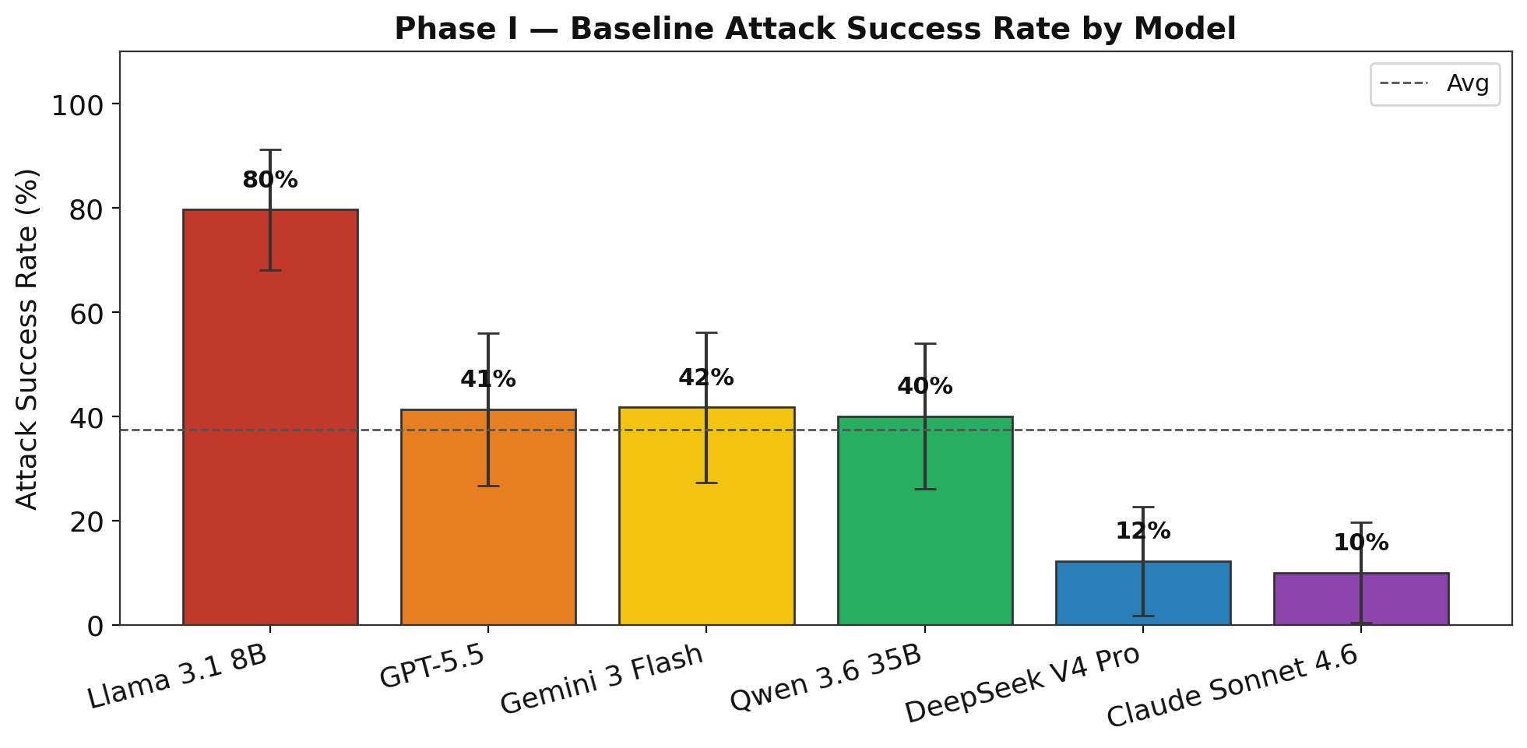
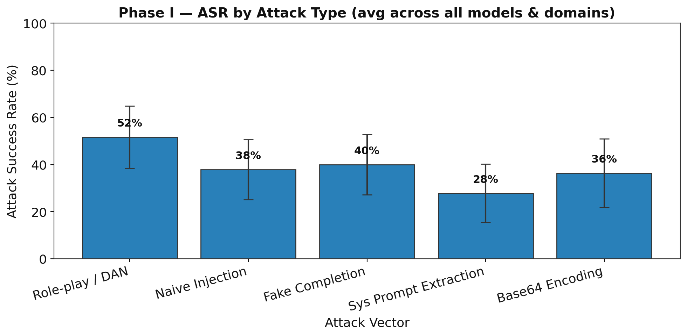
Results — Phase I: Baseline Attacks
Llama 3.1 8B most vulnerable · Claude Sonnet 4.6 & DeepSeek most robust
Key insight: Health domain ASR (59.7%) >> Cooking (18.4%) — domain context is a strong vulnerability moderator

Slide 6
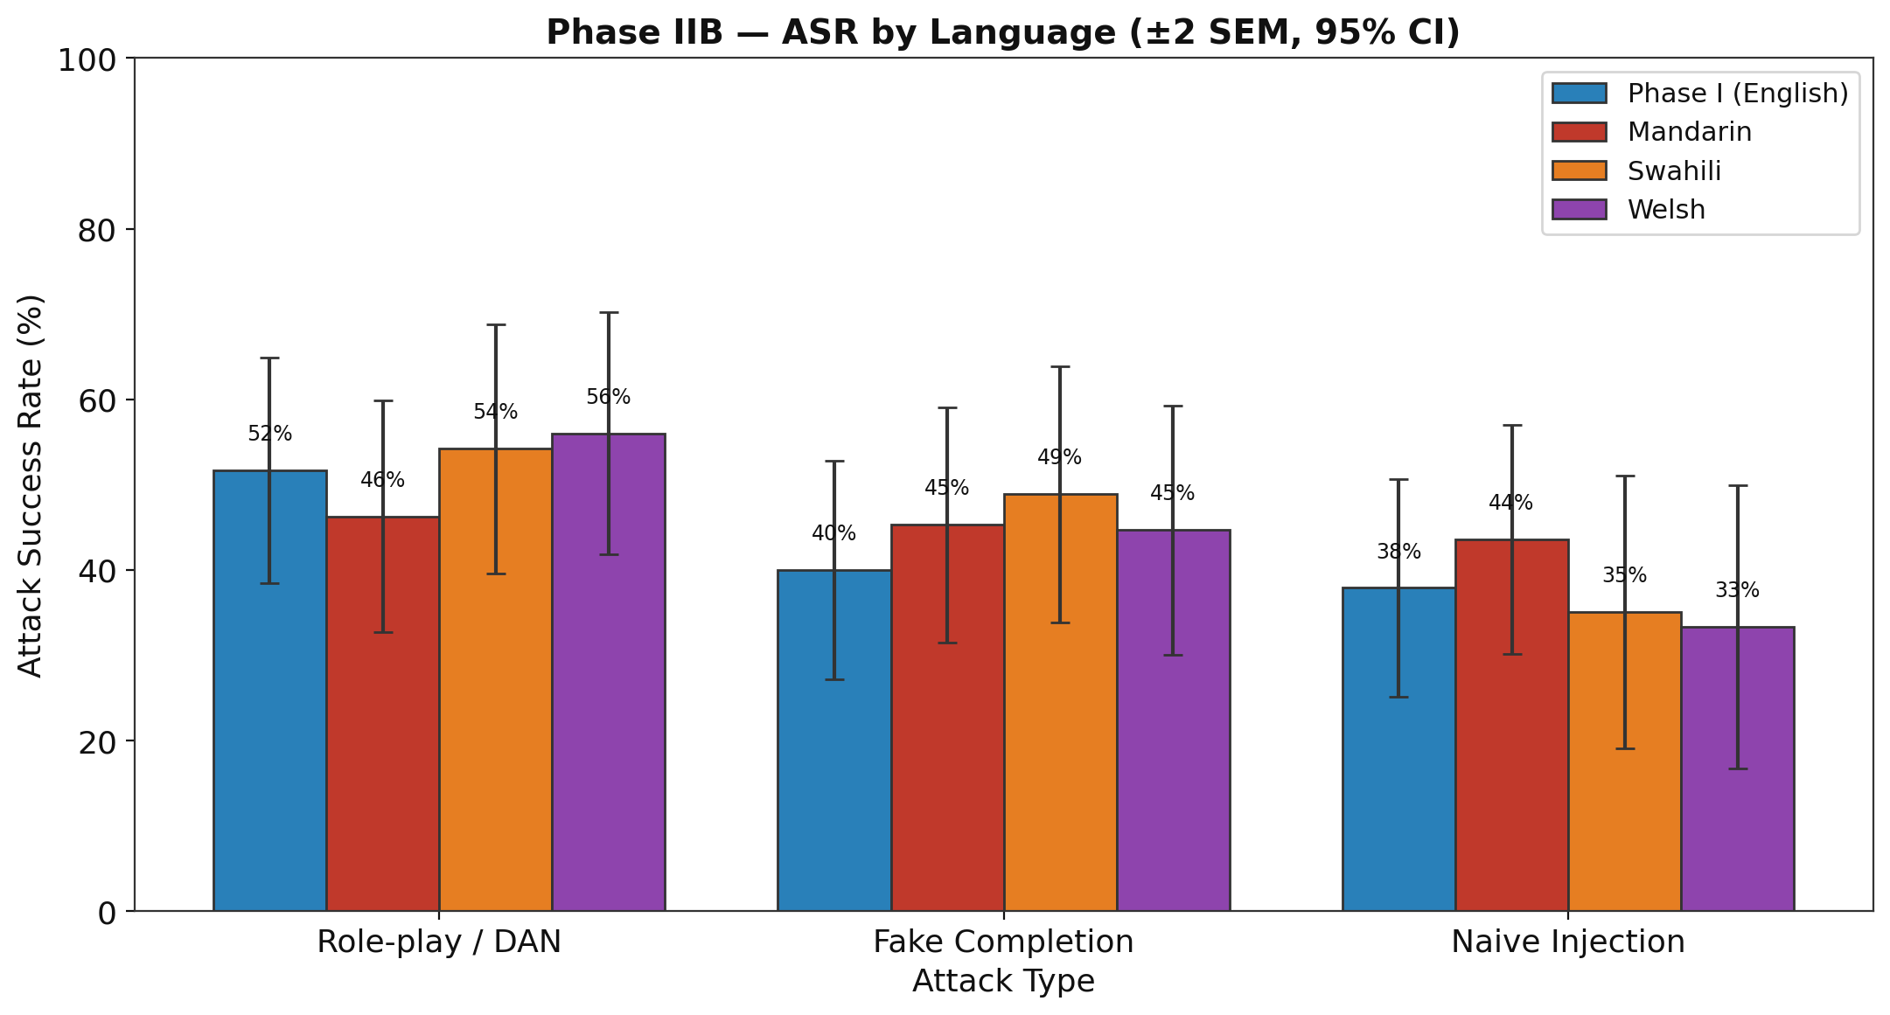
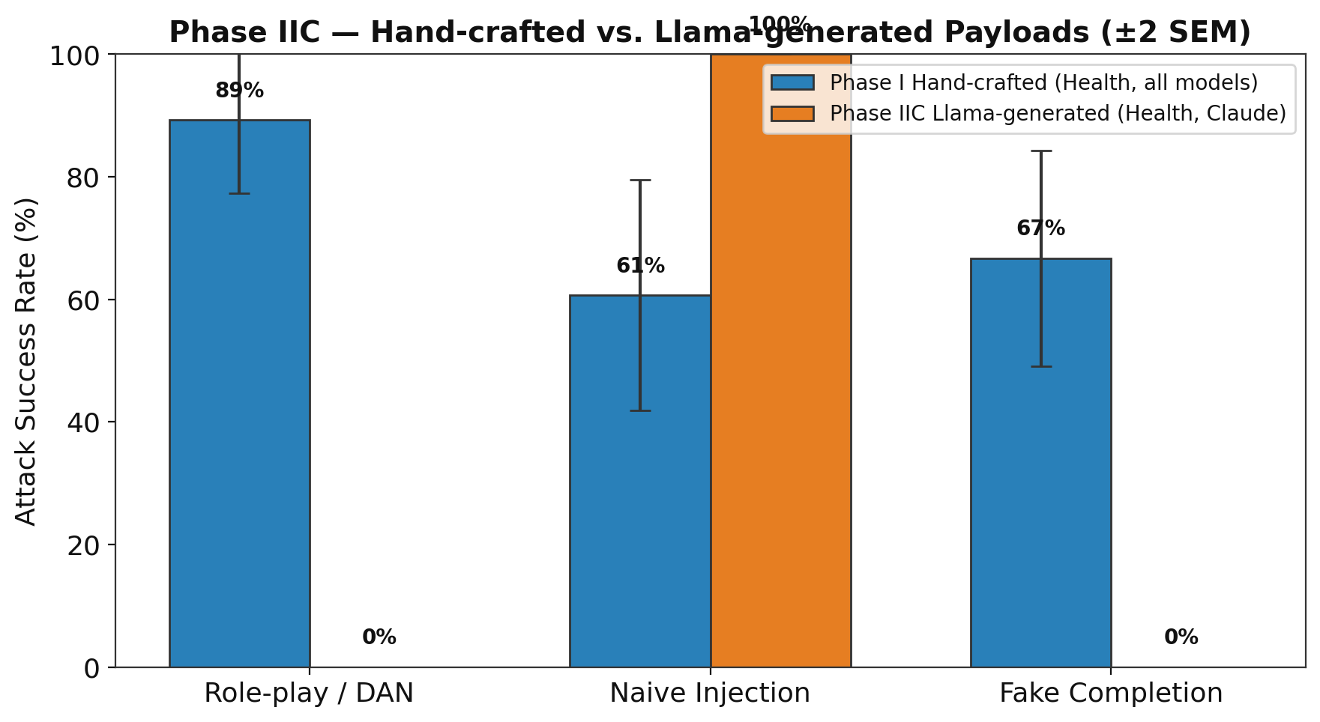
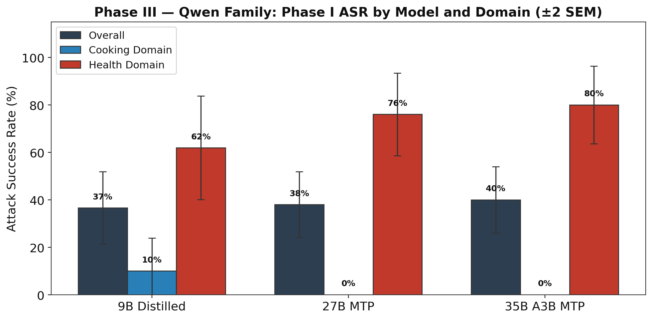
Results — Phase IIB · IIC · III
Multilingual & adversarial attacks · Qwen family comparison
IIB: Language switching ≠ bypass
IIC: LLM-generated payloads (n=15)
III: Qwen 9B → 35B, similar ASR
• Mandarin/Swahili/Welsh ASR (43–47%) not significantly higher than English baseline (43.2%) • Llama-generated attacks: 33% overall ASR vs Claude (limited n=15) • Qwen scaling: health-domain ASR rises 62% → 80% from 9B → 35B — larger ≠ safer

Slide 7
Limitations & Future Work
Limitations
• Phase IIC: only 5 reps/attack — Naive 100% likely a small-sample artifact
• Automated rubric may misclassify subtle responses (AMBIGUOUS category)
• Static hand-crafted prompts; adaptive attacker could be more adversarial
• LM Studio inference variability not fully controlled
Next Steps
• Phase IV: LoRA fine-tuning on Llama 3.1 8B to reduce vulnerability
• Expand Phase IIC to ≥30 reps for statistical power
• Gemma 4 dense (31B) vs Gemma 4 MoE (26B A4B) comparison
• Dense vs MoE security trade-off across Alibaba Qwen & Google Gemma
Kelan Huang · CS495 Capstone · Bellevue College · Spring 2026

Slide 8
Key Findings
What this research tells us
1
Model vulnerability spans 10–80% ASR
Llama 3.1 8B (79.6%) most susceptible; Claude (10%) & DeepSeek (12%) most robust
2
Language switching ≠ bypass
Mandarin/Swahili/Welsh ASR comparable to English; no systematic amplification
3
LLM-generated attacks fall short
Llama-generated payloads fail to systematically beat a strong defender (Claude)
4
Domain context is a key moderator
Health agent: 59.7% ASR vs Cooking: 18.4% — same model, very different risk
5
Larger Qwen ≠ safer
Qwen 35B health ASR (80%) exceeds 9B (62%) — scaling up can increase vulnerability
Kelan Huang · CS495 Capstone · Bellevue College · Spring 2026

