Slide 1
Kelsey Cameron
Create your dreams, and never stop moving
forward!

Slide 2
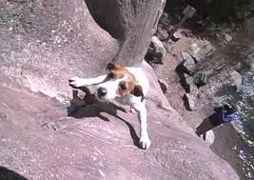

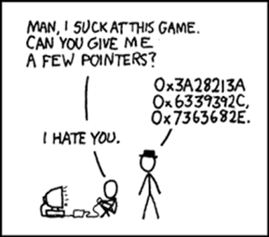
Kelsey Cameron
University of Central Florida (UCF!)
I will graduate December of 2017
Graduated from Oviedo High School in 2014
What I’m like:
I love to program and create team projects in Robotics.
I love to Rock Climb, and I am belay certified at the UCF gym.
Piano is also one of my greatest passions. Making my songs remind of making programming algorithms.
I strive to become a Systems Engineer one day where I will work in an integrated environment, and understand how to take an idea and turn it into a product that will change the world.
Life Goal: “I aspire to be a successful engineer and entrepreneur, and make as many people in the world happy as I can, because I desire it.”

Slide 3
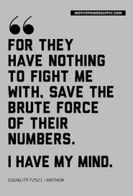
Story time
People will tell you every single day that what you dream about can’t be done, that your desires can’t be fulfilled, that you won’t make it in this competitive world. People will tell you that you’re not making the right decision, and they won’t believe a seven year old talking about how they will someday change the world with their inventions. People will tell you anything to get you to believe that your potential is limited in essence, that there are certain restrictions, and barriers, that no one can pass. Prove them wrong.
Prove to them that human potential is only as small as you believe it is, that truly, anything is possible, if you work hard enough. You are both your greatest limitation and your greatest release. Imagine what our world would be like if you could harness the strengths, the knowledge, and the energies of everyone in the entire world, to create a project that many of us can only dream about for right now. Your ideas matter, your thoughts are twice as powerful as you could ever know, and your humanity extends into the hearts and minds of everyone you help. Don’t let the ideas die. Change the world now, because tomorrow will always be one day too late.

Slide 4
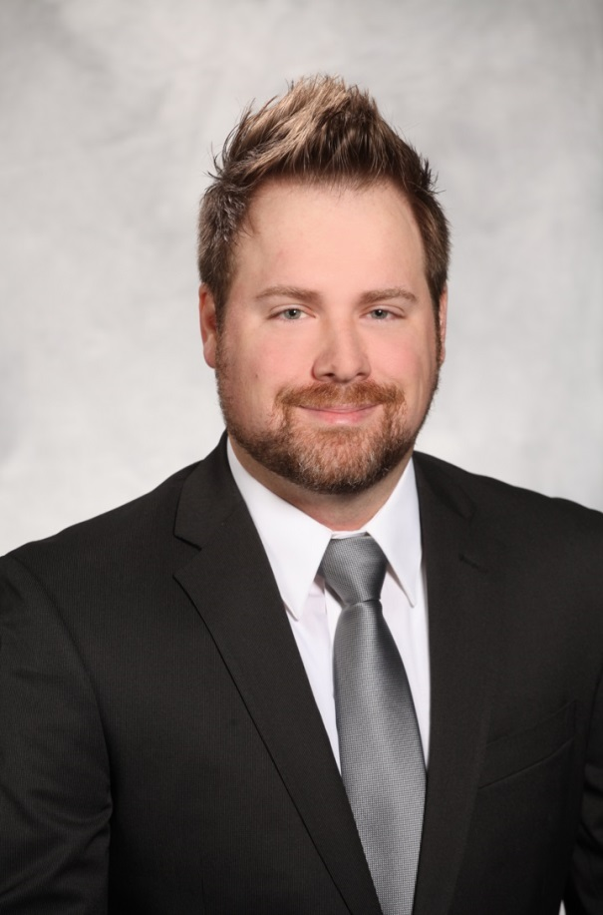
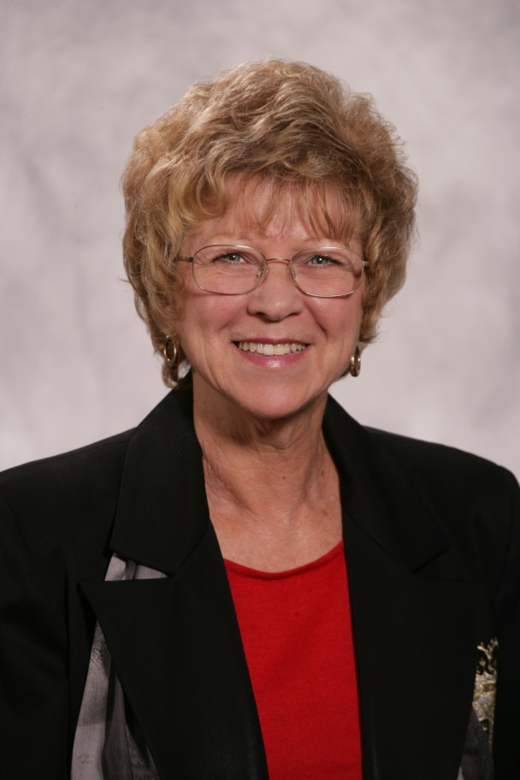
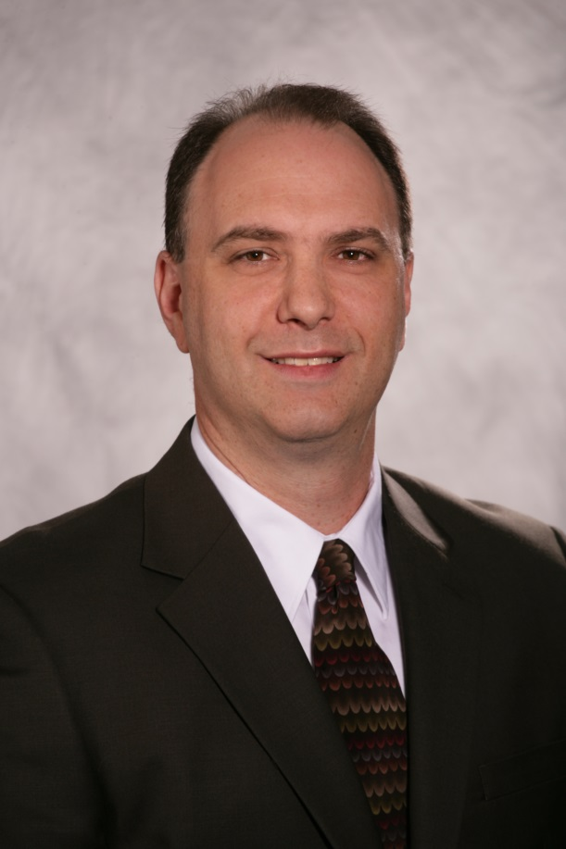
The joys of helping everyone with everything
Throughout my internship with Northrop Grumman, I’ve had the opportunity to work with many different sectors in many different projects. I may be a computer engineer, but I’ve gained so much more from this experience.
And look how happy they are. You can tell they’re eager to help. Irene Williams – the first excited and happy face you will see if you walk into the IT Sector (the sector that I am technically in).
That guy who does all the work that other people could be doing themselves.
The icon of IT, nicest lady you will ever meet, a great supporter.
That strange guy who thinks Starbucks is the root of all evil.

Slide 5
Learning how android works
I’m working on an Android app that sideloads (installs from a stored file, rather than from an app store) apps onto various work devices. I learned how to root Android phones, and I’m currently working with the Engineering sector to create an app that confirms the location of a bomb, to make sure detonating it won’t destroy critical buildings nearby.
I learned about how Android is integrated with XML, how to create a nice GUI, and how to create classes and objects.
I’d love to continue with this project, but sadly it is contract dependent, so we can’t do much else without a contract. (If you work here, you’ll see that a lottttt.)

Slide 6
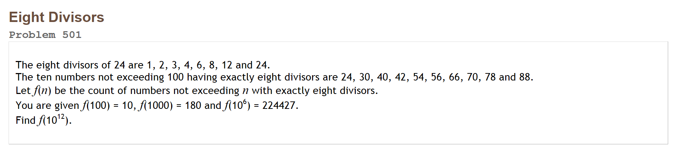
Project euler – PRONOunced oiler
I’ve completed about 25 programs on a website called Project Euler. This website is centered around understanding various math concepts that are continually present in our world, and this project has taught me how to combine my passions of math and programming into one successful endevour.
I’ve even caused one of my coworkers to spend all of his free time solving as many of these math puzzles as he can, simply from the satisfaction of finding that correct answer!
Yes, it is hard. It’s worth it although the highest I’ve gotten to was 92, so the one below makes almost no sense.

Slide 7
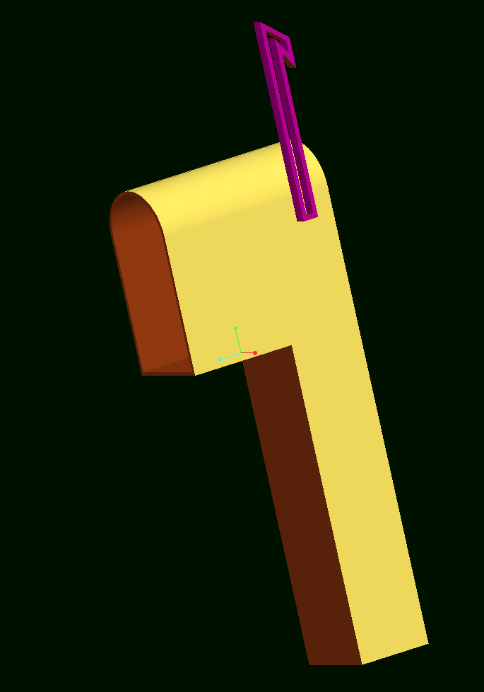
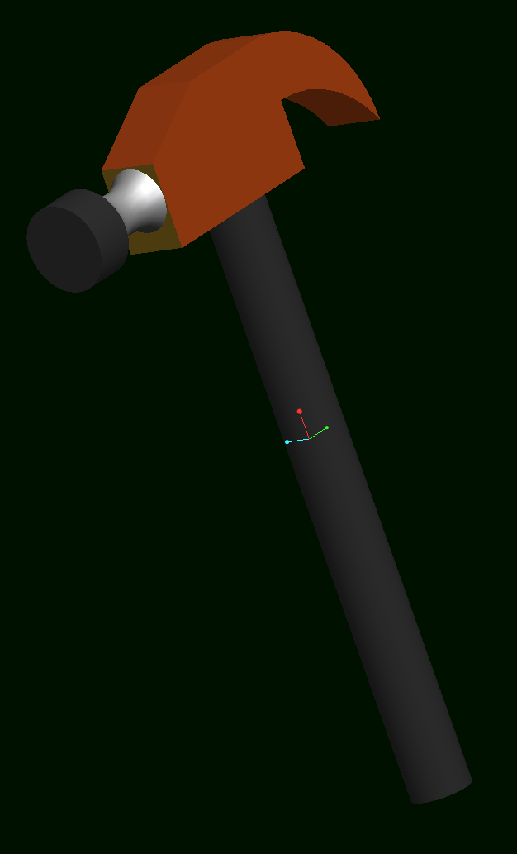
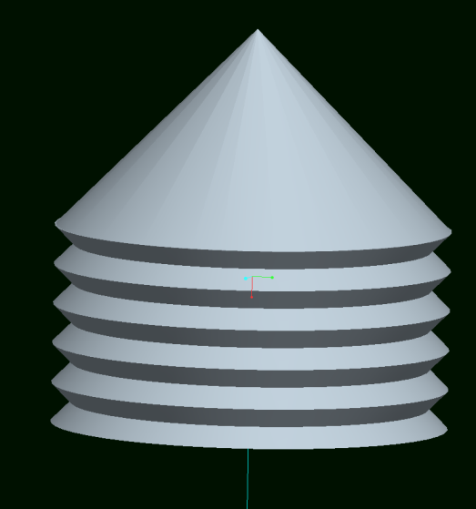
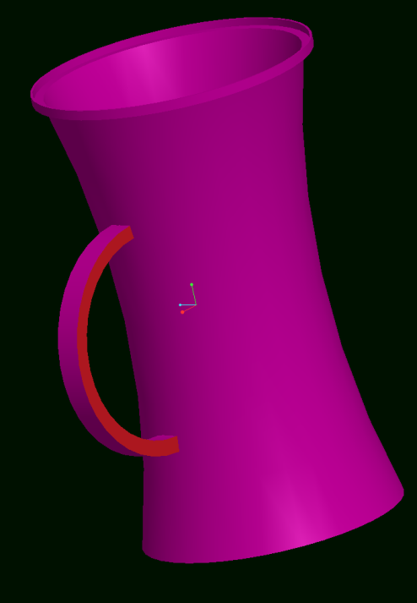
Pro engineer wildfire 5
I learned how to CAD various designs in Pro Engineer Wildfire 5, since one of the very kind Mechanical Engineering Interns was willing to teach me. This interest in CAD paved the way to explore how 3-D printers work, and motivated me to work with a different intern to configure the software for a mini printer that I was luckily allowed to use at my desk. This useful skill created another opportunity for me to do some part time work with CAD next semester with one of my parent’s friends. It just goes to show, that opportunity creates opportunity.

Slide 8

Reports……
Yes, they are reports. No one really likes to do them.
But sometimes by doing things that you already know how to do, your mind is able to harness that time to focus on finding more opportunies.
At Northrop, I learned how to double sort issue notes into an excel spreadsheet, and how to test each report to see if it works in Internet Explorer 11. (The main browser we use here, for some weird reason).
And I compiled all the data I found about Crystal Reports into Excel, and supported the IT Team from their migration from Internet Explorer 10!

Slide 9
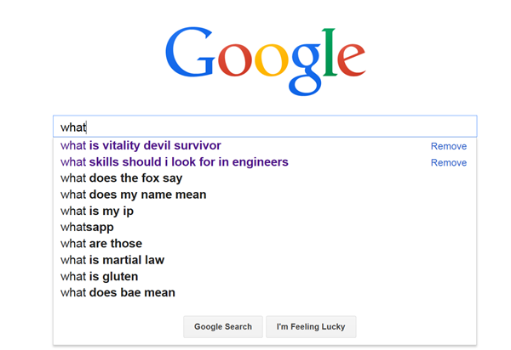
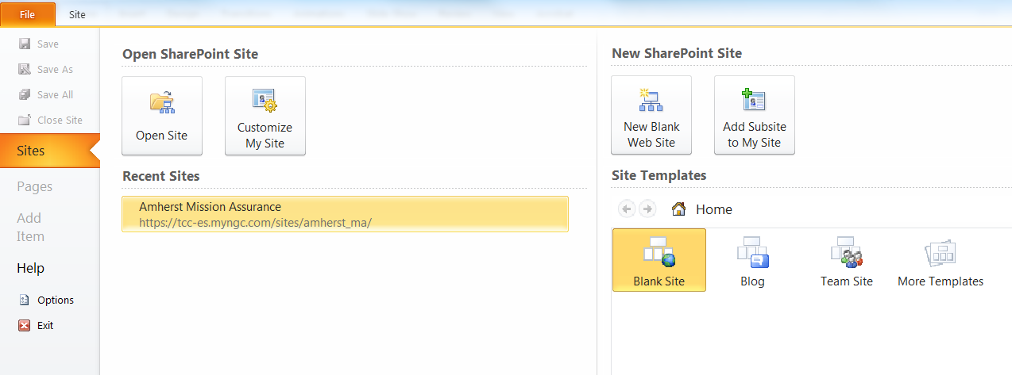
Sharepoint designer
Sharepoint Designer, Sharepoint Designer, Sharepoint Designer. Wow, this seems to be a popular program in this company.
I learned how to create filters, add parameters, and make connections in a web server, as well as extracting SQL from each web page.
For those of you who have absolutely no idea what I just said, it means that when you access the webpage and type something in right here, these connections bring up the results. It’s like a search engine.

Slide 10
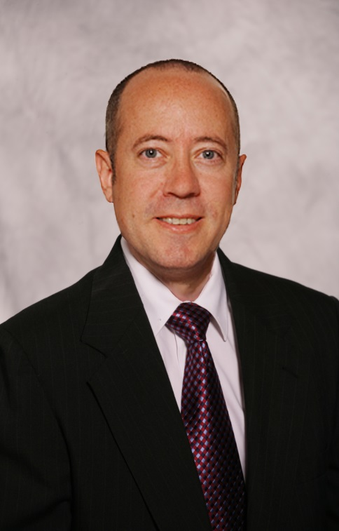
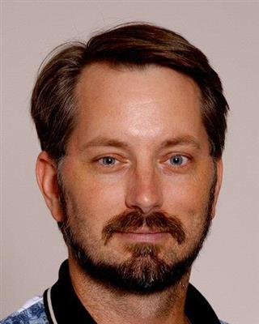
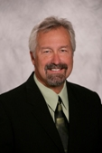
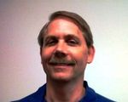
Who I’d like to thank
Dave Howard
Scott Krywick
Steve Swederski
Scott C. Smith
Dave Howard – the Programming Genius. Capable of completing up to 100 programming problems in one glorious weekend.
My Android Mentor: Yes, there actually are that many Scotts. But seriously, this guy knows a lot about Android.
My Other Boss ☺ I see him every day and he amazes us all with his humor and remarkable ability to make everyone happy.
My Boss ☺ True story though, this is the first time I’ve seen his face. We’ve only spoken over the phone, and yet he is the reason I have this job.
WE are Northrop Grumman.

