Slide 1
PASSWORD BYPASS ON WINDOWS USING UTILITY MANAGER
Local Account Password Recovery via Offline System Access
Presented by:
NWAIGWE KELECHI PETER
Course:
Security +
Instructor:
MR DANIEL
Date:
September 2026

Slide 2
INTRODUCTION7 & OBJECTIVE
Introduction
Utilman.exe, also knows as Utility Manager, is a Window system utility that provides accessibility options from the sign in screen.
This project looks at how access to Windows system file from outside the normal login process can affect local account security.
Objective
Understand what utilman.exe does.
Demonstrate the effect of modifying the utility.
Show how offline system access can affect the normal authentication process

Slide 3
UNDERSTANDING UTILMAN.EXE
What is Utilman.exe?
Utilman.exe is the window Utility Manager.
It provides accessibility features from the sign in screen.
It can be accessed before the user enters their password.
This make it an important part of the pre login environment.
Security Point
The project focuses on what happen when someone has offline access to the window system file

Slide 4
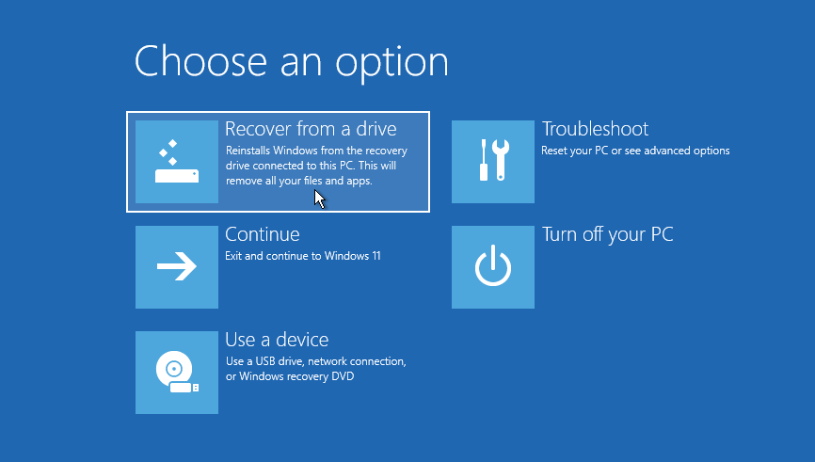
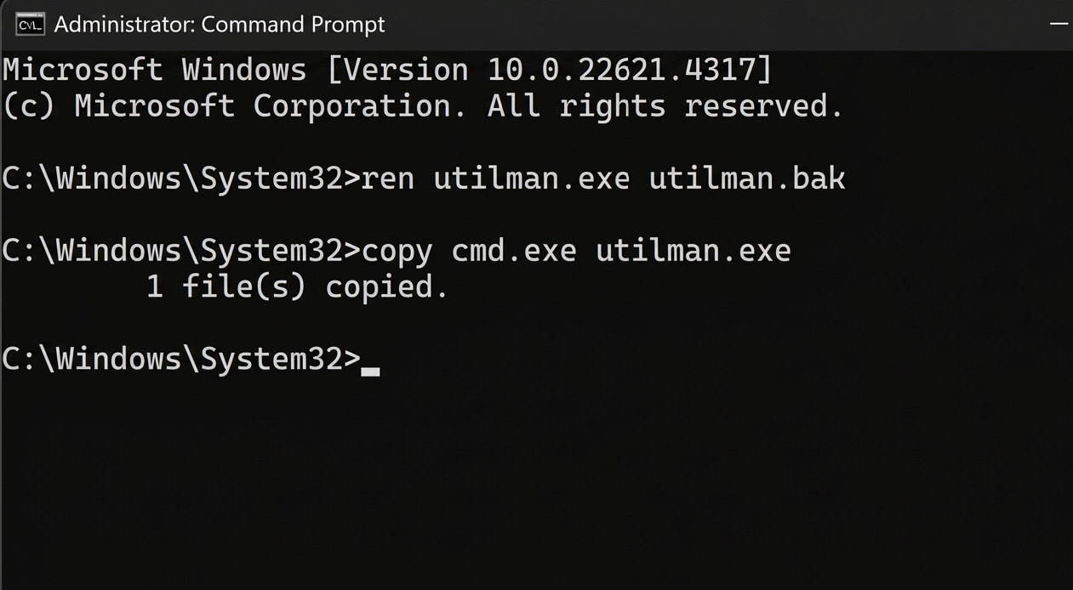
PROOF OF CONCEPT
Proof of Concept: Recovery & System32
Step 1- Accessing Recovery Environment
The computer is started in the Windows Recovery Environment where command prompt can be accessed without entering the normal windows desktop.
Step 2- Locating System32
The Windows installation is located and system32 folder is accessed. This is where the Utilman.exe system file is located.

Slide 5
PROOF OF CONCEPT
Proof of concept: Utilman Modification
Step 3 – Modifying Utilman.exe
The original Utilman.exe file is renamed and kept as a backup
A copy of cmd.exe is placed in its position.
The computer is then restarted.
This changes what is launched when the Accessibility icon is selected at the Windows sign in screen.

Slide 6
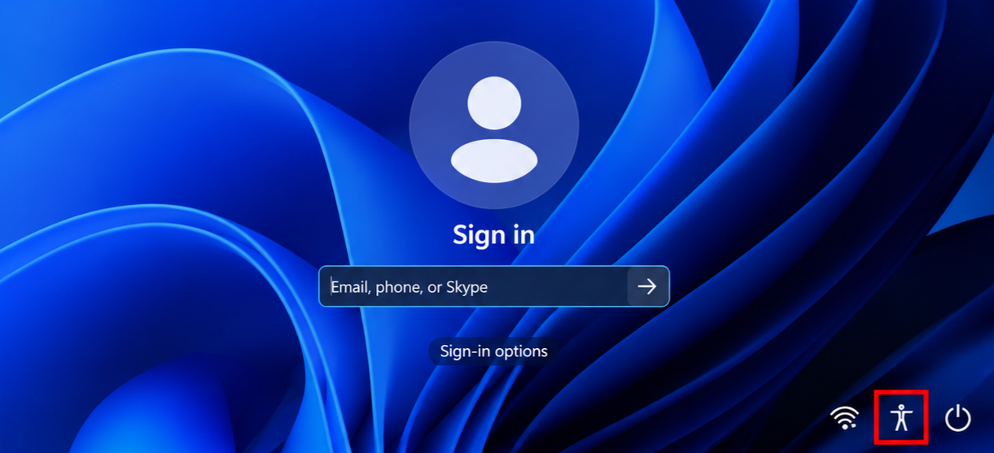
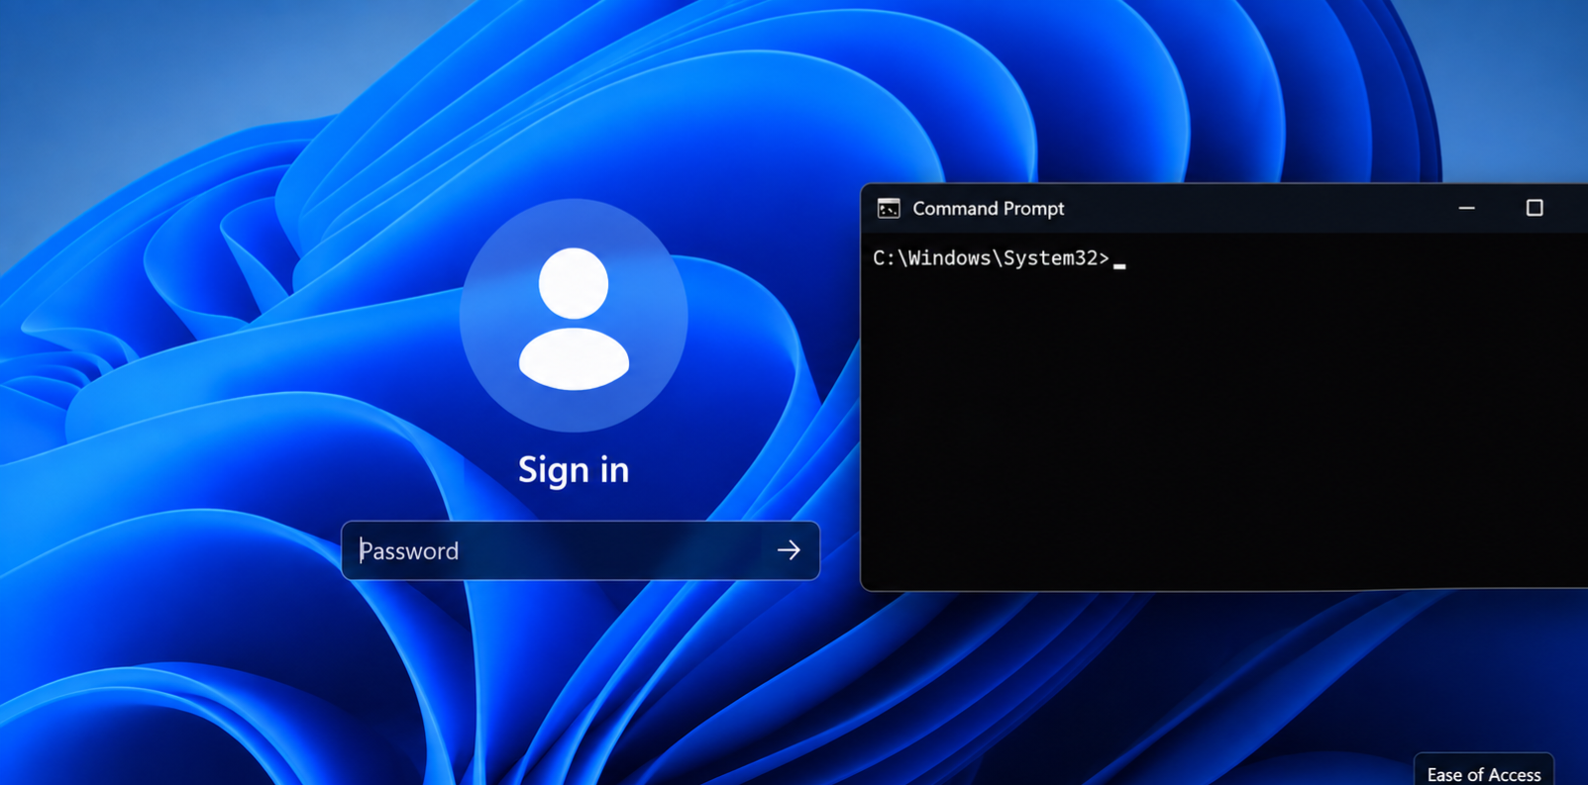
PROOF OF CONCEPT: LOGIN SCREEN
Step 4- Testing the change
After restarting :
Windows returns to the sign in screen.
The Accessibility icon is selected.
Instead of normal utility manager, a Command Prompt appears.
This shows the effect of changing a system utility that can be lunched before normal authentication.

Slide 7
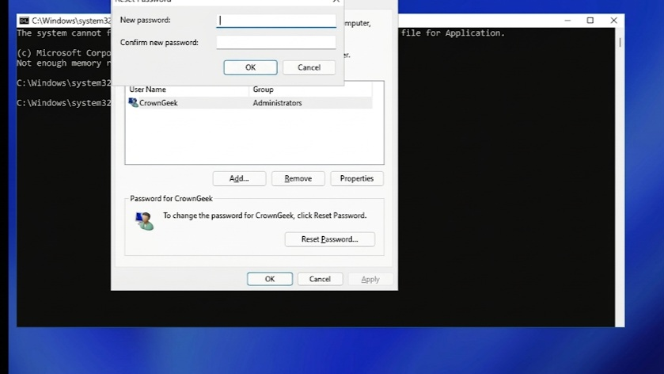
PROOF OF CONCEPT: ACCOUNT MANAGEMENT
Step 5 – Local Account Management
From the command prompt environment, the Windows account-management tool is opened.
The available local account is selected
The password is changed for the controlled test account
The computer is restarted.
The new password is tested.
The demonstration shows that the original password does not have to be cracked to recover access to the test account

Slide 8
RESULT & CONCLUSION
Result
The proof of concept successfully demonstrated how offline access to Windows system file can affect the normal login process.
Conclusion
Utilman.exe is a legitimate Windows accessibility tool, but the demonstration showed how modifying a trusted system can create a path around normal local authentication.

