Slide 1

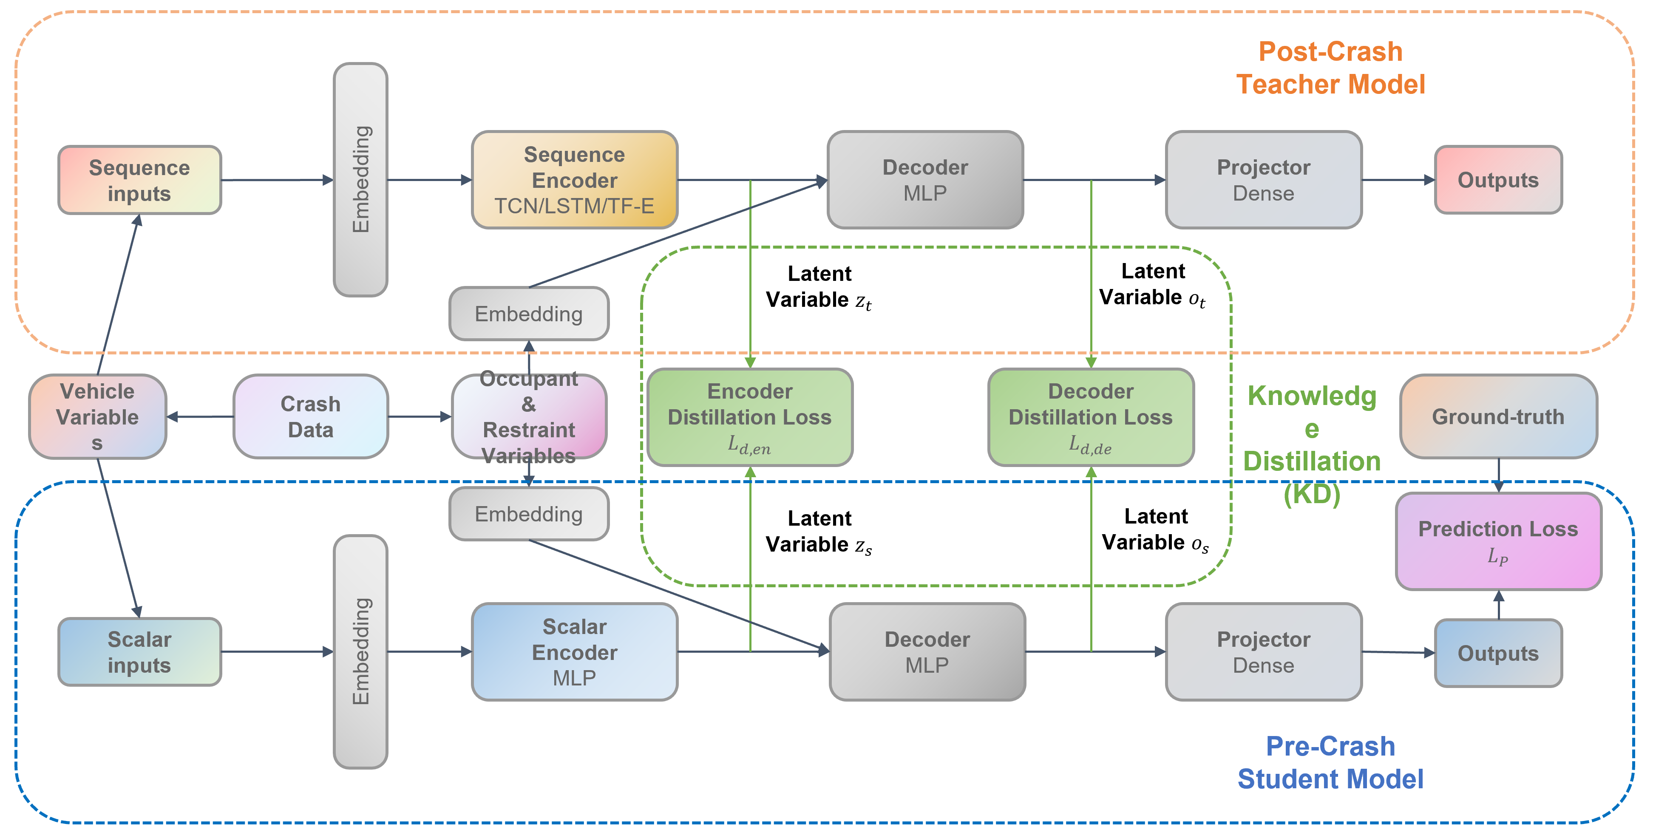
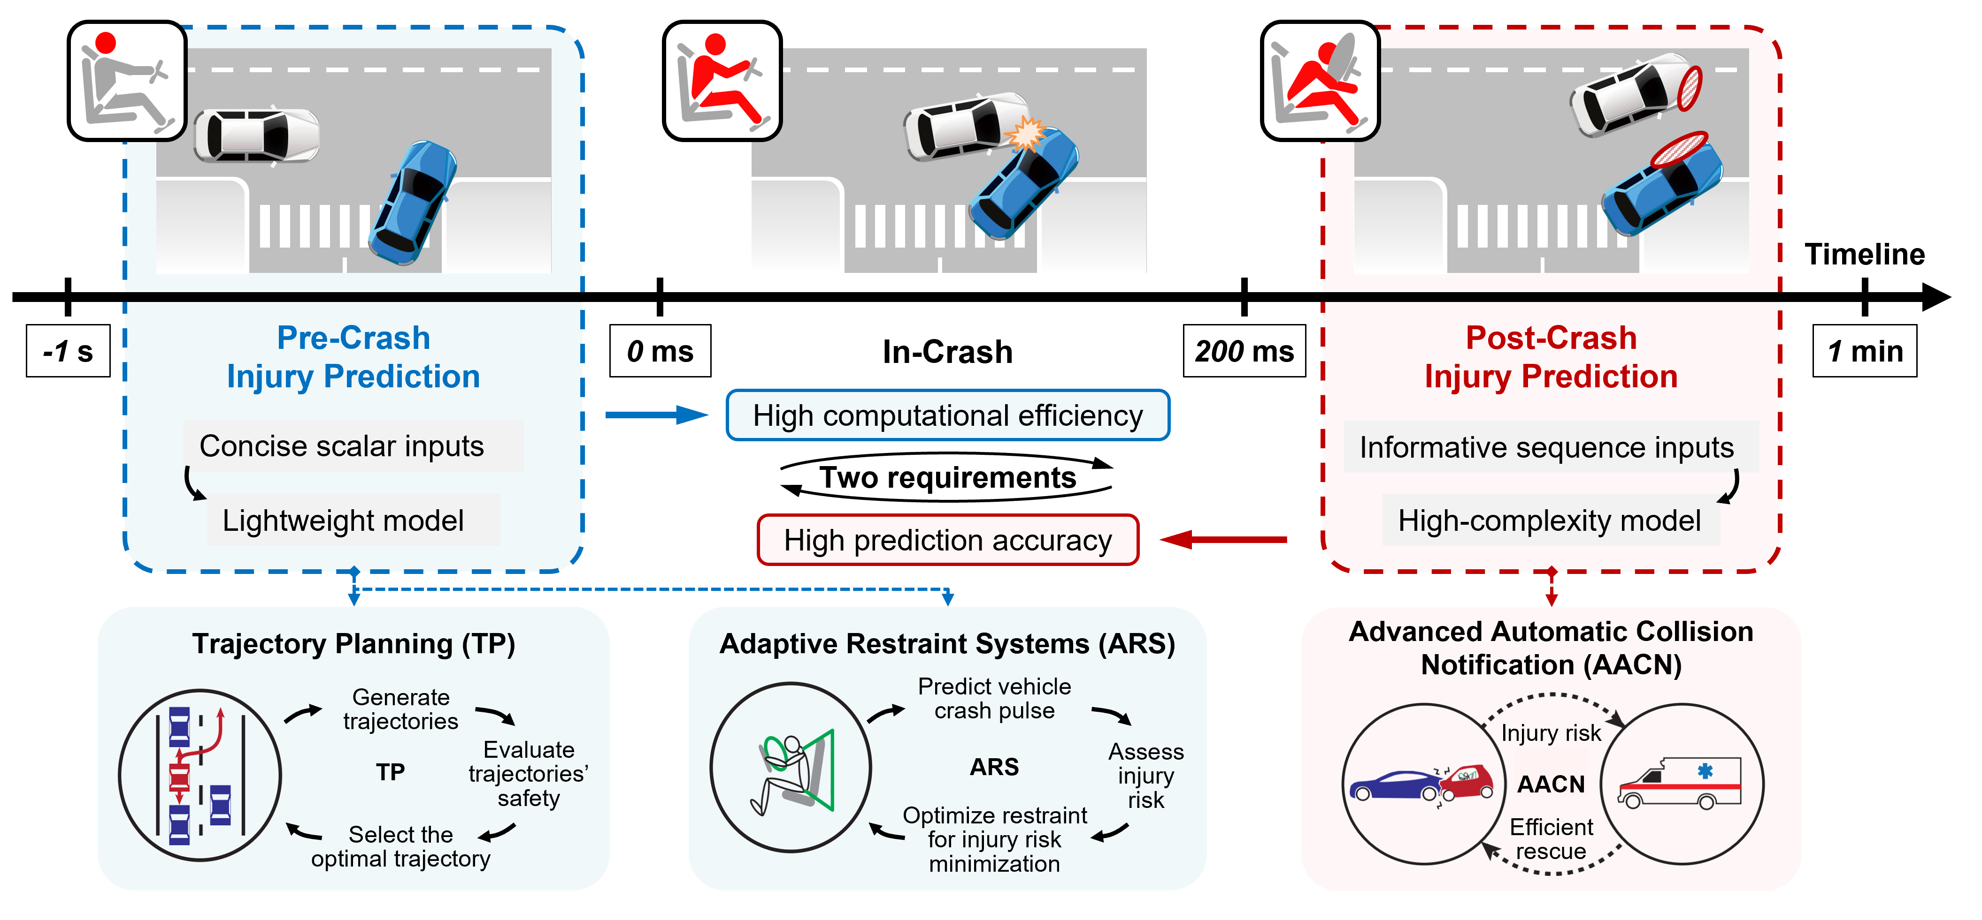
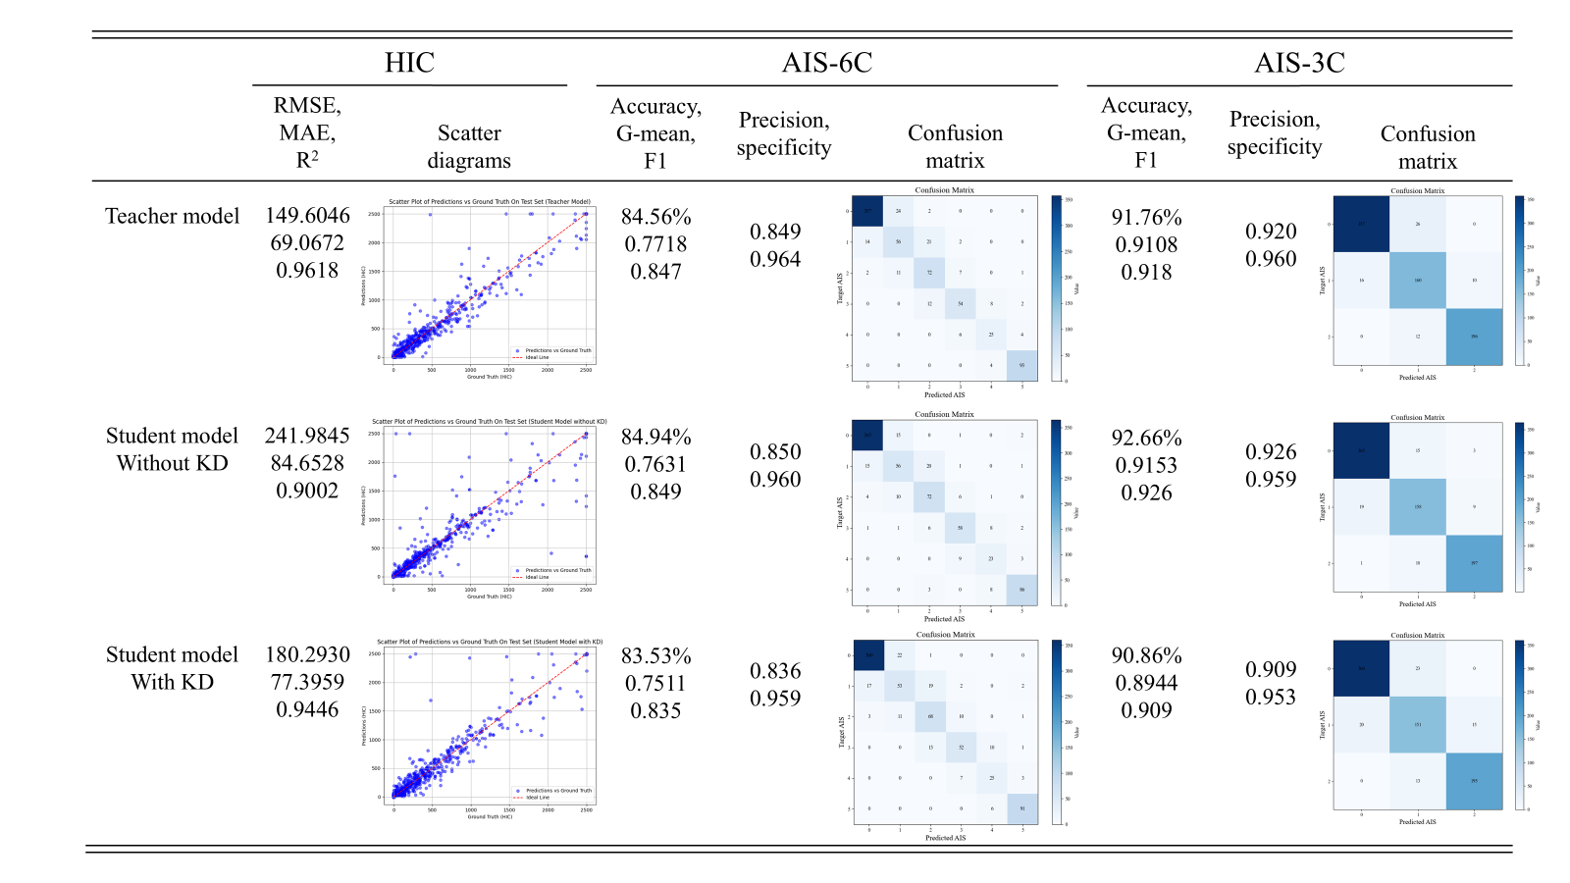

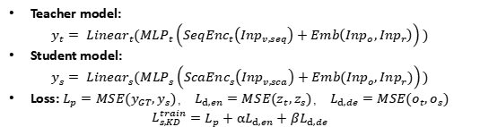
PRECISE: A Pre-Crash Injury Severity Estimation Model
Tsinghua University
Zijian He, Jiajie Shen, Yi Wang, Mingkun Zhang, Yiquan Zhao
Comparison of model prediction effect
Introduction
Method
Description of Main Experiment Results
Road traffic accidents cause millions of fatalities and injuries worldwide each year.
Intelligent vehicles offer new opportunities to reduce collision injuries.
However, the high computational cost of injury prediction models limits real-time application.
We propose PRECISE, a lightweight pre-crash injury severity estimation model that improves accuracy while maintaining efficiency through knowledge distillation.
KD-based Framework:
Teacher Model: Post-crash model using TCN, LSTM, or Transformer Encoder (TF-E) for detailed crash pulse data processing and high-accuracy injury prediction.
Student Model: Lightweight pre-crash model using Multilayer Perceptron (MLP) to process simplified vehicle data while learning from the teacher’s intermediate representations to improve prediction performance.
Dataset: 5777 rear-end collisions.
Accuracy: KD-guided student model achieved 83.5% AIS six-class accuracy, nearing the teacher model.
Efficiency: The prediction time is only about 26% of the teacher model's.
Analysis
Ablation Study: With the same model structure and inputs, adding KD reduces the student's RMSE by 25% , increase R² by 0.45.
Problem Mitigation: KD mitigates performance degradation in pre-crash model caused by insufficient input information through intermediate-layer supervision.
Efficiency Balance: KD balances accuracy and efficiency for real-time predictions.
Project value: Balances prediction accuracy with computational efficiency.
Showcases
Characteristics and application of pre-crash and post-crash occupant injury prediction
KD-based framework of lightweight pre-crash occupant injury prediction models
Motivation
Teacher model:
$$y_{t}= {Linear}_{t}({MLP}_{t}\left({SeqEnc}_{t}\left({Inp}_{v,seq}\right)+Emb\left({Inp}_{o},{Inp}_{r}\right)\right))$$
Student model:
$$y_{s}= {Linear}_{s}({MLP}_{s}\left({ScaEnc}_{s}\left({Inp}_{v,sca}\right)+Emb\left({Inp}_{o},{Inp}_{r}\right)\right))$$
Loss: $L_{p}=MSE(y_{GT},y_{s})$， $L_{d,en}=MSE(z_{t},z_{s})$， $L_{d,de}=MSE(o_{t},o_{s})$
$$L_{s,KD}^{train}=L_{p}+αL_{d,en}+βL_{d,de}$$
Use Knowledge Distillation (KD) to transfer knowledge from a post-crash model to a lightweight pre-crash injury prediction model.
Enhance prediction accuracy while ensuring computational efficiency.
Comparison of model prediction effect

