Slide 1

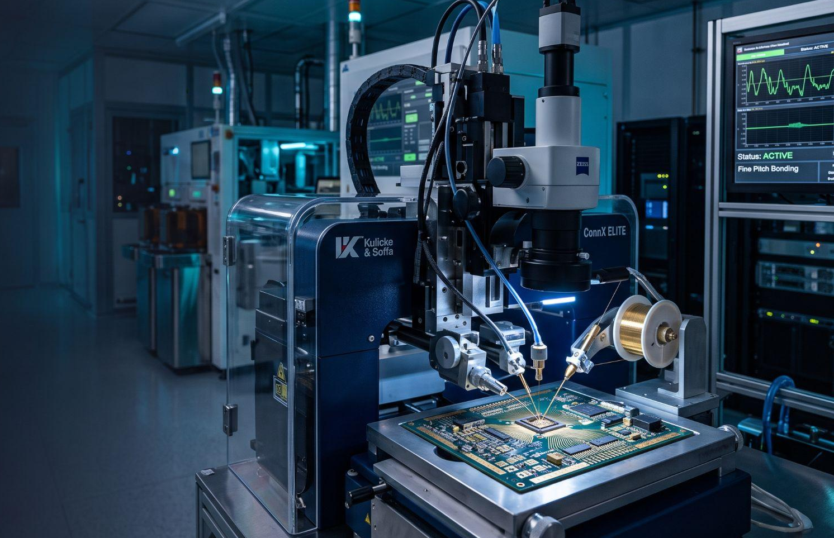






COMPANY PROFILE
CLM
Electronics Engineering
Services
Technical Solutions for Semiconductor & Manufacturing Industries
ESTABLISHED · JANUARY 10, 2023

Slide 2
CLM / 02
Company At A Glance
01
calendar_today
02
precision_manufacturing
03
engineering
04
verified
ESTABLISHED
INDUSTRY FOCUS
CORE FOCUS
SERVICE PHILOSOPHY
January 10, 2023
Semiconductor &
Manufacturing
Industries
Technical &
Engineering
Services
Immediate, Quality
& Reliable
Service
ABOUT CLM ELECTRONICS ENGINEERING SERVICES
CLM supports semiconductor and manufacturing operations with accountable engineering services, responsive technical support, and a commitment to dependable long-term customer relationships.

Slide 3
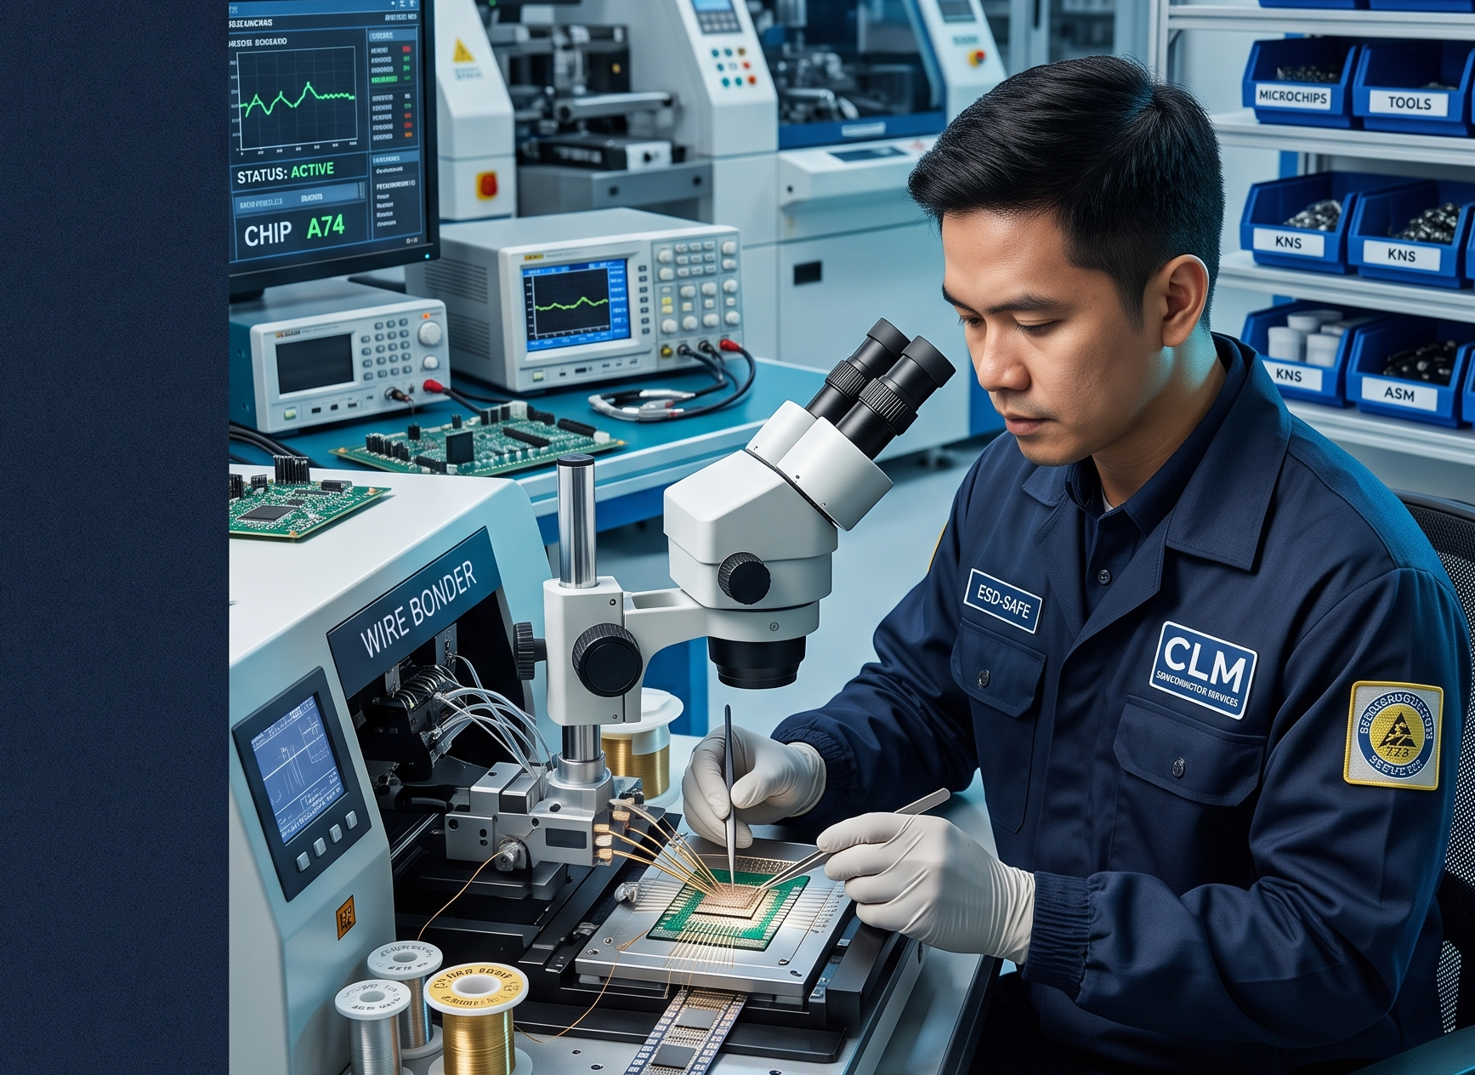
CLM / 03
Who CLM Is
Built around hands-on technical expertise.
Founded in 2023, CLM Electronics Engineering Services focuses on the practical needs of semiconductor and manufacturing equipment users. Our work brings together technical assessment, repair, maintenance, rebuild, process support, parts, and training.
build
Repair & Maintenance
assessment
Technical Assessment
settings_suggest
Rebuild & Process
school
Parts & Training
OUR POSITION
“Our position is simple: solve responsibly, support consistently, and earn long-term trust.”
SEMICONDUCTOR & MANUFACTURING EQUIPMENT SPECIALISTS

Slide 4

CLM / 04
Mission & Vision
track_changes
OUR MISSION
visibility
OUR VISION
“
To establish a total customer satisfaction through quality product support and services by providing a best and effective quality solution and accountable after sales/service support.”
“
We envision to be the one of the best supplier in term of sales and Technical support services known for its quality and in time services.”

Slide 5
CLM / 05
Technical Service Portfolio
build01
assessment02
published_with_changes03
verified04
Minor & Major Repair
Assessment & Technical Support
Preventive & Predictive Maintenance
Process Support & Qualification
tune05
settings_suggest06
extension07
school08
Machine Baselining & A1 Conditioning
Rebuild & Overhaul
Parts Replacement & Calibration
Technical Training

Slide 6
CLM / 06
Preventive Maintenance
update
13 WEEKS / QUARTERLY
Quarterly maintenance and condition checks
build_circle
26 WEEKS / SEMIANNUAL
Semiannual comprehensive maintenance
verified
52 WEEKS / ANNUAL
Annual deep inspection and major servicing
Maintenance schedules are customizable per equipment and customer requirements.

Slide 7
CLM / 07
Equipment Expertise
precision_manufacturing 01
memory 02
hardware 03
ASM Wire Bonders
KNS Wire Bonders
ASM Automatic Die Bonders
settings_input_component 04
content_cut 05
cable 06
ESEC Die Bonders
Dicing / SAW / Back Grinding
Aluminum Wedge Bonding
Detailed equipment models are covered through technical assessment and service consultation.

Slide 8

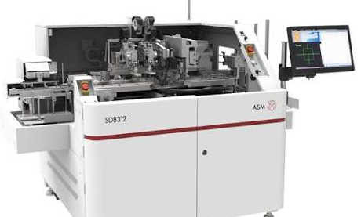
CLM / 08
Sub-Assembly Rebuild & Overhaul
Bond Head Assembly
High-precision bonding unit alignment & overhaul
01
X/Y Table Assembly
Motion axis calibration, lead screw & guide rebuild
02
Workholder Assembly
Clamping mechanism, thermal plate & sensor refurbishment
03
Precision rebuild work combines technical expertise, controlled assembly practices, functional checks, and quality-focused verification.

Slide 9

CLM / 09
Technical Training
LEVEL 5
engineering
Subassembly Rebuild /
Equipment Overhaul
Complete component tear-down, structural overhaul & system rebuild.
LEVEL 3
tune
Preventive Maintenance /
Calibration
Routine PM schedules, sensor calibration & fine tuning.
LEVEL 2
build
Setup /
Minor Repair
Equipment configuration, tooling changeover & line adjustments.
LEVEL 1
play_circle
Basic
Operation
Essential operator controls & foundational workflow.

Slide 10
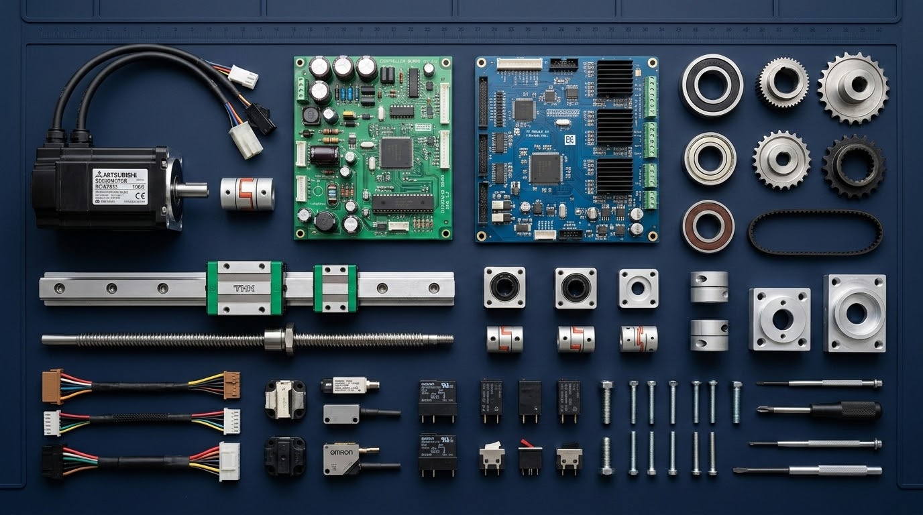
CLM / 10
Spare Parts & Components
developer_board BOARDS
Main boards • PR boards • CPU boards • Logic boards • Driver boards • I/O boards
settings_suggest MOTION
Servo drivers • Motors • Bond head parts • XY table parts
visibility VISION
Sensors • Vision components & optics
tune CONTROL
Power supplies • Control modules & system interfaces
SPARE PARTS • INSTALLATION • REPLACEMENT • CALIBRATION SUPPORT

Slide 11
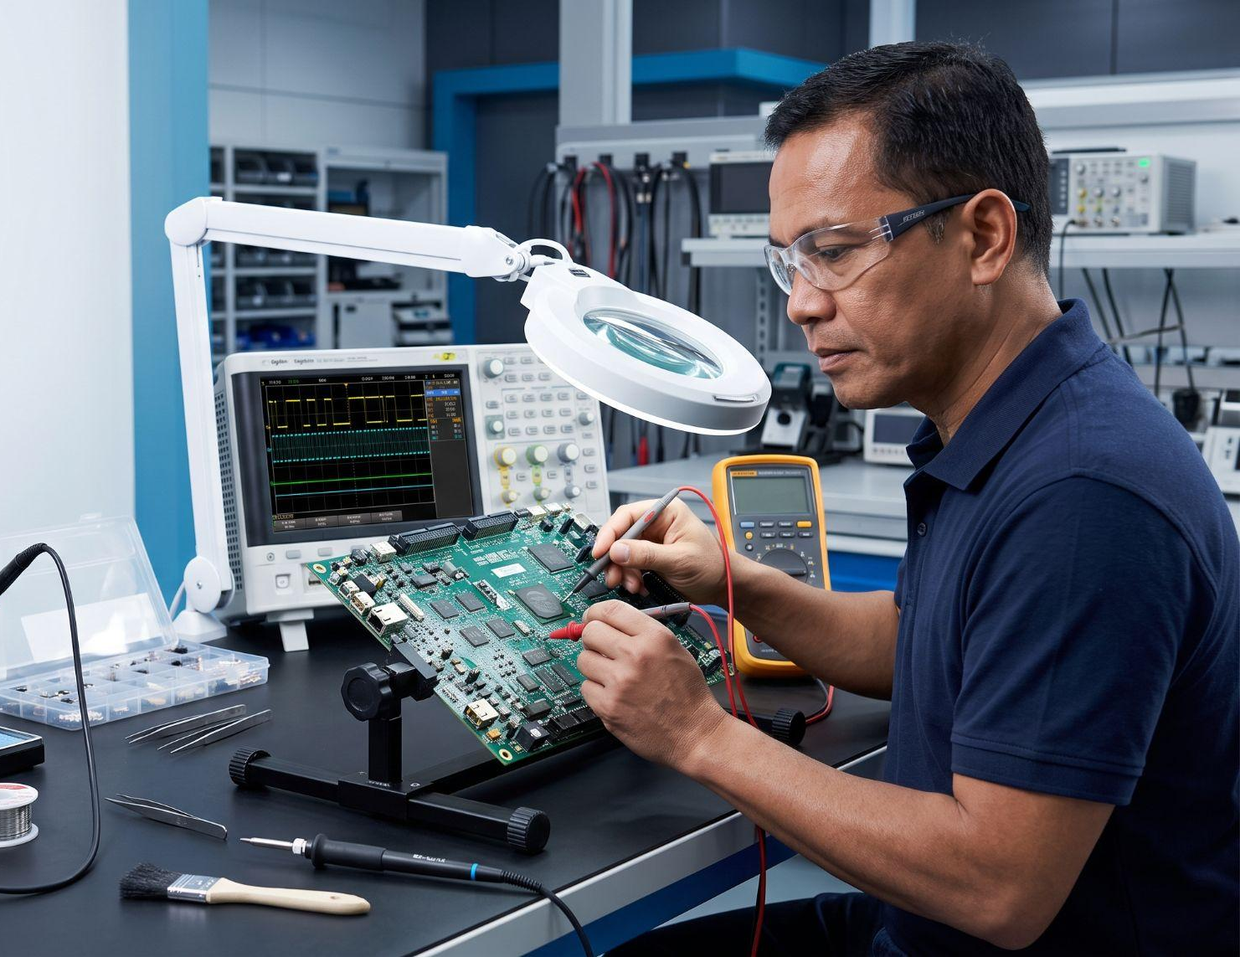
CLM / 11
Board Repair Services
Precision diagnosis. Accountable repair.
memory CONTROL & PROCESSING BOARDS
Main Boards • CPU Boards • Logic Boards • HiPEC Boards
power POWER & MOTION DRIVERS
Power Supplies • Driver Boards • Servo Driver Boards • Bond Head Driver Boards
alt_route SIGNAL & INTERFACE MODULES
Motor Interface Boards • Motor I/O Boards • I/O Boards • PRS Boards
TECHNICAL PRECISION & QUALITY-FOCUSED VERIFICATION GUIDE EVERY BOARD REPAIR ENGAGEMENT

Slide 12
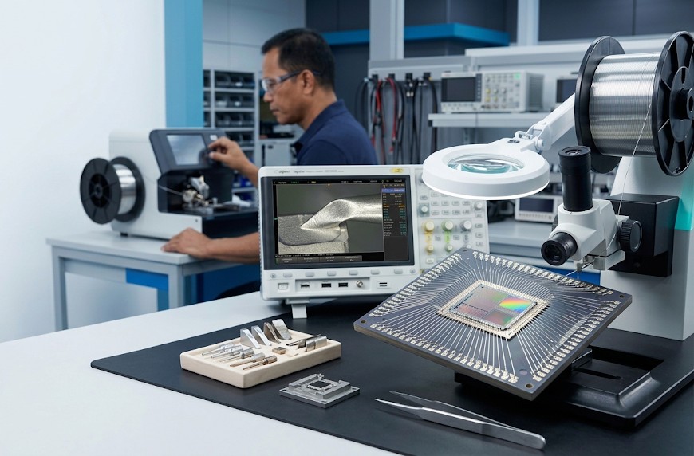
CLM / 12
Aluminum Wedge Bonding Consumables
ORTHODYNE ELECTRONICS
Compatible Consumables
build Bondtool content_cut Wirecutter linear_scale Wireguide
FNK / DELVO TECHNOLOGY
Compatible Consumables
build Bondtool content_cut Wirecutter linear_scale Wireguide
COMPATIBILITY AND AVAILABILITY DEPEND ON EQUIPMENT AND PROCESS REQUIREMENTS

Slide 13
CLM / 13
After-Sales & Service Support
headset_mic TECHNICAL ASSISTANCE
Responsive expert help and remote diagnostic support for quick issue resolution.
extension SPARE PARTS INSTALLATION
Original component supply, precise fitment, and verified system calibration.
autorenew
CONTINUOUS SERVICE RELATIONSHIP
A dedicated, end-to-end partnership delivering complete lifecycle care and reliable technical excellence.
school TECHNICAL TRAINING
Comprehensive engineer and operator training programs to maximize internal capability.
build MAINTENANCE SUPPORT
Proactive health checks and scheduled preventive maintenance routines.
published_with_changes ONGOING EQUIPMENT SUPPORT
Sustained machine performance monitoring, upgrades, and operational optimization.
home_repair_service REPAIR SUPPORT
Precision component-level diagnosis, board repair, and rapid turnaround.
verified WARRANTY / SERVICE SUPPORT
Assured quality assurance and structured warranty coverage.

Slide 14
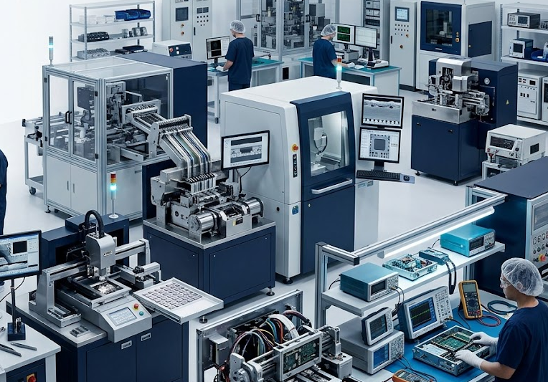
CLM / 14
Broader Equipment Support
FLEXIBLE BY CAPABILITY
“CLM also provides services for other brands based on available technical capabilities, resources, equipment requirements, and customer needs.”
psychology TECHNICAL CAPABILITIES
Assessed against engineering scope & toolsets.
inventory_2 AVAILABLE RESOURCES
Allocated expertise and support capacity.
tune EQUIPMENT REQUIREMENTS
Tailored machine & process alignment.
handshake CUSTOMER NEEDS
Customized engagement & SLAs.
EVERY ENGAGEMENT BEGINS WITH A PRACTICAL REVIEW OF FIT, SCOPE, AND SUPPORTABILITY

Slide 15
CLM / 15
Why Work With CLM
workspace_premium01
QUALITY SERVICE
Delivering rigorous engineering standards and uncompromised precision in every engagement.
headset_mic02
RELIABLE TECHNICAL SUPPORT
Responsive expert assistance and swift troubleshooting to minimize system downtime.
precision_manufacturing03
INDUSTRY-FOCUSED EXPERTISE
Deep domain knowledge tailored for semiconductor and electronics manufacturing environments.
published_with_changes04
AFTER-SALES SUPPORT
Comprehensive maintenance, spare parts, and warranty coverage post-installation.
autorenew05
EQUIPMENT LIFECYCLE SUPPORT
End-to-end machinery optimization, upgrades, and scheduled preventive care.
handshake06
LONG-TERM CUSTOMER RELATIONSHIPS
Building trusted, ongoing partnerships dedicated to continuous technical success.

Slide 16
CLM / 16
CLM Service Lifecycle
01
02
03
04
05
06
analytics
build
tune
verified
school
support_agent
Assessment
Initial evaluation & technical scoping
Repair /
Maintenance
Restoration & preventive care
Parts &
Calibration
Precision alignment & spares
Process Support/
Qualification
System verification & fit
Training
Empowering technical teams
After-Sales
Support
Sustained long-term partnership
A connected technical support path—from first assessment through sustained equipment support.

Slide 17
CLM / 17
Let’s Build a Reliable Technical Partnership
location_on ADDRESS
#9 Bayabas St. Mutual Homes Putatan,
Muntinlupa City
MAIN SERVICE AREAS
precision_manufacturing
Semiconductor & Manufacturing
build
Equipment Maintenance & Repair
inventory_2
Spare Parts & Components
memory
Board Repair
contact_phone CONTACT
09979269559 · 88384882
er.canlas23@gmail.com
school
Technical Training
support_agent
After-Sales Support

Slide 18
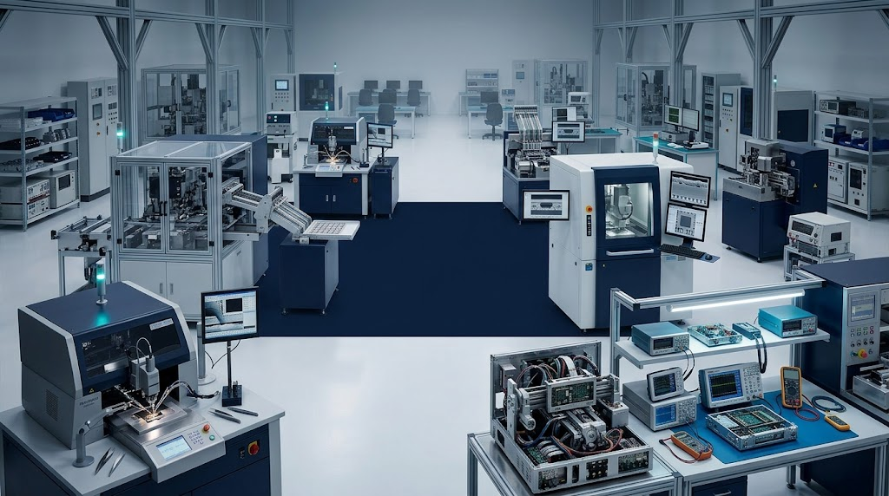
CLM
SEMICONDUCTOR & MANUFACTURING TECHNICAL SERVICES
CLM Electronics
Engineering Services
analytics TECHNICAL SOLUTIONS
Precision engineering & specialized semiconductor toolsets.
headset_mic RELIABLE SUPPORT
Responsive expert troubleshooting to minimize critical downtime.
handshake LONG-TERM PARTNERSHIPS
Building trusted, ongoing relationships across equipment lifecycles.
High-Precision Engineering & Equipment Technical Services

