Slide 1
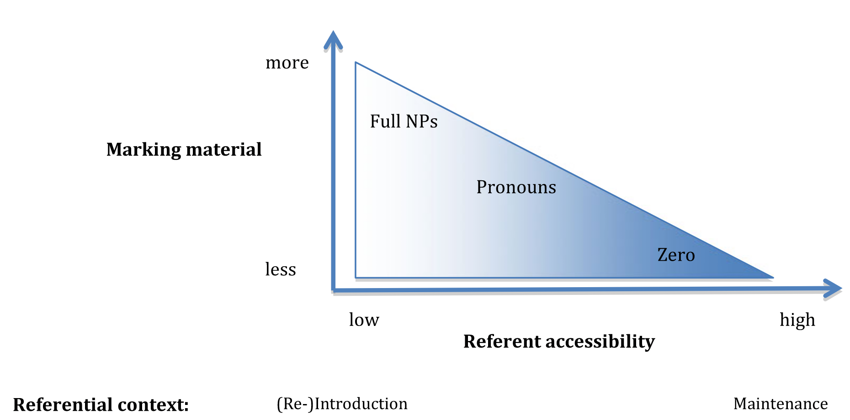

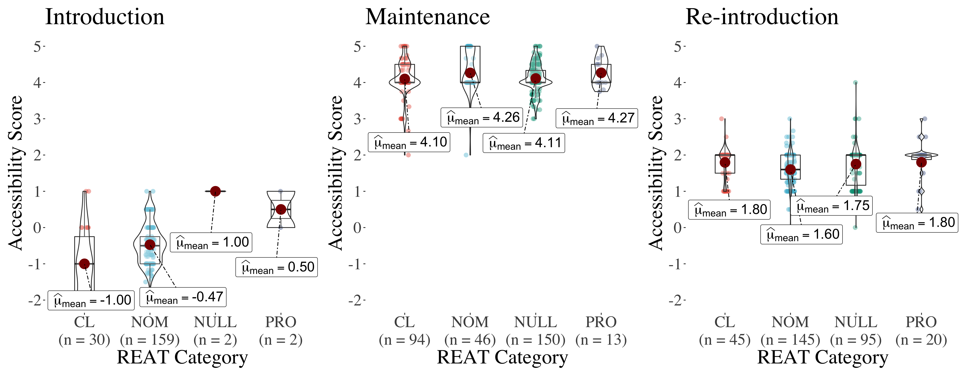
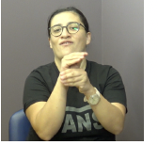

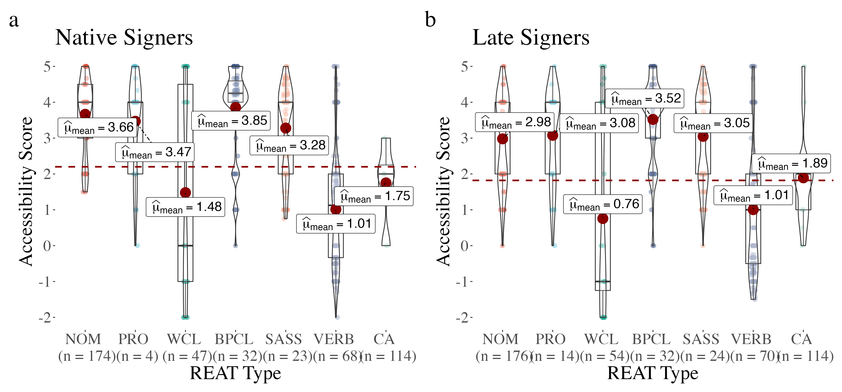
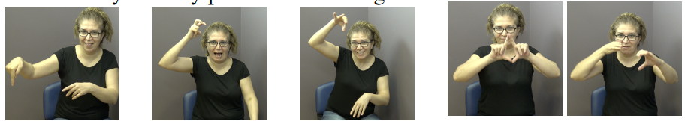


Age of Acquisition Effects on Referential Accessibility in Signed Narratives
Onur Keleş (Boğaziçi University, onurkeles.boun@gmail.com) & Kadir Gökgöz (Boğaziçi University, kadir.gokgoz1@boun.edu.tr)
FOCUS OF THE STUDY
HIGHLIGHTS
RESULTS
Referential Accessibility:
We fit a Bayesian linear regression model using the brms package [6] in R to accessibility score (dependent variable) with discourse status and acquisition group as fixed effects and subject as random effect.
In narratives, speakers and signers vary the quantity of marking on referring forms and anaphoric tools (REATs) based on the accessibility of the referent in the addressee’s mind [1-2]:
Accessible → less marking
Inaccessible → more marking
Deaf native and late signers’ reference tracking examined with a story-telling paradigm in Turkish Sign Language.
In introduced and re-introduced contexts, nominals mainly used for referents with low accessibility.
Maintenance condition greatly increased accessibility ratings (β = 4.86, 95% CI [4.76, 4.95]) whereas introduction greatly decreased accessibility (β = - 4.68, 95% CI [-4.78, -4.58]).
NULL was used to maintain highly accessible referents but signers overall preferred NOM for lowly accessible referent introduction and re-introduction.
Discourse Status:
A referent can also be:
Introduced → mentioned for the first time
Maintained → continued across at least two clauses
Re-introduced → old referent brought back to discourse
Taken from [11]
The Present Study: -- investigated the reference tracking strategies of native and late deaf adult signers in Turkish Sign Language (TİD) narratives by using a 7-point scale of referent accessibility.
Referent Tracking in Sign Languages
Sign Languages are natural languages of the Deaf communities all around the
world. REs for sign languages include the following main tools:
Nominal (NOM)
Pronominal (PRO)
Native signers had slightly higher mean accessibility ratings (β = 0.14, 95% CI [0.01, 0.28]) despite employing similar mean numbers of REAT.
Classifiers (CL)
In maintenance, null markers and classifiers were favored for highly accessible referents.
Limited evidence of over-redundancy in late signers’ reference tracking compared to native signers, pointing to less sensitivity to economy of form.
WCL
BPCL
Handling
ExtCL
Null Marking (NULL)
CA
Plain VERB
Agreement VERB
METHODS
Age of Acquisition Effects
Participants:
8 native and 8 late deaf adult signers.
Late signers’ exposure to TİD between ages 3-17.
Procedure:
Participants shown 10 short wordless clips from a cartoon and asked to retell them.
Accessibility Scoring (following [14])
5 for most accessible and -2 for least accessible) based on:
the number of propositions back to previous mention of the current referent
topicality/saliency of the current referent
number of matched competitors between the referent and its previous mention
Annotation
Using ELAN [12], we annotated the accessibility score, discourse status, and REAT.
Two groups of signers
Native deaf signers: have deaf parents, AoA: 0-3 years
Late deaf signers: have hearing parents, AoA: >3 years
Native language deprivation among late signers known to influence morphosyntactic [5] and narrative abilities [3].
DISCUSSION
-- The observed distribution of REAT types was in line with previous
observations [7-8, 12].
-- Limited over-explicitness by late signers in reference tracking is akin to findings from hearing L2 acquirers of a sign language [4, 8] and spoken language [15].
-- Native and late signers share the same linguistic inventory to track referents but differ in pragmatic competence.
-- Delayed first language exposure might negatively affect late deaf signers’ pragmatic competence, and this might be reflected in their sensitivity to economy of form.
References & Acknowledgements
Conclusion:
[1] Ahn D. The determinacy scale: A competition mechanism for anaphoric expressions [PhD Thesis]. Harvard University; 2019. [2] Ariel M. Accessing Noun-Phrase Antecedents. Routledge; 1990. 284 p. [3] Becker C. Narrative competences of Deaf children in German Sign Language. Sign Language & Linguistics. 2009, 12(2):113–60 [4] Bel A, Ortells M, Morgan G. Reference control in the narratives of adult sign language learners. International Journal of Bilingualism. 2015;19(5):608–24 [5] Boudreault P, Mayberry R. Grammatical processing in American Sign Language: Age of first-language acquisition effects in relation to syntactic structure. Language and Cognitive Processes. 2006. [6] Bürkner P-C. Advanced Bayesian Multilevel Modeling with the R Package brms. The R Journal. 2018; 10(1):395. [7] Czubek TA. A comprehensive study of referring expressions in ASL. 2017;244. [8] Frederiksen AT, Mayberry RI. Reference tracking in early stages of different modality L2 acquisition: Limited over-explicitness in novice ASL signers’ referring expressions. Second Language Research. 2019;35(2):253–83. [9] Morgan G. Discourse cohesion in sign and speech. 2000. [10] Nuhbalaoglu D. Comprehension and production of referential expressions in German Sign Language and Turkish Sign Language: An empirical approach [Doctoral Dissertation]. [Germany]: Georg-August-Universität Göttingen; 2018. [11] Perniss P, Özyürek A. Visible Cohesion: A Comparison of Reference Tracking in Sign, Speech, and Co-Speech Gesture. Topics in Cognitive Science. 2015. [12] Sloetjes H, Wittenburg P. Annotation by Category: ELAN and ISO DCR. In: Proceedings of the Sixth International Conference on Language Resources and Evaluation (LREC’08). Marrakech, Morocco: European Language Resources Association (ELRA); 2008. [13] Swabey LA. The Cognitive Status, Form and Distribution of Referring Expressions in ASL and English Narratives [Unpublished Doctoral Dissertation]. [Minnepolis, USA]: University of Minnesota; 2002. [14] Toole J. The Effect of Genre on Referential Choice. In 1996. p. 263. [15] Williams J. Zero Anaphora in Second Language Acquisition: A Comparison among Three Varieties of English. Studies in Second Language Acquisition. 1988; 10(3):339–70.

