Slide 1
KIT107
PROGRAMMING
Dr Julian Dermoudy &
Dr Rainer Wasinger
School of Engineering and ICT
University of Tasmania
Notes:
KXT102 Programming with Data Structures: Introduction
Semester Two, 2012
© Julian Dermoudy

Slide 2
Today
MyLO
Unit Outline
Classes
Resources
  Books and Websites
  Accounts and Proximity Cards
KIT107 ©JRD, February 2014
Slide <number>

Slide 3
MyLO
The University’s Learning Management System is called MyLO
The MyLO site for this unit contains:
  PPT slides, assignments, lecture recordings, tutorial questions and answers, discussion forum, revision material, etc., and, the Unit Outline
KIT107 ©JRD, February 2014
Slide <number>

Slide 4

Julian Dermoudy
KIT107 ©JRD, February 2014
Slide <number>

Slide 5
Unit Outline
The Unit Outline is a ‘contract’ between us and you
We promise to deliver what’s in there at the times advertised in there
We don’t intend to deviate from that promise
  But if we must, we won’t unless we consult with you and have majority support
KIT107 ©JRD, February 2014
Slide <number>

Slide 6
Introduction
“This unit extends the students' knowledge and experience of programming. It introduces dynamic data structures, foundational collection abstract data types, and scientific and engineering computational algorithms and techniques. Programming is undertaken in C and topics include: references and pointers, memory management, self-referential data structures, abstract data types, and an introduction to algorithm complexity.”
KIT107 ©JRD, February 2014
Slide <number>

Slide 7
Prerequisites
KXT101 Programming and Problem Solving or
KIT101 Programming Fundamentals or
KIT001 Programming Preparation or
KIT103 Computational Science or
TCE Computer Science (ITC315108 or ITC315113) or
First year mathematics: KMA1xx
KIT107 ©JRD, February 2014
Slide <number>

Slide 8
Teaching Pattern
Lectures:
  3 x 50 minutes each week for 13 weeks
Tutorials:
  1 x 50 minutes each week for 12 weeks
KIT107 ©JRD, February 2014
Slide <number>

Slide 9
Learning Outcomes
On successful completion of this unit, you will be able to:
  Adapt…
  Select…
  Design…
KIT107 ©JRD, February 2014
Slide <number>

Slide 10
Learning Outcomes
Adapt and apply techniques for scientific and engineering ICT applications
Select and effectively apply processes, methodologies, tools, and techniques to analyse, model, and develop computer programs
Design, implement, and evaluate an ICT program to meet desired needs.
KIT107 ©JRD, February 2014
Slide <number>

Slide 11
Learning Outcomes
You will also acquire attitudes needed by an ICT professional to:
  be an effective team member
  take initiative and work independently
  communicate effectively
  use abstraction and computational, creative and critical thinking to problem solve
Slide <number>
KIT107 ©JRD, February 2014

Slide 12
Generic Graduate Attributes
Knowledge
Communication Skills
Problem-Solving Skills
Global Perspective
Social Responsibility
KIT107 ©JRD, February 2014
Slide <number>

Slide 13
Assessment
40:60 Internal:Examination
Internal:
Exam:
  3 hours, open-book
Component | Weight | Due Date
Short individual program | 5% | 19/3 (week 4)
Peer-marked pair-based program | 15% | 16/4 (week 8)
Pair-based program | 20% | 28/5 (week 13)
KIT107 ©JRD, February 2014
Slide <number>

Slide 14
45% Rule
Note, in KIT units:
  the pass mark is 50% but
  students must get at least 45% in the total internal and in the exam in order to be eligible to pass
  we don’t mark to a curve but some moderation/scaling is possible
KIT107 ©JRD, February 2014
Slide <number>

Slide 15

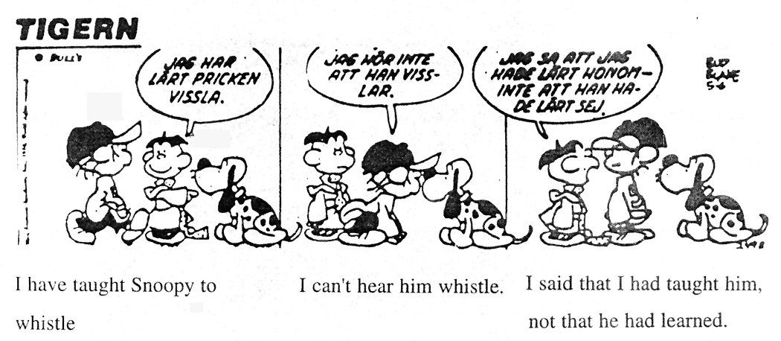
My Task or Your Task?
I've taught
Snoopy to
whistle
I can't
hear him
whistle
I said that I'd
taught him, not that
he'd learned
— Charles M. Schultz
KIT107 ©JRD, February 2014
Slide <number>

Slide 16
What Kind of Learner are You?
“I hear and I forget.
I see and I remember.
I do and I understand.”
Do you learn best by reading, by listening, by watching, by writing, by discussing, or by doing?
KIT107 ©JRD, February 2014
Slide <number>

Slide 17
How Will You Engage?
Lectures and Tutorials are the best opportunity for structured, supported, and interactive learning
  They are about gaining understanding, and not simply knowledge transfer
  Please attend as many lectures and tutorials as you can even though:
    All Hobart lectures are recorded (video & audio)
    All lecture slides, notes, and programs are on MyLO
KIT107 ©JRD, February 2014
Slide <number>

Slide 18
Unit Structure
Introduction
  1 lecture
C Programming
  12 lectures, 3 tutorials
Data Structures and Algorithms
  18 lectures, 6 tutorials
Engineering and Scientific Applications
  8 lectures, 3 tutorials
KIT107 ©JRD, February 2014
Slide <number>
Notes:
KXT102 Programming with Data Structures: Introduction
Semester Two, 2012
© Julian Dermoudy

Slide 19
Content
“C programming, references and pointers, printf and scanf, structures and unions, memory management, type conversions, bitwise operations, static variables, register variables, address arithmetic, single- and multi-dimensional arrays, procedural parameters, singly- and doubly-linked lists, linear collections (stacks, queues, priority queues, circular queues), non-linear collections (binary trees, search trees, general trees), Big O notation and simple time- and space-complexity determination and comparison, applications of scientific and engineering computation.”
KIT107 ©JRD, February 2014
Slide <number>

Slide 20
Classes
Lectures:
  Monday 1 PM Arts Lecture Theatre
  Tuesday 12 PM Centenary Lecture Theatre
  Wednesday 11 AM Arts Lecture Theatre
Tutorial/Practicals:
  see School website
  sign up for a tutorial before noon on Friday
KIT107 ©JRD, February 2014
Slide <number>
Notes:
KXT102 Programming with Data Structures: Introduction
Semester Two, 2012
© Julian Dermoudy

Slide 21
Resources
Books and Websites:
  None specifically — but any “C Programming” and “Data Structures in C” text books would be helpful
  Many websites of relevance…
KIT107 ©JRD, February 2014
Slide <number>
Notes:
KXT102 Programming with Data Structures: Introduction
Semester Two, 2012
© Julian Dermoudy

Slide 22
Building, Lab, and Computer Access
Proximity card
  Get one if you want afterhours access
  Bring it to our Help Desk (on level 3 of the Centenary Building)
Username and password
  Same username for ‘central’ and ‘school’ accounts but (initially) different passwords
KIT107 ©JRD, February 2014
Slide <number>
Notes:
KXT102 Programming with Data Structures: Introduction
Semester Two, 2012
© Julian Dermoudy

Slide 23
Building, Lab, and Computer Access
We provide file servers for your work
  Reachable off-campus
  Backed up by us
  File loss is not a reason for an extension
LPS (or CAPS) account for printing in the labs
  deposit money through School or elsewhere
KIT107 ©JRD, February 2014
Slide <number>
Notes:
KXT102 Programming with Data Structures: Introduction
Semester Two, 2012
© Julian Dermoudy

Slide 24
Software
Visual Studio for C11
  available in our labs and at http://www.microsoft.com/en-au/download/details.aspx?id=40787
KIT107 ©JRD, February 2014
Slide <number>

Slide 25
Contact Details
Lecturer
  Name: Dr Julian Dermoudy
  Email: Julian.Dermoudy@utas.edu.au
  Telephone: 6226 2933
  Office: Centenary 452
  Consultation Hours:
    Tuesday 2–4 PM
    Wednesday 2–4 PM
    (Some variability)
KIT107 ©JRD, February 2014
Slide <number>
Notes:
KXT102 Programming with Data Structures: Introduction
Semester Two, 2012
© Julian Dermoudy

