Slide 1
Practical Programming for Biologists
This week:
Introductions
Course background and impetus
Syllabus and class schedule
Course structure, grading, project
To-do list
Choosing an operating system
Directory structure
Unix and the command line
Text editors
Setting up a work station

Slide 2
The Syllabus

Slide 3
Course structure and grading
Structure
Lecture. Demonstrate. Practice.
Grading
Exercises | 50%
Participation | 15%
Project | 35%

Slide 4


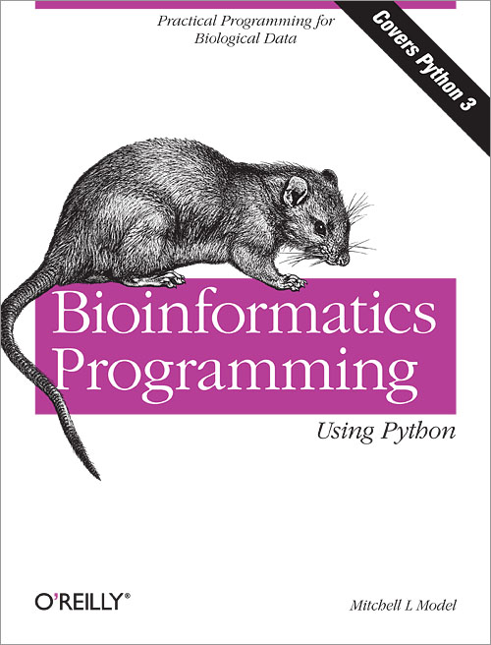
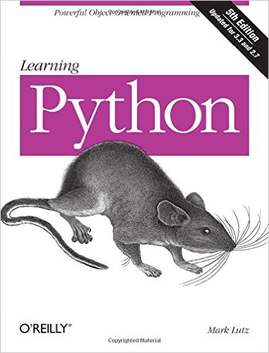

To-do list
Register for an AHPCC user account (link)
Take a look at the suggested books

Slide 5
Choosing an Operating System
Mac OS X
Pros
Unix is fully and naturally integrated into the OS
Perl and Python pre-installed
Can still use Microsoft Office, Adobe, etc.
Easiest transition to make – the choice of many biologists
Can run almost all Linux-based software
Cons
The hardware is expensive, and the OS is proprietary
Does not have the full set of Linux commands

Slide 6


An aside: Unix vs. Linux
Unix | Linux (Linus' Unix)
proprietary | open source
targeted development | diverse development
more consistency b/n versions | less consistency b/n versions
development restrictions | no restrictions
patches are highly tested | not as much beta testing
more slowly evolving | huge open-source community identifies and fixes problems quickly

Slide 7


Slide 8
Choosing an Operating System
Linux
Pros
You can install it on any PC – a Linux box is a fraction of the price of a comparably outfitted Mac
Compatible with all the important bioinformatics software
People will think you're smart; you can snub Mac users
Open source
Cons
Open source
You've probably never used it; steeper learning curve
Maintaining a Linux box requires some time investment

Slide 9
Choosing an Operating System
Microsoft Windows
Pros
None
Cons
Too many to name
Windows is not designed for programming and bioinformatics applications
But there are some workarounds . . .

Slide 10
Running Linux alongside Windows
Install Linux alongside Windows (link)
Use PuTTY, an SSH client that will allow you to just log into and use a remote computer
Run Linux within a virtual machine
https://www.virtualbox.org/wiki/Downloads
Install VirtualBox, launch it, click 'New' button, name the virtual machine, select the Ubuntu version of Linux, and allocate ≥512 Mb of memory
Install Ubuntu: http://www.ubuntu.com/
No need to restart the computer every time you run Linux
Boot into Linux from a flash drive
http://unetbootin.sourceforge.net/
Need to start and restart your computer to switch the OS
Install Cygwin (http://www.cygwin.com/)
probably the worst option

Slide 11
The command line
Why not just use a Graphical User Interface?
Not good for long sequences of operations that need to be repeated on multiple datasets
No log of what you did and what commands you executed
Not conducive to executing jobs remotely on a cluster
Labor intensive to develop and generally restricted to a single OS
Use the command line!
Extremely, extremely powerful – NOT a primitive interface
Up-front investment with ENORMOUS long-term payoff
Absolute necessity for big datasets, which characterize modern biology
Automate tasks
Do and re-do and re-do and re-do analyses with minimal added effort
Easy to record what you did, minimizing mistakes while enhancing repeatability and troubleshooting

Slide 12
What's a Shell?
Interact within a SHELL
Intermediary between user and inner workings of the OS
A command interpreter, providing an interface with programs & utilities
A programming language, combining utilities in different ways to carry out some function(s)
May be used interactively or non-interactively
accepts input from the keyboard
accepts commands from a file
Execute builtin commands, implemented internally by the shell
cd, pwd, exit
Execute programs installed elsewhere on the file system
GNU Core Utilities (coreutils)
ls, mv, rm, mkdir, chmod, pwd

Slide 13
Bash
Lots of different shells
We'll use Bash, which is the default Shell in Linux and Mac OS X
Bash = Bourne again shell, replaced its predecessor (Bourne shell)
Run from a text window, e.g., Terminal in Mac OS X
Could also use X11 (aka, "X"), which has GUI capabilities
Launch Terminal (Finder > Go > Utilities > Terminal)
Add Terminal to your dock by dragging and dropping

Slide 14
1. Download from from Blackboard:
example_files.tgz
watermelon_files.tgz
2. Move them to the Desktop

Slide 15


Slide 16
Bash
Lots of different shells
We'll use Bash, which is the default Shell in Linux and Mac OS X
Bash = Bourne again shell, replaced its predecessor (Bourne shell)
Run from a text window, e.g., Terminal in Mac OS X
Could also use X11 (aka, "X"), which has GUI capabilities
Launch Terminal (Finder > Go > Utilities > Terminal)
Add Terminal to your dock by dragging and dropping
prompt → $ whoami
$ echo $SHELL
$ echo $HOME
$ which ls
$ which pwd

Slide 17
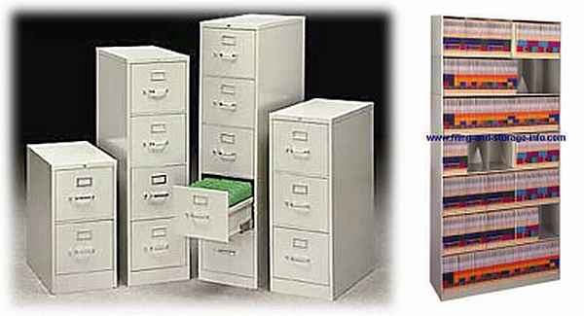
The File System

Slide 18
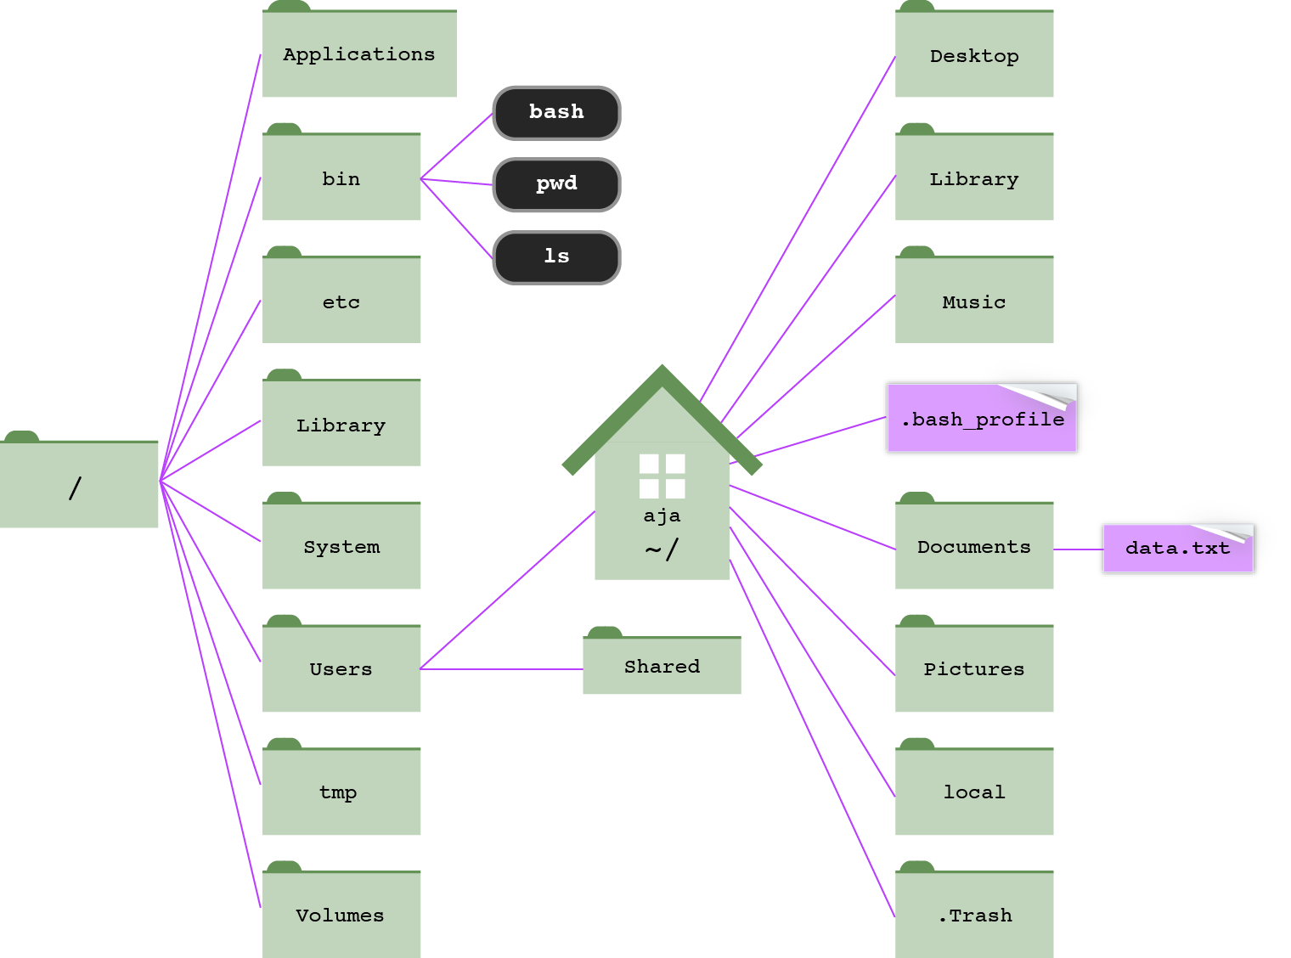
root directory
modified from Haddock & Dunn

Slide 19
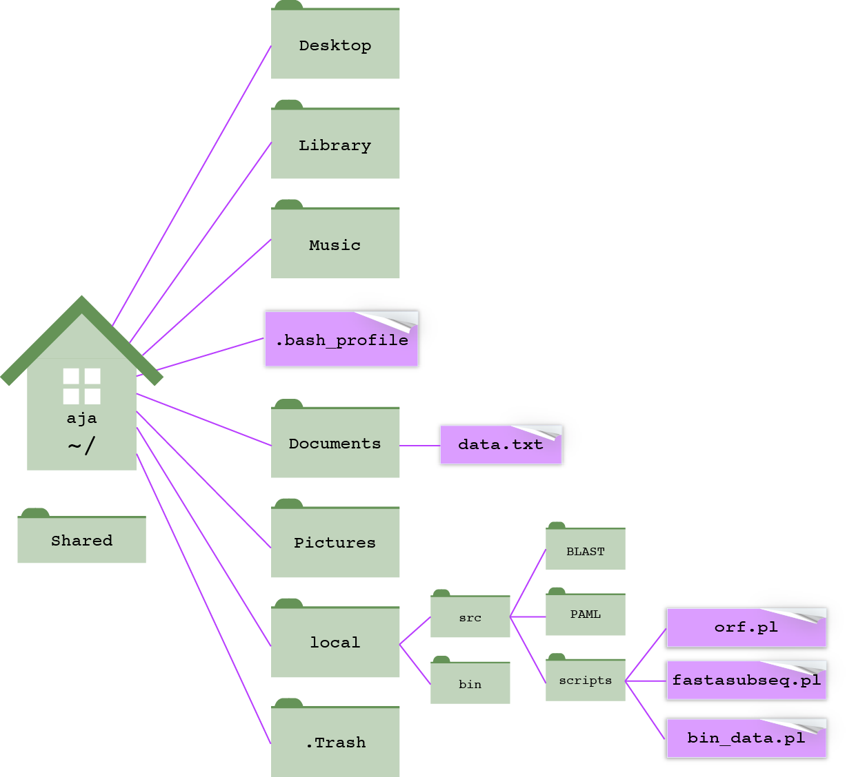
Python scripts in ~/local/src/scripts/
Bioinformatics software in ~/local/src/

Slide 20
PATHS
A path is a written description of a location in the filesystem
Both directories and files have paths
Consists of directory names separated by forward slashes (/)
Absolute path – complete and unambiguous location starting from root; always starts with a forward slash (/)
/Users/aja/Desktop/watermelon_files/watermelon.fsa
Relative path – describes where a file or folder is in relation to another folder, usually the working directory
Working directory – where you're at right now; if you're in the Desktop, the relative path to watermelon.fsa is:
watermelon_files/watermelon.fsa

Slide 21
*MAC SHORTCUT*
You can enter a long path to a file by dragging and dropping that file from Finder into the Terminal window.
Drag ~/Desktop/Don't do this.txt to the Terminal

Slide 22

*NEW RULE*
You will no longer include spaces in your file names.
use underscores – my_file.txt
or, mixed upper/lowercase – myFile.txt
or, dots – my.file.txt

Slide 23
Common Unix commands
$ pwd – prints path of working directory [absolute or relative?]
$ cd – change directory
$ cd .. [move up one directory]
$ cd ../../ [move up two directories]
$ cd [go home]
$ cd ~ [go home]
$ cd ~/Desktop/watermelon_files
$ cd /Users/aja/Desktop/watermelon_files
$ echo argument . . . – write arguments to STDOUT
$ echo $HOME [where's my home directory?]
$ echo crazy
$ echo crazy horse

Slide 24
Common Unix commands
$ clear – clear the Terminal screen
$ clear
$ exit – exit the session
always exit your session before closing the Terminal window and quitting Terminal
not doing so is analagous to uplugging your computer – unceremonious end to all your programs and processes

Slide 25
*AWESOME SHORTCUTS*
Auto-complete with tab
Re-run a previous command with Up [and down] arrow
Find an old command with Ctrl+r
Find an old command with history
Mac OS: open working directory in Finder with open .

Slide 26
*MORE SHORTCUTS*
Ctrl+a – go to beginning of command
Ctrl+e – go to end of command
Ctrl+u – erase command from cursor to start
Ctrl+l – clear the screen (executes clear command)

Slide 27
Common Unix commands
$ which argument – locate a command
$ which pwd
$ which cd
$ which python3
$ ls – list directory contents
$ ls [list contents of working directory]
$ ls ~/Desktop [list Desktop contents]
$ ls ~/Desktop/watermelon_files/
$ ls /Users/aja/Desktop/watermelon_files/
$ ls ~/Desktop/watermelon_files/watermelon.fsa

Slide 28
ls with arguments
-a : list all directory contents, including hidden files
-l : list in long format
-h : make file sizes human readable (only with -l)
-t : sort by time modified (most recently modified first)
-S : sort files by size
$ cd ~/Desktop/watermelon_files
$ ls -a -l
$ ls -al
$ ls -alS
$ ls -alSh

Slide 29
ls output
total 1208
-rw-r--r--@ 1 aja staff 371K Jan 8 20:14 watermelon.fsa
-rw-r--r--@ 1 aja staff 172K Jan 8 20:17 watermelon.gff.docx
-rw-r--r-- 1 aja staff 20K Jan 8 20:14 watermelon.gff
-rw-r--r--@ 1 aja staff 20K Jan 8 20:25 watermelon.mac.gff
drwxr-xr-x 62 aja staff 2.1K Jan 8 20:14 watermelon_nt
drwxr-xr-x 9 aja staff 306B Jan 8 20:29 .
drwxr-xr-x 8 aja staff 272B Jan 8 20:15 ..
-rw-r--r--@ 1 aja staff 228B Jan 8 20:30 watermelon_genes.mac.txt
-rw-r--r--@ 1 aja staff 228B Jan 8 20:29 watermelon_genes.unix.txt
file (-) or directory (d)
permission
how many files under that directory
who's the owner
name of user group
file size
date/time last modified
file name
-rw-r--r--
user
group
other

Slide 30

* wildcards *
* – the wildest of all wildcards, representing any number of any character (except a slash)
$ cd ~/Desktop/watermelon_files
$ ls *.txt
$ ls -al *.txt
$ ls -al *genes*
$ ls -al */sdh*

Slide 31
Try it
Show a long listing of all the atp genes in watermelon_aa
How would you show the file sizes of atp genes in bytes? In kilobytes?
List all the ribosomal protein (rps and rpl) genes in watermelon_nt
List all the genomes in mt_genomes that contain a 'u'
Based on file size, which is the largest genome in the mt_genomes directory?

Slide 32
Common Unix commands: Viewing files
$ head filename – view first 10 lines of a file
$ head watermelon_genes.unix.txt
$ tail filename – view last 10 lines of a file
$ tail watermelon_genes.unix.txt
* good for checking large files *

Slide 33
Common Unix commands: Viewing files
$ more filename – view a file
$ more watermelon.fsa
space bar, ⬆, or ⬇ to move up and down
q to exit
$ less filename – view a file
$ less watermelon.fsa
enhanced functionality compared to more (less is more!)
space bar, ⬆, ⬇, ⬅, ➔ to navigate

Slide 34
More on less
$ less watermelon.fsa
/search-term to search
n for next occurrence
N for previous occurrence
⬆ and ⬇
g to top of file
G to bottom of file
q to exit
Lots of options
-i : ignore case when searching
-S : do NOT fold long lines
-N : show line numbers

Slide 35
More on less
$ less -iSN watermelon.fsa
/search-term to search
n for next occurrence
N for previous occurrence
⬆ and ⬇
g to top of file
G to bottom of file
q to exit
Lots of options
-i : ignore case when searching
-S : do NOT fold long lines
-N : show line numbers

Slide 36
Manual pages
Two main ways to find help:
Man pages contain comprehensive program usage and options
$ man program
navigate and search as you would with less
q to exit
generally straightforward, but not always
Google

