Slide 1
Tailoring your Shell

Slide 2
Tailoring your Shell
The .bash_profile file specifies your settings
Located in $HOME
This is a script that runs each time you log in or open a new Terminal window
It begins with a ".", so it's a system file (ls -a to see it)
Virtually no limit to the number of settings you can specify
View all your settings with set command

Slide 3
.bash_profile
export TERM=xterm-color
export CLICOLOR=true
export LSCOLORS=cxfxcxdxDxegedabagacad
export PATH=$PATH
# set history preferences
HISTSIZE=50000
HISTTIMEFORMAT="%Y-%m-%d "
alias cl='clear'
alias cx='chmod u+x'
Color settings for ls output
Your Path
Format history output
Aliases (keyboard shortcuts)
"Comment out" lines with '#'; these are ignored when the file is read

Slide 4
The PATH
Where the Unix shell looks for programs and executables
$ which pwd
$ which less
How did the shell know where to look, so that it could find and execute those commands?

Slide 5
The PATH
$ echo $PATH

Slide 6
The PATH
$ echo $PATH
The shell searches directories specified in your path to find programs
You already have a default path, e.g.,
/sw/bin:/sw/sbin:/usr/bin:/bin:/usr/sbin:/sbin:/usr/local/bin
Specified as series of directories separated by colons

Slide 7
The PATH
Add a directory to your path by appending it to the end of your path in .bash_profile
What's the difference between:
export PATH=$PATH:$HOME/local/bin
and
export PATH=$HOME/local/bin

Slide 8
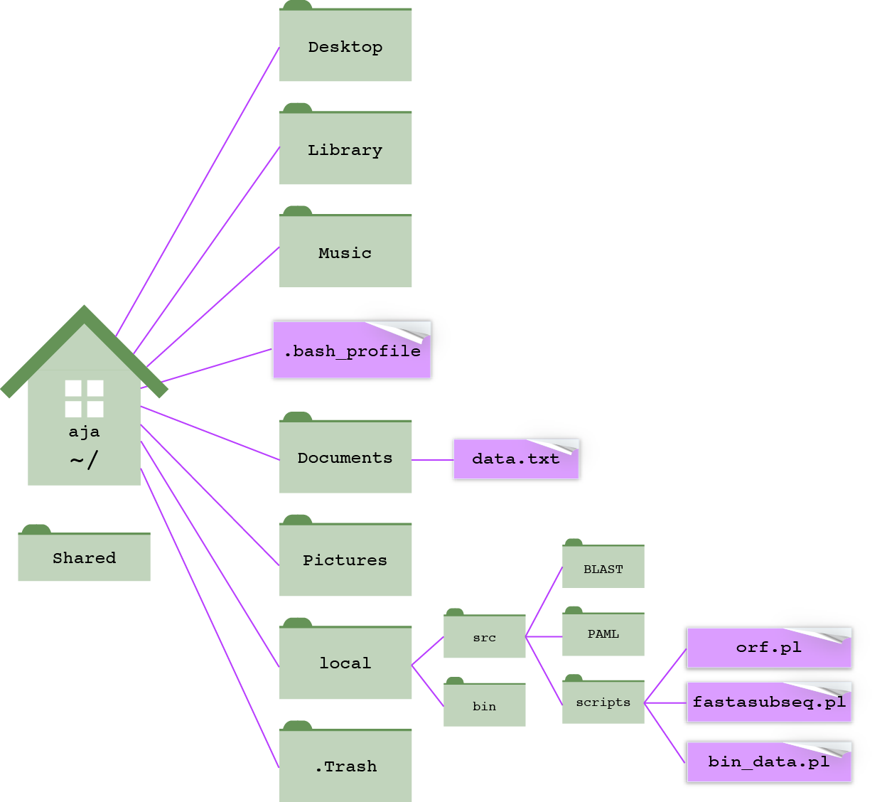
Python scripts in ~/local/src/scripts/
Bioinformatic software in ~/local/src/

