Slide 1

BLAST

Slide 2
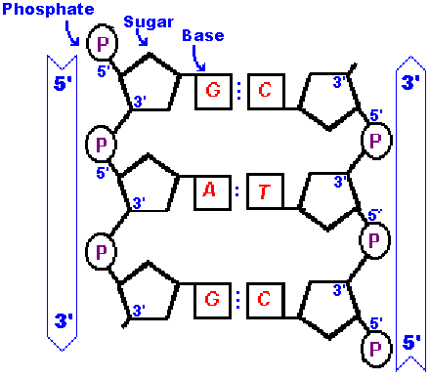
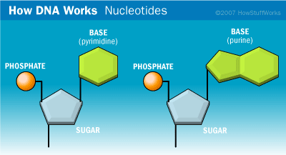
REVIEW: DNA structure
Purines: A & G, double-ringed
Pyrimidines: C & T, single-ringed
5' and 3' → direction of 3rd and 5th carbons on the sugar

Slide 3
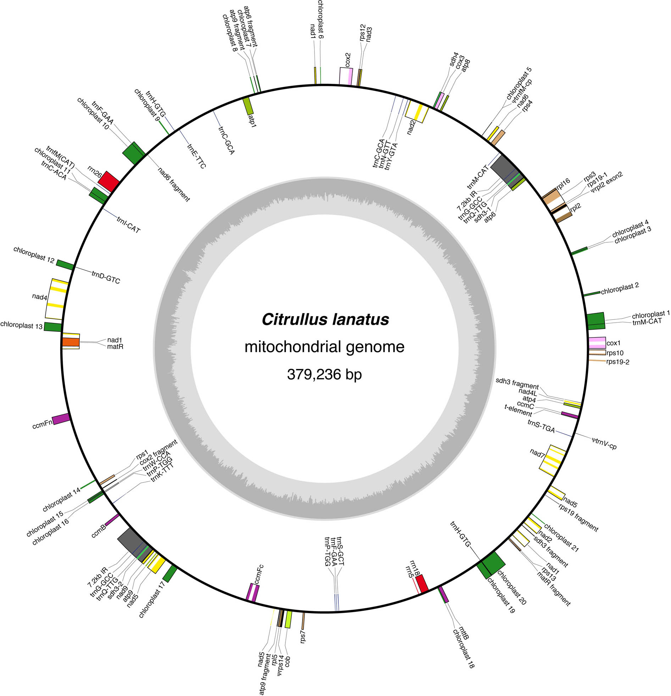
Genes are encoded on both DNA strands
Transcription

Slide 4
Reverse complementing DNA
5' CCTCTCGAATGGTAA 3'
1. REVERSE IT
AATGGTAAGCTCTCC
TTACCATTCGAGAGG
2. COMPLEMENT IT
THE REVERSE
COMPLEMENT
5' TTACCATTCGAGAGG 3'

Slide 5
Reverse complementing DNA
5' CCTCTCGAATGGTAA 3'
3' GGAGAGCTTACCATT 5'
THE REVERSE
COMPLEMENT
5' TTACCATTCGAGAGG 3'

Slide 6
Translation frames
FRAME
+1
+2
+3
-1
-2
-3
5' CCTCTCGAATGGTAA 3'
3' GGAGAGCTTACCATT 5'

Slide 7
Translation frames
FRAME
+1
+2
+3
-1
-2
-3
5' CCTCTCGAATGGTAA 3'
3' GGAGAGCTTACCATT 5'

Slide 8
Translation frames
FRAME
+1
+2
+3
-1
-2
-3
5' CCTCTCGAATGGTAA 3'
3' GGAGAGCTTACCATT 5'

Slide 9
Translation frames
FRAME
+1
+2
+3
-1
-2
-3
5' CCTCTCGAATGGTAA 3'
3' GGAGAGCTTACCATT 5'

Slide 10
Translation frames
FRAME
+1
+2
+3
-1
-2
-3
5' CCTCTCGAATGGTAA 3'
3' GGAGAGCTTACCATT 5'

Slide 11
Translation frames
FRAME
+1
+2
+3
-1
-2
-3
5' CCTCTCGAATGGTAA 3'
3' GGAGAGCTTACCATT 5'

Slide 12
BLAST
Basic Local Alignment Search Tool
Single most important software program in the field of bioinformatics
In essence, BLAST finds statistically significant similarities between sequences by evaluating pairwise alignments
Two types of alignment
Global – sequences aligned across their entire length, and the best alignment is found
Local – the best subsequence alignment is found

Slide 13
BLAST
Local – find the two most similar sentences in a book
Global – compare those two sentences, end to end
Global alignment methods are often used when making multiple sequence alignments of single genes
Lots of non-homologous intergenic DNA in genomes, so global alignments don't always make sense
We're often interested in doing local alignments
Conserved regions of a genome
Mapping mRNAs to a genome
Conserved protein domains

Slide 14
The BLAST algorithm
"Seeding" – Chop up the query sequence into short subsequences (or "words")
Make a look-up table of the query words
Scan the look-up table for similar (not necessarily identical) "neighboring words" in the subject sequence (= "word hits")

Slide 15
The BLAST algorithm (continued)
"Extension" – When there's a match, try to extend it beyond the word match using a set of rules and scoring schemes, including:
match rewards and mismatch penalties
penalty for opening a new gap
penalty for extending an existing gap
CCTCTCGAGAGTTCT
GCTCTTGGTCT
CCTCTCGAGAGTTCT
GCTCTTG----GTCT

Slide 16
The BLAST algorithm (continued)
"Extension" – When there's a match, try to extend it beyond the word match using a set of rules and scoring schemes, including:
match rewards and mismatch penalties
penalty for opening a new gap
penalty for extending an existing gap
you can adjust these parameters to select for increased or decreased stringency in your matches
Compile the alignments based on their scores

Slide 17
Scoring matrices
DNA has only 4 states, so simple match/mismatch scoring is used
There are 21 amino acids, and not all amino acid substitutions are equally probable (far from it)
need to use substitution matrices
e.g., PAM and BLOSUM matrices
empirically derived transition "probabilities"

Slide 18
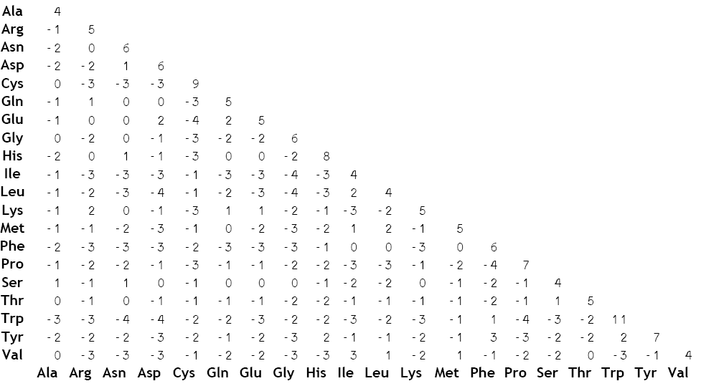
Scoring matrices
BLOSUM62

Slide 19
The Five BLAST Programs
Program | Query | Database
BLASTN | Nucleotide | Nucleotide
BLASTP | Protein | Protein
BLASTX | Translated nucleotide | Protein
TBLASTN | Protein | Translated nucleotide
TBLASTX | Translated nucleotide | Translated nucleotide
* Translations are in all SIX possible reading frames *

Slide 20
BLAST* report: HEADER
Program and version
Citation
59,012 citations!
BLAST Database data
Query data

Slide 21
BLAST* report: ONE-LINE SUMMARIES
List of hits in the database, ranked from best to worst

Slide 22
BLAST* report: ALIGNMENTS
Database sequence

Slide 23
BLASTX report: ALIGNMENTS
Statistics

Slide 24
BLASTX report: ALIGNMENTS
Expect
Score

Slide 25
BLAST: Expectations and Scoring
Questions
Do you expect more hits under very stringent or relaxed mismatch penalties?
Given two databases of sizes 10 and 10⁶ sequences, which do you expect to return more hits for your query?
Given queries of lengths 10 and 10⁶ nucleotides, which do you expect will have more matches when compared to the same database?

Slide 26
BLAST scores
Raw score – based on match/mismatch or substitution scores
bigger is better
Bit score – rescaled and normalized raw scores
a rescaled version of the raw score that's independent of the size of the search space
in essence, K and λ provide "units" of measure for raw scores
the K parameter normalizes for the size of the search space
the λ parameters normalizes for the particulars of the scoring system
bigger is better

Slide 27
BLAST scores
Expect (E) value – the number of hits one can expect to find by chance, i.e., the random background noise
decreases exponentially as the score of the match increases
lower is better
default = 10
E = 1e^{–6} means "in this database, I'd expect to find 1 in a million hits with a similar score simply by chance"

Slide 28
BLAST scores
In practice, these scores are used to set significance thresholds.
Important: BLAST similarity and homology are two entirely different concepts.

Slide 29
Number of hits by e-value

Slide 30
BLASTX report: ALIGNMENTS
What are
these?
Identical
residues

Slide 31
Positively scoring mismatches in the scoring matrix
BLOSUM62

Slide 32
BLASTX report: ALIGNMENTS
Translation
frame
Number of gaps

Slide 33
BLASTX report: ALIGNMENTS
Query start
coordinate
Query end
coordinate
Why is the query start larger than the query end-coordinate?

Slide 34
BLASTX report: ALIGNMENTS
Subject start
coordinate
Subject end
coordinate

Slide 35
BLASTX report: ALIGNMENTS
What are the lower-case letters?

Slide 36
BLASTN report: ALIGNMENTS
>
Database (subject) sequence
Score
TWO hits (hsp's) to Ricinus trnG(GCC)
Score

Slide 37
BLASTN report: ALIGNMENTS
Score
Expect
Score
Expect

Slide 38
BLASTN report: ALIGNMENTS
Match
statistics
Match
statistics

Slide 39
BLASTN report: ALIGNMENTS
A
G
T
|
T
match
mismatch
T
C
A
|
A

Slide 40
BLASTN report: ALIGNMENTS
Strand
Subject start
coordinate
Subject end
coordinate
Strand
Subject start
coordinate
Subject end
coordinate

Slide 41
Displaying strand information
Program | Plus/Plus | Plus/Minus | Minus/Plus | Minus/Minus
BLASTP | Always | Never – proteins don't have a strand
BLASTN | Same strand | NCBI-BLAST flips the subject sequence |  | Never
BLASTX | Query frame = +1, +2, or +3 | Never | Query frame = -1, -2, or -3 | Never
TBLASTN | Sbjct frame = +1, +2, or +3 | Sbjct frame = -1, -2, or -3 | Never | Never
TBLASTX | Any combination of positive or negative frames for both the query and the subject sequences

Slide 42
BLAST report: FOOTER
Matrix-specific normalizing constant
Matrix-specific normalizing constant
Product of the effective* lengths
of the query and database sequences
Database properties
Scoring parameters
*effective length is the length minus length of an hsp with Expect = 1

Slide 43
Let’s install BLAST

Slide 44
Running BLAST locally
Two parts of a local BLAST search
make a database
query the database
Input FASTA-formatted files
>Citrullus_nad4L
ACGGATCCTATCAAATATTTCACATTTTCTATGATCATC
TTGGGTTAGCCATTTTCGTTATTACTTTCCGAGTCCGAG

Slide 45
Making a BLAST database
Step 1: Format a BLAST database with makeblastdb
input is a FASTA file with one or more sequences
nucleotide OR amino acid sequences, not both
# see the program usage and options
$ makeblastdb -help
# make a nucleotide database
$ makeblastdb -in mt.fasta -dbtype nucl

Slide 46
Making a BLAST database
Step 1: Format a BLAST database with makeblastdb
input is a FASTA file with one or more sequences
nucleotide OR amino acid data
# make a protein database (the default)
$ makeblastdb -in mt_aa.fasta
# do it all on the fly
$ cat *.fasta | makeblastdb -dbtype nucl -out mt -title mt

Slide 47
Querying a local BLAST database
Step 2: Query your database with any of the following programs
blastn
blastp
blastx
tblastn
tblastx
# see the program usage and options for blastn
$ blastn -help
# see the program usage and options for blastx
$ blastx -help

Slide 48
Querying a local BLAST database
# BLASTN search with default parameters (megablast)
# search nad4L.fasta against the mt database
# print output to STDOUT
$ blastn -query nad4L.fasta -db mt.fasta
# BLASTN search for 'somewhat similar' matches
# redirect output to out.blastn
$ blastn -outfmt 0 -dust yes -word_size 9 -reward 2
-penalty -3 -gapopen 5 -gapextend 2 -query nad4L.fasta
-db mt.fasta > out.blastn

Slide 49
Formatting the output
Use the -outfmt option to modify the output format
The default 'alignment' view is '-outfmt 0'
Tabular view '-outfmt 6' is sometimes easier/sufficient
Tab-separated columns are easy to parse
# search nad4L.fasta against the mt database
$ blastn -query nad4L.fasta -db mt.fasta -outfmt 6
# -outfmt 6
qseqid, sseqid, pident, length, mismatch, gapopen, qstart, qend, sstart, send, evalue, bitscore

