Slide 1
Dictionaries
Known as “hashes” or ”associative arrays” in other languages
A dictionary is just like a list, except that the stored values are indexed by a name instead of a number
Lists are *ordered*
Dictionaries are *unordered*
A hash is similar to a dictionary
words = dictionary keys
definitions = dictionary values
The key is just a string, and you can choose a number to be the key

Slide 2
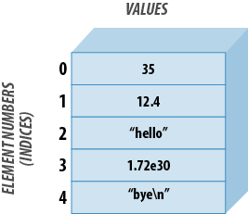
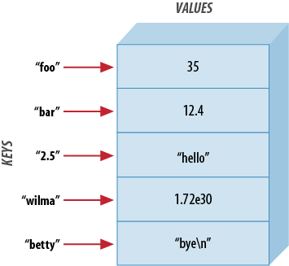
Data Storage in Lists vs. Dictionaries
list
dictionary

Slide 3
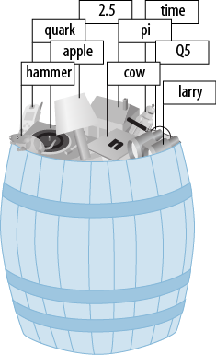
Dictionaries are unordered

Slide 4
Dictionaries
Dictionaries are good when you have two sets of related data
Word, definition
Social security number, name
Gene, expression level
Species, relative abundance
Codon, amino acid
Keys must be unique!
Values can be anything – strings, lists, or dictionaries

Slide 5
Building a dictionary
One way to do it:
AminoDict={
'TCA’:'S', # Serine
'TCC’:'S', # Serine
'TCG’:'S', # Serine
}

Slide 6
Building a dictionary
In Python, the value must be initialized the first time a given key is used.
Otherwise you’ll get an error message.
This can be an issue when the values are lists or dictionaries
Use defaultdict to solve this
from collections import defaultdict
# declare the dictionary
gene_dict = defaultdict(dict)
# add an element
gene_dict[start] = gene
presidents[44] = ‘Obama’

Slide 7
Accessing a dictionary
from collections import defaultdict
# declare the dictionary
gene_dict = defaultdict(dict)
# add an element
gene_dict[start] = gene
# print it
print(gene_dict[1])
>cox1
# add an element
presidents[44] = ‘Obama’
# print it
print(presidents.get(’44’,’Not entered’))
>Obama
print(presidents.get(’46’,’Not entered’))
>Not entered

Slide 8
Accessing a dictionary
# add an element
presidents = (43:’Bush’, 44:‘Obama’, 45:’Trump’)
# print all of them
for num in presidents.keys():
print(“President”, num, “is”, presidents.get(num))
# print all of them
for num, name in presidents.items():
print(“President”, num, “is”, name)

