Slide 1

Langmuir Circulation in the Presence of Lateral Density Gradients
Presenter: Ke Li
Advisor: Greg Chini
Notes:
Hello everyone, it is my great pleasure to have you come to my Presentation.
My name is Ke Li. Big-Data Data Scientist with 8 years of experience in research and data analytics specializing in advanced statistical modeling, simulation, visualization and prediction algorithms of high dimensional datasets.
I got my bachelor degree in Thermal Science and Energy Engineering at University of Science and Technology of China. In 2007, I cam to University of New Hampshire, and gained Master's in Mechanical Engineering, and in 2010, I went to University of Wisconsin-Madison, and gained a second master's degree in atmospheric and oceanic sciences. I love programming, swimming and hiking.

Slide 2
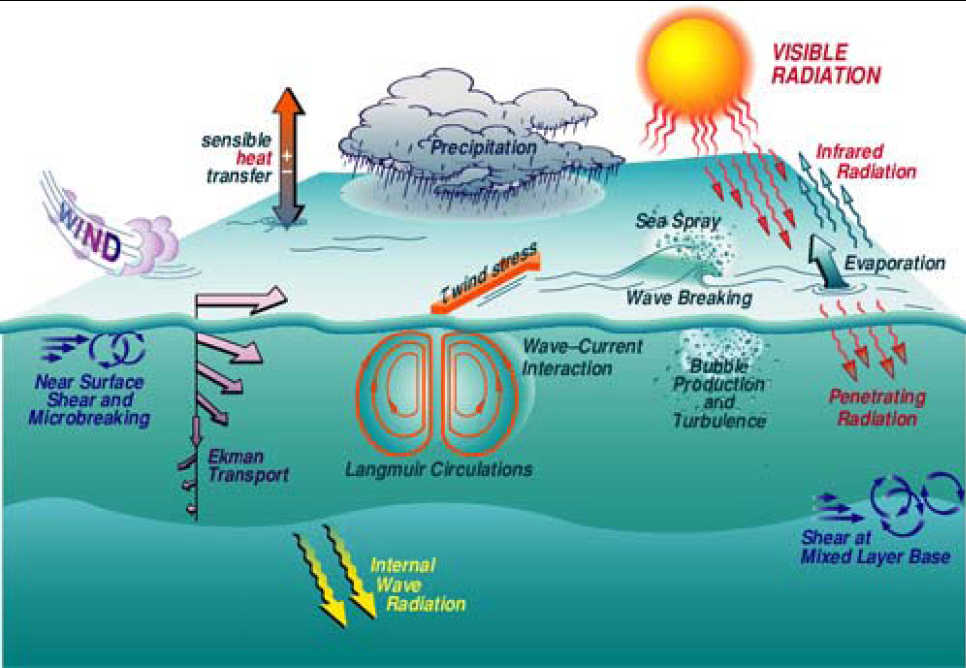
(Bob Weller, WHOI)
Notes:
(1). Top thin layer with depth of roughly 10~100m.
(2). Solar Radiation and evaporation, precipitation.
(3). Ekman transport, gravity waves on the surface and thermocline.
(4). Ocean surface turbulence-> Langmuir Circulation

Slide 3
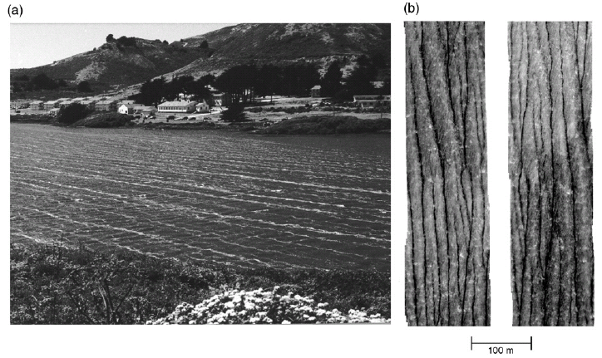
Figure1. Images of LC windrows: (left) a photograph of Rodeo Lagoon in CA (Szeri 1996), (right) an infrared image of the surface of Tampa Bay (Marmorino et al. 2005)
Notes:
here shows us LC at Rodeo Lagoon and at Tampa Bay.
At right hand side, bubble streams are converged at the surface of the ocean, which, here at least, implies LC streaks are developing underneath
This convergence comes from Langmuir Cells circulating underneath

Slide 4
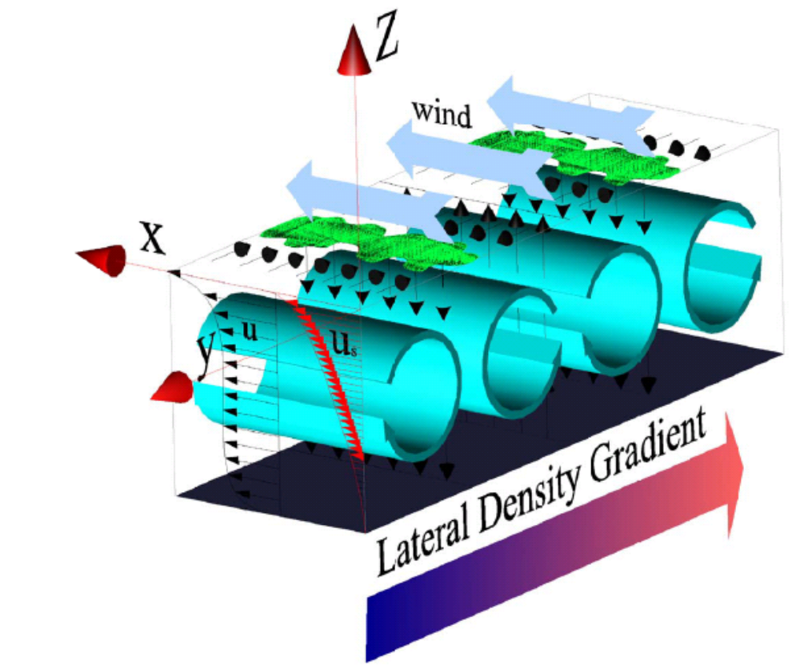
Process Study
Notes:
1. Motivation: Currently in this research area, LCs have been simulated in 2D/ 3D homogeneous models, or simulated in those cases that Langmuir cells are imposed on a background with vertical density stratification. Comparably little is known about the impact of lateral density gradients (associated with, e.g., submesoscale fronts) on Langmuir circulation in the ocean surface mixed layer.
2. Coordinates setup: In the coordinates set-up, x direction is along-wind direction, y direction is cross-wind direction while z direction is vertical direction.
Connection to next: how we should mathematically describe this interesting physical phenomenon with equations and their corresponding physical scales

Slide 5


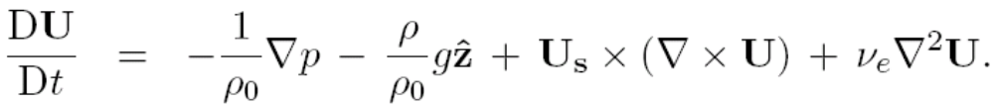
Physical Ingredients
Prescribed surface-wave Stokes drift
Craik-Leibovich parameterization of surface wave effects though CL vortex force:
Notes:
Governing equation: The Governing equation set for LC is Craik-Leibovich equation, as is written here
Craik-Libovich vortex force: It is different from NS equations by having an extra forcing term, which is called “CL vortex force”
Stokes drift: It is cross product of Stokes drift and vorticities. Stokes drift is a prescribed term, only a function of “z”
Connection to the next: With dimensional equations, here comes our assumption

Slide 6
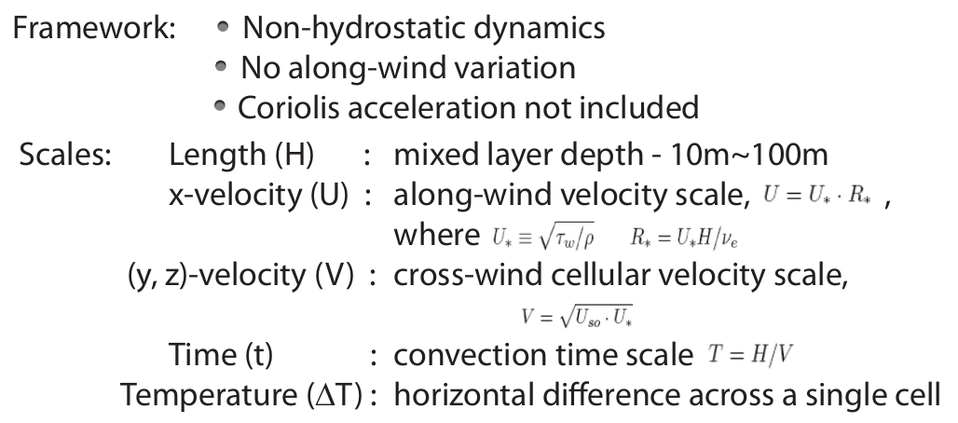
Physical Ingredients
Notes:
Non-hydrostatic dynamics (pressure of a fluid is only a function of vertical components due to the gravity)
No along-wind variation: d/dx = 0
Coriolis force that comes from earth rotation is neglected, due to its length scale.
U_*: water friction velocity, associated with surface wind stress and fluid density
Time scale is taken as the convection time scale

Slide 7
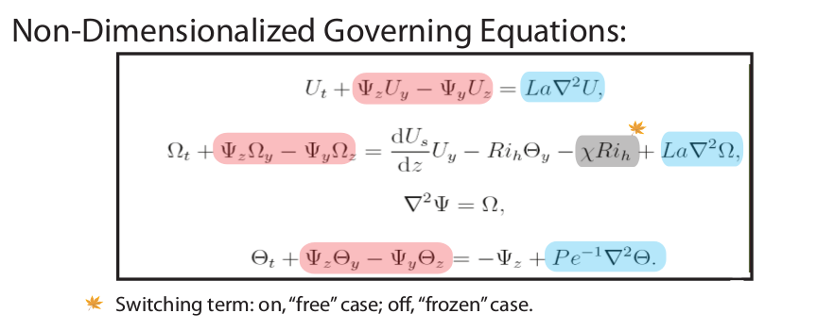
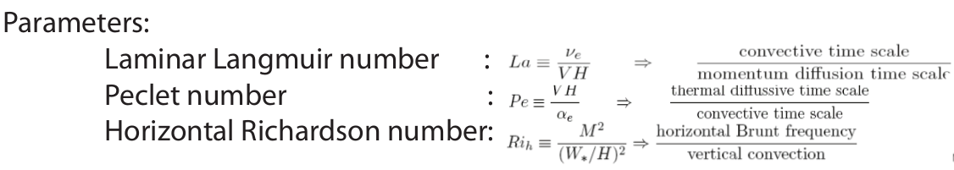
Notes:
The first equation is the momentum equation for along wind velocity U;
The second equation is the momentum equation for x-vorticity at y-z domain that describes the cellular motion at y-z domain.
The third equation is the temperature equation. Where theta is the perturbation term
T = y + theta
Horizontal Richardson number is the ratio between horizontal ossilation due to lateral temperature gradient and vertical convection due to gravity. It really measures how strong the lateral temperature gradient is, compare with vertical stratification.
Frozen : At the background, Lateral temperature gradient is fixed. (lateral density gradient Fixed as a background doesn’t cause fluid to spin. It holds even when there is no convection, since we cut off the term in the x-vorticity that causes the fluid to spin due to buoyancy term with background temperature gradient in it)
Outside heating source to maintain horizontal temperature gradient
Free: Caused by the horizontal temperature gradients, hydrostatic pressure variations drive a horizontal shear flow to advect the temperature field,
Hot water and cold water separated by a board, pulling the board away temds to cause fluid over turn, horizontal shear flow is formed.
To next slide, with these equations bear in our mind, let's take a look at numerical method.

Slide 8
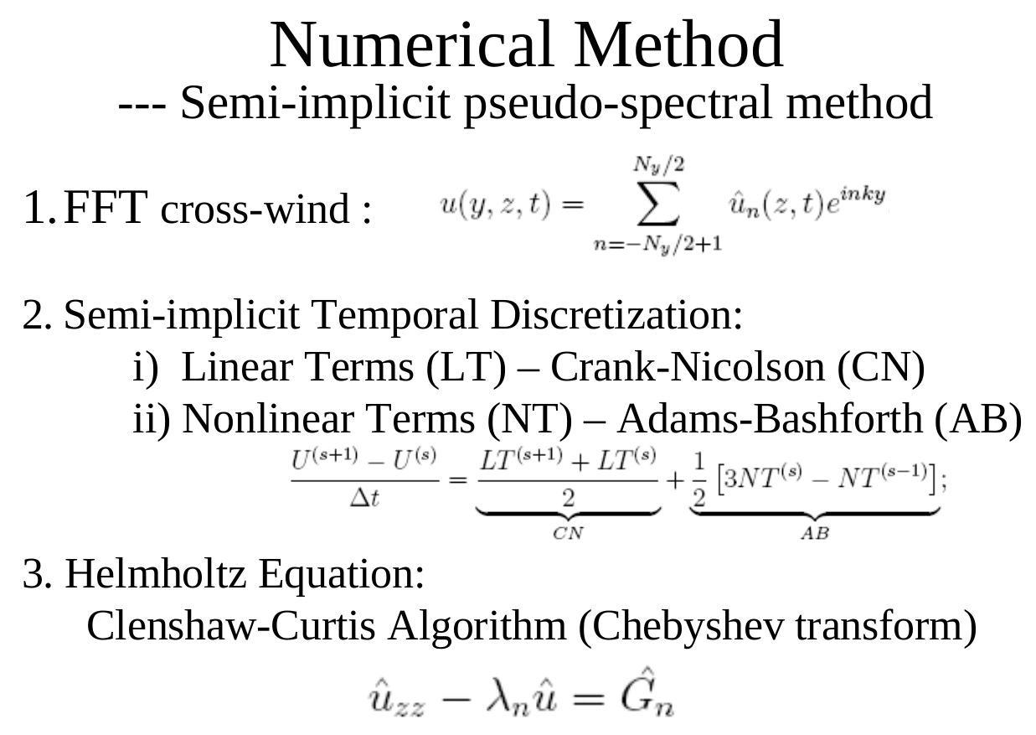
Notes:
For numerical method,
I chose to take semi-implicit pseudo-spectral method
1. Horizontally, due to LC's periodiocity, FFT is used across wind , transforming equations from physical space to spectral space
2. Time-wise, Lienar terms takes crank Nicolson scheme. and Nonlinear Terms takes Adams-bashforth scheme
3. Vertically, it is not periodical, FFT is not really applicable. I chose to take Clenshaw-Curtis Algorithm, involving Chebyshev transform to transform the variables into chebyshev space.

Slide 9
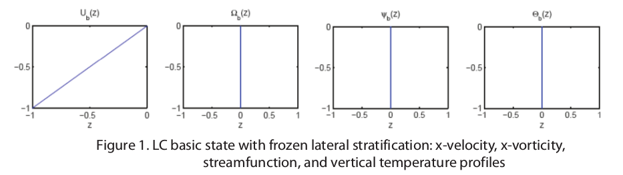
1. “Frozen” Background
Lateral temperature stratification maintained
(such as: Ocean front, thermal wind balance)
Buoyancy-driven instability is possible
Initial condition:
Parameters: La = 0.01, Pe = 4000, Ri_h = 4.0
Notes:
1. First, let's see the “Frozen” background
In this case, Lateral temperature stratification is maintained by the ocean front, or thermal wind balance
Thus, Buoyance-driven instability is possible when a horizontal perturbation is imposed.
Imagine a bath tub with constant heating one one end and cooling on the other. When we blow some wind on the surface perpenticular to the temperature gradient, idealling, along the wind, a couette flow would be generated along the wind direction.

Slide 10

Notes:
1. First order: cells are tilted toward the cold side
2. cells aspect ratio is changed,
3. strong turbulence
4. stick and slip phenomenon
5 cells reconstructed and reach new balance

Slide 11
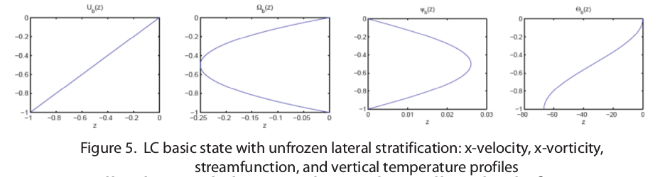
2. “Free” Background
Cross-front shear flow
Stabilizing vertical stratification
Initial condition
Parameters:
1) La = 0.01, Pe = 4000, Ri_h = 0.01
2) La = 0.01, Pe = 4000, Ri_h = 0.016
Notes:
In this case, The horizontal temperature gradient is balanced by a horizontal shear flow.
The steady state is a combination of couette alongwind and horizontal shear flow across the wind

Slide 12
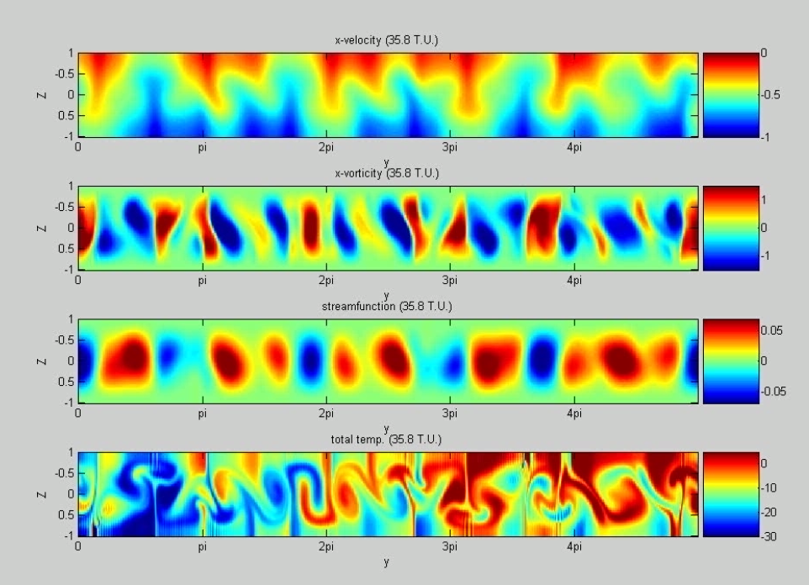

Slide 13
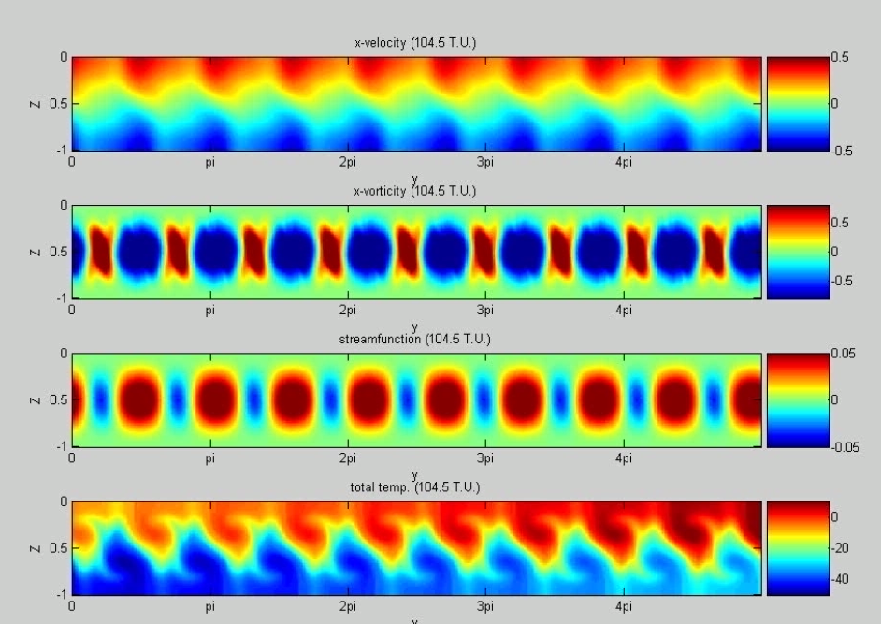

Slide 14
Thank you!

Slide 15
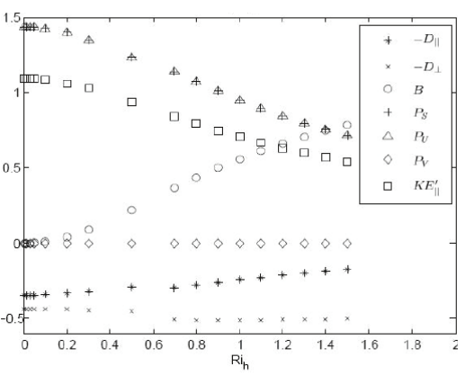
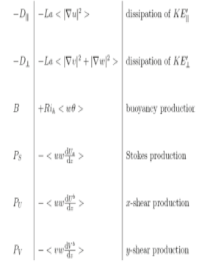
Energy Budget
“Frozen” Background
Notes:
I did a linear stability analysis and further conducted the energy budget before the turbulence starts.
IN this diagram, each sign line types represent energy contribution of a term.
Let's focus only on: diffusion terms (triangle and plus signs),
buoyancy production, in circles
and
Square for kinetic energy
Vertical axis gives the ratio between each energy terms and cellular kinetic energy over y-z domain, how strong the cells are.
As Rh increase, it is more horizontally stratefied, to generate a unit energy for collular flow at y-z domain, it takes more buoyancy production and less wind stress

Slide 16
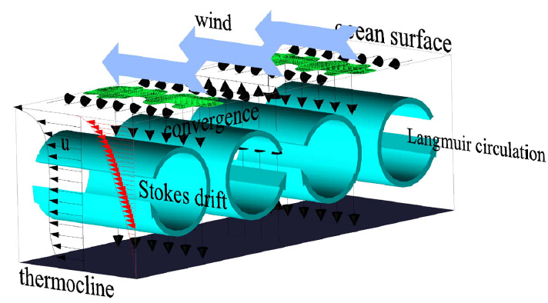
Notes:
Here is our schematic for LC, At ocean surface, streams of Sargasso weed and bubbles are formed along wind direction, in the mixed layer, LCs are generated, together with upwelling and downwelling jets between cell pairs. Stokes drift here is a prescribed term. It is denoted as u_s, only a function of z, It is time averaged stokes drift along wind direction, which is defined as the Lagrangian mean of ocean surface waves.

