Slide 1

Machine Learning Based State-of-the-art Hurricane Rainfall Prediction Ke Li

Slide 2
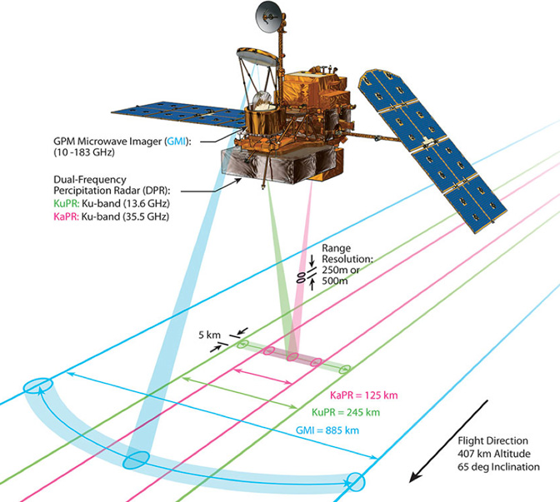

Slide 3
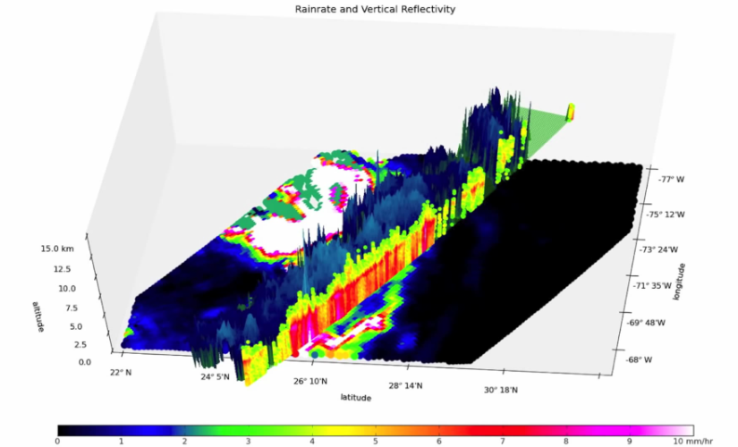
Synopsis

Slide 4
Content
Data
Bayesian Based Algorithm
K-means Clustering
Dimension Reduction
Naive Bayes Classifier
Neural Networks

Slide 5
Data
Source: Tropical Rainfall Measuring Mission (TRMM)
http://trmm.gsfc.nasa.gov/data/quicklook/last_2_cal.html
Huge!
2.2 Tb, 16 times day for 20 years
High dimensions!
11 variables
Noisy
Dominant signals are irrelevant to rain fall

Slide 6
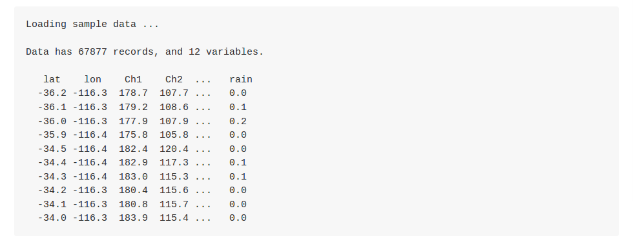
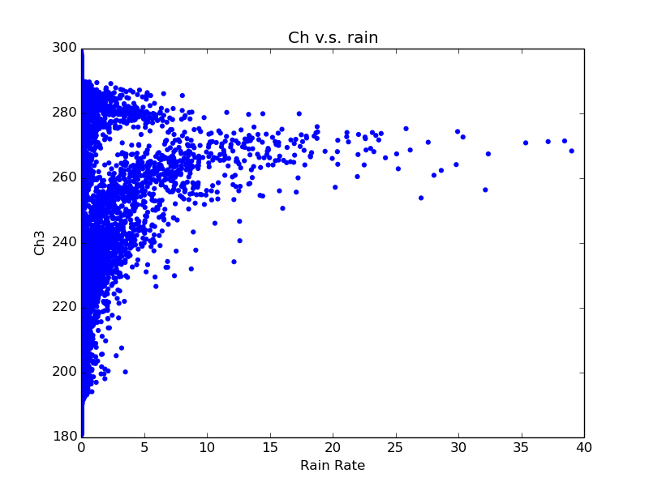
Data

Slide 7
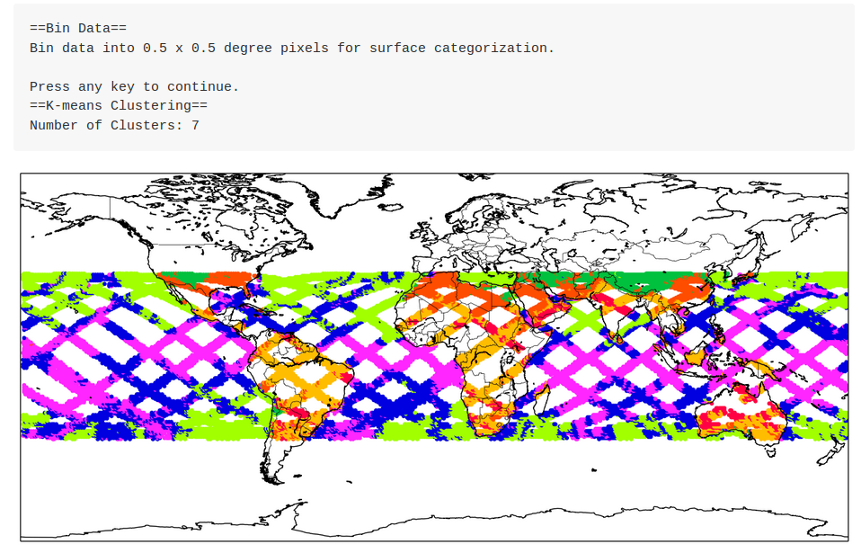
K-means Clustering

Slide 8
Dimension Reduction
9 Channels => 3 Pseudo Channels (PCs)
Save computational power
(show PCs v.s. rain rate)

Slide 9
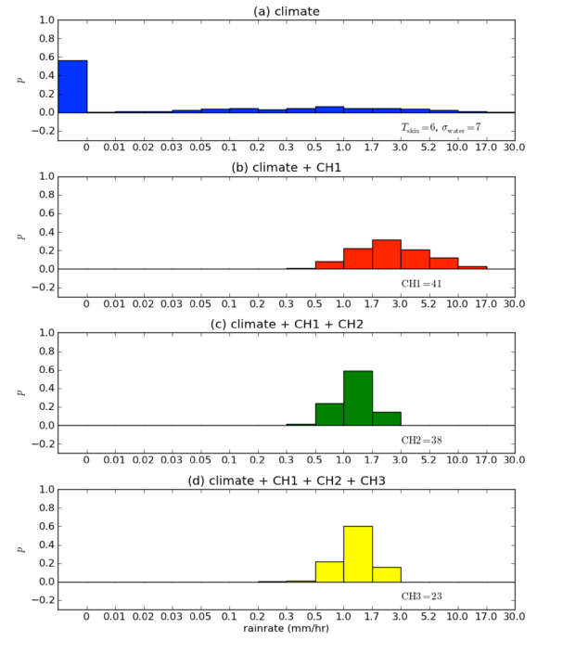
Naive Bayes Classifier

Slide 10
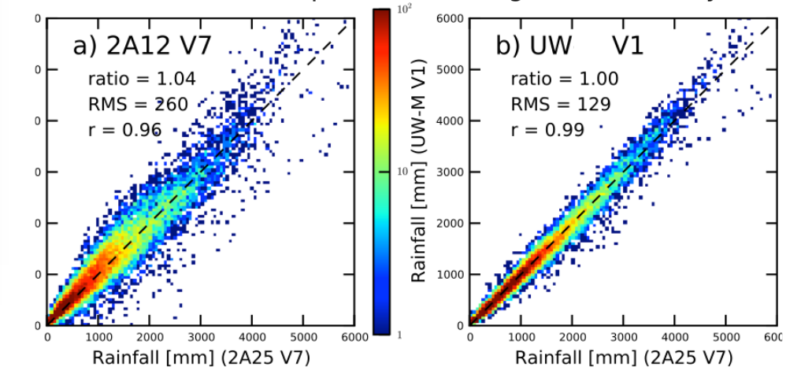
Result

Slide 11
So far
Machine Learning name:
Bayesian Based Algorithm
Beats NASA previous algorithm by 3% (96% v.s. 99%)
Currently used for Global Precipitation Measuring Mission Satellite
Complicated (additional variables)
Large computational power (land classification, large samples needed)

Slide 12
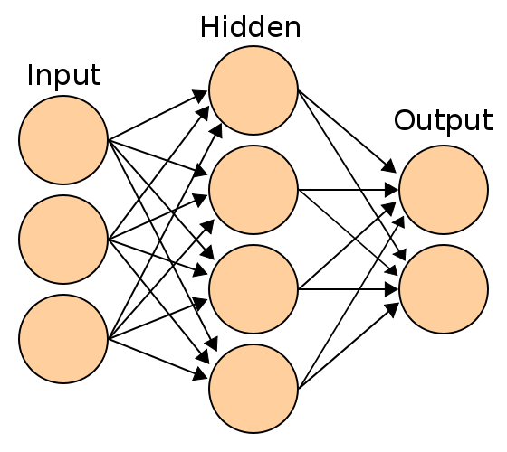
Neural Networks (NN)
Neurons: transmit patterns of data
Interconnected: Human brain
Receive input signals
Fire an output signal
*show github
(Picture comes from"Artificial neural network" wikipedia)

Slide 13
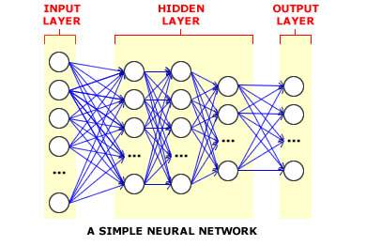
Future Work
Current NN: under-fitting
Increase NN hidden layer number

