Slide 1


AI-POWERED STUDY BUDDY
Revolutionizing Education with RAG Technology - Advanced Learning Assistant for Modern Students
KELIN WU
EE542 - Fall 2025

Slide 2
01. The Problem
Current challenges in student learning, limited resources, and ineffective tools causing educational crisis.
02. Our Solution
RAG-powered AI assistant providing accurate, cited answers from course-specific materials with zero hallucination.
Contents
03. Technical Innovation
Cutting-edge architecture with hybrid retrieval, GPU acceleration, and multi-modal knowledge processing capabilities.
04. Market & Demo
Proven demand validation, scalable business model, live demonstration, and implementation roadmap overview.

Slide 3
Join the Education Revolution
Help 20M Students Learn Better with AI-Powered Study Buddy
10+ hours
40%
95%
$500K
Weekly search time wasted
ChatGPT accuracy
Our system accuracy
Monthly revenue target
THE PROBLEM
OUR SOLUTION
BUSINESS MODEL
●
Students waste 10+ hours weekly searching
●
RAG-powered AI with 95% accuracy
●
GPU-accelerated vector search (100ms response)
●
Student tier: $4.99/month (5 courses)
●
Office hours overcrowded (50+ students for 2 hours)
●
Zero hallucination with exact citations
●
University tier: $5/student/semester
●
ChatGPT hallucinates with only 40% accuracy
●
Hybrid retrieval: dense + sparse search
●
Target: 100K users = $500K MRR
●
Chegg costs $240/year without course materials
●
80% cheaper than Chegg
●
Multi-modal processing (text, equations, diagrams)
●
$2.8B EdTech market opportunity

Slide 4
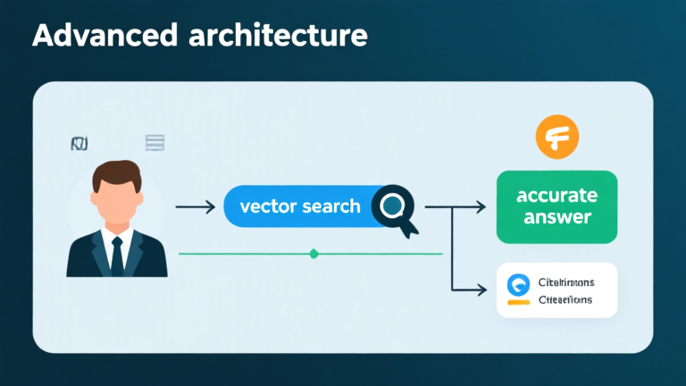



AI STUDY BUDDY: RAG-POWERED LEARNING ASSISTANT
Student Question Input
GPU Vector Search
LLM Generation
AI generates accurate answer with exact citations, page references, and zero hallucination guarantee.
Student submits course-specific question to the AI system for instant processing and analysis.
Advanced GPU-accelerated search through course PDFs to find top 3 most relevant pages and content.

Slide 5
KEY SOLUTION BENEFITS
Revolutionary Accuracy
Our RAG-powered system achieves 95% accuracy on course content with instant answers, source citations, and zero hallucination through grounded AI technology.
Performance Metrics
Reliability Features
●
95% accuracy on all course-specific content
●
Every answer includes exact page references
●
Instant answers with complete source citations
●
Grounded exclusively in YOUR course materials
●
Zero hallucination through grounded materials
●
Complete transparency with lecture citations
Speed Advantage
Verified Sources
Course Focused
100ms response time with GPU acceleration
All answers traceable to specific materials
Exclusively trained on your class content

Slide 6
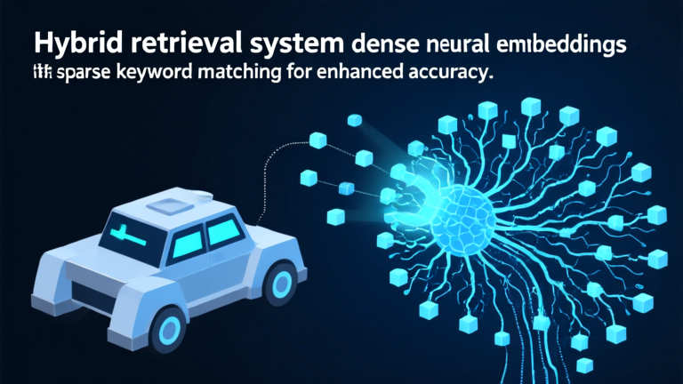

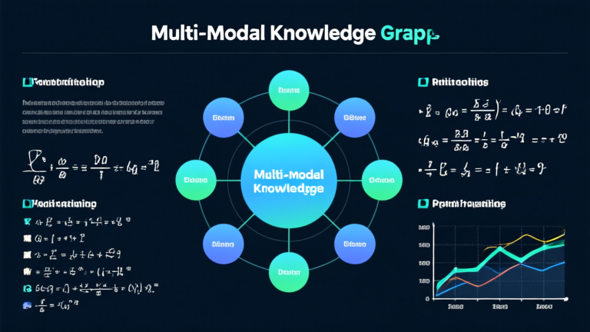
CUTTING-EDGE AI ARCHITECTURE
Hybrid Retrieval System
GPU Acceleration
Multi-Modal Processing
●
Dense vector embeddings for semantic search
●
CUDA-optimized embedding generation technology
●
Advanced text, equation, and diagram parsing
●
Sparse BM25 for keyword matching
●
5x faster response time improvement
●
Complete STEM content handling capabilities
●
30% accuracy improvement over baseline RAG
●
500ms reduced to 100ms processing
●
Intelligent knowledge graph construction system

Slide 7
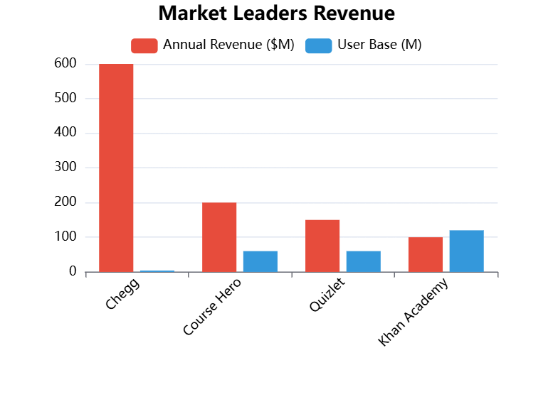


PROVEN MARKET DEMAND
Market Validation
Established players like Chegg generate $600M annually from 4M subscribers, proving strong market demand.
User Research
100% of interviewed students prefer our system over ChatGPT due to citation accuracy and course relevance.

Slide 8
SCALABLE MONETIZATION STRATEGY
Student Tier - $4.99/month
University Tier - $5/student/semester
Individual student subscription allowing upload of 5 courses with full AI assistance and citation features for enhanced learning.
Institution-wide licensing providing campus-wide access to AI study assistance with administrative controls and comprehensive analytics reporting.
●
Upload and analyze up to 5 courses per student account
Target 100K users generating $500K monthly recurring revenue
●
Complete institutional license with campus-wide deployment capabilities
●
●
80% cheaper than Chegg's $240 annual subscription cost
●
Target 50 universities generating $2.5M in annual recurring revenue
●
Course-specific content that neither Chegg nor ChatGPT can match

Slide 9
"
According to Lecture 5, Slide 12, backpropagation computes gradients using the chain rule. The algorithm works backward through layers...
— AI Study Buddy Demo Response
This live demonstration showcases our system's ability to provide accurate, cited answers directly from course materials. Students receive instant explanations with exact page references, enabling immediate verification and deeper understanding.

Slide 10



6-WEEK DEVELOPMENT ROADMAP
Week 1: Research Complete
Stakeholder interviews completed, market validation confirmed, and technical requirements fully defined and documented.
Week 2: Core Development
Basic RAG pipeline implementation with functional user interface and initial course material processing capabilities.
Week 3: Optimization
GPU acceleration integration and hybrid search implementation for enhanced performance and accuracy improvements.
Week 4-6: Final Polish
Multi-modal parsing, citation system, user testing, evaluation metrics, and final demo video production completion.

Slide 11

Thank You For Watching
Join the Education Revolution - Help 20M Students Learn Better with AI

