Slide 1
HOOKSHOT
Producer - Egi
Lead Designer - Liu ke
Technical Director - Wei Wen
Testing Manager - Yong Hui

Slide 2
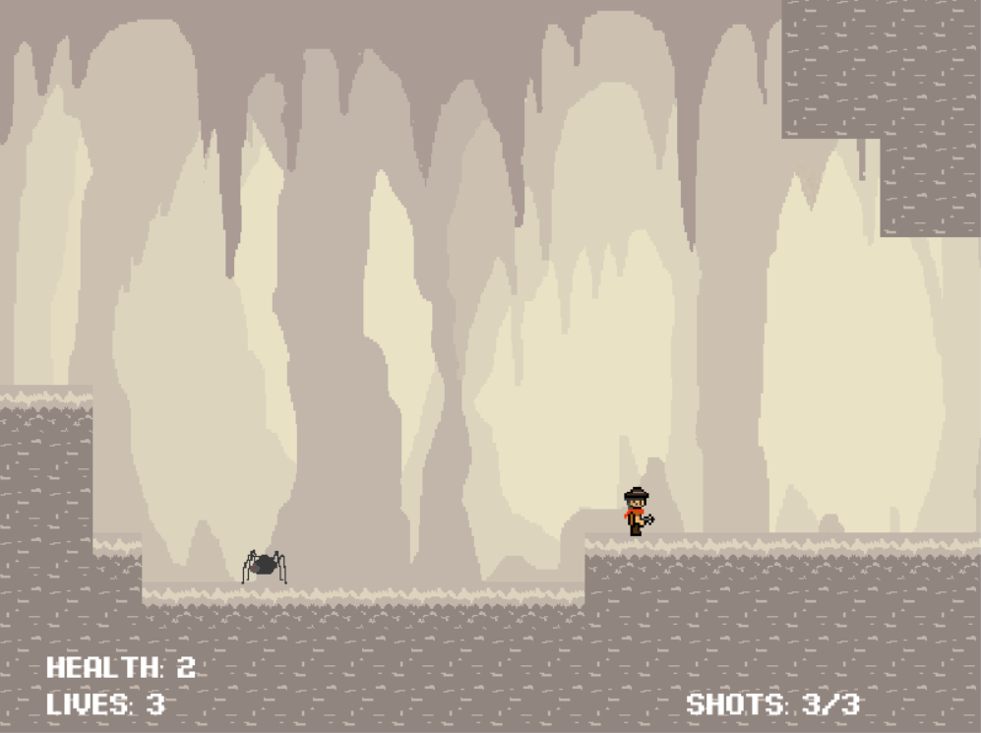
Overview
Storyline:
Mr hook (player) was separated from his partner, Rex before their adventure can begin. Now, Mr hook have to uncover the treasure and find his way back out on his own.
USP: | Hookshot mechanic
Genre: | Adventure, Exploration, 2D Side Scroller
Style: | Pixel
Goal: | Get the treasure

Slide 3
Alpha Presentation
Present Demonstration

Slide 4
Plans
Final version
Additional 4 levels - basic, medium, hard, extreme hard
Extra obstacle - spikes
Include music & audio
User testing & polishing art / levels / mechanics

Slide 5
Thank You!

