Slide 1
HOOKSHOT
Engine Proof Presentation
By team: Hook
Producer - Egi
Lead Designer - Liu ke
Technical Director - Wei Wen
Testing Manager - Yong Hui
Notes:
Good morning we are team hook and our game is hookshot.
Let's start the engine build presentation with the core mechanic, the hookshot.

Slide 2
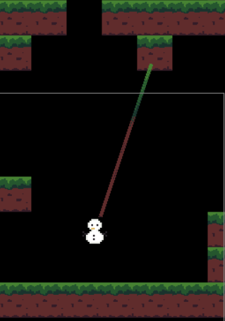
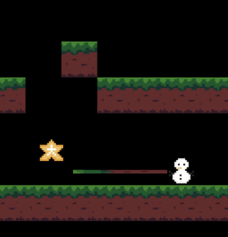
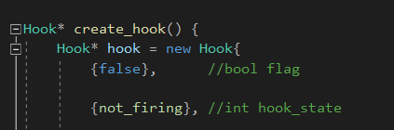
Hookshot Mechanic
Physics
Object Manager
Issues / Risks
Possible changes to Object Manager
Unsure of what we could still be lacking or missed out
Notes:
It allows the character to fire a hook and extends and once it reaches its position
It calculates the directional velocity and also ensures the character stays within the length of the hook. Creating the swinging motion,
The physics system sets the position of the objects based on different forces, acceleration, velocity, gravity.
Object Manager in a way manages the memory of engine by creating,initializing and freeing objects used in the game.
A possible risk is that more changes might be needed to be made to the object manager as as much as we try to plan for it, sometimes
There are factors that we don't know what we could be lacking or missed out until we actually try to implement it in code.

Slide 3
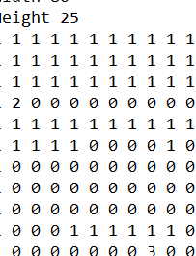
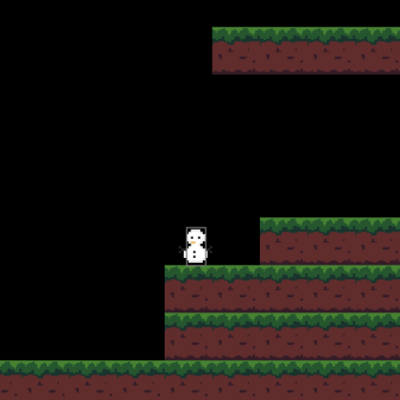
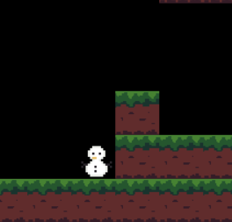
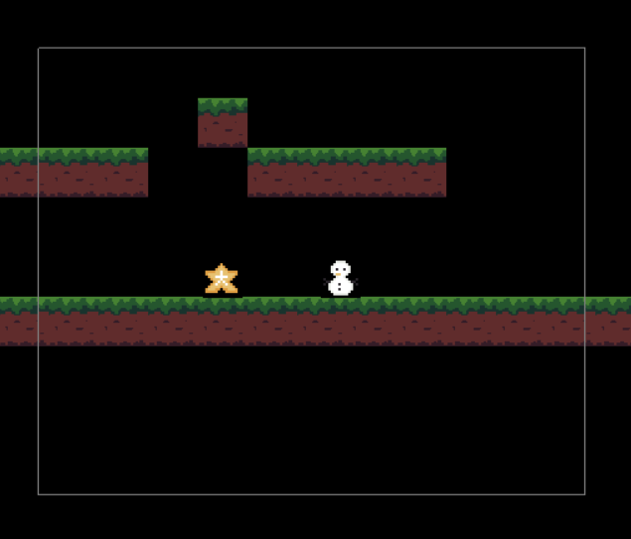
Loading Map Data
Collision
Camera
Issues / Risks
Snapping Character to empty binary map

Slide 4


Rendering and Animation
Enemy
Sample use of sprites
Each sprite will use a mesh and placed in as a texture image / map.
Issues / Risks
Animation was not working due to lack of time and sprite images for each functions and movements are still in progress.
Loading of sprites in a rather in a ineffective way.
Enemy AI needs to be dynamic. More work needs to be done.
Currently a temporary solution, needs to be fleshed out.

Slide 5
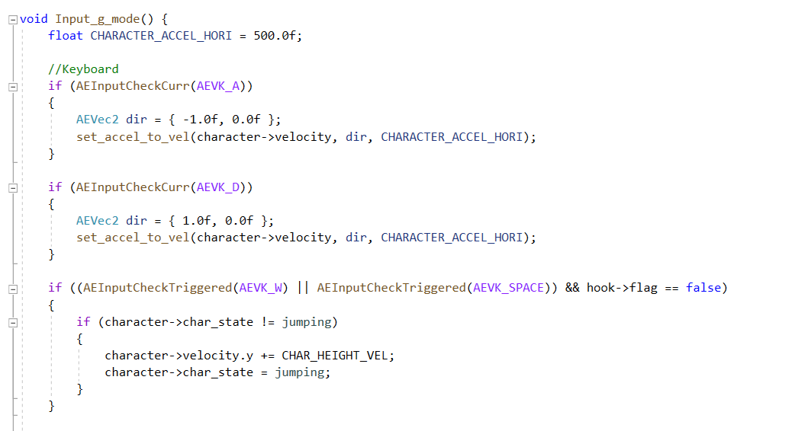

Input
UI and Menu
Issues / Risks
displaying both text and images at the same time.
Making the Menu UI interactive with the mouse.
Notes:
2

