Slide 1
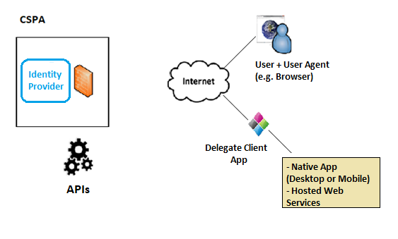
Idea in action
User interacts with client & initiates request for protected resource
Client redirects user agent to server with authorization request
OK!
Authorization Code
User authenticates & authorizes client access
Server redirects user to Client with an Authorization Code (AC)
Access Token
Refresh Token
Client submits AC & client credentials to AS’s Token Endpoint
Server validates AC. If valid, issues Access Token (AT) and optional Refresh Token (RT)
Access Token
Client accesses Protected REST API, passing AT as proof of authorization. Same AT used for INTERAPI Communication
Client can use optional Refresh Token to obtain a new Access Token when AT expires

