Slide 1

Addis Ababa University
Addis Ababa Institute Of Technology
Department of Electrical and computer engineering
Smart Cane for blind people
Kelem Negasi ATR/8467/07
Meles Kidane ATR/6466/07
Advisor: Mr. Dagmawi Demissie

Slide 2
introduction
Visual impairment is one of the most common disabilities worldwide
Visually impaired people face a lot of challenges while walking outside independently
This project aims on the modification and modernizing of the white cane for the visually impaired

Slide 3
Problem Definition and motivation
Visually impaired people uses a conventional cane to navigate around
The white Cane is limited in in its capability of detecting obstacles
This could be simplified if the walking stick is modified to be more smarter
The smart Cane for blind people is the device to achieve this goal

Slide 4
Objectives
Main objectives
To solve the problem of navigation
study an alternative way of obstacle detection
design and build a new and smarter blind stick
Specific objectives:
To implement the principles of computer vision
To Implement sensor based navigation
To develop image recognition system using camera and openCV

Slide 5
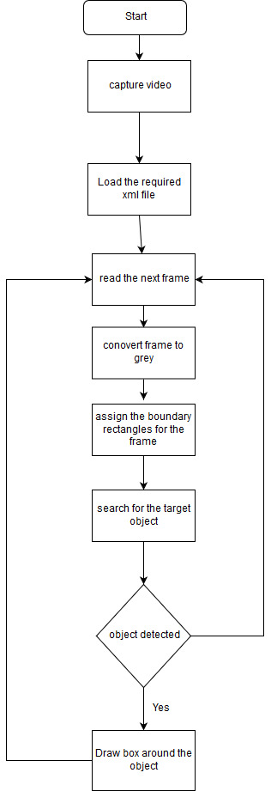
Methodology
Flow chart of the image recognition system
Software Design
an image recognition application that uses web cam
It detects cars and stairs

Slide 6
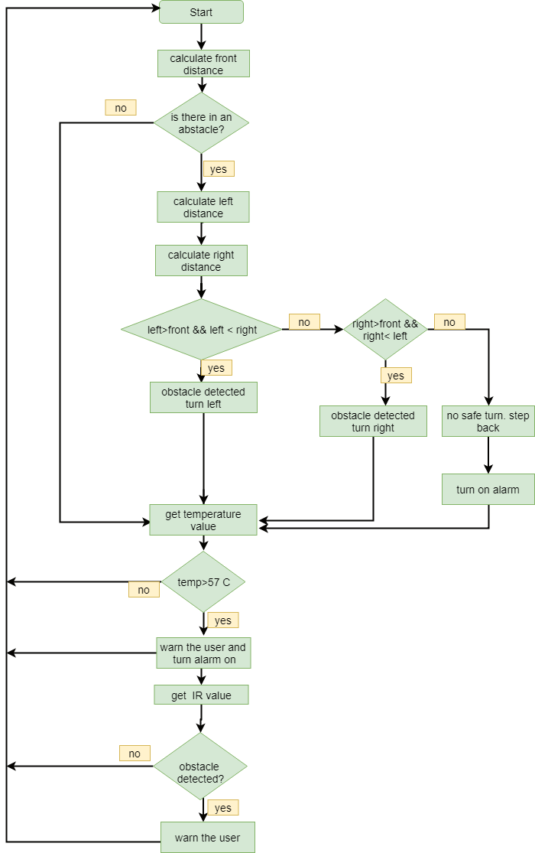
Hardware Design
Mainly composed of the following sensors
With the raspberry pi
Proximity sensors; ultrasonic and IR
Temperature sensor
Light sensor(LDR)
Water sensor
Obstacle detection algorithm

Slide 7
Implementation- Hardware
Web Cam
Ultrasonic
And IR
Sensors
Raspberry pi
Alarm and feedback unit
(Buzzer and LED)
LDR
Moisture Sensor
Power supply
Block diagram of the overall device

Slide 8
Implementation - image recognition
Haar Cascade Classifier
What is Haar Cascade Classifier?
machine learning object detection algorithm
Accurate
Fast
Low false positive
Color- Independent
Haar object detection

Slide 9
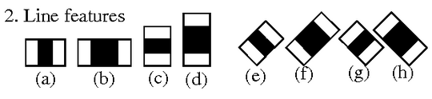
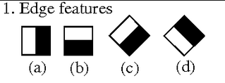
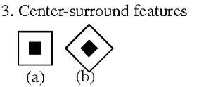
Haar cascade
machine learning object detection algorithm
cascade function is trained from a lot of positive and negative images
Has four stages:
Haar Feature Selection
Digital image features

Slide 10
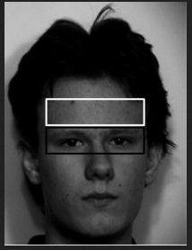
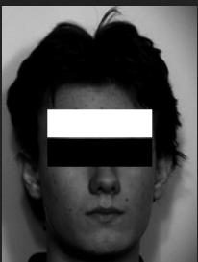
Haar Cascade –Haar features cntd.

Slide 11
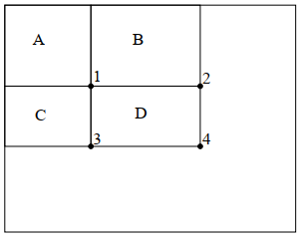
Haar cascade
INTEGRAL IMAGES
Fast ways of calculating Haar features
1 =A
4 = A+B+C+D
= 2+3-1+D
D =4+1-(2+3)

Slide 12
Haar cascade
Adaboost
Best feature selection algorithm
constructs a strong classifier out of cascaded combination of weak classifiers
target size window is moved over image
Cascade Classifier
Collection of weak classifiers stages

Slide 13
Haar cascade
Three main results from Haar Cascades
A true positive
A false positive
A false negative

Slide 14
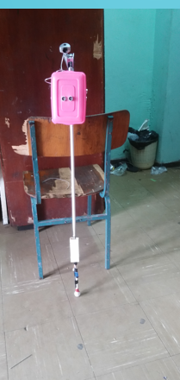
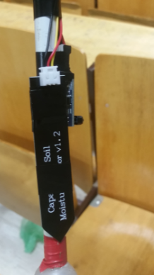
Results
Assembled device

Slide 15
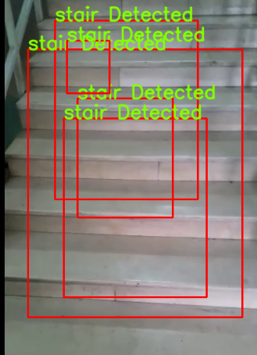
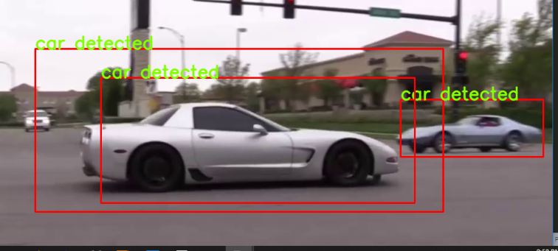
Results contd.
Object detection system in action

Slide 16
Conclusion
the device smart Cane for blind people includes two main components ,Hardware and software
Sensors and camera based object detection mechanism was used.
The main thing we have learned in designing and building this device
variety of different sensors and their of application
Learned concepts of Haar Cascades
implementation of the concepts of computer vision to detect cars and stairs

Slide 17
Challenges
The main challenges of this project was
Collecting and preprocessing of data sets
Training the Haar cascade classifiers i.e. time and space
Availability and cost of sensors and other electrical components

Slide 18
Future work
the future work on this matter will mainly be based on computer vision
More trained detectors like Human emotion detectors will be included
Detection of house hold objects
The area of stereo camera vision will be explored in aiding visually impaired people
Stereo camera based image recognition
can measure the depth features of stairs and pitfalls
represents the 3-D world more accurately

