Slide 1

OPEN CHALLENGE
Donate a Bit, Impact a Lot
Duwei Chen, Andrea Pascucci, Ianco Cregut, Shady Elshater, Sven Kellenberger, Gökçe Babür
Notes:
According to a report by Fidelity Charitable, 2017 was a record year for crypto donations. Organisations received $69 million in cryptocurrencies like Bitcoin, and claims this was almost 10 times higher than the year before.
https://cointelegraph.com/explained/blockchain-in-charity-explained

Slide 2
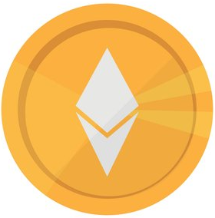




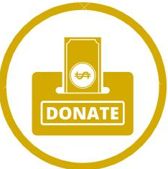


OPEN CHALLENGE
Challenges
Solutions
Lack of charity / NGO’s accepting the cryptocurrency
Creating an additional channel to collect donations
Increasing donations for sustainable actions by incentivizing people with tokens
Incentivizing people to donate
Creating a convenient mean for crypto holders to contribute to sustainable development
Creating an alternative way to spend your cryptocurrencies with smart contracts

Slide 3
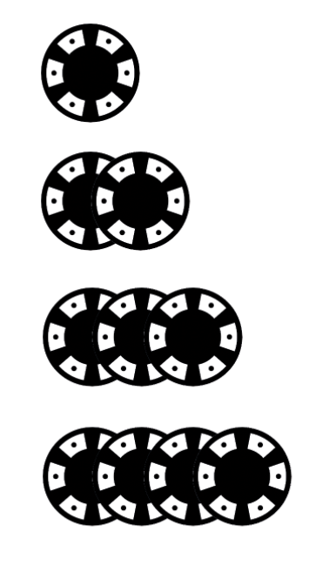

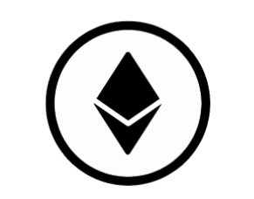


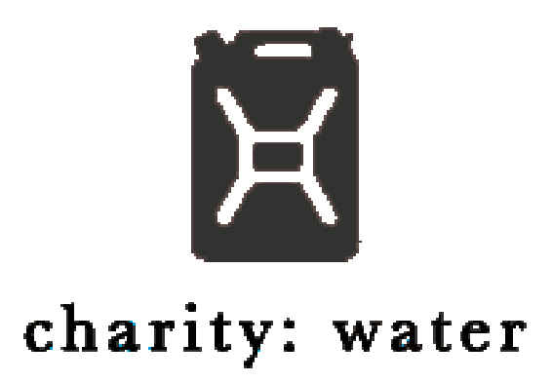



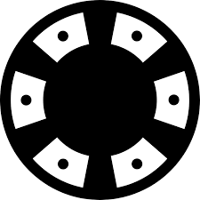

OPEN CHALLENGE
Working Structure
A Bit Of Charity
Is a registered NGO
Verifies/manages the list of NGO’s and charities
Organizes rewards for donors (e.g. tax docs, trips)
ChariBit Redeeming Examples
Voucher for bio products
Sustainable classes for kids
Sustainable trips organized by WWF
Smart contract
Transparent, reliable and secure transactions
Trust
Privacy protection
Financial sources of rewards are partner charities/ NGO’s, sponsors and donations to ABitOfCharity.
#donors
#smartcontract
#NGO’s/Charities
# tokens (ChariBit)
# tax reduction
** Donors can submit tax reduction confirmation (issued by A Bit Of Charity) to the tax authority for their tax refund.

Slide 4
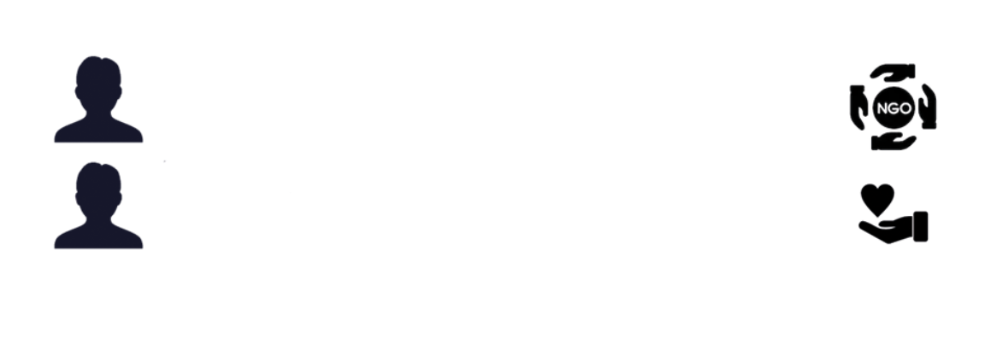

OPEN CHALLENGE
Network Effects
More Donors
More NGO’s/Charities
More donors on the platform make it more attractive for NGO’s and charities
More NGO’s/charities offer more possibilities for sustainable contributions

Slide 5
OPEN CHALLENGE
Summary and Outlook
Our unique selling point:
Central platform to donate to multiple charities / NGO’s and manage rewards (tax deduction, tokens).
Decentralized and transparent transaction recordings
Questions which remain to be solved:
The smart contract to burn the tokens needs to be prepared
The smart contract to release the tokens
Potential negative outcomes:
Duplication of source code and business model for bad purposes, e.g. Include fake NGO’s/charities for cheating.
Losing donors’ trust by listing fake NGO’s and charities by mistake

