Slide 1
National Energy Strategy of
Australia
Kellen Downey
POSC 370: Energy Politics

Slide 2
Table of contents
01
04
02
05
03
06
Overview
Challenges
Overview of Australia’s Energy Resources: Coal, Natural Gas, Renewables
Challenges and Concerns in Australia’s Energy Sector
Current Needs
Broad Objectives
Current Energy Needs and Usage Patterns
Formulating Broad Strategic Objectives
Projections
Conclusion
Projections for Energy Demand Over the Next 20 Years
Thank You!

Slide 3
01
Overview
Overview of Australia’s Energy Resources: Coal, Natural Gas, Renewables

Slide 4
Australia Energy Overview
Fossil Fuel Dominance
Declining Dominance of Coal
Rapid Renewable Growth
Energy Exports
Grid Modernization and Storage
Liquified Natural Gas
Energy Legislation
Solar Energy
Policy Shifts

Slide 5
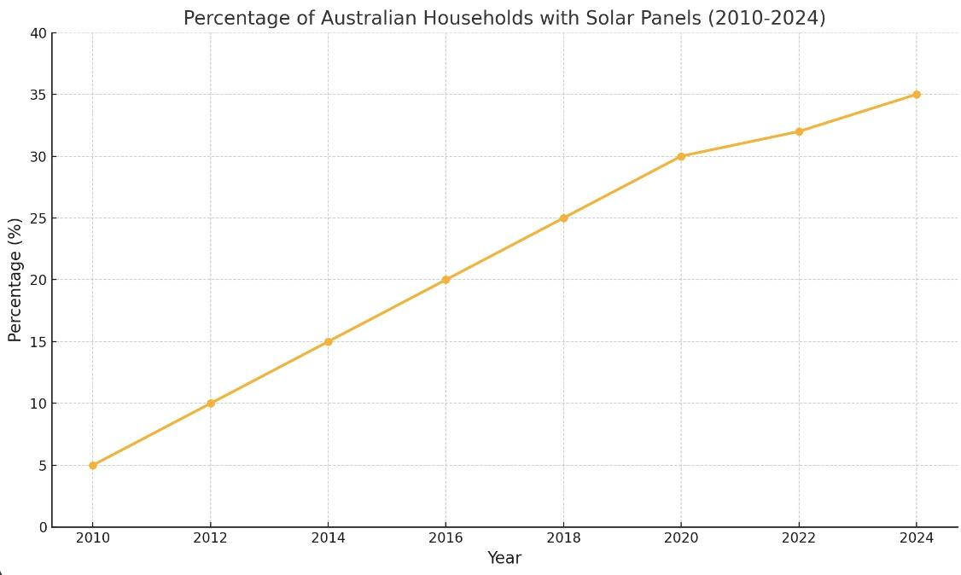
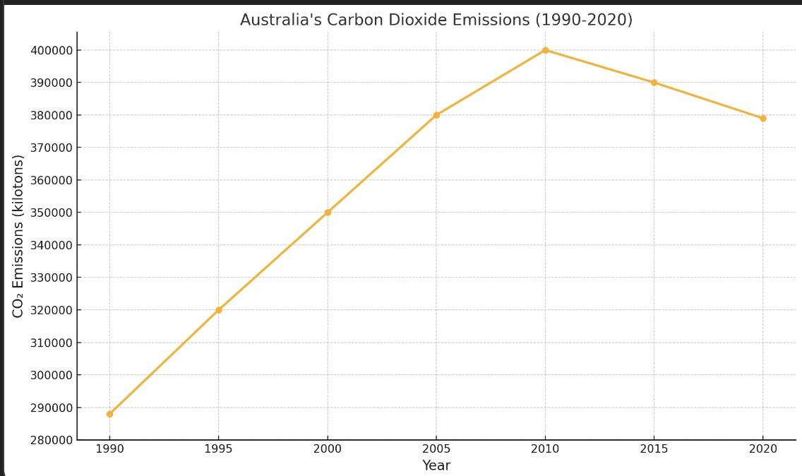
Australia Energy Illustration

Slide 6
02
Current Energy Needs
Current Energy Needs and Usage Patterns

Slide 7
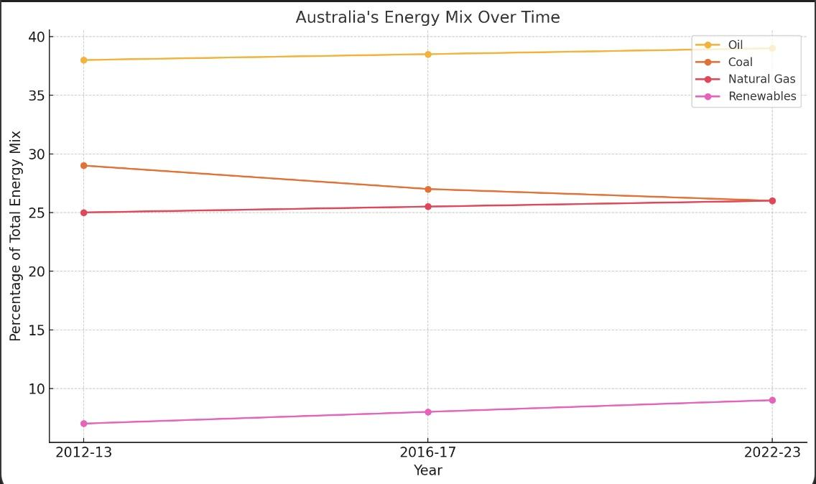
Current Needs
Problems
Industrial
Transportation
Residential
Mining, Manufacturing, construction
Petroleum Dominance
Solar Panel Advancements, Energy Growth

Slide 8
03
Projections
Projections for Energy Demand Over the Next 20 Years

Slide 9
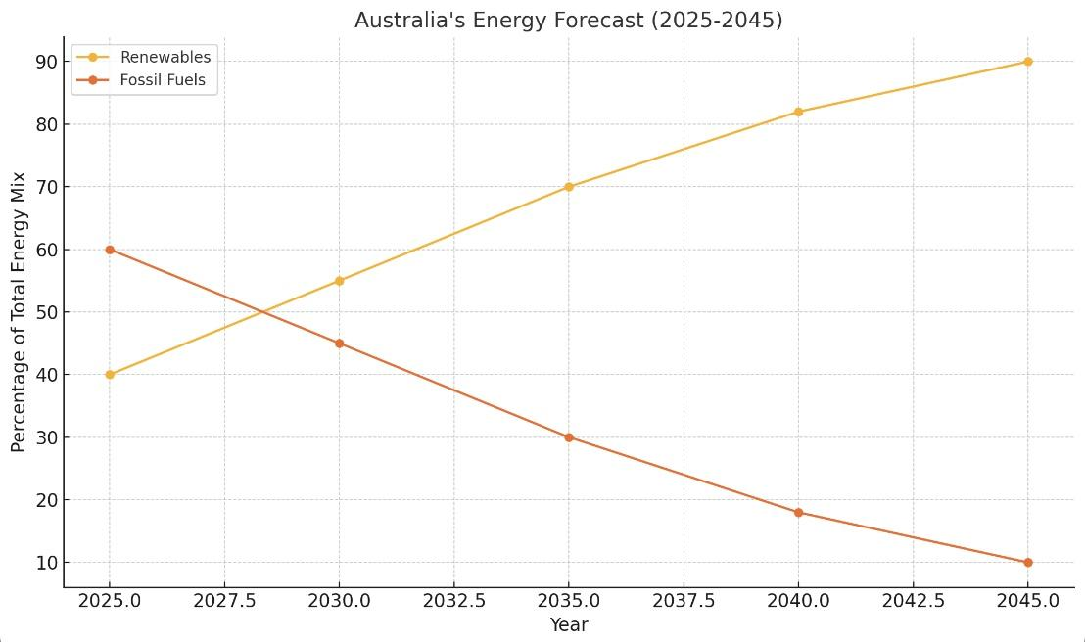
Projections
Energy Reduction
41% since 2019
EV Charging Infrastructure
Natural Resource Advantage
Challenges
Dependency on Asian coal exports
Coordination
Optimism

Slide 10

04
Challenges and Concerns
Challenges and Concerns in Australia’s Energy Sector

Slide 11
Plausibility
Environmental Sustainability
Neglecting Carbon Emissions
Exporter of Coal and Natural Gas
Reliance on Creating Carbon Emissions
Economic Sustainability
Policy
support
Susceptible to Global Market Fluctuations
Expensive Infrastructure when Finances can go Elsewhere

Slide 12
05
Broad Objectives
Formulating Broad Strategic Objectives

Slide 13
The Priority
Sustainability
Energy Independency
Economic Growth
Renewable Energy Target
Small Scale Renewable Energy Scheme
Clean Energy Finance Corporation
Nativating Global Markets
Advanced Grid Infrastructure
Energy Storage
Legal Reforms
Australian Leadership
Climate Change Risks
Updating Current Legislation
Regulation versus Market Incentives

Slide 14
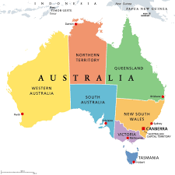
06
Conclusion
Thank you for listening!

Slide 15

Works Cited
List of works cited:
https://docs.google.com/document/d/1xfyv6e6Z36jFvVDrNqXOzNo5ENO48E1mRE1XE9pfYwk/edit?tab=t.0

