Slide 1
Finding Revenue Hotspots in Shared Housing
Prioritized property shortlist, pricing drivers, and next steps
Luca Heines, Kellen Downey
Oct 21, 2025
Notes:
Hi, I’m Luca. We will walk you through where our best, minimal risk growth is hiding in the portfolio, how we found it using the data we already have, and what to do next.

Slide 2
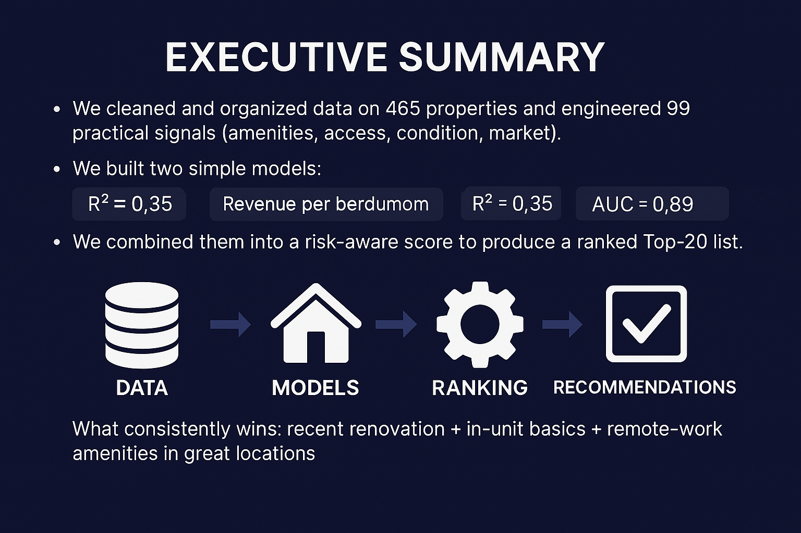
Notes:
This dataset covers 465 shared housing properties and 99 engineered features across amenities, location, and market factors. It measures how design and access impact revenue per bedroom and occupancy, helping identify where modern, WFH-friendly upgrades yield the highest return.
We used two models that are easy to explain and defend. Revenue per bedroom gives us dollars directionally; the winner model ranks the assets that are most likely to perform well. We blend both and then haircut for risk to get a usable shortlist.
Our revenue model explains roughly a third of pricing variation, while the classification model is strong at identifying top performers with nearly 0.9 AUC.
Our analysis covered 465 properties and engineered 99 meaningful features across amenities, access, condition, and market factors. We built two simple, explainable models—a linear regression for revenue per bedroom and a logistic regression for top-performer probability. The models achieved solid performance (R² = 0.35, RMSE ≈ $410 / bed; F1 = 0.72, AUC = 0.90, Accuracy = 0.85). Combined into a single risk-adjusted ranking, they produced a prioritized Top-20 shortlist of properties. The results show that recent renovations, in-unit basics, and remote-work amenities in strong locations consistently drive higher performance.

Slide 3
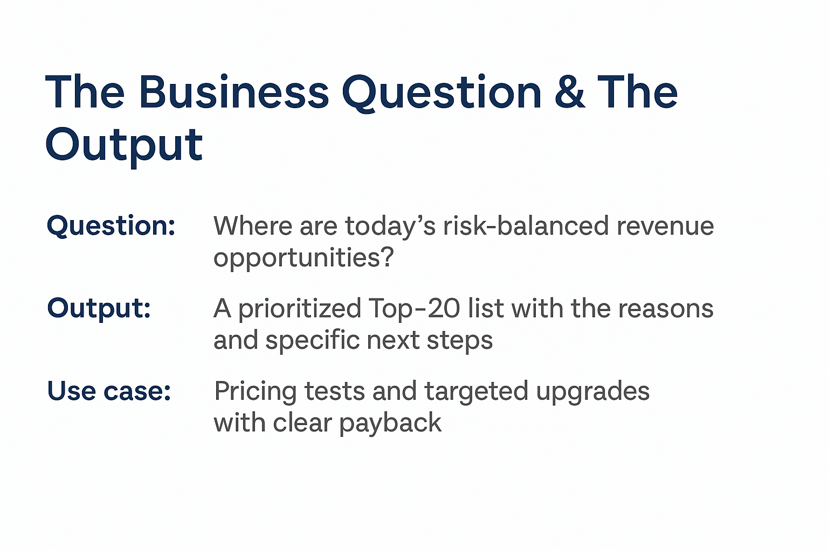
Notes:
This project addresses a central question: Where are today’s risk-balanced revenue opportunities? Using the cleaned dataset, we generated a prioritized Top-20 property list that explains not just where the best opportunities lie, but why. Each recommendation includes the factors driving performance and actionable next steps. The use case centers on pricing experiments and targeted upgrades that yield measurable payback and data-driven insight into where to invest next.

Slide 4
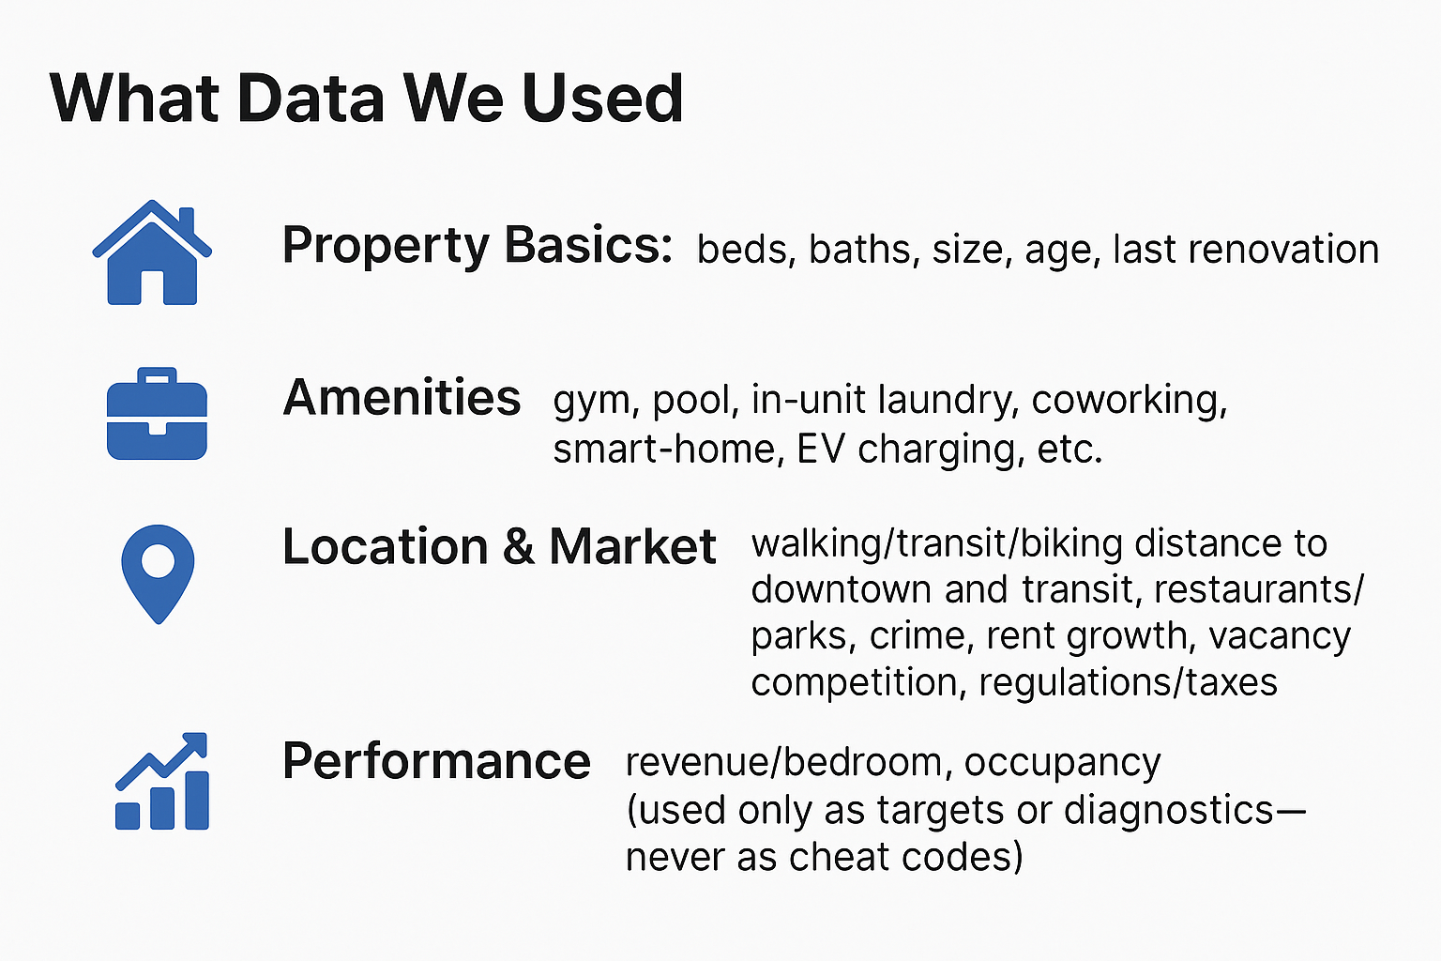
Notes:
We pulled together the things renters pay for: comfort, convenience, and location. We were careful not to let today’s revenue sneak back in as an input to predict tomorrow’s revenue.
The dataset integrates four key dimensions: property basics, amenities, location & market factors, and performance metrics. Property data captures core traits such as bed/bath counts, size, age, and renovation history. Amenity features reflect the presence of gym, pool, coworking space, smart-home integration, and EV charging. Location features quantify walkability, proximity to downtown and transit, neighborhood quality, and market conditions such as rent growth or vacancy. Performance data, including revenue per bedroom and occupancy rates, serve as targets and diagnostics—never as predictors—to preserve model integrity.

Slide 5
How we cleaned it
Dropped truly empty fields (e.g. nearest_* labels with no data)
Dropped redundant raw fields llat/long as it was another alias for the city abbreviation
Turned missing amenities such as coworking-space or smart-home into “None” instead of guessing
Filled any missing numbers throughout categories with a simple median (robust and fair)
Trimmed only extreme target outliers (2 properties beyond ~3 standard deviations) so one odd case doesn’t skew
Notes:
We give extra weight to coworking and smart-home because that’s where demand shifted. We blend walkability with true proximity, and model that the same amenity is worth more in an A-location.
Mobility = mean(walk, transit, bike)
Accessibility = 30/(dist_downtown+1) + 30/(dist_transit+1) + 20/(dist_university+1) + 20/(dist_tech+1)
LocationQuality = 0.6×Mobility + 0.4×Accessibility

Slide 6
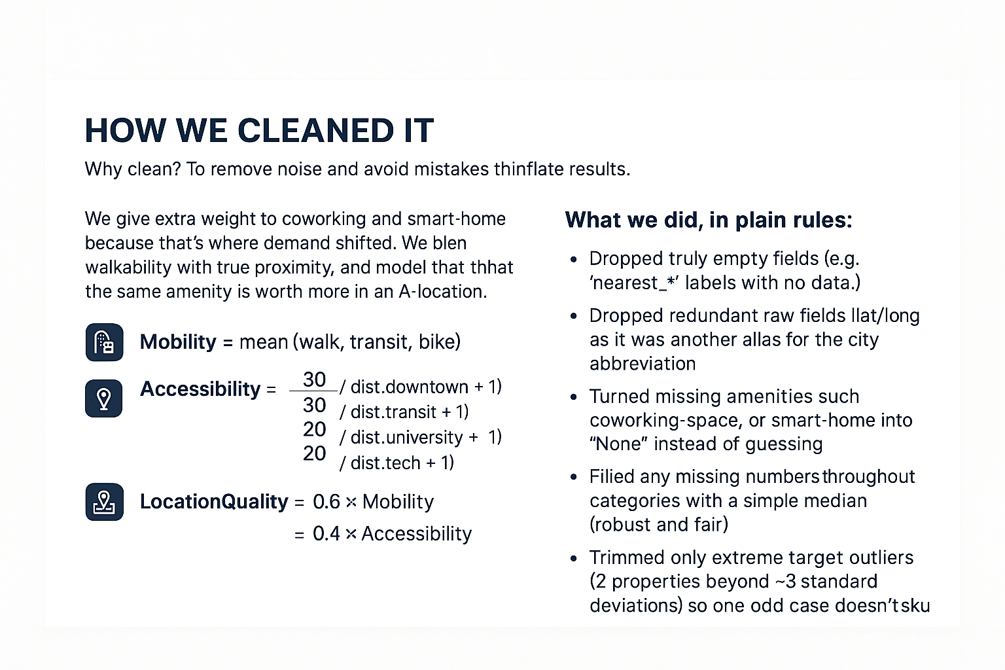
Notes:
We applied systematic data cleaning to eliminate noise and bias, ensuring fair comparisons across properties. Empty or redundant fields (e.g., unused geographic tags) were dropped, missing amenities were filled as “None,” and numeric gaps were imputed with median values. Outliers beyond three standard deviations were trimmed to prevent distortion. Additionally, we engineered interpretable variables: Mobility and Accessibility (based on walk, transit, and proximity scores) combined into LocationQuality = 0.6 × Mobility + 0.4 × Accessibility. This process produced reliable, balanced data for model training.

Slide 7
The Three Signals
Amenity signal (what’s in the home and building)
We count the core amenities (gym, pool, EV, etc.), and we give extra weight to work-from-home features like coworking and smart-home.
In-unit laundry also matters and gets a meaningful bump.
Bottom line: modern, WFH-friendly upgrades move rent and retention more than basic amenities.
Location signal (how easy life is from this address)
We combine everyday convenience (walkability, transit, bike-ability) with proximity to key places (downtown, transit hubs, universities, tech).
We lean a bit more on day-to-day convenience, but proximity still counts.
Bottom line: car-light, centrally connected locations support stronger pricing and faster lease-ups.
Context signal (the value of an upgrade depends on where it is)
Amenities matter more in A-locations—the same pool or coworking space delivers a bigger payoff in a great neighborhood.
Coworking pays off most where remote workers live; in low-remote areas, returns are smaller.
Older but well-kept isn’t bad—good condition can offset age and still perform.
Notes:
When we say ‘amenity signal,’ we mean everything renters can use or feel day-to-day. We include the basics like gym and pool, but we weigh work-from-home features more—coworking and smart-home consistently move willingness-to-pay and help retention. In-unit laundry gets a meaningful bump as well because it reliably improves both price and satisfaction.
For ‘location signal,’ we look at how easy life is without a car and how close the home is to important places. We lean more on everyday convenience—being able to walk or hop on transit—while still recognizing the value of being near downtown or a major station. These homes lease faster and hold pricing better.
Finally, context matters. The same upgrade is worth more in an A-location than in a car-dependent pocket. Coworking makes the biggest difference where remote workers actually live. And an older property in great condition can still outperform—age isn’t a deal-breaker if the experience is good.
Practically, this means we put pricing tests and upgrades first where the amenity story and the location story are both strong. Where location is weaker, we either choose smaller, targeted improvements or we hold off. This is how we keep the plan business-savvy and focused on real payback.

Slide 8
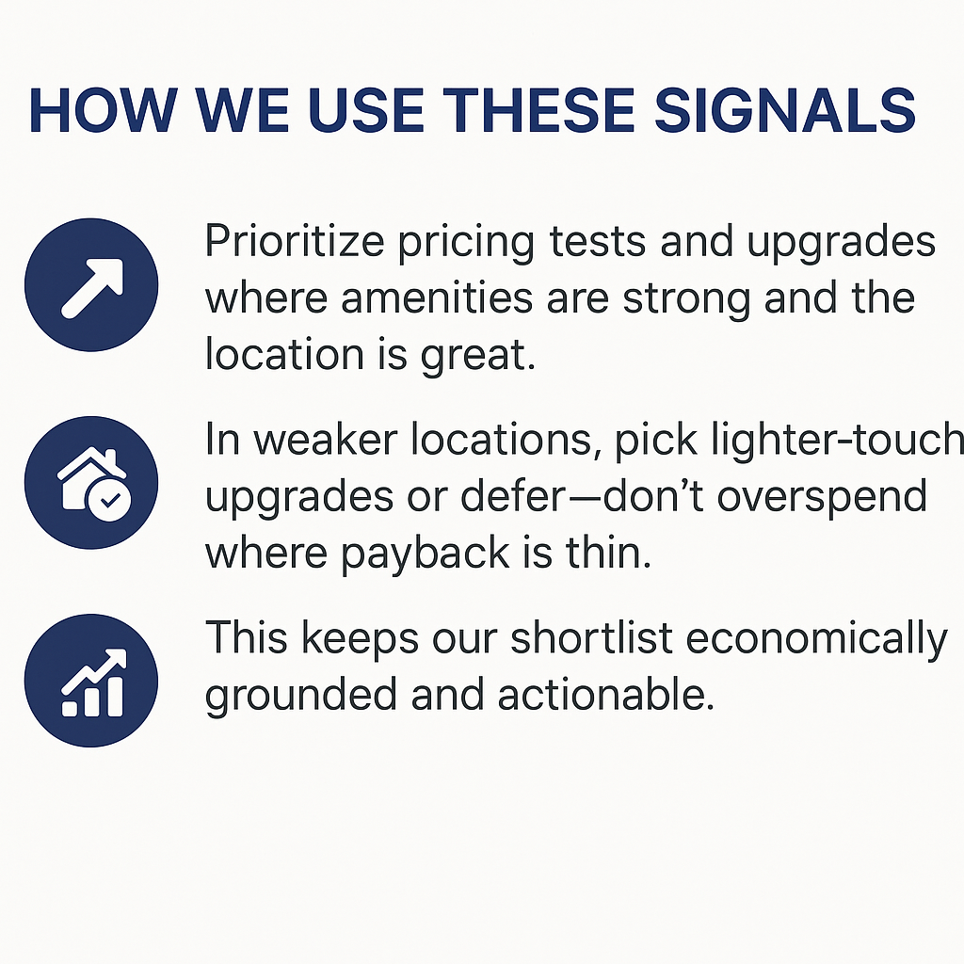
Notes:
This framework ensures that every investment decision is data-driven and economically grounded. By concentrating upgrades and pricing adjustments in high-performing areas, we maximize returns where the payoff is clear and measurable. In contrast, scaling back in weaker markets prevents overinvestment and keeps the portfolio efficient. Overall, this disciplined approach transforms model insights into practical, profitable actions that balance opportunity with risk.

Slide 9
What models we tried, and what we chose
What we tried
Revenue (dollars per bedroom): Linear, Ridge, Lasso
Winners (which homes are likely to do well): Logistic, KNN, Decision Tree, Random Forest
What we picked for the live workflow
Revenue: Linear — the most reliable after cleanup; easy to explain
Winners: Logistic — best balance and gives clean “chance-to-win” percentages
Why not the others (plain reasons)
KNN: too jumpy with lots of features; missed more good homes
Decision Tree: easy to read, but not as accurate overall
Random Forest: close second, but harder to explain to business partners
Ridge/Lasso: no real benefit over Linear once we removed risky inputs
How we kept it fair
Split the data into training and test sets
Tuned only on training data
Fixed class imbalance the right way (on training data only)
Removed anything that could “leak” the answer
Notes:
We tried several common methods so we weren’t betting on one idea. For revenue, a simple Linear model worked best once we cleaned out risky inputs. For predicting winners, Logistic did the best job and gives us clear percentages we can use for decisions. KNN and Decision Tree were useful checks but weaker. Random Forest was close, just harder to explain. We kept the process clean: proper train/test split, tuning on train only, balanced the classes correctly, and avoided leakage.

Slide 10
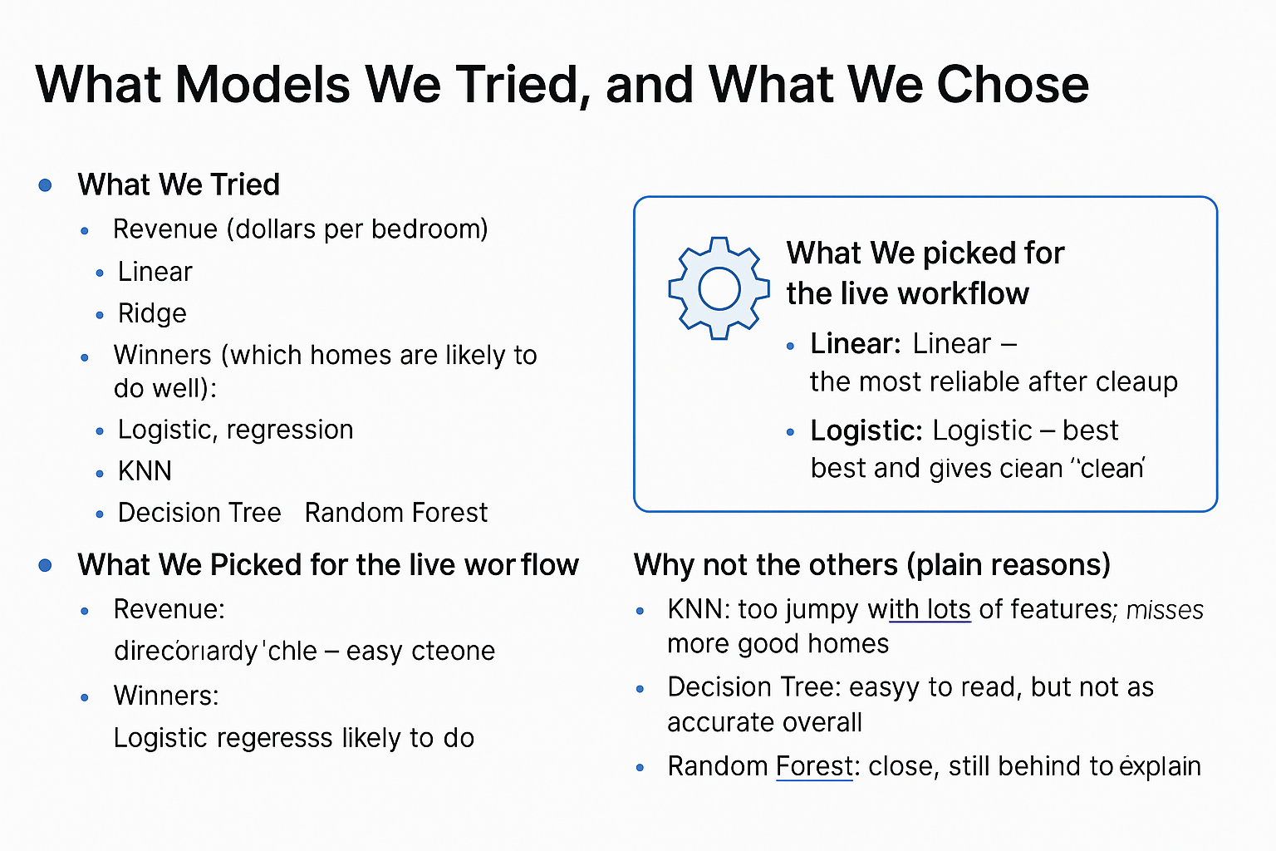
Notes:
We tested several models to find the right balance between accuracy, interpretability, and business usability. For predicting revenue per bedroom, Linear Regression proved the most stable and transparent after data cleanup—Ridge and Lasso offered no major gains. For classifying top-performing properties, Logistic Regression provided the best precision and clarity, outperforming KNN and Decision Tree models, which tended to overfit or misclassify. Random Forest came close but lacked the simplicity needed for clear stakeholder communication. By choosing Linear and Logistic models, we built a workflow that’s both statistically sound and easy to explain, ensuring our insights remain credible and actionable

Slide 11
How the models work
Revenue guidance (used to size actions)
Good enough to rank opportunities and size pricing and upgrades
Not meant to price to the exact dollar — it’s a guide, not a crystal ball
Winner ranking (used to prioritize where to act)
Strong separation between likely winners and the rest
The percentages are trustworthy enough to set simple rules (e.g., act when ≥ 70% chance)
How the others compared (quick confidence check)
KNN: missed more winners and raised more false alarms
Decision Tree: okay, but not the best
Random Forest: close, still behind Logistic and harder to explain
Ridge/Lasso: similar to Linear after cleanup
What this means in practice
Use the winner percentage to set the queue (who gets attention first)
Use the revenue guide to decide how big a move to make
Keep the risk haircut so we don’t chase high-drama assets
Notes:
Here’s the simple takeaway. The revenue model helps us compare properties and decide how big a move makes sense. The winner model tells us which ones deserve attention first, and its percentages are good enough to set a rule like ‘act when the chance is at least 70%.’ The alternatives were useful benchmarks but not as practical for decisions. We also keep a risk haircut so we don’t over-index on assets with policy or safety headaches.

Slide 12
What actually drives results (in real life)
What renters reward
Fresh + well-kept homes (recent renovation, good condition)
Everyday convenience (can walk, easy transit, close to what matters)
WFH-friendly features (in-unit laundry, coworking access, smart-home)
Where context changes the payoff
Great locations multiply upgrades (amenities pay more in A-locations)
Coworking is most valuable where remote workers live
Older isn’t bad if it’s in great shape (good condition offsets age)
What this means for us
Put pricing tests and upgrades first where location and amenities both look strong
In weaker locations, pick lighter-touch improvements or hold off
Favor practical, felt upgrades over flashy, low-return projects
Notes:
If we had to sum it up: fresh buildings with the right WFH amenities, in places where people don’t need a car, win. That’s what the data says, and it matches common sense.

Slide 13
How we turn signals into a rank you can use
Two simple views
Quality: the chance a property behaves like a top performer
Value: a directional revenue per bedroom guide to size the move
How we combine them
We favor quality slightly (it’s more durable for cash flow)
Then apply a moderate risk haircut for regulation, safety, and value-trap economics (e.g., high HOA with poor efficiency)
The result
A Top-20 list that balances upside and execution risk
Each property comes with a plain-English “why” and a first action
How to use it
Use winner % to set the queue (who gets attention first)
Use the revenue guide to decide how big a move to make
Keep the risk check so we don’t chase high-drama assets
Notes:
We boil everything down to two ideas: how likely is this home to perform, and how much value is on the table. We give a little more weight to quality because utilization and resilience matter for cash flows. Then we subtract a bit for policy or safety risk and for value traps like high HOA with poor efficiency. The output is a Top-20 that’s not just ‘high upside,’ but also practical to execute. In use: set the queue by the winner percentage, size the move with the revenue guide, and keep the risk check so we don’t buy headaches.

Slide 14
Snapshot of the Top-20
Where they cluster
Heavier in walkable, central submarkets with strong access
Many are recently updated or in good condition with WFH-friendly features
What they look like
Mix of Premium assets and high-upside Standard properties
Clear “why” for each: location, renovation/condition, and practical amenities
Risk view
Obvious policy or safety flags are already haircut in the score
Exposure by city and tier looks sensible (caps can be added if needed)
How to use the list
Start with top quintile items for pricing tests and upgrades
Keep a bench (next 10–20) ready if scheduling or budgets shift
Treat it as a living list—refresh monthly as results come in
Notes:
Our Top-20 concentrates where we expect returns to be most reliable: walkable, central areas with practical, WFH-ready features. You’ll see a mix of Premium properties and Standard assets that have clear upside. Each entry has a plain-English ‘why’ so the team knows exactly what to test or improve. We’ve already applied a risk haircut, so the obvious policy or safety issues are tempered. We’ll start with the top items, keep a bench ready for scheduling changes, and refresh the list monthly as we see what’s working.

Slide 15
What to do next (the 90-day plan)
Weeks 1–4: Pricing tests
Try small rent increases on the top properties (the ones with great location and high “winner” score).
Watch what happens: do they still rent fast and get good inquiries?
If it holds, keep it. If not, roll back.
Weeks 2–8: Easy upgrades
Add in-unit laundry where it’s doable.
Improve coworking in areas with lots of remote workers.
Add smart-home bundles (locks/thermostats) in walkable, central spots.
Plan the work so it doesn’t hurt occupancy.
Ongoing: Measure and learn
Track: rent lift, time to lease, retention or NPS, and maintenance tickets.
Keep a simple log: what we tried, what it cost, what we got back.
Update the Top-20 list every month and invest more in what’s working.
Guardrails (safety checks)
Policy or safety issues? Set a higher bar or do them later.
High HOA + poor efficiency? Fix efficiency first before fancy upgrades.
Don’t over-concentrate: set caps by city and tier.
Notes:
We start small and measurable: price experiments and two or three high-ROI upgrades. We track lift, keep what works, and then make the shortlist a monthly habit.

Slide 16
Risks & guardrails
Policy / rules
If there’s rent control or local limits, we raise the bar or delay work.
Double-check taxes and permits before we spend.
Safety
If an area has higher crime, we pair upgrades with visible safety steps.
If safety looks weak, the expected return must be higher.
Value traps
High HOA + poor efficiency = fix basics first (energy, water, maintenance) before fancy upgrades.
Concentration
Don’t pile into one place: set caps by city and by tier.
Budget control
Start small. Stop or scale based on results (no sunk-cost traps).
Notes:
Our plan stays practical by adding guardrails. If there are policy limits, we set a higher hurdle or wait. In higher-crime pockets, we add visible safety steps and demand a higher return. If HOA is high and efficiency is poor, we fix the basics first. We also cap exposure so we don’t over-concentrate in one city or tier. Most important: we start small, measure, and only scale what works.

Slide 17
Close: the ask
What we’ll do (next 90 days)
Weeks 1–4: Small price tests on the top picks; keep only what holds.
Weeks 2–8: Easy, renter-felt upgrades (in-unit laundry, coworking where remote is high, smart-home in walkable cores).
Measure weekly: rent lift, time-to-lease, retention/NPS, maintenance tickets. Update the Top-20 monthly.
Guardrails
Policy/safety flags = higher bar or later.
High HOA + weak efficiency = fix basics first.
Cap city/tier exposure.
What we need
Green light for a 4–6 property pilot, budget range, and point person per market.
We’ll share a simple dashboard weekly and a win/loss log; scale what works, stop what doesn’t.
Notes:
This is a fast, low-drama 90-day plan. We test pricing on the best candidates, run simple upgrades people feel, and measure weekly. We keep guardrails to avoid headaches and update the Top-20 monthly. To start, we need approval, a budget range, and a contact in each market. We’ll report weekly and only scale what proves out.

Slide 18
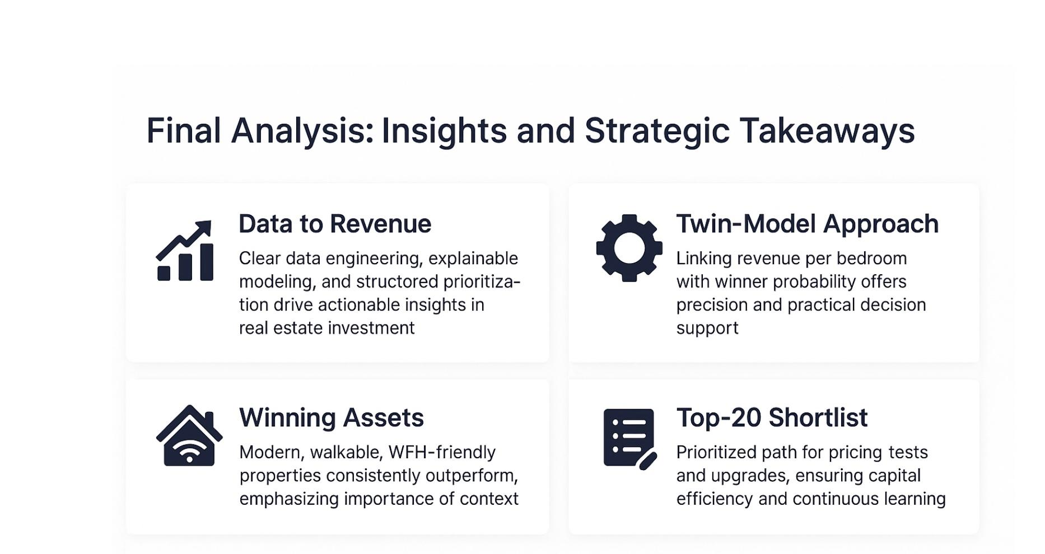
Final Analysis: Insight and Strategic Takeaways
Notes:
This project demonstrates how clear data engineering, explainable modeling, and structured prioritization can drive actionable insights in real estate investment. By integrating 465 properties and 99 engineered features, we produced a defensible system for identifying risk-balanced revenue opportunities. The twin-model approach—linking revenue per bedroom with winner probability—provides both precision and practical decision support. Our findings confirm that modern, walkable, WFH-friendly assets consistently outperform, while context (location and regulation) remains essential to risk-adjusted value. The Top-20 shortlist offers a measurable, repeatable path for near-term pricing tests and upgrades, ensuring capital efficiency and continuous learning through monthly refresh cycles.

