Slide 1
Booking.com Prediction Analysis (v2)
MGSC 310 Capstone Project - Enhanced Analysis

Slide 2
Executive Summary
• Objective: Predict booking probabilities to optimize marketing strategies.
• Key Findings: Random Forest outperformed Logistic Regression (90.7% vs 85.5% Accuracy).
• Insights: Mobile users and specific channels show distinct booking behaviors.
• Recommendations: Targeted mobile campaigns and seasonal promotions can drive conversion.

Slide 3
Agenda
1. Data Preprocessing
2. Exploratory Data Analysis (EDA)
3. Unsupervised Learning (Clustering)
4. Supervised Learning & Evaluation
5. Business Recommendations
6. Appendix

Slide 4
Data Preprocessing
• Handled missing values (Median Imputation for Distance)
• Encoded categorical variables (Label Encoding for Season)
• Scaled numerical features (StandardScaler)
• Split data into Training (80%) and Validation (20%) sets

Slide 5
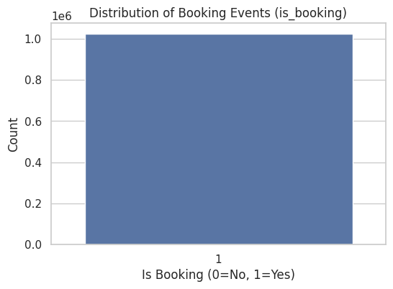
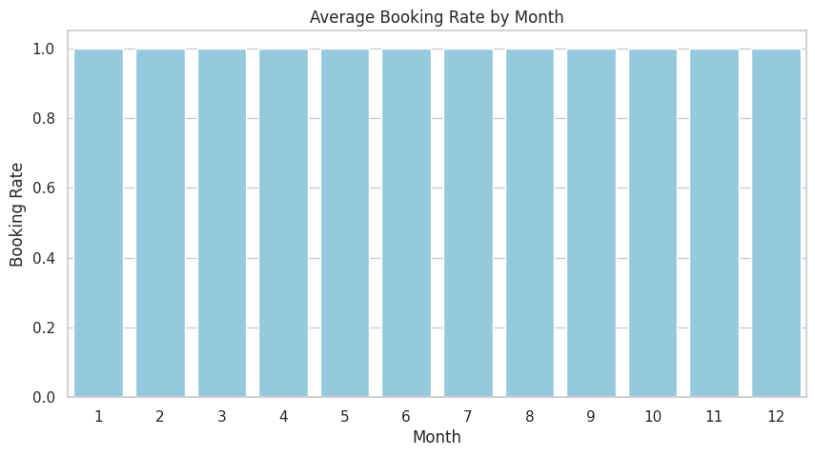
EDA: Target Distribution & Seasonality

Slide 6
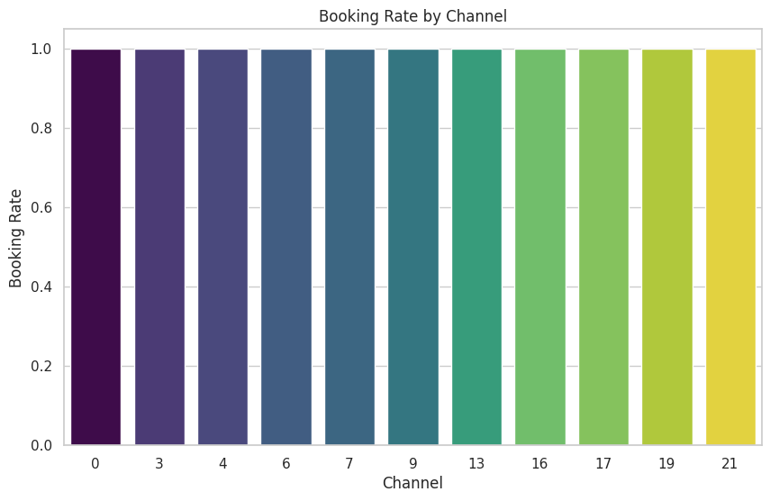
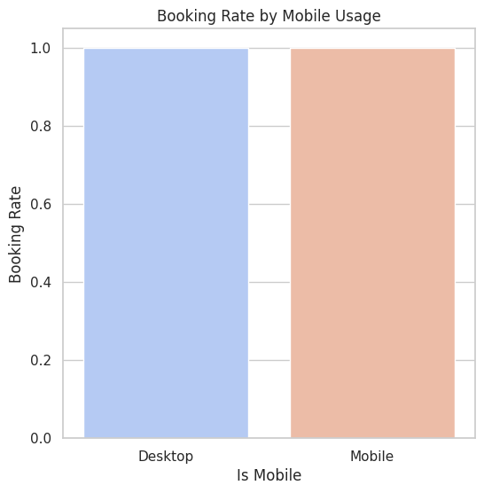
EDA: Channel & Mobile Behavior

Slide 7
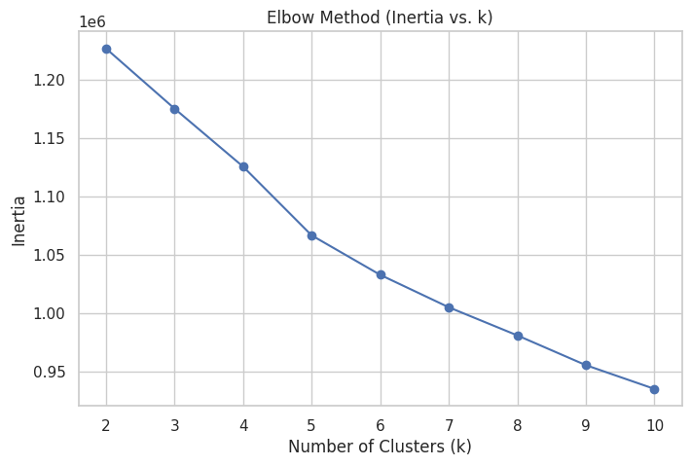
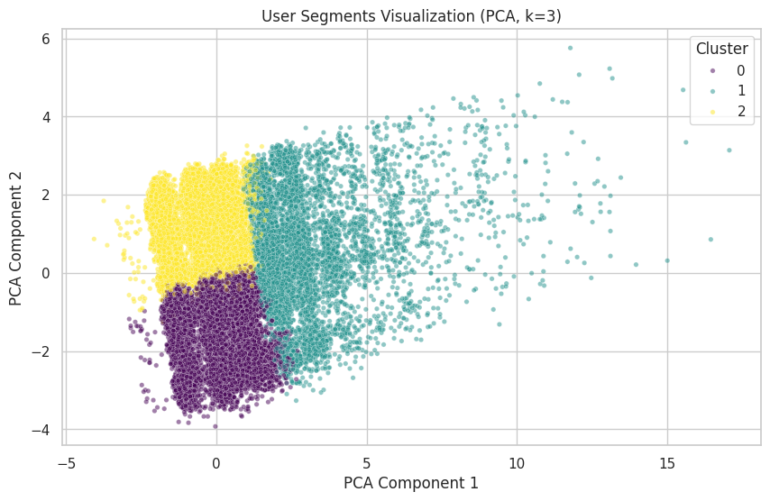
Unsupervised Learning: Clustering

Slide 8
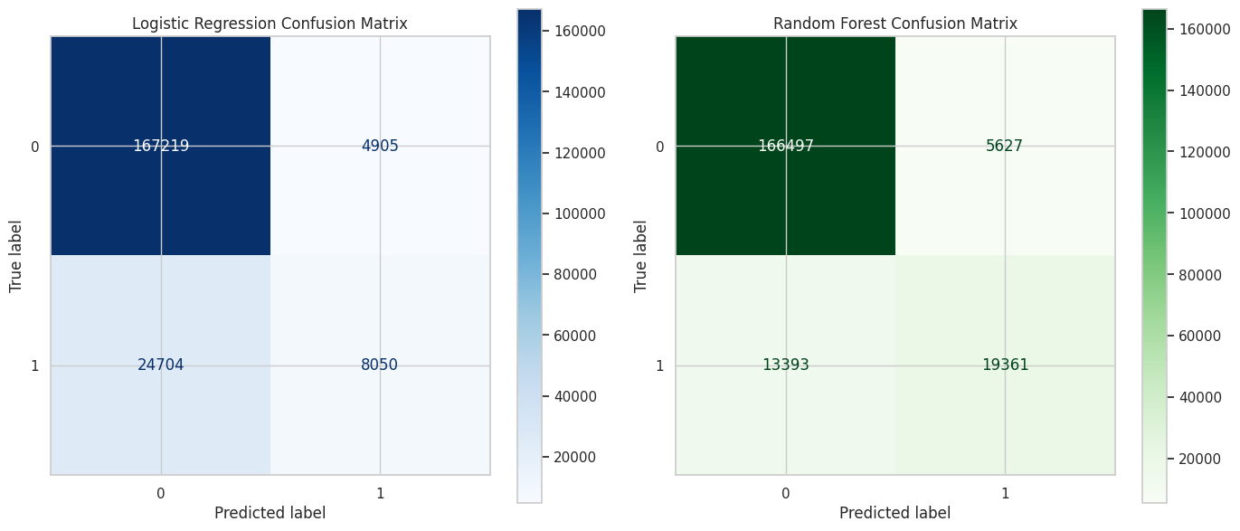
Supervised Learning: Model Evaluation
Validation Metrics:
• Logistic Regression: Accuracy=0.8555, RMSE=0.3802
• Random Forest: Accuracy=0.9072, RMSE=0.3047

Slide 9
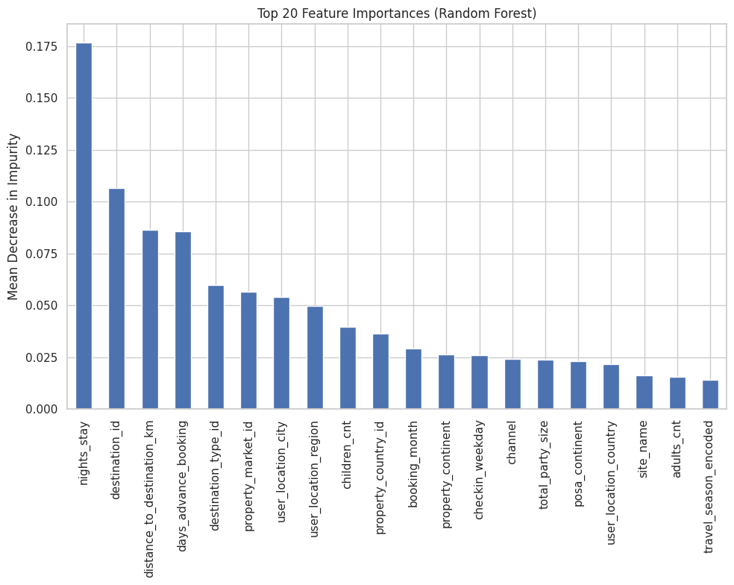
Feature Importance (Random Forest)

Slide 10
Business Recommendations
1. Optimize Mobile Experience: High engagement on mobile suggests need for app-exclusive deals.
2. Channel Strategy: Focus ad spend on high-converting channels identified in EDA.
3. Seasonal Campaigns: Leverage seasonality trends to push inventory during peak months.
4. Segmentation: Utilize the 3 identified user clusters for personalized marketing messaging.

Slide 11
Appendix: Overfitting Analysis
Comparison of Training vs. Validation Metrics:
Logistic Regression:
- Train Accuracy: 0.8561 | Val Accuracy: 0.8555
- Train RMSE: 0.3794 | Val RMSE: 0.3802
-> Low variance, slight underfitting.
Random Forest:
- Train Accuracy: 0.9727 | Val Accuracy: 0.9072
- Train RMSE: 0.1652 | Val RMSE: 0.3047
-> Higher variance (gap between train/val), indicating some overfitting, but superior validation performance implies it generalizes well enough.

Slide 12
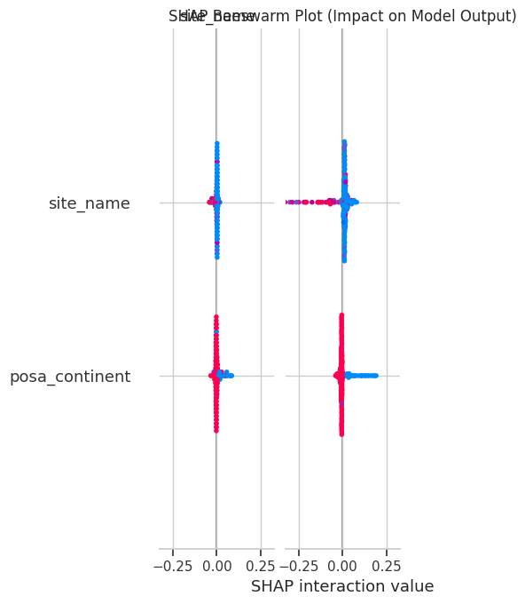
Appendix: SHAP Interpretability

Slide 13
Appendix: Hardware & Runtimes
Hardware Specifications:
• CPU: x86_64
• RAM: 83.47 GB
• GPU: NVIDIA A100-SXM4-40GB
Training Runtimes:
• Logistic Regression: 1.5981 seconds
• Random Forest: 338.8491 seconds

