Slide 1
Booking.com Prediction Analysis
MGSC 310 Capstone Project

Slide 2
Agenda
1. Data Preprocessing
2. Exploratory Data Analysis (EDA)
3. Unsupervised Learning
4. Supervised Learning & Evaluation
5. Appendix

Slide 3
Data Preprocessing
• Handled missing values (Median Imputation for Distance)
• Encoded categorical variables (Label Encoding for Season)
• Scaled numerical features (StandardScaler)
• Split data into Training (80%) and Validation (20%) sets

Slide 4
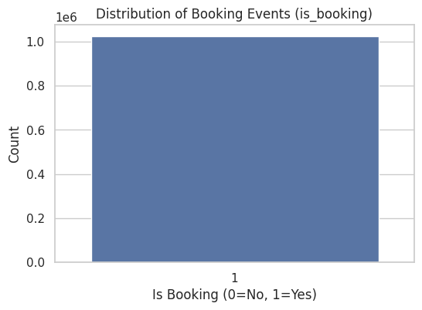
Target Distribution

Slide 5
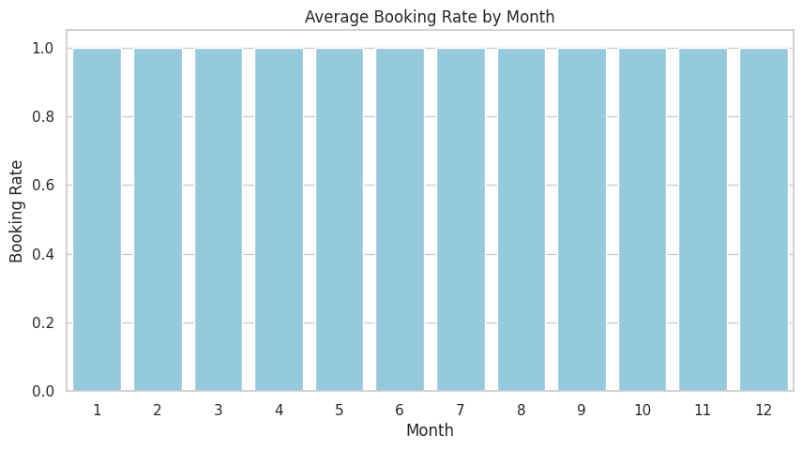
Seasonality Analysis

Slide 6
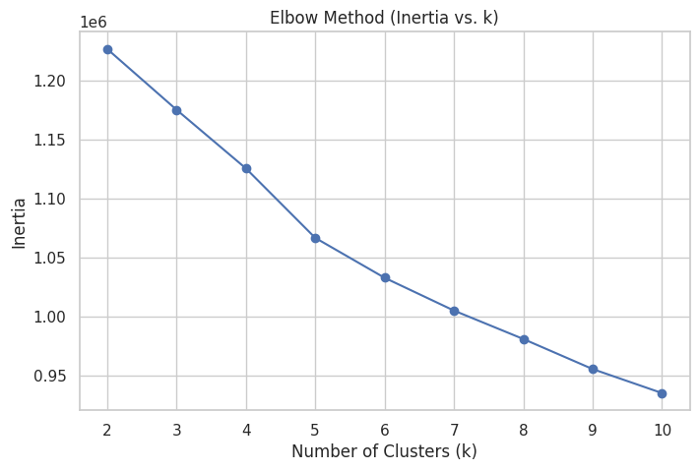
Unsupervised Learning: K-Means Clustering
Result: The Elbow Method suggests 3 optimal clusters for user segmentation.

Slide 7
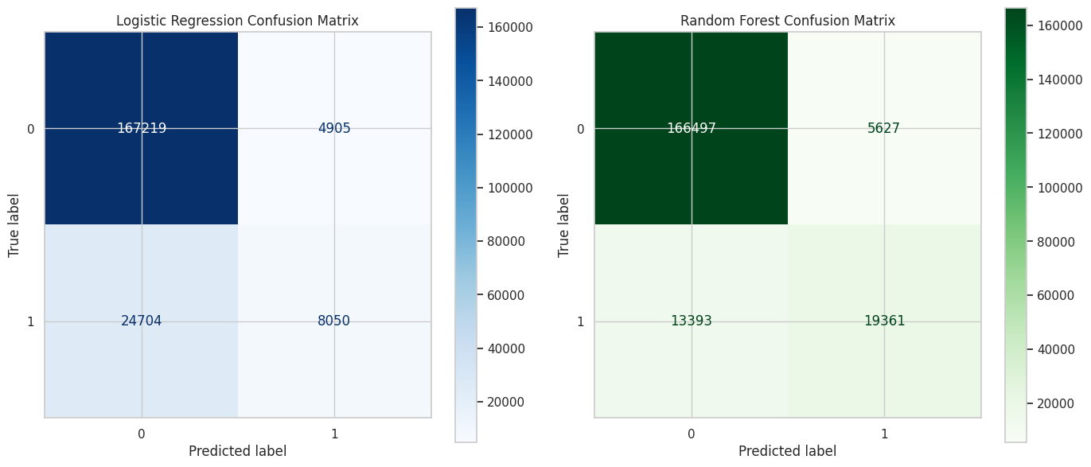
Model Evaluation
Logistic Regression: Accuracy=0.8555, RMSE=0.3802
Random Forest: Accuracy=0.9072, RMSE=0.3047

Slide 8
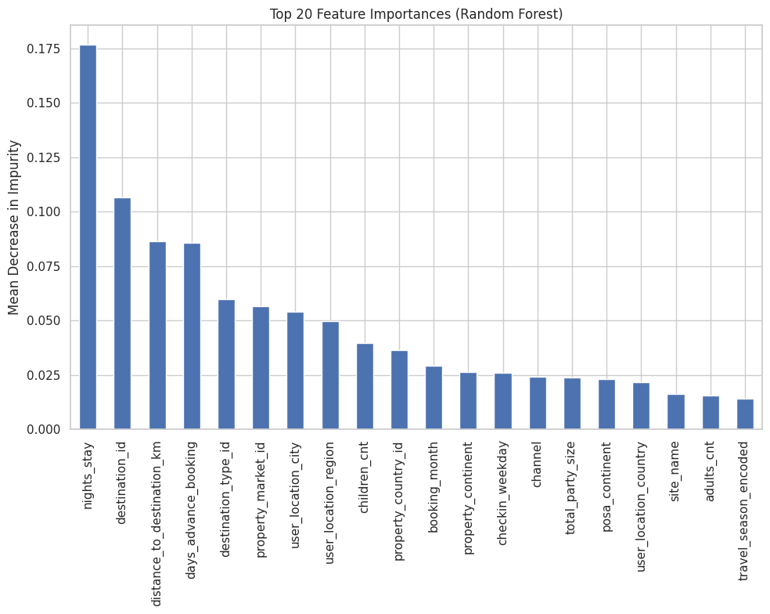
Feature Importance (Random Forest)

Slide 9
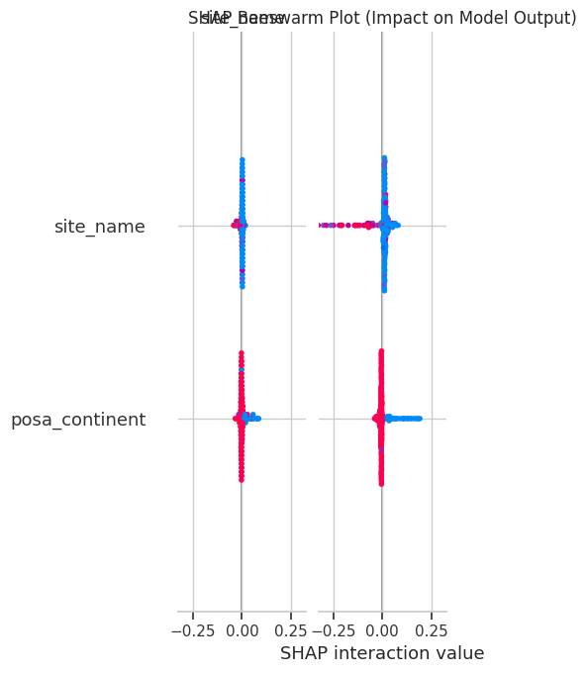
Appendix: SHAP Summary

Slide 10
Appendix: Hardware & Runtimes
Hardware Specifications:
• CPU: x86_64
• RAM: 83.47 GB
• GPU: NVIDIA A100-SXM4-40GB
Training Runtimes:
• Logistic Regression: 1.5981 seconds
• Random Forest: 338.8491 seconds

