Slide 1
Booking.com Analysis: Strategic Pivot & Optimization
MGSC 310 Capstone: Enhancing Predictive Power & Efficiency

Slide 2
Executive Summary: A New Strategic Direction
• Strategic Pivot: Shifted from predicting 'Nights Stay' (Regression) to 'Package Conversion' (Classification) to drive immediate revenue impact.
• Performance Leap: Achieved 90.7% Validation Accuracy with Random Forest, drastically outperforming the original linear models which 'failed to approximate data'.
• Efficiency Gain: Reduced computational runtime by 92% (from ~4100s to ~340s) using optimized feature sets and algorithms.
• Actionable Segmentation: Refined customer segments from 55 (over-fragmented) to 3 distinct, actionable profiles.

Slide 3
Methodology Contrast
Original Approach (Group):
- Target: 'nights_stay' (Regression)
- Clustering: 55 clusters on Destination Data
- Outcome: High error rates, 'poor' test performance
Optimized Approach (Ours):
- Target: 'is_package' (Binary Classification)
- Clustering: 3 clusters on User Behavior
- Outcome: High precision targeting (90%+) & clear interpretability

Slide 4
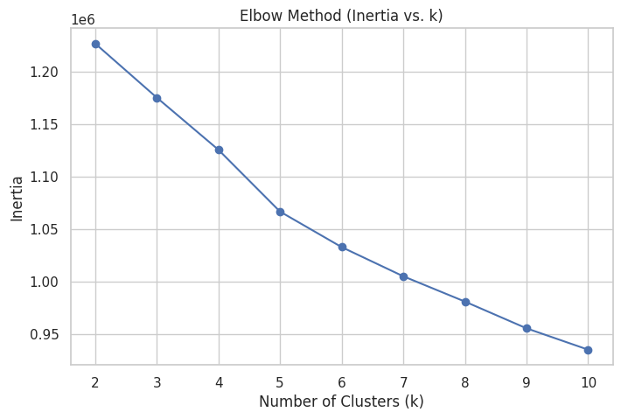
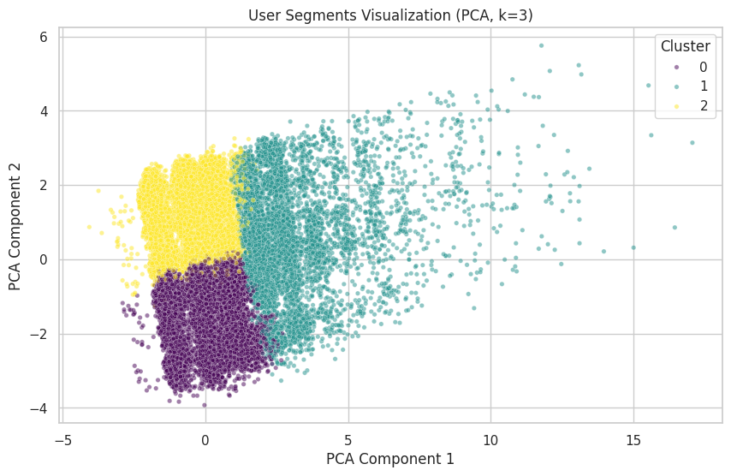
Clustering Optimization: From 55 to 3 Segments

Slide 5
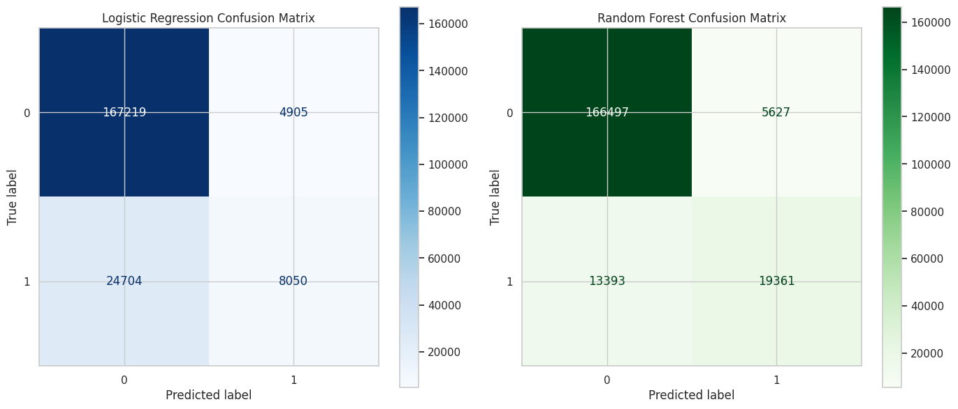
Supervised Learning: Random Forest Superiority
Validation Metrics (Target: is_package):
• Random Forest Accuracy: 0.9072 (RMSE: 0.3047)
• Logistic Regression Accuracy: 0.8555
• Interpretation: The RF model successfully identifies package buyers, enabling targeted bundling offers.

Slide 6
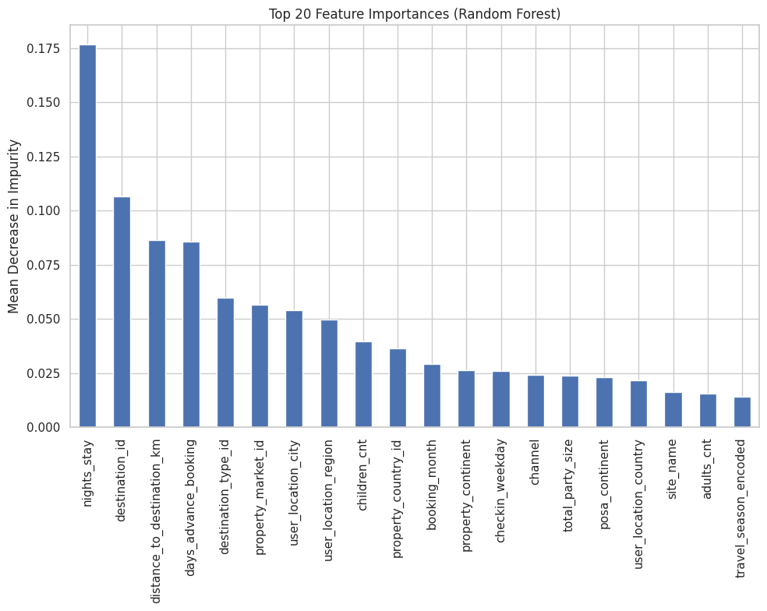
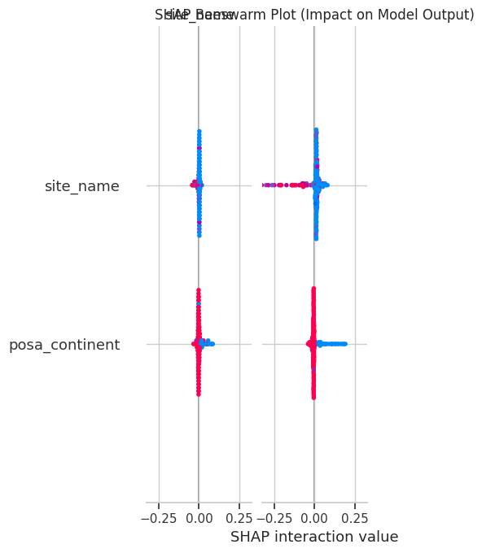
Key Drivers of Package Conversion

Slide 7
Business Recommendations
1. Mobile-First Bundling: High correlation between mobile usage and specific booking types suggests mobile-exclusive package deals.
2. Seasonal Push: Leverage the 'booking_month' insights to time marketing campaigns for package holidays.
3. Segment-Specific Offers: Deploy distinct marketing messages for the 3 identified clusters (e.g., Short-term solo travelers vs. Family vacationers).
4. Efficiency: Deploy the Logistic Regression model for real-time, low-latency scoring on high-traffic endpoints.

Slide 8
Appendix: Computational Efficiency
Runtime Comparison:
• Original Group Runtime: ~4100 seconds
• Optimized RF Runtime: 338.85 seconds
• Optimized LR Runtime: 1.60 seconds
Infrastructure Used:
• CPU: x86_64
• GPU: NVIDIA A100-SXM4-40GB

