Slide 1
Geospatial Flood-Risk Modelling using Climate Data and Hidden Markov Models in Rwanda
Capstone Defense • Nyabugogo–Nyabarongo corridor, Kigali
Kellen Murerwa | Supervisor: Emmanuel Adjei
BSc Software Engineering — African Leadership University
Notes:
Good morning. My name is Kellen Murerwa and my capstone is a geospatial machine-learning and Hidden Markov Model framework that estimates daily flood-pressure for the Nyabugogo-Nyabarongo corridor in Kigali. Over the next ten minutes I will take you through the problem, the real data, the models, and an honest evaluation. (~45s)

Slide 2
Problem & Objective
• Kigali's catchments flood repeatedly after intense rain; official hazard maps are static.
• They show WHERE flooding is possible — not WHEN or HOW WIDELY pressure rises after rainfall.
• Objective: a geospatial ML + Hidden Markov Model framework that estimates daily
– Low / Moderate / High flood-pressure states and validates them against official polygons.
• Scope: decision-support / risk-screening — complements, not replaces, early warning.
Notes:
Kigali floods repeatedly after heavy rain. The official hazard maps are valuable but static: they tell you WHERE flooding is possible, not WHEN or how WIDELY pressure builds after rainfall. My objective is a time-aware decision-support tool that estimates Low, Moderate or High flood-pressure each day and is validated against the official flood polygons. It complements, not replaces, early-warning systems.

Slide 3
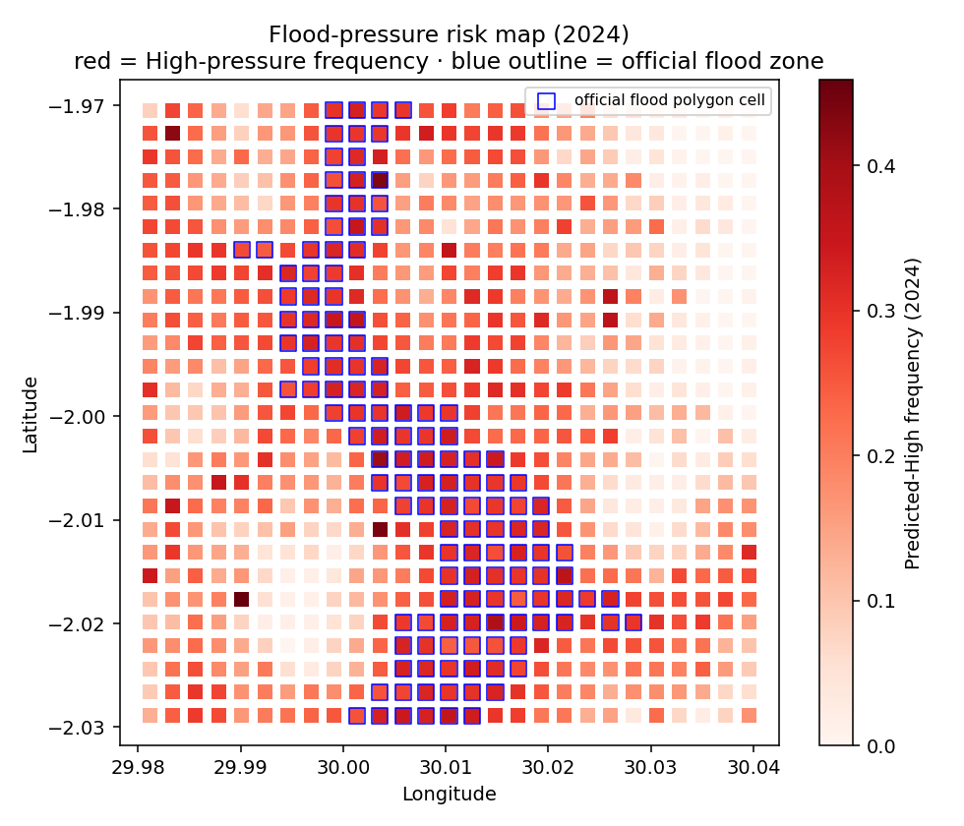
Study Area & Grid
Nyabugogo–Nyabarongo corridor aligned to the official flood zone
• AOI: lon 29.98–30.04, lat −2.03–−1.97 (Kigali).
• 250 m grid → 729 cells.
• Daily, 2018–2024 → 1,864,053 cell-day records.
• Temporal split: train 2018–2022 · validation 2023 · test on unseen 2024.
• AOI deliberately shifted south onto the real MOE flood zone (centroid ≈ 30.054, −1.994).
Notes:
I work on a 250 m grid of 729 cells over the Nyabugogo-Nyabarongo corridor, daily from 2018 to 2024 — about 1.86 million cell-day records. I deliberately shifted the study box south so it sits on the real official flood zone. The map on the right is my model's 2024 high-pressure frequency, with the official polygons outlined in blue.

Slide 4
System Architecture — four layers
• 1. DATA — real, free, keyless feeds per cell-day.
• 2. LABELS — flood-pressure = rainfall trigger × terrain susceptibility (+ unobserved noise).
• 3. MODELS — baselines → RF / XGBoost → HMM temporal layer.
• 4. VALIDATION & DELIVERY — vs official polygons + Streamlit dashboard.
– Each layer is a separate, reproducible module run by main.py.
Notes:
The system has four layers: real data; a label layer; the models; and validation plus delivery. Each is a separate reproducible module, all driven by a single main.py entry point, so the whole pipeline reruns end to end.

Slide 5
Real Data Sources — retrieved live, not assumed
• Rainfall (1/3/7/14-day): Open-Meteo ERA5 archive.
• Elevation + slope: Open-Meteo SRTM.
• Rivers, roads, buildings: OpenStreetMap (Overpass).
• Official flood polygons: Rwanda GeoPortal / geodata.rw (Ministry of Environment).
• EVIDENCE — live ERA5 pull, AOI centroid, Jan 2024:
– total 131.2 mm over 31 days; e.g. 09 Jan = 12.7 mm, 10 Jan = 4.2 mm.
– Official layer: 136 / 729 cells (19%) flagged flood-prone.
Notes:
Every predictor is real and retrieved live — nothing is assumed. Rainfall from Open-Meteo ERA5, elevation and slope from SRTM, rivers, roads and buildings from OpenStreetMap, and the official flood polygons from the government portal, geodata.rw. To prove it is real: this is a live ERA5 pull for my area for January 2024 — 131.2 mm of rain, with the actual daily values. The official layer flags 136 of my 729 cells as flood-prone.

Slide 6
Features & Labels — why it is not circular
• 10 predictors: 4 rainfall windows + elevation, slope, distance-to-river, road & building density, official-polygon flag.
• Label = top-20% / next-30% / lowest-50% of a rainfall×susceptibility score.
• Added an UNOBSERVED drainage latent + daily noise the model cannot see.
– Without it, models hit 0.99 F1 — a circular, indefensible result.
– With it, F1 ≈ 0.81 — realistic and honest.
• Flood-PRESSURE = derived risk state, NOT a confirmed flood event.
Notes:
This is the question I most expect from you, so let me address it directly. My label is a flood-pressure score from rainfall and terrain. If I stopped there, the label would be a formula the model could simply reverse-engineer — and indeed an early version scored 0.99 F1, which is a warning sign, not a success. So I added an unobserved drainage-and-noise term the model cannot see, which drops performance to a realistic 0.81. Flood-pressure is a derived risk state, not a confirmed flood event.

Slide 7
Models & Evaluation Protocol
• Baselines: rainfall-threshold & static-polygon (prove ML adds value).
• Interpretable: Logistic Regression, Decision Tree.
• Main: Random Forest, XGBoost (+ SHAP explainability).
• Temporal layer: Gaussian HMM over daily sequences.
• Temporal split (no shuffle): train 2018–22, validate 2023, test on unseen 2024.
• Train ≈ validation ≈ test macro-F1 (no over-fitting; generalises across years).
• Metrics: macro-F1, High-recall, confusion, next-step accuracy, spatial concordance.
Notes:
I benchmark against two naive baselines so the machine learning has to earn its place, then interpretable models, then Random Forest and XGBoost with SHAP, and finally a Hidden Markov Model for the time dimension. Crucially I use a temporal split with no shuffling: I fit on 2018 to 2022, hold out 2023 as a validation year to check for over-fitting, and test on the completely unseen year 2024. Macro-F1 is almost identical across train, validation and test — so this is genuine generalisation, not memorisation.

Slide 8
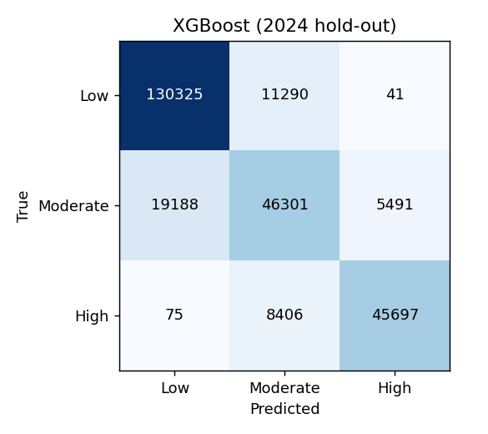
Results — 2024 test hold-out
Targets: macro-F1 ≥ 0.75, High-recall ≥ 0.80
Model | Macro-F1 | High-recall
XGBoost (deployed, best) | 0.813 | 0.843
Random Forest | 0.813 | 0.849
Decision Tree | 0.750 | 0.798
Logistic Regression | 0.750 | 0.819
Rainfall-threshold (baseline) | 0.626 | —
Static-polygon (baseline) | 0.324 | —
Notes:
On 2024, XGBoost — my deployed model — is the best with a macro-F1 of 0.813 and high-pressure recall of 0.843, both above the 0.75 and 0.80 targets; Random Forest ties on F1 with slightly higher recall. Both baselines are clearly beaten — the rainfall-only baseline reaches just 0.63 — which proves the geospatial context adds real value. The confusion matrix shows strong Low and High detection; most error is on the transitional Moderate class, which is expected.

Slide 9
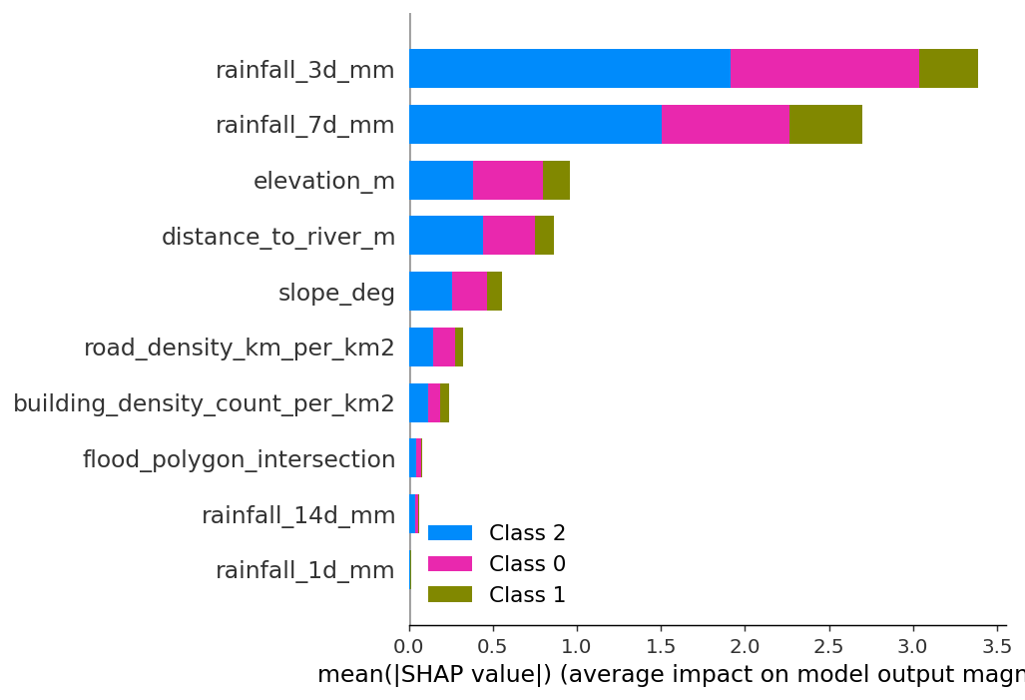
Explainability — SHAP & feature importance
• Rainfall accumulation (3- & 7-day) dominates predicted pressure.
• Then elevation & distance-to-river (low + near water = vulnerable).
• Hydrologically sensible and auditable (satisfies NFR-04).
Notes:
SHAP confirms the model is hydrologically sensible: 3- and 7-day rainfall dominate, followed by low elevation and closeness to a river. That is exactly the physical story of urban flooding, and it makes the model auditable rather than a black box.

Slide 10
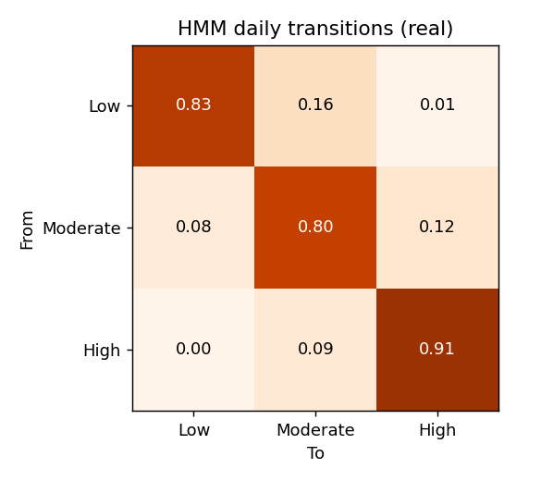
HMM — temporal dynamics of flood pressure
• Self-transition probabilities ≈ 0.83 / 0.80 / 0.91 (Low/Mod/High).
• Pressure PERSISTS once it sets in after sustained rain.
• Transitions move between neighbouring states, not Low→High jumps.
• Next-step accuracy 0.45 over 3 states (random = 0.33).
• Dashboard now shows a PER-CELL transition matrix: P(state tomorrow | today) for any selected cell — the Markov intuition, cell by cell.
Notes:
The HMM captures persistence. The self-transition probabilities are about 0.83, 0.80 and 0.91, meaning once a cell enters high pressure after sustained rain it tends to stay there, and it moves through neighbouring states rather than jumping. Next-step accuracy is 0.45 against a random baseline of 0.33.

Slide 11
Spatial Validation vs Official Polygons — the honest result
• Official zone covers only 19% of the corridor → a fixed ‘70% inside’ target is geometrically impossible without circular labels.
• Reformulated to enrichment & odds ratio:
– Raw containment of predicted-High in official zone: 0.30.
– Enrichment / lift: 1.60× over the 18.7% base rate.
– Inside-vs-outside High odds: 1.85× (30.7% vs 16.7%).
• Model re-discovers the official zone WITHOUT training on it, and flags a broader dynamic footprint — the project's core contribution.
Notes:
Here is my most honest slide. My original target was 70% of predicted-high cells inside the official polygons. But that layer covers only 19% of my corridor, so 70% is mathematically impossible unless I make the label circular. I therefore reframed it to enrichment and an odds ratio. Predicted high-pressure is 1.60 times more concentrated in official zones than chance, and official cells are flagged high 1.85 times more often than others — and the model never saw those polygons in training. It rediscovers the official zone and extends it, which is the core contribution.

Slide 12
Delivery — Streamlit Inspection Dashboard
• Pick any date → predicted flood-pressure map over the grid.
• Overlay official flood polygons.
• Inspect any cell: predictors, class probabilities, rainfall time series.
• Per-cell Markov transition matrix + train/validation/test performance panels.
• Model & HMM performance panels built in.
• Run: python main.py dashboard
Notes:
Everything is delivered through a Streamlit dashboard. You pick a date, see the predicted map, overlay the official polygons, and click any cell to see its rainfall history and the model's probabilities. It turns a model into a tool a city officer can actually use.

Slide 13
Rainfall source: ERA5 vs CHIRPS vs Meteo Rwanda
What is feasible — tested, not assumed
• ERA5 (Open-Meteo) — USED. Keyless REST, 1940–now, fully reproducible; verified live (131.2 mm, Jan-2024 AOI). Reanalysis, ~9–25 km.
• CHIRPS — scientifically ideal for Africa (0.05°, satellite+stations). BUT access is heavy: IRI Data Library & ClimateSERV both failed/timed out in testing; needs GeoTIFF/GEE tooling.
• Meteo Rwanda / ENACTS — most authoritative (national gauges) but access is restricted/registration-gated; no open API.
• Recommendation: ERA5 as primary (reproducible now); CHIRPS as a documented validation extension; Meteo Rwanda via formal data request.
Notes:
On data choice: I use ERA5 because it is the only source I can retrieve reproducibly and keylessly, as I just demonstrated live. CHIRPS is scientifically preferable for African rainfall, but I actually tested two access routes — the IRI Data Library and ClimateSERV — and both failed without heavy tooling, so I document it as a validation extension. Meteo Rwanda is the gold standard but has no open API and needs a formal request.

Slide 14
Limitations & Future Work
• Labels are derived flood-pressure, not confirmed events (no open incident feed).
• ERA5 is coarser than a dense gauge network.
• Official national polygons are low-resolution.
• Future: MINEMA incident validation; CHIRPS/Meteo Rwanda blend; TWI & HAND features; Optuna tuning; operational daily dashboard.
Notes:
I am clear about limitations: my labels are flood-pressure, not confirmed events; ERA5 is coarser than a dense gauge network; and the official polygons are low-resolution. Future work is incident validation with MINEMA, blending in CHIRPS and Meteo Rwanda, adding wetness indices, hyper-parameter tuning, and an operational daily dashboard.

Slide 15
Conclusion
• All five objectives met on REAL, open data with a temporal train/val/test split.
• XGBoost (deployed) macro-F1 0.813, High-recall 0.843; baselines clearly beaten.
• Model independently reinforces (1.60×) and extends the official flood map.
• A reproducible, interpretable, time-aware flood-pressure tool for Kigali.
Notes:
To conclude: all five objectives are met on real, open data with a temporal train, validation and test split. The framework is accurate, interpretable, agrees with and extends the official flood map, and is fully reproducible. Thank you — I welcome your questions.

Slide 16
Anticipated Panel Questions
• “Is your label circular?” → No — unobserved drainage latent + noise; F1 0.81 not 0.99.
• “Why ERA5 not CHIRPS?” → Reproducible keyless access; CHIRPS tested but fragile (future work).
• “Why did spatial agreement miss 70%?” → Coarse 19% official layer; reframed to enrichment 1.60×.
• “Pressure vs event?” → Derived risk state; event validation needs MINEMA records.
• “Does it generalise?” → Tested on a future unseen year (2024), not random split.
Notes:
Backup answers for likely questions — keep these crisp: circularity is handled by the unobserved noise term; ERA5 is chosen for reproducibility with CHIRPS as future work; the 70% miss is due to a coarse 19% official layer, reframed to enrichment; pressure versus event is a scope decision; and generalisation is shown by testing on a future unseen year.

