Slide 1
Geospatial Flood-Risk Modelling using Climate Data
and Hidden Markov Models in Rwanda
Nyabugogo–Nyabarongo corridor, Kigali
Progress presentation · ML gap → solution → status → prototype
Kellen Murerwa | Supervisor: Emmanuel Adjei
BSc Software Engineering · African Leadership University
Notes:
Good [morning]. I'm Kellen Murerwa. My capstone builds a geospatial machine-learning system that estimates daily flood-pressure for a flood-prone corridor in Kigali, using only open climate and map data. In the next 10 minutes I'll cover the ML gap, my solution, where I am now, and a working prototype. (~30s)

Slide 2
PROBLEM
The ML gap we address
• Kigali's existing flood-risk tools are STATIC hazard maps — they cover only ~19% of the study corridor and never change with the weather.
– They give no time-aware, day-to-day view of where flood pressure is building after heavy rain.
• ML flood-susceptibility studies exist, but in this setting they rarely:
– combine supervised geospatial ML with a temporal (sequence) model,
– rely only on open / free data for a data-scarce African urban catchment,
– or ship a validated, usable artefact — most stop at an accuracy table.
• → The gap: a reproducible, time-aware ML system from OPEN data that beats static maps and rule baselines — and is validated against the official flood polygons.
Notes:
The problem: Kigali's flood tools are static hazard maps. They're authoritative but cover only ~19% of my corridor and never change — so they can't tell you where pressure is building after a storm. ML studies exist, but they rarely pair geospatial ML with a temporal model, rarely stick to open data for an African city, and rarely ship something usable. That intersection is my gap. (~1.5 min)

Slide 3
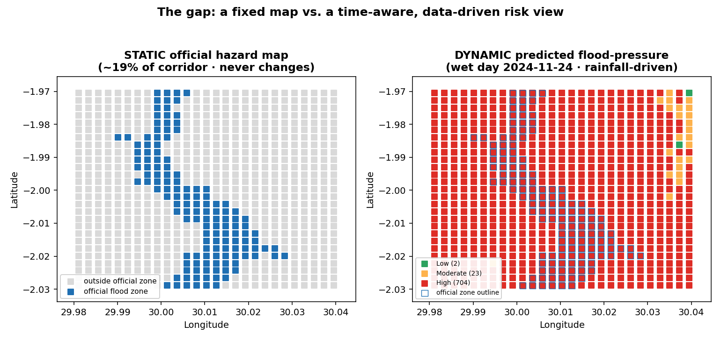
THE GAP, VISUALISED
Static map vs. dynamic prediction
Left: the fixed official zone (same every day). Right: on a wet day the model flags a far broader, rainfall-driven footprint — the risk the static map misses.
Notes:
Here's the gap in one picture. On the left is the official hazard map — a fixed blue zone, ~19% of the area, identical every day of the year. On the right is my model on a wet day: it still concentrates risk in and around the official zone, but it flags a much wider rainfall-driven footprint the static map simply can't show. Same place, but a time-aware view. (~1 min)

Slide 4
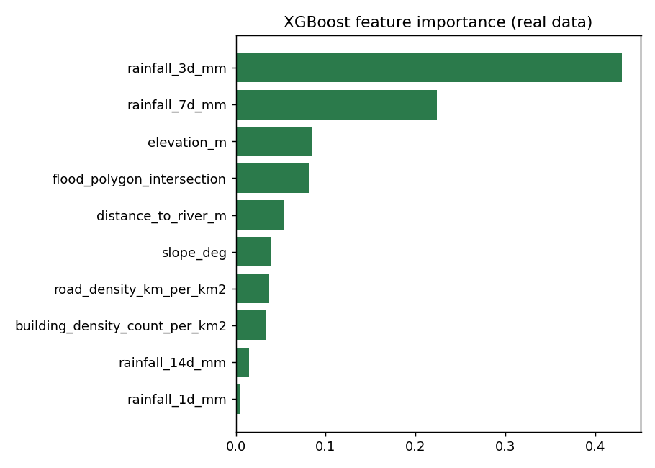
APPROACH
Proposed solution
• A 250 m grid over the corridor (729 cells), one row per cell-per-day, 2018–2024 (1.86 M cell-days).
• Fuse four open, keyless sources into 10 features:
– rainfall accumulations (1/3/7/14-day) — Open-Meteo ERA5,
– terrain (elevation, slope) — SRTM; exposure (river, roads, buildings) — OSM,
– official flood-zone membership — Rwanda GeoPortal / MOE.
• Predict daily Low / Moderate / High flood-pressure states.
• Benchmark LR/DT, Random Forest, XGBoost vs. rainfall-threshold & static-polygon baselines; add an HMM temporal layer.
• Honest test: temporal split — train 2018–22, validate 2023, test on unseen 2024; then spatial validation + a Streamlit dashboard.
Engineered features ranked by importance
Notes:
My solution: lay a 250 m grid over the corridor — 729 cells, one row per cell per day, seven years, 1.86 million rows. I fuse four open, keyless sources into ten features: rainfall accumulations from Open-Meteo ERA5, terrain from SRTM, exposure — rivers, roads, buildings — from OpenStreetMap, and official flood-zone membership from the Rwanda GeoPortal. I predict Low/Moderate/High pressure, benchmark Random Forest and XGBoost against rule and static-map baselines, add an HMM temporal layer, and — crucially — test on an unseen year, 2024. The chart shows rainfall features dominate, which is hydrologically sensible. (~2 min)

Slide 5
WHERE WE ARE
Current status
• Data pipeline COMPLETE — 1.86 M real cell-days, fully reproducible (cached, offline-friendly).
• Models trained & benchmarked on the 2024 test hold-out — targets MET.
• XGBoost (deployed) macro-F1 0.813 / High-recall 0.843; Random Forest 0.813 / 0.849.
• Train ≈ val ≈ test macro-F1 — no over-fitting. Beats baselines: +0.19 F1 over rainfall, +0.49 over static map.
• Spatial validation DONE — enrichment 1.60× (≥1.4 ✅), inside/outside odds 1.85× (≥1.5 ✅).
• HMM temporal layer integrated (descriptive; supervised layer is the predictor).
• Working dashboard + 10/10 automated tests; live-query latency p95 ≈ 9.6 ms (budget 2 s).
• Clean GitHub repo + deployment artifacts (Docker / Streamlit Cloud / Render) ready.
Notes:
Status: the build is essentially done. The data pipeline is complete and reproducible. Models are trained and tested on 2024 — and the proposal targets are met: XGBoost — my deployed model — hits 0.81 macro-F1 and 0.84 high-recall, beating the rainfall rule by 0.19 F1 and the static map by 0.49, and train, validation and test scores match so it isn't over-fitting. Spatial validation passes both targets — 1.6x enrichment and 1.85x odds inside the official zones. The HMM is integrated as an explanatory layer. And there's a working dashboard, a full passing test suite, sub-10-millisecond queries, and a clean repo with deployment ready. (~1.5 min)

Slide 6
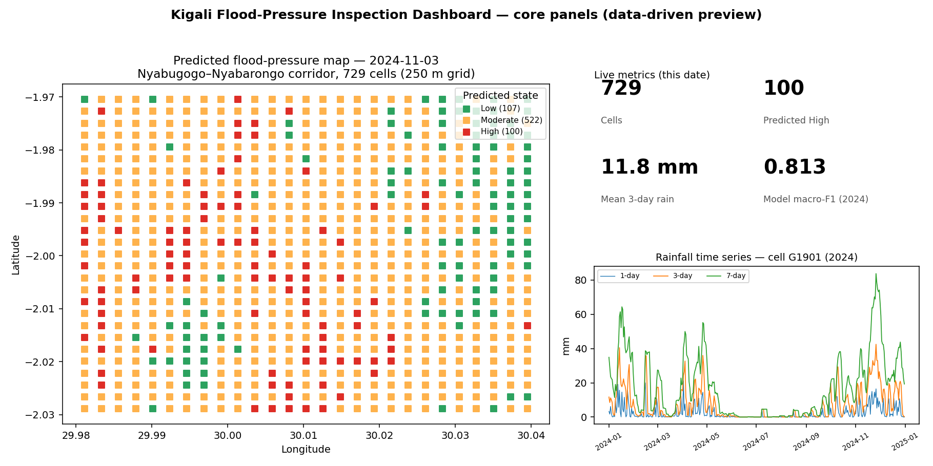
DEMO
Working prototype — the dashboard
• Streamlit app
– Any date → Low/Mod/High map over 729 cells
– Toggle official flood polygons
– Inspect a cell: features + class probabilities
– Per-cell Markov transition matrix
– Rainfall series, train/val/test & HMM panels
• Boots headless, serves HTTP 200
• p95 ≈ 9.6 ms / query
Pick a date → predicted flood-pressure map, metrics, per-cell inspector
Notes:
Here's the prototype — a Streamlit dashboard. You pick any date and see the predicted Low/Moderate/High map over all 729 cells. You can overlay the official polygons, click any cell to see its features and the model's class probabilities, and view rainfall trends and the HMM panel. It boots cleanly and answers a query in under 10 milliseconds, so it's genuinely interactive. (~1.5 min — demo live here if time)

Slide 7
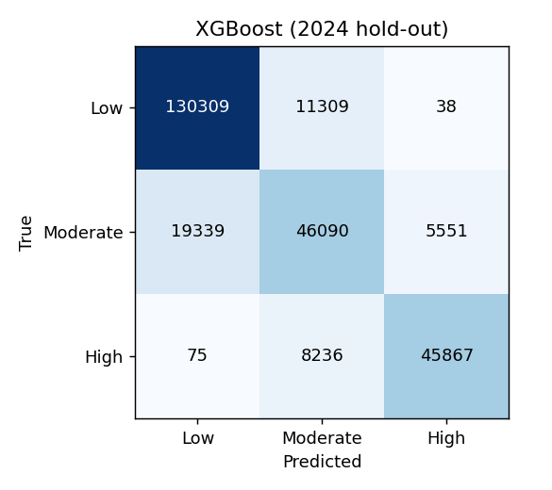
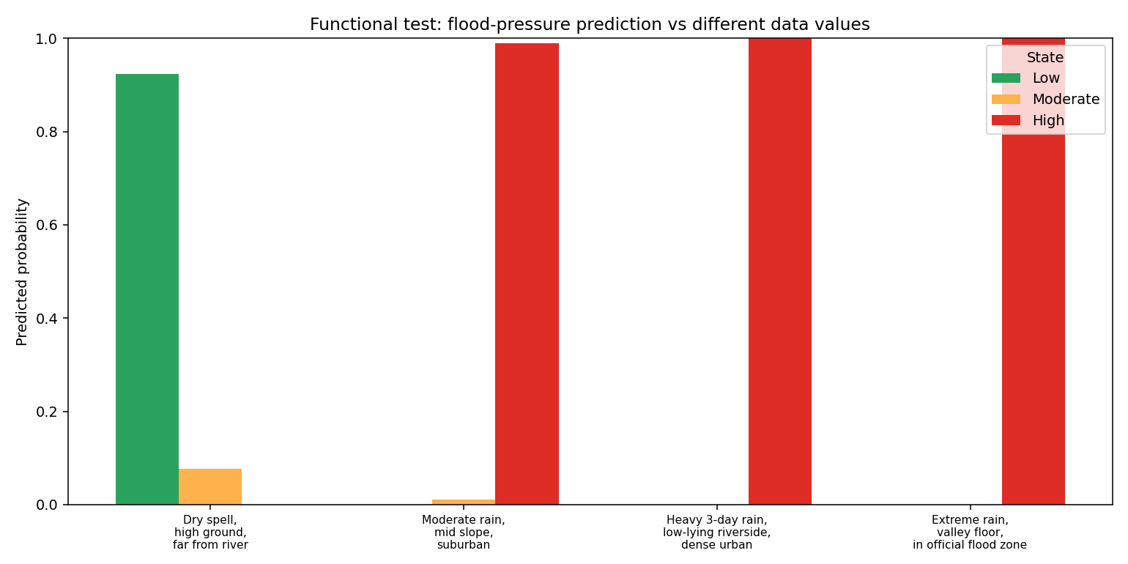
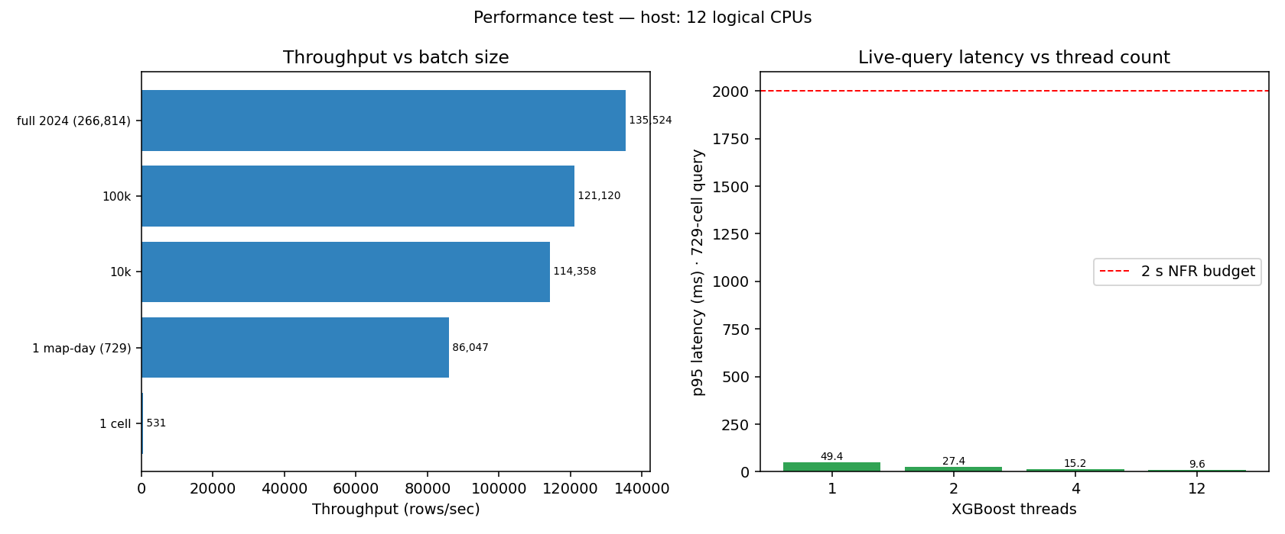
EVIDENCE
Working prototype — it works on real & varied data
XGBoost confusion (2024 hold-out)
Prediction responds to different data values
Latency well inside the 2 s budget
Notes:
And it's tested, not just demoed. Left: the confusion matrix on the 2024 hold-out — errors sit on neighbouring states, not wild misses. Middle: a functional test showing predictions shift correctly as I change the inputs — dry high ground stays Low, heavy rain on low ground goes High. Right: a performance benchmark — latency stays well under the 2-second budget even on a single thread. Ten of ten automated tests pass. (~1.5 min)

Slide 8
WRAP-UP
Summary & next steps
• Thesis demonstrated: open climate + geospatial data + ensemble ML give a time-aware flood-pressure view that beats static maps and rule baselines.
• End-to-end and reproducible: data → models → validation → live dashboard.
Next steps
• Ground-truth against real flood-incident records (biggest validity gain).
• Calibrate probabilities → a meaningful Moderate band; feed forecast rainfall for a 1–7 day outlook.
• Operationalise: scheduled refresh, drift monitoring, alert push; finalise hosting.
Notes:
To wrap up: I've shown the thesis holds — open climate and geospatial data plus ensemble ML give a time-aware flood view that beats static maps and rule baselines, end-to-end and reproducible. Next, I'll ground-truth against real flood-incident records, calibrate the probabilities and feed forecast rainfall for a forward-looking outlook, and finalise hosting. Thank you — happy to take questions. (~1 min)

