Slide 1
Kigali Flood-Pressure Dashboard — Demo & Defense Practice
Rehearsal deck (reference only — not for submission)
Kellen Murerwa · Supervisor: Emmanuel Adjei · ALU
Target: a clear ≤5-minute demo mapped to the rubric
Notes:
Open with the framing sentence: this is a decision-support tool that estimates daily flood-PRESSURE — a Low/Moderate/High risk state — for every 250 m cell in the Nyabugogo corridor. Flood-pressure is a derived risk condition, NOT a confirmed flood event. Say this before anything else.

Slide 2
The 5-minute flow
Practise this order, timed
• 0:00 Framing — what flood-pressure is, and what it isn't.
• 0:30 Map + date slider — the risk map that CHANGES with rainfall.
• 1:30 Metrics + polygon overlay — agrees with the official map AND extends it.
• 2:15 Cell inspector — features → probabilities → rainfall history.
• 3:15 Per-cell transition matrix — the Markov contribution (spend time here).
• 4:00 Model & splits panel — honest metrics, no over-fitting.
• 4:45 Close — reproducible, interpretable, beats baselines.
Notes:
If you only get 3 minutes, keep map + cell inspector + transition matrix — that's the story that is uniquely yours. Cut the model panel to one line.

Slide 3
Problem & framing (say it in 30s)
• Kigali floods after intense rain; official hazard maps are STATIC.
• They show WHERE flooding is possible — not WHEN or HOW WIDELY pressure rises.
• Our tool: daily Low / Moderate / High flood-pressure per 250 m cell.
– Flood-pressure = derived risk state (rainfall + terrain + exposure).
– NOT a confirmed flood event. Complements early warning, doesn't replace it.
• Real, keyless data only: ERA5 rainfall, SRTM terrain, OSM exposure, MOE polygons.
Notes:
The static-vs-dynamic contrast is your hook. A reviewer remembers 'their map moves with the rain, the official one can't'.

Slide 4
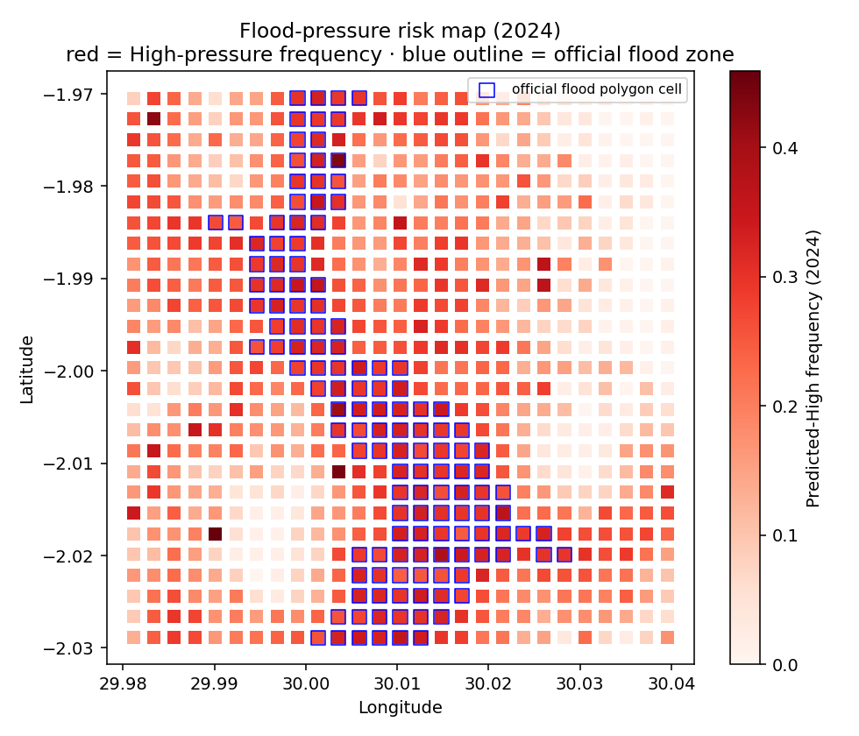
The product — a dynamic risk map
729 cells · green Low / orange Moderate / red High
• Drag the date slider dry → wet: the red High zone grows along the river corridor.
• Hover any cell: ID, predicted class + confidence, 3-day rain, elevation.
• Three colour modes: predicted state · ground-truth label · 3-day rainfall.
• Toggle the blue official-polygon overlay to compare.
Notes:
Move the slider LIVE. The single most persuasive moment of the demo is the red zone expanding as you step onto a high-rainfall day.

Slide 5
Results — 2024 test hold-out
Targets: macro-F1 ≥ 0.75, High-recall ≥ 0.80
Model | Macro-F1 | High-recall | Note
XGBoost (deployed) | 0.813 | 0.843 | best & shipped
Random Forest | 0.813 | 0.849 | ties; best recall
Logistic Regression | 0.750 | 0.819 | linear baseline
Decision Tree | 0.750 | 0.798 | clears the bar
Rainfall-threshold (base) | 0.626 | 0.902 | high recall, low precision
Static-polygon (base) | 0.324 | 0.292 | static maps inadequate
Notes:
Land the value-add: beats the rainfall rule by +0.19 F1 and the static map by +0.49. The rainfall baseline's 0.90 recall is a trap — its precision is poor, which macro-F1 exposes (0.626).

Slide 6
Train / validation / test — no over-fitting
The exact thing your supervisor asked for
• Temporal split, NO shuffle: train 2018–2022 · validate 2023 · test 2024.
• Every cell appears in all three periods; only TIME is partitioned.
• Macro-F1 barely moves across splits:
– XGBoost: 0.804 (train) / 0.805 (val) / 0.813 (test).
– Random Forest: 0.813 / 0.806 / 0.813.
• Train ≈ val ≈ test ⇒ it generalises to unseen future years, not memorising.
• A random split would leak future weather into training — this is the honest test.
Notes:
This slide is your direct answer to 'how did you split, and does it over-fit?'. Say the three numbers out loud — their closeness IS the proof.

Slide 7
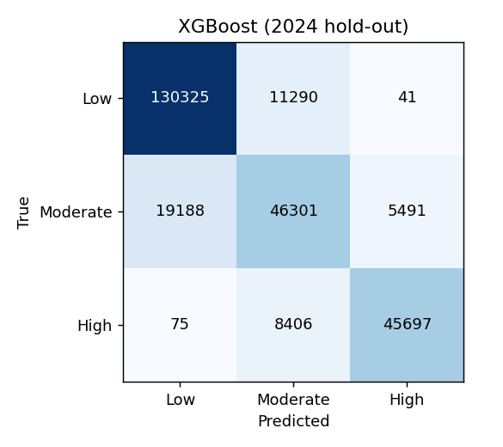
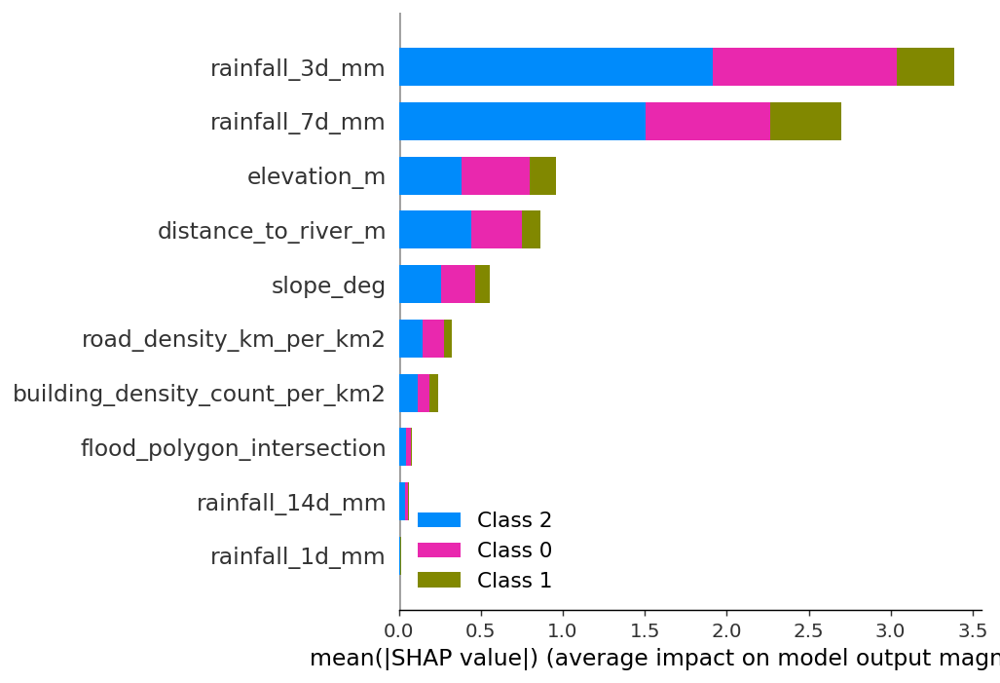
Confusion matrix & explainability
• Diagonal = correct. Strong Low & High; error concentrates on the
– transitional Moderate class — off by one band, not a wild miss.
• We optimised High-recall (0.84): a missed High day costs more than a false alarm.
• SHAP + feature importance: rainfall (3/7-day) dominates, then elevation & river.
– Hydrologically sensible → auditable, not a black box.
Notes:
If asked 'why is Moderate weak?' — it's the in-between band on a continuous surface; its errors land on neighbours. Point at the diagonal.

Slide 8
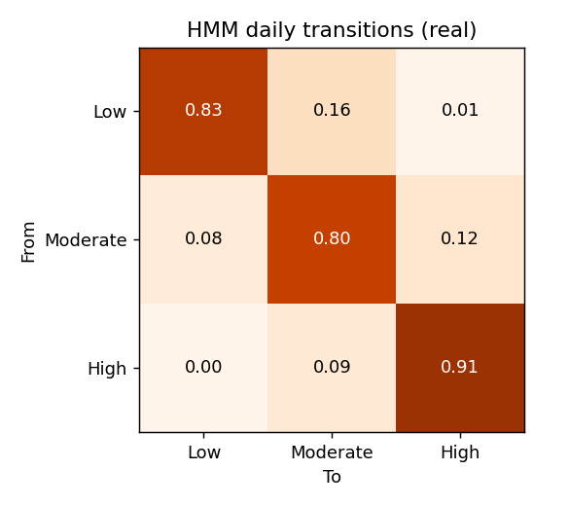
★ Per-cell Markov transitions — the contribution
Not just WHAT state — what state NEXT
• For a SELECTED cell: P(state tomorrow | state today), from its own history.
• Strong diagonal = pressure PERSISTS after sustained rain.
• Off-diagonal Low→Moderate→High = how a cell escalates.
• '—' = a state that cell never entered (shown honestly, not faked).
• Global HMM: self-transitions ≈ 0.83 / 0.80 / 0.91; next-step acc 0.45 (chance 0.33).
– Turns a snapshot into a short-horizon forecast a manager can act on.
Notes:
Spend the most time here — it's what your supervisor wanted and what makes the project more than a classifier. Distinguish the per-CELL matrix (one cell's history) from the global HMM (whole corridor).

Slide 9
Spatial validation vs the official map — the honest result
• Official MOE zone covers only ~19% of the corridor.
• So a fixed '70% of High inside the zone' is geometrically impossible without circular labels.
• Reframed to enrichment & odds ratio:
– Enrichment / lift: 1.60× over the 18.7% base rate.
– Inside-vs-outside High odds: 1.85×.
• Model RE-DISCOVERS the official zone (never trained on it) AND extends the footprint.
Notes:
This is your most honest slide — examiners reward candor. 'Containment 0.30 looks low, but it's capped by geometry; enrichment and odds are the fair measures, and both clear the bar.'

Slide 10
Rubric self-check — hit every box in the demo
Rubric item | Where you show it | Number to say
Testing Results (5) | Model panel · testing_results/ | 0.813 F1 · 10/10 tests
Analysis (2) | Map + leaderboard | +0.19 vs rainfall, +0.49 vs static
Discussion | Persistence + spatial | 1.85× odds, agrees & extends
Recommendations | Limitations / future work | incident validation, CHIRPS
Deployment (3) | Running app + Dockerfile | HTTP 200 · p95 9.6 ms
Demo / live app | This walkthrough + URL | record ≤5 min
Notes:
Keep this as your mental checklist. If you name the number for each row during the demo, you've touched every rubric criterion explicitly.

Slide 11
Anticipated questions — crisp answers
• ‘Real floods?’ → No, derived pressure; incident validation is future work.
• ‘Circular label?’ → Hidden drainage + noise; F1 0.81 not 0.99.
• ‘Split / over-fit?’ → 3-way temporal; train≈val≈test (0.804/0.805/0.813).
• ‘Why XGBoost?’ → Ties RF, calibrated probs + SHAP; RF has slightly higher recall.
• ‘Why ERA5?’ → Reproducible & keyless; CHIRPS tested but fragile; Meteo Rwanda gated.
• ‘Containment only 0.30?’ → 19% coverage caps it; enrichment 1.60× / odds 1.85×.
• ‘Biggest limitation?’ → No incident register; labels are pressure, not events.
Notes:
Full answers are in DEMO_WALKTHROUGH.md §4. Rehearse Q2, Q3 and Q6 until they're automatic — those are the three most likely to be pressed.

Slide 12
Close (one sentence)
• A reproducible, interpretable, time-aware flood-pressure tool for Kigali —
– beats both naive baselines on real open data,
– agrees with and extends the official flood map,
– and runs as a live dashboard with a passing test suite.
• Everything reruns end-to-end from one main.py. Thank you — questions welcome.
Notes:
End on reproducibility — it's the reviewer's favourite word and your strongest, most defensible claim.

