Slide 1


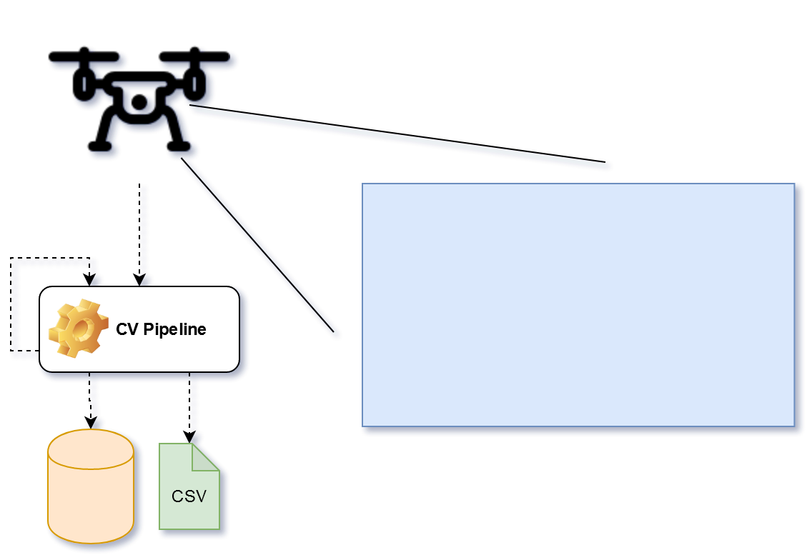
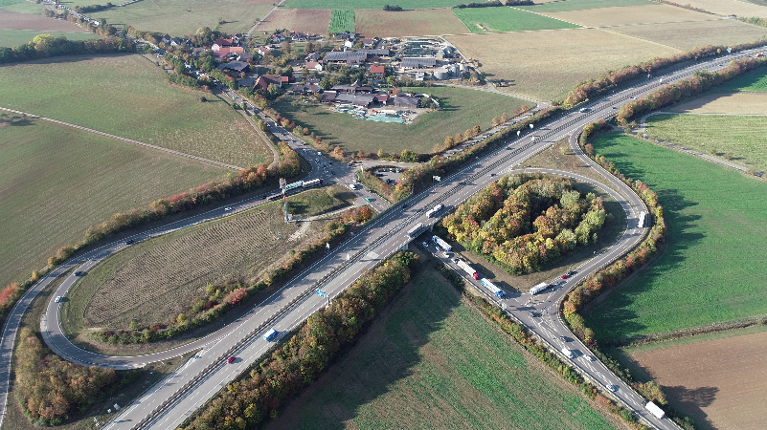
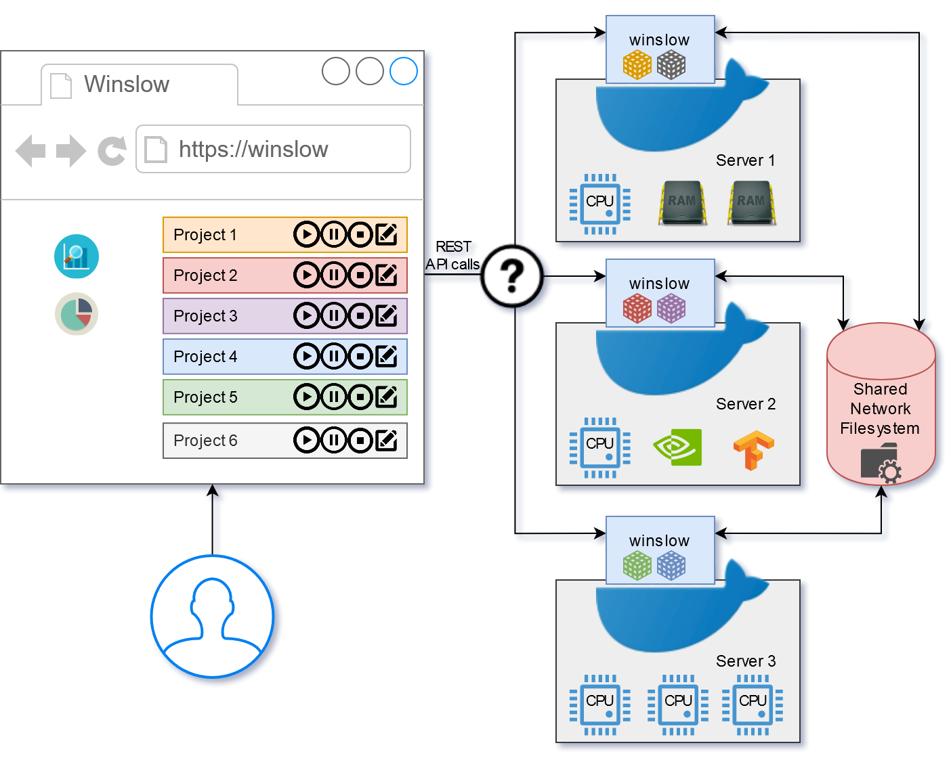

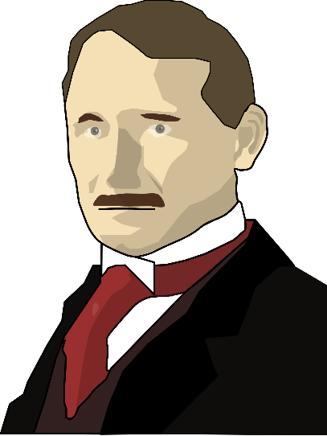
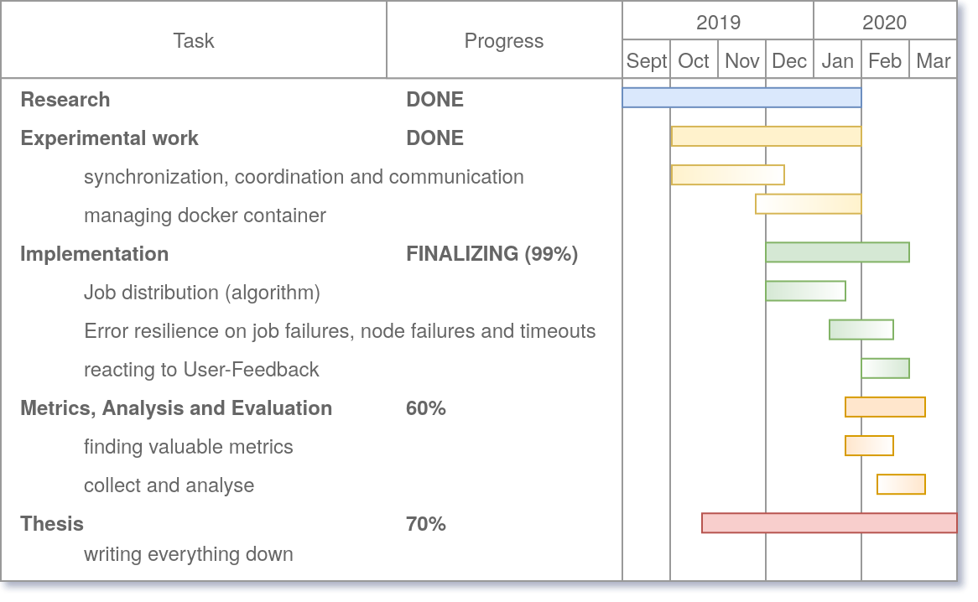
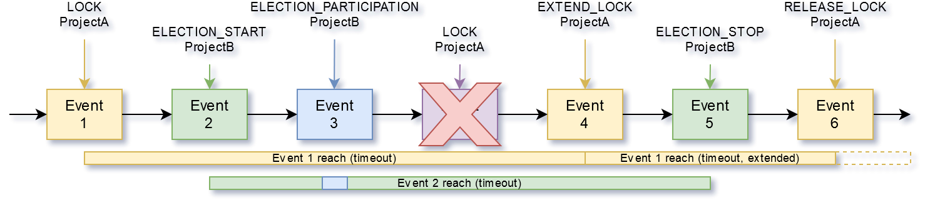
Conception and realization of a distributed and automated computer vision pipeline
Supervisor: Dr. Paul Kyberd
Student: Michael Watzko
Student ID: 1841795
Project Context
Detecting vehicles in video footage using Computer Vision and Artificial Intelligence
Tracking vehicles throughout the video to determine speed, size, acceleration, class, position and lane changes
Export data for further traffic flow analysis (in other projects or for the customer)
Main Goal
Automate manual workflow that distributes the workload onto servers and collects the data
Further Requirements and Objectives
Handle large files (4k video footage) and multiple projects
Representation as multi-stage pipeline that can be paused at any stage and investigated, to re-do stages with optimized parameters
Consider specific hardware requirements for CV and AI for each pipeline stage
Architecture, Design and Technologies
Decentralized decision making
Resilient against node failures
Shared network filesystem
Docker
Challenges and Experimental Work
Finding a fitting network filesystem
Communication and coordination
Finding the most fitting execution node for a job
Frederick Winslow Taylor
1856 - 1915
Project Progress
Results
Time savings because of higher hardware utilization due to automatic stage execution
Creation of a distributed and synchronous EventSystem with timeout based mutex ontop

Slide 2
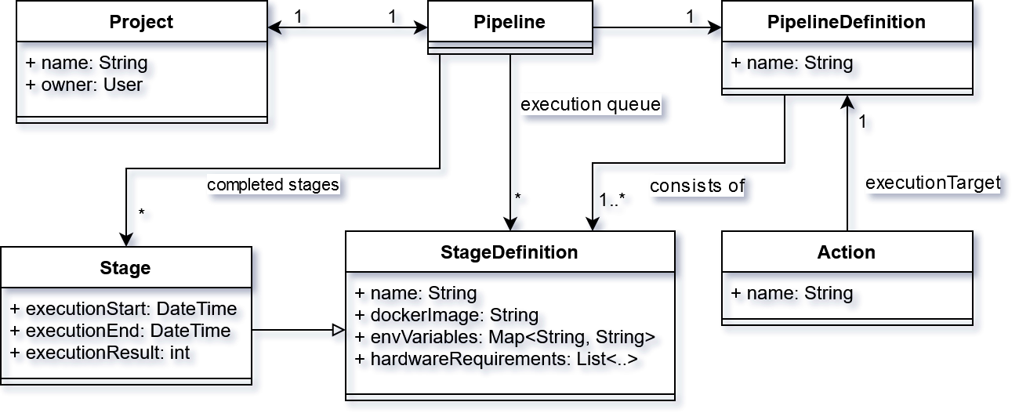

Challenges and Experimental Work
Finding a fitting network filesystem
Some require big installation overhead
Truly decentralised filesystems are rare
Tons of different centralized network filesystems
Some provide site awareness or replication services
How to manage separate execution history from project and pipeline template
Can you use a shared filesystem for communication and coordination to strip down external (system) dependencies
Results
Synchronous EventSystem with Boradcast functionality based on files on a shared filesystem
Implementations of a timeout Mutex on-top of the EventSystem to lock projects throughout the whole system
Further Requirements and Objectives
Automatically distribute jobs onto computing nodes
Handle large files (4k video footage) and multiple projects
Representation as multi-stage pipeline that can be paused at any stage and investigated, to re-do stages with optimized parameters
Consider specific hardware requirements for CV and AI
Architecture, Design and Technologies
Decentralized decision making
Resilient against node failures
Shared network filesystem for data, configuration and coordination
Docker for easy installation of additional compute nodes
Challenges and Experimental Work
Finding a fitting network filesystem
Solely depend on a shared filesystem for communication and coordination to strip down external (system) dependencies
Results
Synchronous EventSystem with Boradcast functionality based on files on a shared filesystem
Implementation of a timeout based mutex on-top of the EventSystem to lock projects throughout the whole system
Much more time efficient because of higher hardware utilization due to automatic stage execution

