Slide 1


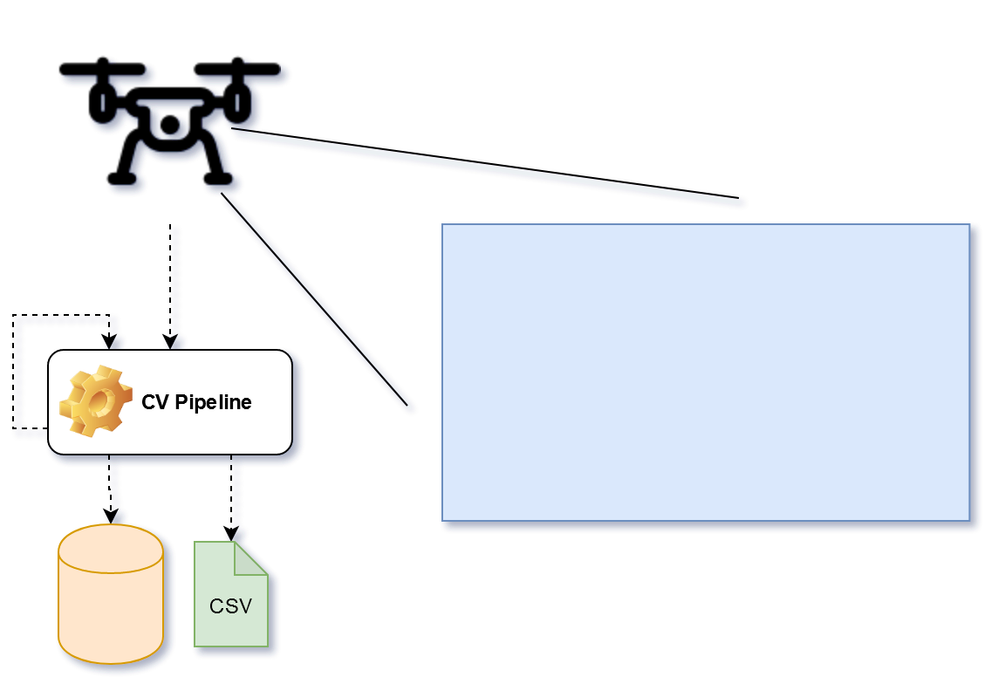
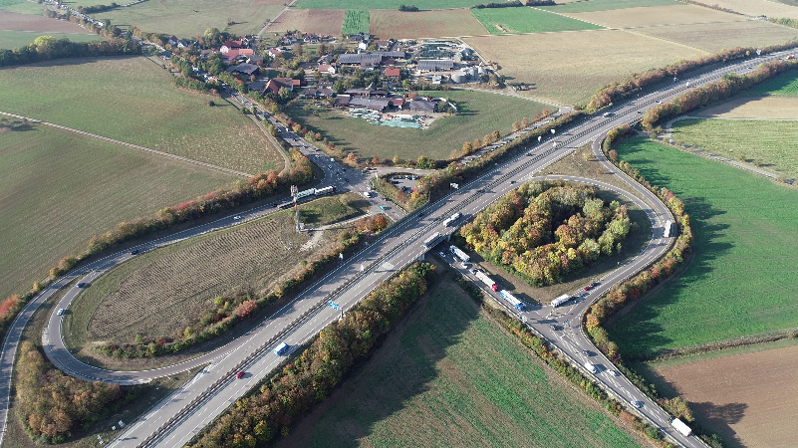
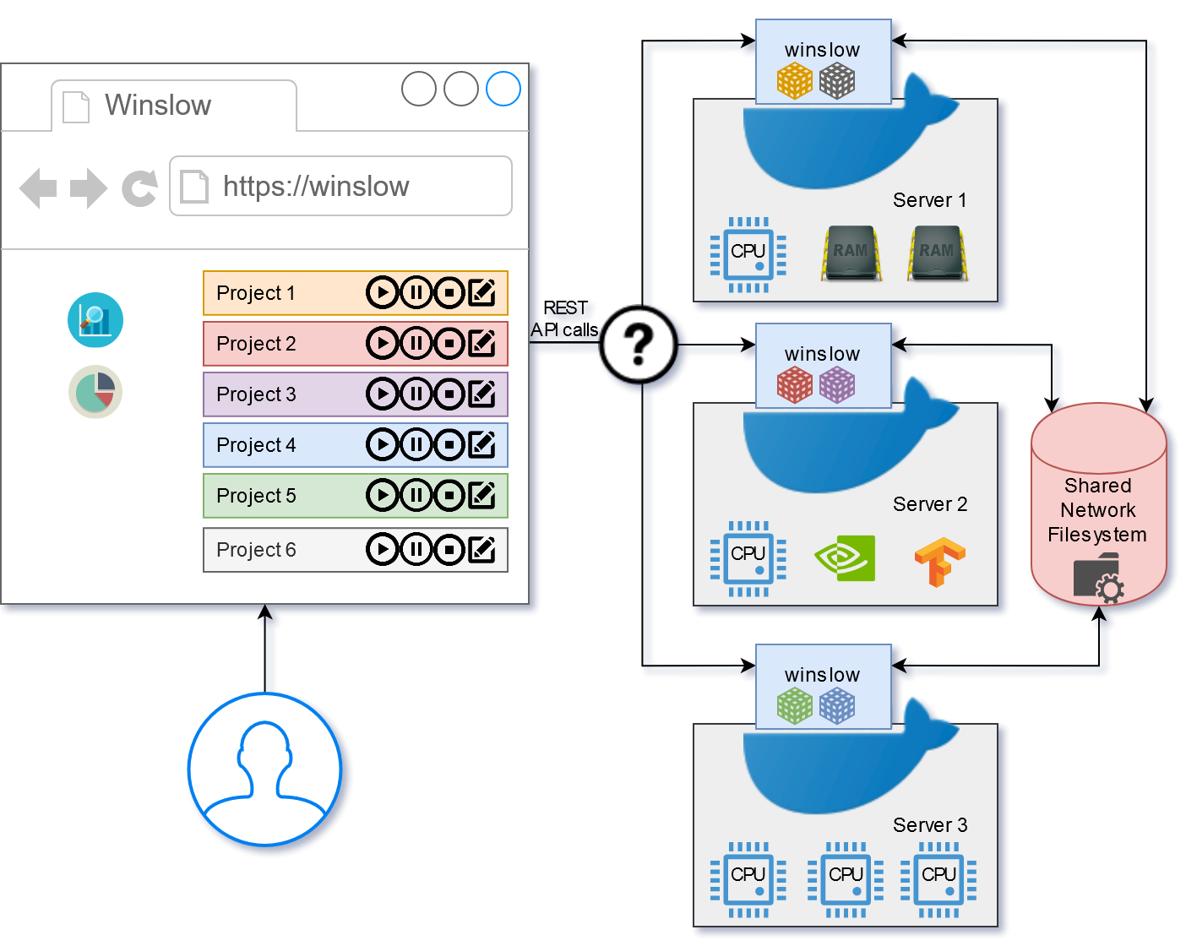

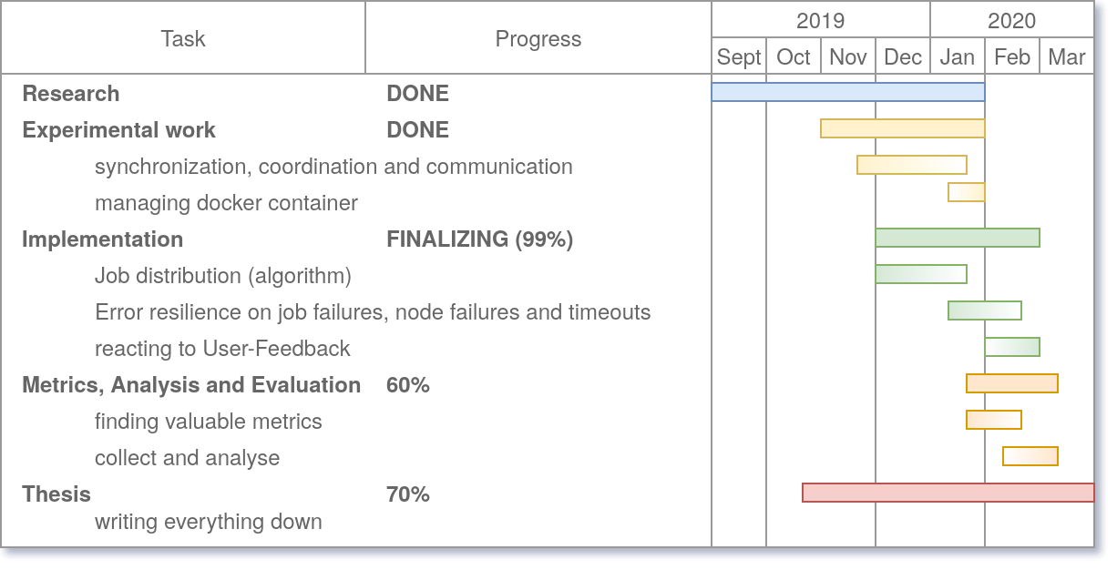
Conception and realization of a distributed and automated computer vision pipeline
Supervisor: Dr. Paul Kyberd
Student: Michael Watzko
Student ID: 1841795
Project context
Utilizing Computer Vision and Artificial Intelligence to detect vehicles in video footage
Tracking vehicles throughout the video to determine speed, size, acceleration, class and position
Find lanes, assign vehicles to lanes and detect lane changes
Visualize detected vehicles
Provide data for traffic flow analysis (in other projects or for the customer)
The Goal
Automate manual and tedious multi-stage process of data extraction and distribute workload onto multiple servers
Further Requirements and Objectives
Automatically distribute jobs onto computing nodes
Be able to manage multiple projects simultaneously
Handle large files (4k video footage)
Utilize hardware acceleration for CV and AI (some jobs have specific hardware requirements)
Provide a WebInterface for the user to manage projects, see job progress and compute node usage
Architecture, Design and Technologies
Decentralized decision making
Resilient against node failures
Shared network filesystem for data, configuration and coordination
Docker for easy installation of additional compute nodes
Implementation in Java, using SpringBoot to provide a REST Api, use Typescript and Angular to provide a rich and responsive WebInterface by utilizing the REST API
Challenges and Experimental Work
Finding a fitting network filesystem
Some require big installation overhead
Truly decentralised filesystems are rare
Tons of different centralized network filesystems
Some provide site awareness or replication services
How to manage separate execution history from project and pipeline template
Can you use a shared filesystem for communication and coordination to strip down external (system) dependencies
Results
Synchronous EventSystem with Boradcast functionality based on files on a shared filesystem
Implementations of a timeout Mutex on-top of the EventSystem to lock projects throughout the whole system
Project Progress

Slide 2
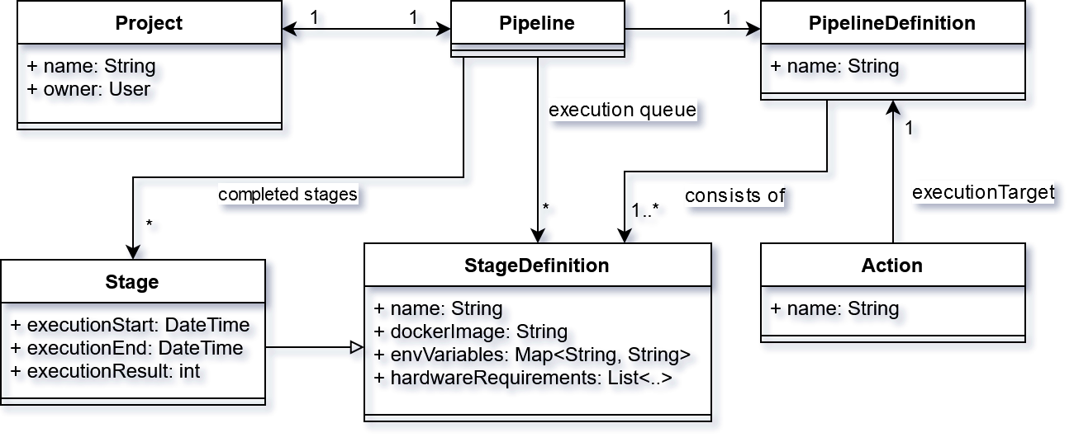

abc
Results, Evaluation and Analysis of the experimental work
Project Plan (timeline)
Aims and Objectives
Description of experimental work
Conclusion

