Slide 1
INTERNAL PILOT REHEARSAL
Signals, not scores. Aggregate evidence only.
FluencyTracr AI Work Evidence Packet
A full aggregate run using company-owned telemetry to show what an executive-ready pilot can deliver before ROI claims.
4.93 TB
99.95%
43.1%
99.6%
Fresh BigQuery run
High-confidence trust coverage
Trust evidence gap
Skill-read parent join coverage
Executive thesis
The data already separates AI activity from workflow evidence, trust evidence, source coverage, and value-readiness. The current blocker is not telemetry volume; it is downstream outcome evidence and governed assumptions.
No individual scoring | No team ranking | No ROI calculation | No causality claim

Slide 2
EXECUTIVE SUMMARY
Signals, not scores. Aggregate evidence only.
What Leaders Should Take Away
High-level outcomes and strategies come first; detailed evidence sits in the appendix.
1
Evidence layer is viable
Existing aggregate telemetry can produce a structured AI Work Evidence packet without starting with client HR, survey, or finance data.
2
The recommendation engine is the product
FluencyTracr turns observed AI work patterns into the next outcome data, formula family, caveat, and blocked claim.
3
Workflow evidence beats adoption volume
2,025 workflow/trust patterns are more executive-useful than broad activity alone.
4
ROI stays held
The packet recommends value tests, but does not calculate ROI or claim causality without governed outcomes and assumptions.
No individual scoring | No team ranking | No ROI calculation | No causality claim

Slide 3
RECOMMENDATION ENGINE
Signals, not scores. Aggregate evidence only.
From AI Work Evidence to Executive Action
The engine is framework-driven: observe aggregate patterns, route the value hypothesis, then name the smallest outcome evidence needed next.
1
Observe
2
Classify
3
Recommend
4
Hold or test
Surfaces, workflow keys, behavioral primitives, trust signals, source coverage
→
Velocity x Depth, AI-service workflow family, value-readiness zone
→
Outcome signal, source family, formula template, caveat, blocked claim
→
Proceed only when aggregate outcome evidence and assumptions are governed
Example output
Support friction is the first value test candidate: 1,333 aggregate patterns combine search-to-agent movement and post-friction continuation. Request resolution time, escalation rate, reopen rate, backlog movement, and CSAT. Do not claim causality or ROI yet.
No individual scoring | No team ranking | No ROI calculation | No causality claim

Slide 4
STRATEGIC RECOMMENDATIONS
Signals, not scores. Aggregate evidence only.
Where This Points a Client Next
Each recommendation names the outcome evidence needed to test value without overclaiming value.
Support friction value test
Search-to-agent workflow
Resolution time, escalation rate, reopen rate, backlog movement, CSAT
Outcome evidence missing
Workflow execution capacity test
Agent/action execution workflow
Completed work volume, cycle time, backlog movement, stage progression
Outcome evidence missing
Verification quality and risk test
Verification or feedback-attached workflow
QA pass rate, defect rate, correction rate, approval coverage
Trust attribution hold
Proof-loop repair agenda
Trust-evidence repair workflow
Verification coverage, feedback-loop coverage, unresolved trust-gap rate
Source coverage hold
Source-linkage repair
Source-linkage or boundary repair
Source coverage, join completeness, metadata completeness
Source coverage hold
No individual scoring | No team ranking | No ROI calculation | No causality claim

Slide 5
WHAT THE RUN OBSERVED
Signals, not scores. Aggregate evidence only.
Observable Variables, Not Client Requirements
The rehearsal starts from variables already visible in company-owned telemetry, then names gaps as product readiness work.
Surfaces
Workflow keys
Behavior primitives
Search, autocomplete, workflow runs, AI summary, bot activity, MCP, agent spans.
Run/action keys, session tokens, trace/tracking keys, workflow context.
Frequency, engagement, breadth, iteration/refinement, recovery-like continuation, verification.
Trust signals
Value context
Held evidence
Feedback, citations, citation clicks, action success, post-friction continuation.
Velocity x Depth zones, AI work pattern tiers, source coverage, outcome-readiness gates.
Outcome joins, assumption ledger, causality design, monetary range values.
No individual scoring | No team ranking | No ROI calculation | No causality claim

Slide 6
FRESH RUN
Signals, not scores. Aggregate evidence only.
Velocity, Depth, Reliability, and Quality
The microcosm view shows growing breadth and sustained reliability/quality context across the latest 90-day window.
Frequency
Engagement
Breadth
Reliability
Quality
70.2
62.3
80.6
17.3
15.7
20.6
5.7
5.1
6.5
0.71
0.64
0.69
1.22
1.12
1.18
Window 1 Window 2 Window 3
No individual scoring | No team ranking | No ROI calculation | No causality claim

Slide 7
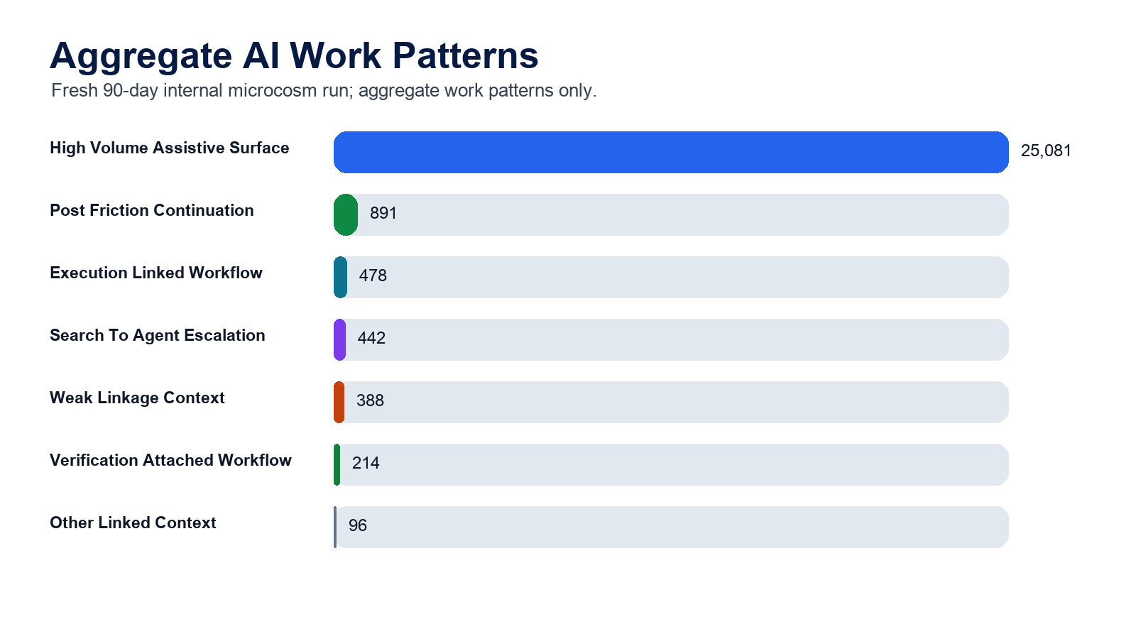
AI WORK PATTERNS
Signals, not scores. Aggregate evidence only.
Activity Is Not the Same as Workflow Evidence
Work pattern tiers prevent high-volume assistive events from drowning out stronger workflow and trust evidence.
No individual scoring | No team ranking | No ROI calculation | No causality claim

Slide 8
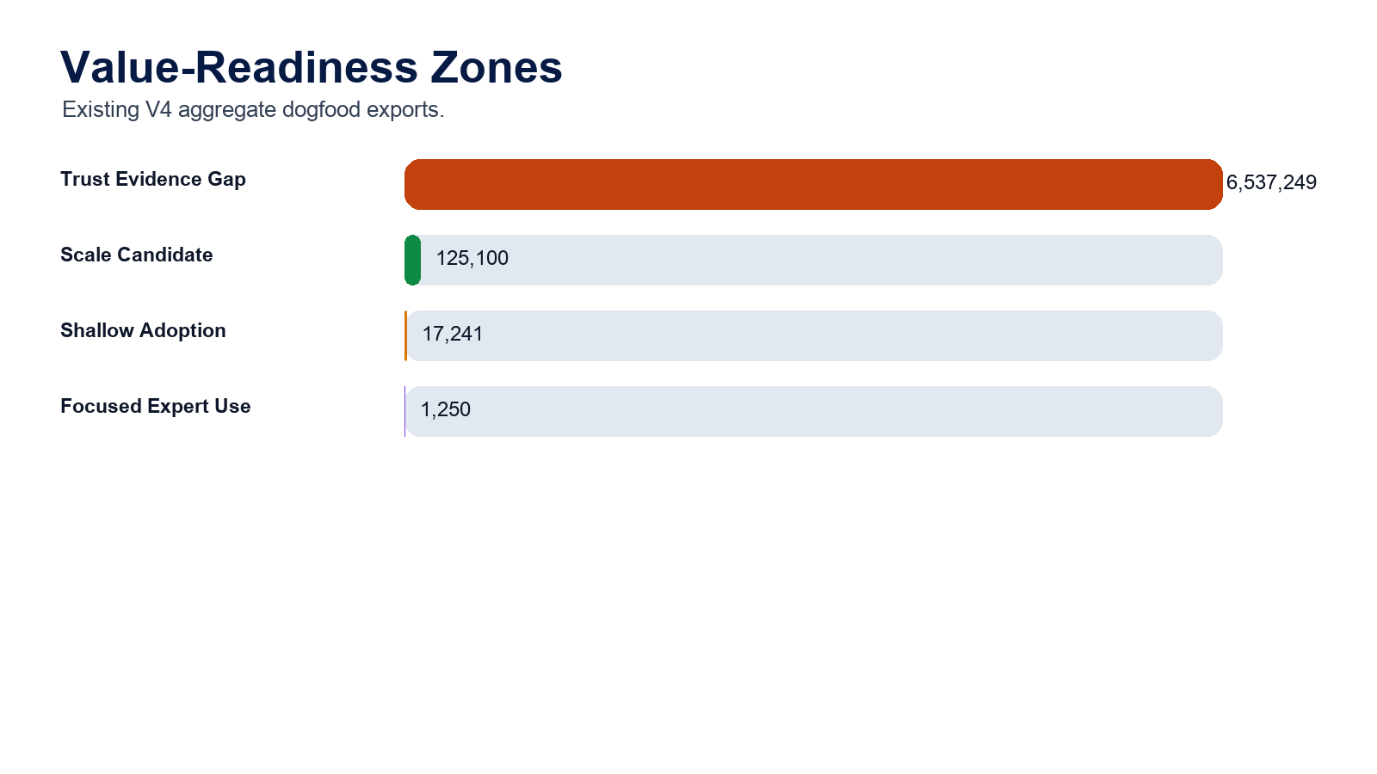
VALUE READINESS
Signals, not scores. Aggregate evidence only.
Where the Evidence Points Leaders
The largest lane is trust-evidence repair; the most commercial lane is scale-and-measure review with outcome evidence attached.
No individual scoring | No team ranking | No ROI calculation | No causality claim

Slide 9
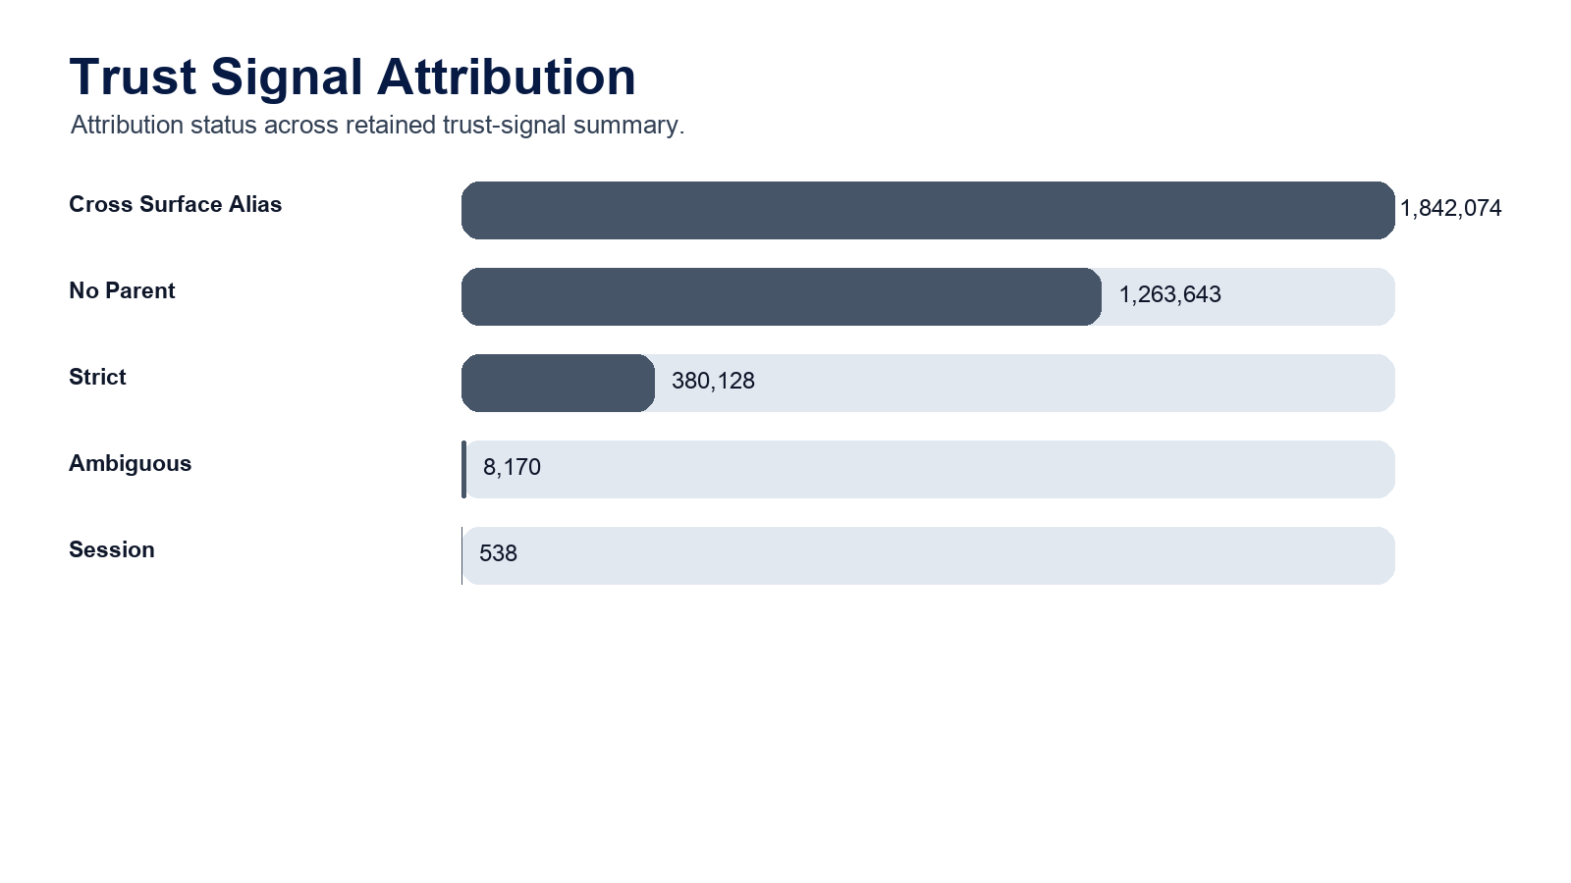
TRUST
Signals, not scores. Aggregate evidence only.
Trust Attribution Is the Product Problem
The best trust evidence is workflow-attached verification and continuation, not standalone citation behavior.
No individual scoring | No team ranking | No ROI calculation | No causality claim

Slide 10
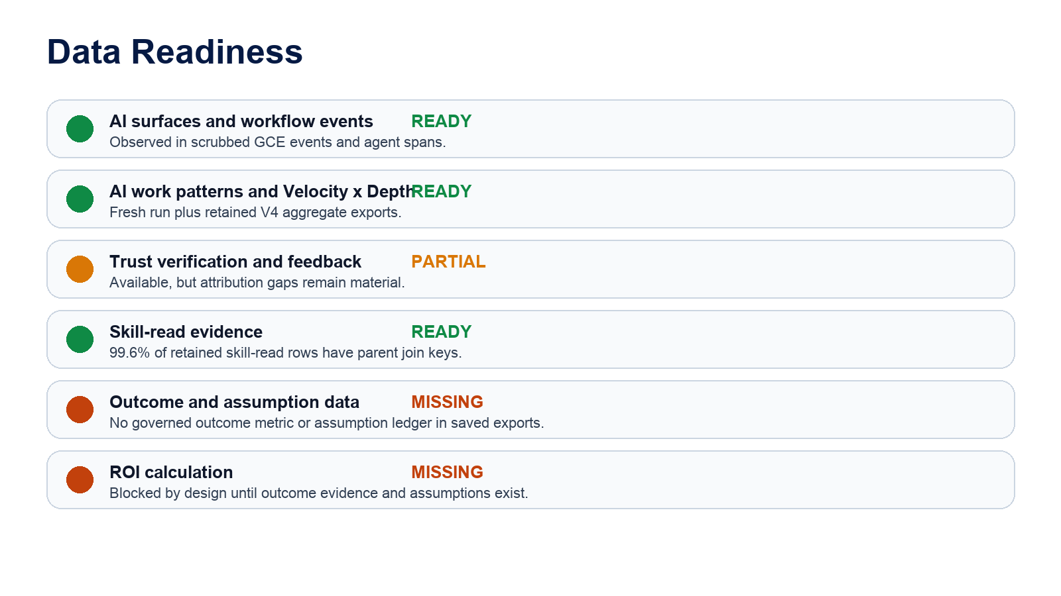
DATA READINESS
Signals, not scores. Aggregate evidence only.
What We Have and What Is Still Held
Missing evidence is presented as a product-readiness gap, not as an ask that blocks the first pilot conversation.
No individual scoring | No team ranking | No ROI calculation | No causality claim

Slide 11
DECISION MEMO
Signals, not scores. Aggregate evidence only.
Proceed, But Keep the Claim Narrow
This is commercially useful as an evidence layer, not yet as an ROI calculator.
Proceed
Build the external executive rehearsal packet from this internal pilot.
Promise
Aggregate work evidence, workflow integration, trust gaps, source coverage, and value-investigation routing.
Hold
Dollarized ROI, causal impact, productivity lift, correctness, and people/team comparison.
Next
Use the same aggregate variable names for client pilots and add outcome/assumption lanes only when they are governed.
No individual scoring | No team ranking | No ROI calculation | No causality claim

Slide 12
GLOSSARY
Signals, not scores. Aggregate evidence only.
Terms That Explain the Evidence Layer
Plain-English definitions for the terms used in this packet.
AI Work Evidence
AI surface
Aggregate telemetry showing where AI appears in work, how it connects to workflows, and where evidence is strong or weak.
A place where AI can be used: search, chat, autocomplete, workflow runs, agent spans, or embedded assistants.
Workflow evidence
Velocity
Aggregate signs that AI is attached to a real work path instead of a standalone interaction.
How quickly AI-assisted work appears to move, using aggregate frequency, engagement, and repeat-use patterns.
Depth
Frequency
How embedded AI appears to be across surfaces and workflows; not an individual skill label.
How often AI activity appears in the aggregate window.
Engagement
Breadth
How much aggregate interaction occurs around AI-assisted work, such as repeated use or continued activity.
How many distinct AI surfaces or work contexts appear in the aggregate evidence.
Reliability Factor
Quality Multiplier
A confidence lens using abandonment, friction loops, recovery, and verification before interpreting behavior.
A caveat lens for later time-saved assumptions; not used here to calculate ROI.
No individual scoring | No team ranking | No ROI calculation | No causality claim

Slide 13
GLOSSARY
Signals, not scores. Aggregate evidence only.
Terms That Explain Readiness and Boundaries
Plain-English definitions for the terms used in this packet.
Trust evidence
Trust attribution
Aggregate signs that people verified, continued, corrected, recovered, or gave feedback after AI assistance.
Whether a trust signal can be attached to a workflow path with enough confidence to interpret it.
Evidence gap
AI work pattern tier
Activity exists, but source coverage, attribution, or downstream context is too weak to interpret.
A plain-language bucket separating raw AI activity from stronger workflow, verification, or coverage evidence.
Value-readiness zone
Outcome evidence
An executive action lane: scale, redesign, repair trust loops, or hold interpretation.
Customer-owned aggregate business context that can be attached later without claiming causality by default.
Value hypothesis
Source coverage
A testable idea about possible value, such as acceleration, quality premium, or net-new work; not ROI proof.
How complete and unambiguous the available telemetry is for a given aggregate interpretation.
Suppressed
A fail-closed result where FluencyTracr withholds interpretation because the evidence bar is not met.
No individual scoring | No team ranking | No ROI calculation | No causality claim

