Slide 1
https://github.com/hyperledgendary/full-stack-asset-transfer-guide
Part 1: Smart Contract Development
Gateway Client Application
MicroFab
Orderer/Peer
asset-tx-cc
(external ccaas)
Part 2: Client Application Development
Docker Registry
Part 3: Cloud Native Fabric Deployment (k8s)
peers
peers
asset-tx-cc
(k8s-builder)
peers
peers
Gateway Client Application
orderers
fabric-operator
k8s

Slide 2
00-setup.md
Enterprise Integration
Gateway Client Applications
Fabric Chaincode
Fabric gRPC Services
Container Orchestration
Virtualization
Bare Metal

Slide 3
12-kube-ec2-vm.md
Cloud Virtual Machine
*. 107-20-49-98.nip.io
Docker Registry
:5000
cert + key
TLS cert
peers
asset-tx-cc
(k8s-builder)
peers
peers
peers
:443
Gateway Cilent Application
orderers
fabric-operator
k8s

Slide 4
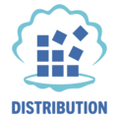
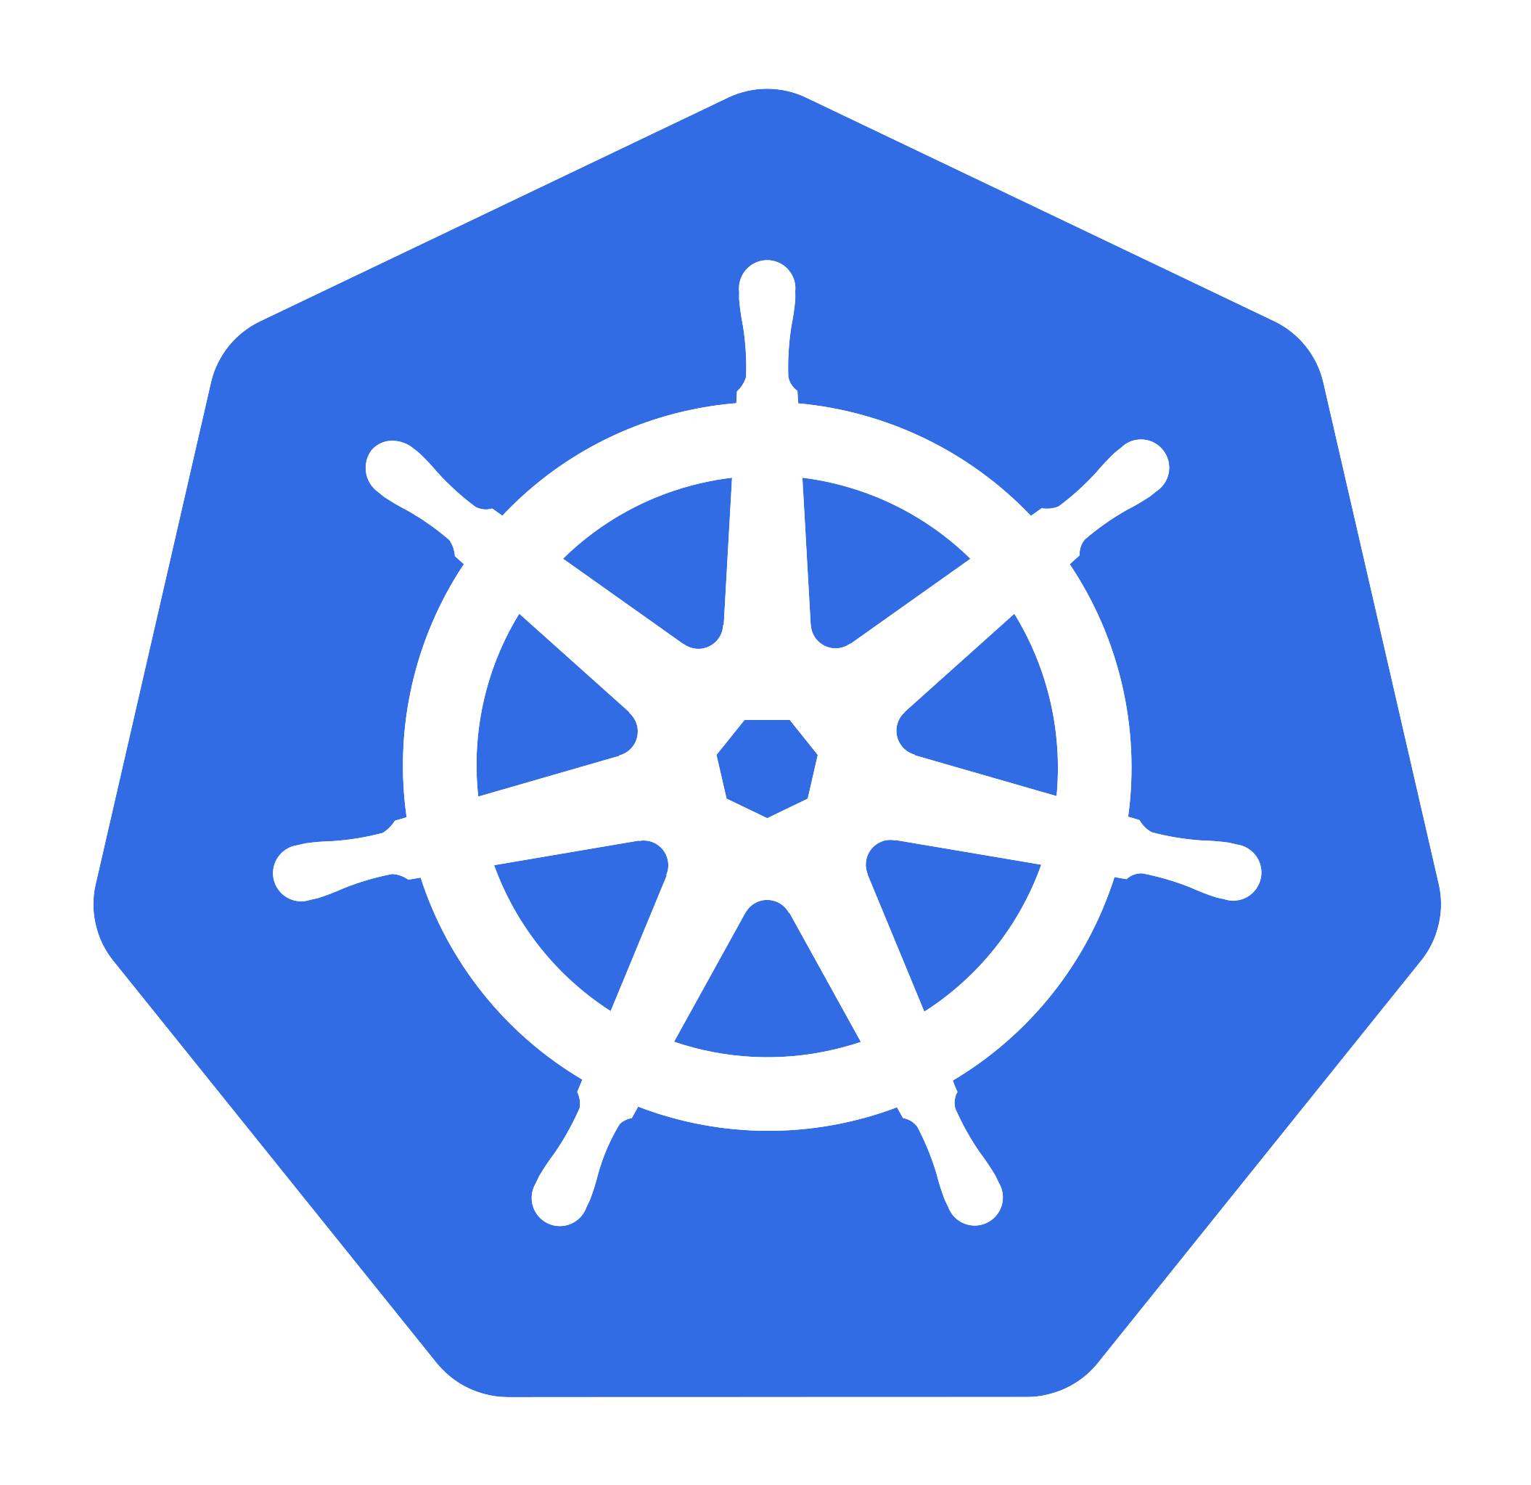


10-kube.md
127.0.0.1:5000
Container registry
kubectl
127.0.0.1:8888
API Controller
KIND
127.0.0.1:443
Nginx Ingress
*.localho.st

Slide 5
12-kube-ec2-vm.md
EC2 Virtual Machine
:5000
Container registry
kubectl
:22
(0.0.0.0 -> ssh tunnel)
Kube API Controller
:443
Nginx Ingress
*.203-0-113-43.nip.io
KIND

Slide 6


20-fabric.md
ca
peer
orderer
console
kubectl
KIND
channel config
Fabric CLI
fabric-operator
Fabric nodes

Slide 7
30-chaincode.md
asset-transfer.ts
CC image
image@sha256:abc
docker CLI
image@sha256:abc..
KIND
CC package
fabric-k8s-builder
image@sha256:abc
peer CLI
fabric-operator
peer pods

Slide 8
30-chaincode.md
register(); enroll()
fabric-ca-client
Org CA
cert.pem
key.pem
asset-transfer
KIND
trader.ts
Gateway Client Application
peers
contracts
npm start transact

