Slide 1
TITLE: BREAST CANCER PREDICTION USING MACHINE LEARNING NAME: KELLIE NJOKI NDARU DATE: 30/08/2024

Slide 2
INTRODUCTION
Project Objective: To develop a model to predict whether a breast tumor is benign or malignant.
Dataset Used: Breast Cancer Wisconsin (Diagnostic) Dataset
Stakeholder: Healthcare providers, patients

Slide 3
Problem STATEMENT
Problem: Early and accurate diagnosis of breast cancer is crucial for effective treatment and patient survival.
Goal: To build a reliable model that can assist in early detection of malignant tumors.

Slide 4
DATA OVERVIEW
Dataset description:
569 samples, 31 features
Target Variable:
Diagnosis (B=Benign, M=Malignant)

Slide 5
DATA PREPROCESSING
Steps taken:
Dropped irrelevant columns (ID column)
Handled missing columns (dropped unamed32 column)
Feature scaling
Split the data into training and testing sets

Slide 6
MODEL SELECTION
Models Evaluated: Logistic Regression, Decision Tree, Random Forest, Gradient Boosting.
Evaluation Metrics: Accuracy, Precision, Recall, F1-Score.

Slide 7
MODEL PERFORMANCE
Logistic Regression:
Accuracy: 98%
Precision and Recall: High performance in both classes.
F1-Scores: This indicates a better balance between precision and recall.

Slide 8
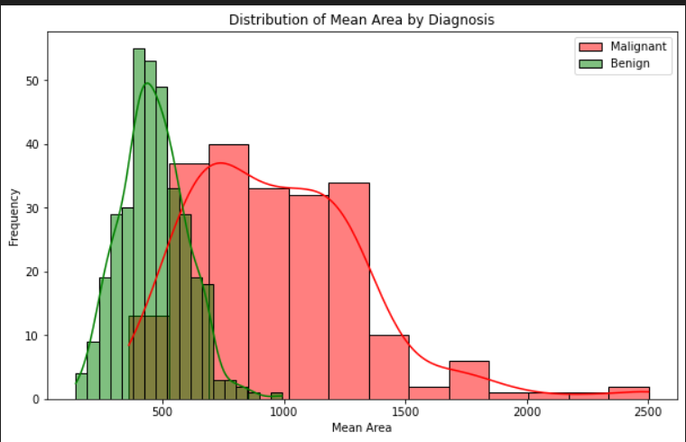
VISUALIZATIONS DISTRIBUTION OF FEATURE VALUES FOR EACH DIAGNOSIS

Slide 9
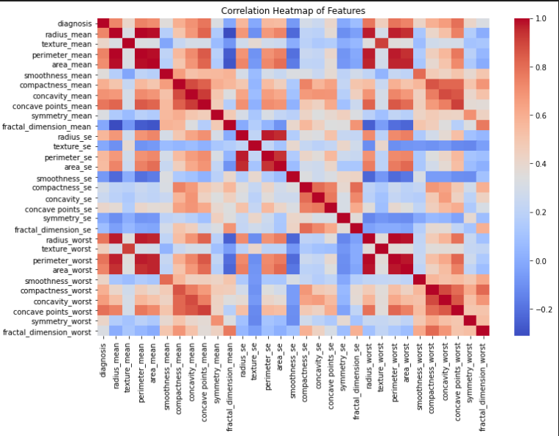
CORRELATION HEATMAP

Slide 10
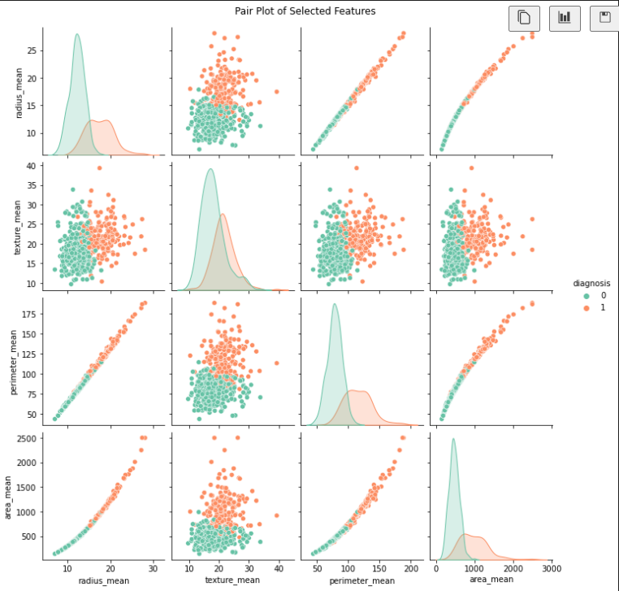
PAIR PLOT OF SELECTED FEATURES

Slide 11
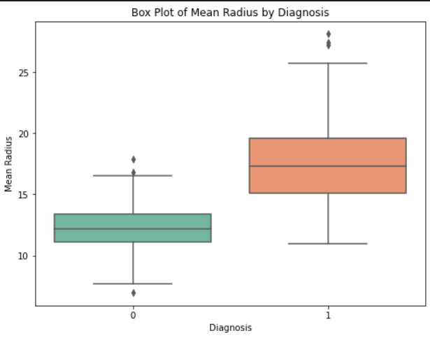
BOX PLOT OF FEATURE VALUES BY DIAGNOSIS

Slide 12
rECOMMENDATIONS
Deploy the Logistic Regression Model for real world use.

Slide 13
THANKYOU

