Slide 1
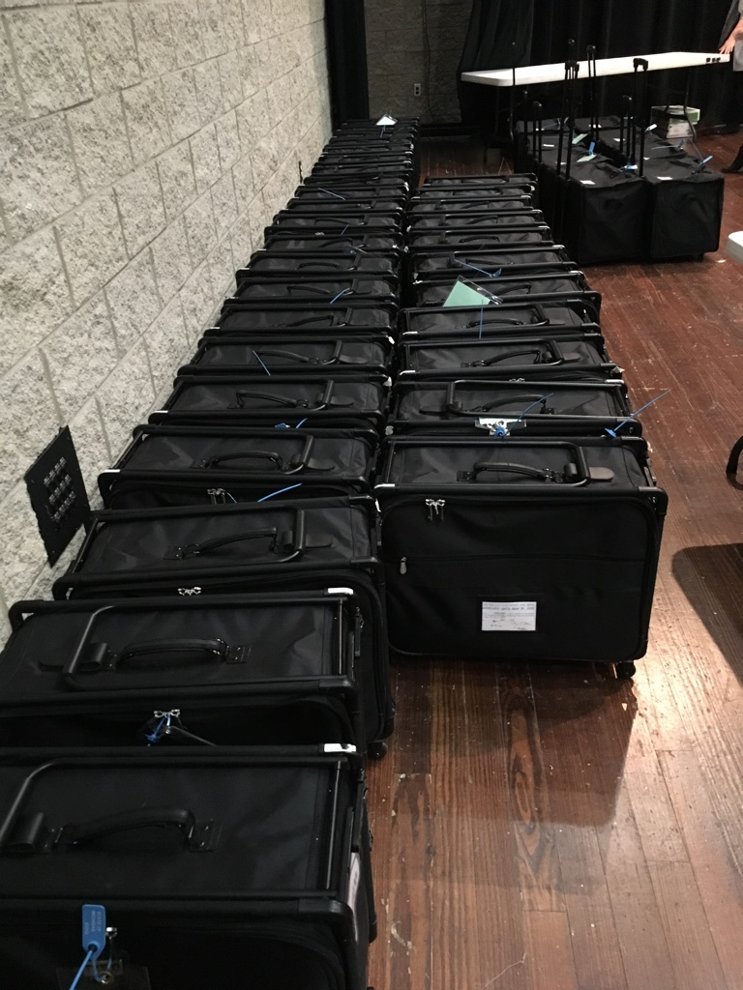
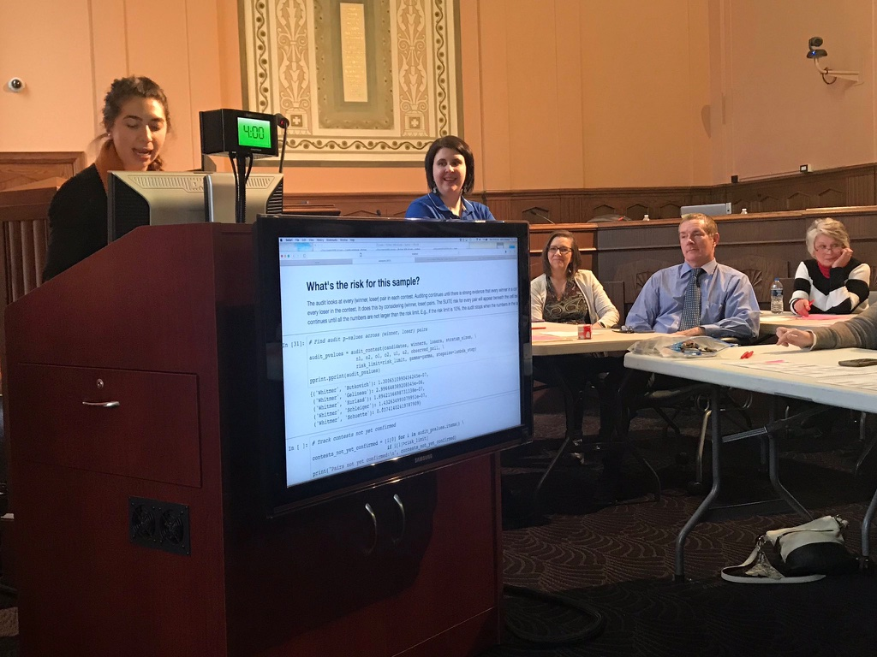
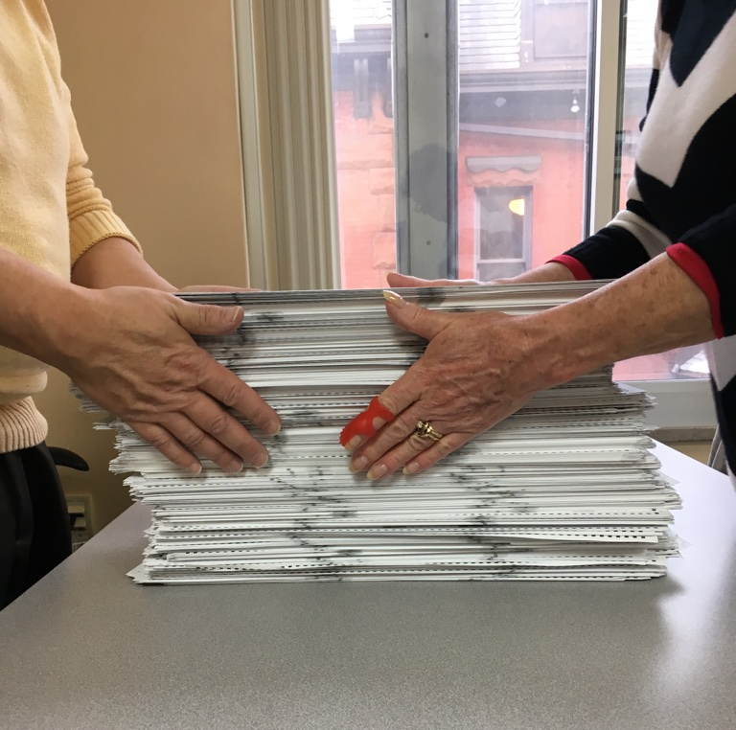
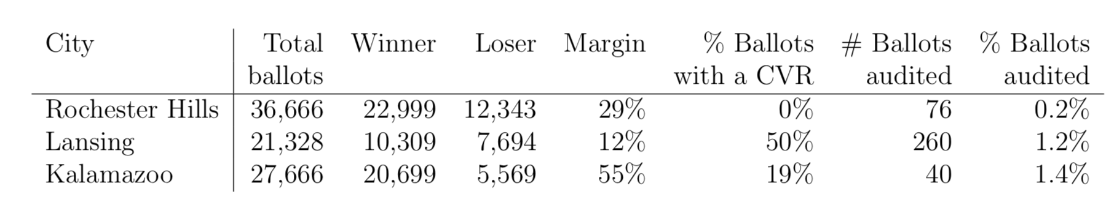



Piloting Risk-Limiting Post-Election Audits in Michigan
Kellie Ottoboni
Risk-Limiting Audits
The SUITE Tool
Challenges
Communication
RLAs in general
Jupyter notebook tool implementing x y and z…
Jupyter logo
Photo presenting the notebook at Kalamazoo
Creating the sampling frame – ballot manifest image
Locating ballots – ballot stack image
CVRs are difficult to work with. The file format is ugly, ballot handling needs to be extra careful.
State election rules – certain ballot bags couldn’t be opened. Censoring
Between academics and election officials is difficult but important!
They need confidence that they can do RLAs.
Academics need to understand the constraints they work under and the difficulties they face so new methods can be more usable.
SUITE
SUITE is a general framework for RLAs of stratified samples of ballots
I’d like to thank Philip Stark, Mark Lindeman, Neal McBurnett, and the ElectionAuditWare group for helpful suggestions on the math and SUITE tool, and the city clerks and state election officials in Michigan for inviting me to their pilots.
kellieotto@berkeley.edu
www.kellieottoboni.com
@kellieotto

