Slide 1


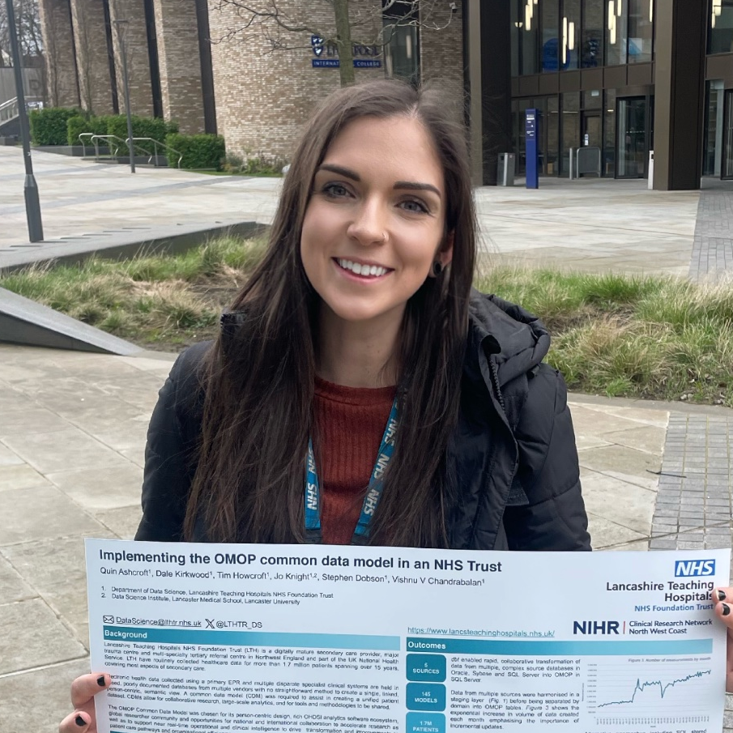



NHS Data
Routinely collected data
Patient-level prediction models
Data engineering

Slide 2


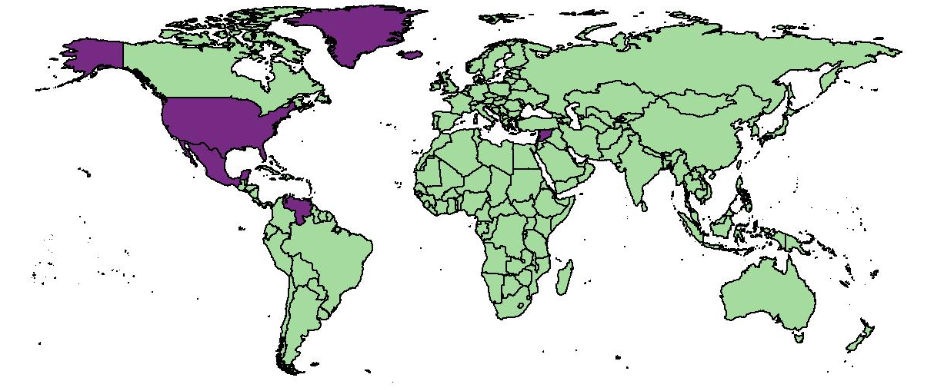

Statistics
Methodology development
Schools outreach work
Teaching statistics research

Slide 3
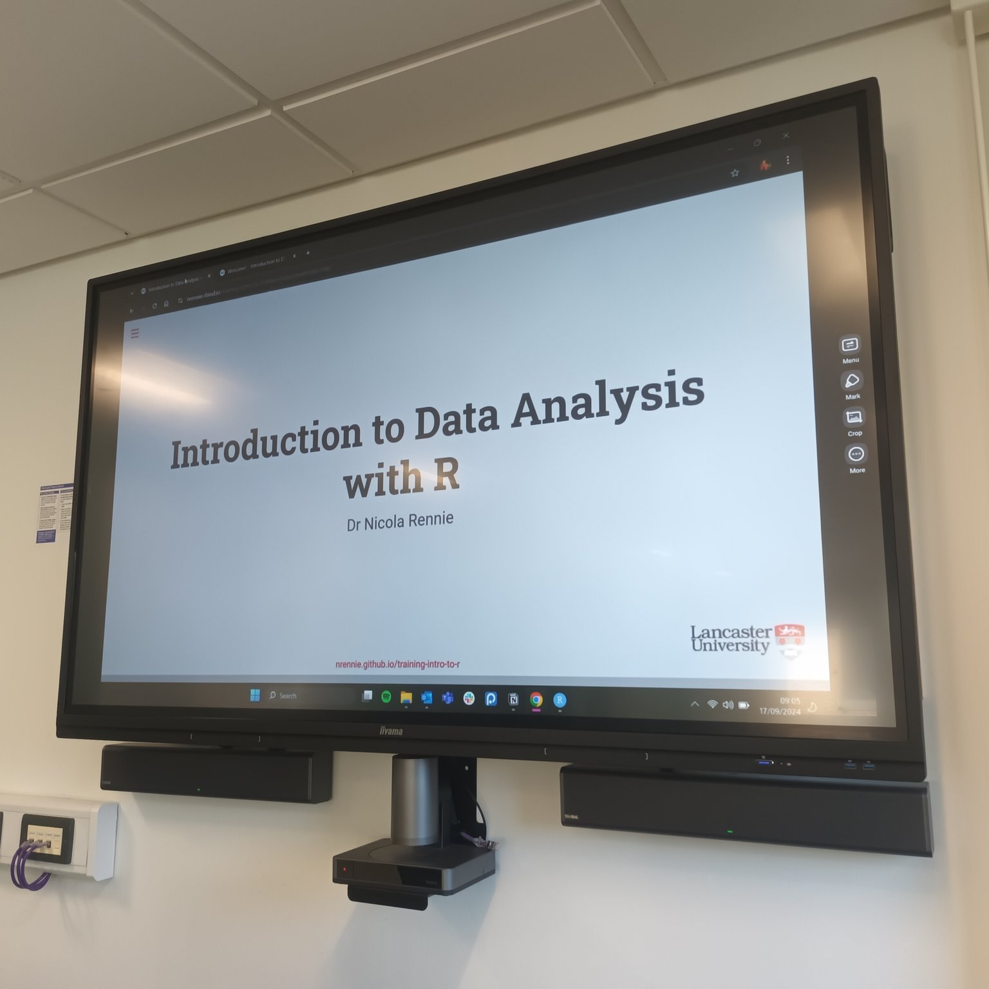



Research Software Engineering
Software development
Training
courses
Community building

Slide 4
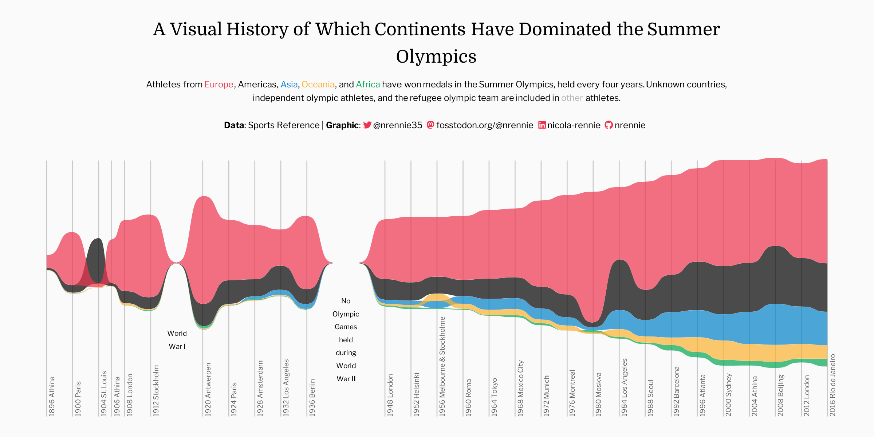

Data Visualisation
Best practices for visualisation
Visualisation review and editing
Developing teaching resources

