Slide 1


Method for functional MRI mapping of non-linear response
Peter Kellman
Peter van Gelderen
Jacco A. de Zwart
Jozef H. Duyn
Notes:
I will present a new method for mapping the non-linear response using functional MRI.

Slide 2
Can BOLD* fMRI be used to measure non-linear neuronal responses?
simplified cascade system model
neuronal response
~ 10’s milli-seconds
non-linear system1
(fast response)
non-linear
system2
(slow response)
Measured
BOLD
signal
stimulus
probe
hemodynamic response
  vasculature
  capillary bed
BOLD effect (MRI)
retinal
LGN
cortical cells (V1)
hemodynamic response
~ several seconds
* Blood Oxygen-Level Dependent
Notes:
The questions I pose is whether the BOLD fMRI signal can be use to measure neuronal non-linearities which have a fast response on the order of 10’s of msec even though the hemodynamic response lasts several seconds.
I will consider the problem as the non-linear system identification of a cascade of neuronal and hemodynamic effects which we seek to treat as a “black box” by measuring the response to a various stimuli.

Slide 3
Can BOLD fMRI be used to measure non-linear neuronal responses?
simplified cascade system model
non-linear
system1
(~ 10’s ms response)
non-linear
system2
(several sec response)
Measured
BOLD
signal
stimulus
probe
retinal
LGN
cortical cells (V1)
hemodynamic response
  vasculature
  capillary bed
BOLD effect (MRI)
Notes:
We may consider the system as a cascade of 2 non-linear dynamic systems with memory. The fast neuronal response includes the retino-cortical pathway, and the much slower hemodynamic response includes the vasculature and capillary bed.
We seek to find a set of probe stimuli to discriminate between the fast and slow systems.

Slide 4
Previous studies* have shown:
non-linearities in electrical activity
  ERG: Sutter (1987)
  EEG: Baseler & Sutter (1997)
  Intra-cellular: Benardete & Victor (1994)
non-linearities in BOLD fMRI
  Vasques & Noll (1998)
  Boynton, et al. (1996)
  Birn, et al. (2001)
  Friston, et al. (1998)
* key publication dates
Notes:
Previous studies have reported non-linearity in measured electrical activity as well as non-linearity in BOLD fMRI.
Non-linear response to visual stimulus activation have been measured using electro-retinograms, surface electrodes using EEG, and intracellular recordings.
Non-linearities in BOLD fMRI were reported by Vasques & Noll as well as Boynton who observed deviation from linear superposition when varying the stimulus duration. Birn, et al. reported a spatial heterogeneity of the non-linear response using a similar measurement method. Friston, et al. characterized the BOLD fMRI non-linearity by estimating Volterra kernel coefficients using a basis fitting approach, and concluded that the non-linearity was predominately caused by the hemodyamic effect.

Slide 5
Presentation Outline
Non-linear systems analysis
  Volterra-Wiener Models
Method
  M-sequence Probe method
  fMRI paradigms
Results
  Simulations
  Experimental
Notes:
I will present a non-linear systems analysis based on Volterra-Wiener modeling.
I will describe the m-sequence probe method and various fMRI stimulus paradigms used to disentangle the cascade of fast and slow systems.
I will present results from simulations and experimental data using fMRI to measure the response to visual activation.

Slide 6
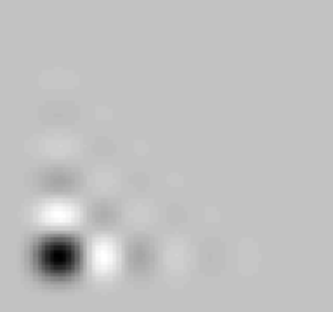
Volterra model
Example 1st and 2nd order kernels
k₂(n₁,n₂)
k₁(n)
n₁
n
n₂
Notes:
The Volterra model is a functional expansion of the output in terms of multi-dimensional convolutions of varying orders.
It is customary to truncate the model to 2nd order due to practical measurement limitations.
The variables k0, k1, k2, … in the functional expansion are referred to as the Volterra kernels. Example 1st and 2nd order kernels are shown for illustration. Note that the 2nd order kernel weights lag products of the form x(t-n1)x(t-n2).

Slide 7
Wiener model & kernel estimates using cross-correlation method
orthogonalization of Volterra functional series with white Gaussian noise stimulus:
Notes:
The Wiener model is based on the Volterra functional expansion. Wiener kernels of varying orders are orthogonalized for a white Gaussian noise probe.
The Wiener kernels may be estimated directly using the correlation method by Lee and Schetzen, which cross-correlates the measured response with the white Gaussian probe stimulus. The 2nd order kernel is estimated with a higher order correlation.

Slide 8
m-sequence probe method
reduce statistical fluctuation (as compared to white Gaussian noise)
previously used for measuring of electrical response to visual stimuli*
* Sutter (1987), Benardete & Victor (1994)
Notes:
M-sequence probing has been used for systems identification in many applications and, in particular, has been used for electrical measurement of the non-linear response to visual activation.
M-sequence probes have a reduced statistical fluctuation as compared with white Gaussian noise, and thereby an improved estimation efficiency.

Slide 9
m-sequence probe method
using cycle-and-add
property of m-sequences
b_{i}b_{i-j}=b_{i-k} (b = ±1)
h₁
h₂
inverse repeat method used to separate even and odd order responses
Notes:
Using m-sequence probes, we estimate the Wiener kernels by cross correlation.
Using the cycle-and-add property of m-sequences you can see that the product of a ±1 m-sequence with a delayed version produces a shifted version of the same sequence.
Thus the 2nd order kernel produces a response in the shifted m-sequence correlation. By judicious choice of m-sequence, it is possible to measure the 1st and 2nd order kernels without overlap.
The full period m-sequence correlation illustrates the response to 1st and 2nd order kernels using a 255-length sequence.
The inverse repeat method may be used to further separate even and odd order responses.

Slide 10
inverse repeat method
used to separate even and odd order responses
binary m-sequence
inverted binary m-sequence
full
period
cross-
correlations
r₁
r₂
r₁ - r₂
r₁ + r₂
odd order
even order
Notes:
The inverse repeat method measures the response to both the probe sequence and its inverse where a 1 becomes a 0 and 0 becomes a 1.
The 1st order response changes sign proportional to the sign of the input while the 2nd order response does not change sign.
Therefore, the odd and even order responses are separated by a simple difference and sum.

Slide 11
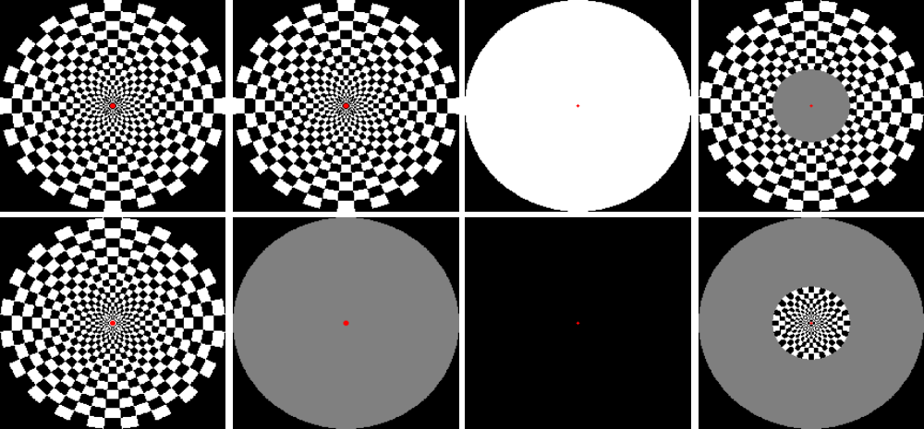
Visual Stimuli
bullseye
reversals
bullseye
gray
uniform disk
reversals
fovea-periphery bullseye
reversals (e = 2.5 & 8º)
“1”
“0”
block paradigm
(30s on/30s off)
m-sequence paradigms
Notes:
Various fMRI visual paradigms were used in conjunction with the binary m-sequence probe.
In one experiment a bulleye and its reverse were presented in correspondence to a 1 and 0 of the m-sequence.
In a 2nd experiment, a 0 corresponded to a uniform gray with mean luminance equal to that of the bullseye after gamma correction for the display.
In a 3rd experiment, black & white uniform disks were presented.
A conventional block design paradigm alternating between annular and central disk regions of bullseye reversals was used to define foveal and peripheral regions for measuring average correlation scores.

Slide 12
bullseye-reversal paradigm (simulation)
0 ms gap
200 ms gap
intensity
contrast
linear filter
output (L₁)
nonlinear sys.
output (L₁N₁)
time
time
m-sequence
Correlation
(L₁N₁L₂N₂)
lag delay
lag delay
2nd order response
no 2nd order response
Notes:
A simulation was performed using a cascade model of 2 nonlinear systems as described, each a Wiener system composed of a linear dynamic system followed by a memoryless nonlinearity (i.e., L₁N₁L₂N₂).
The 1st system (L₁) was bandpass and had a fast response, and the 2nd system (L₂) was a lowpass with a slow response on the order of several seconds. Full-wave rectification non-linearities were used.
On the left is the simulation for bullseye reversals. The intensity is 1,0 corresponds to a check that is initially white. The ±1 signed contrast corresponds to the output of the spatial Laplacian resulting from retinal processing. The linear filter L1 causes spikes at the transitions and a small proportional or DC response is produced as well.
Various waveforms are displayed for the 1st 16 m-seqence bits, and the full period cross-correlation is shown on the bottom.
After rectification the proportional response is constant & no longer correlates with the m-sequence. The second order response corresponding to the transitions is evident.
Next, consider the stimulus paradigm on the right. A 200 msec gap was introduced between stimuli as a decorrelating delay to discriminate between fast and slow systems. This gap is much > the fast neuronal response but much < than the several sec hemodynamic response. A uniform gray was presented during the gap.
In this case, there are periodic spikes which do not result in a second order correlation.
If the system had been a single cascade L₂N₂ with slow L₂, the 2nd order response would not have disappeared.

Slide 13
bullseye-gray paradigm
(simulation)
0 ms gap
200 ms gap
intensity
contrast
linear filter
output (L₁)
nonlinear sys.
output (L₁N₁)
time
time
m-sequence
Correlation
(L₁N₁L₂N₂)
lag delay
lag delay
1st order response
2nd order response
no 2nd order response
Notes:
Simulated waveforms are shown for a bullseye-gray paradigm with and without a gap.
In this case, the proportional response is unipolar and, therefore, the rectified output correlates with the m-sequence producing a 1st order response.
The 2nd order response disappears using a decorrelating delay, as before.

Slide 14
Stimulus timing
10 minute acquisition
(600 bits at 1 bit per second)
binary m-sequence
inverted binary m-sequence
augmented
(45 bits)
full period (255 bits)
1 0 1 1 1 0 0 1
paradigm without gap
1 g 0 g 1 g 1 g 1 g 0 g 0 g 1 g
paradigm with gap (g)
Notes:
The stimulus timing is shown for the inverse repeat method.
The visual stimulus is presented according to the m-sequence followed by the inverse.
Each 255-bit period m-sequence is augmented to enable discarding of the transient response.
The entire scan is 10 minutes in duration.

Slide 15
Imaging Parameters
Scanner GE LX
Field Strength 3 Tesla
Imaging Sequence single shot EPI
Repetition Period (TR) 1 s
# slices (per repetition) 8
FOV (typical) 18 x 24 cm²
Spatial resolution (nominal) 3.75 x 3.75 x 4 mm³
Image plane orientation parallel to calcarine fissure
Notes:
Imaging was performed using a 3T scanner with these scan parameters.
8 slices oblique slices parallel to the calcarine fissure and encompassing the primary visual cortex were scanned each second with a resolution of approximately 4 mm.

Slide 16
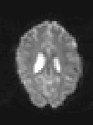





Bullseye-Gray
image intensity
1st order response
0 gap 200 ms gap
A
B
C
D
E
F
t-score
(block paradigm)
2nd order response
0 gap 200 ms gap
Notes:
The results of correlation analysis are shown here for a normal subject using the bullseye-gray paradigm.
The upper left image displays the image intensity to serve as an anatomical reference.
The lower left is a map of the t-score from the block design where the dark region corresponds to the fovea and the light region corresponds to the periphery (2 to 8 degrees eccentricity)
(B) and (E) are the 1st and 2nd order response maps without a gap, and (C) and (F) are the 1st and 2nd order responses with a 200 ms gap. As predicted, the 2nd order response is greatly attenuated with the gap indicating the 2nd order nonlinear response is predominantly due to the fast neuronal response.
Note that there is also a trend that the fovea has a stronger 1st order response than the periphery, while the periphery has a stronger 2nd order response than the fovea.

Slide 17
Example raw correlation plots bullseye-gray paradigm
fovea
periphery
raw correlation for inverse repeat
raw correlation for inverse repeat
1st order response (difference)
1st order response (difference)
correlation
2nd order response (sum)
2nd order response (sum)
lag delay
lag delay
Notes:
Raw correlation waveforms are shown for a single pixel in the fovea on the left and a single pixel in the periphery on the right.
The top traces show the raw correlation for both m-sequence and inverse repeat overlaid.
The 1st order response or difference is shown in the middle row. The 1st order response is an estimate of the hemodynamic response function which is delayed 3 to 4 seconds and has a several second duration. The 1st order response also has a characteristic undershoot.
The 2nd order response or sum is shown in the bottom trace. The 2nd order response is negative and correlates at a delay offset which is determined by the specific m-sequence used.
Note that the higher relative strength of the 2nd order response in the periphery and higher relative strength of the 1st order response in the fovea.

Slide 18
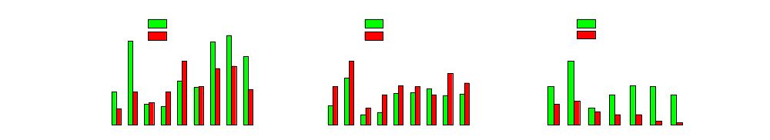
mean correlation scores bullseye-gray paradigm
1-st order (linear)
response
2-nd order (non-linear)
response
2-nd order response
(peripheral region)
correlation
subject
subject
subject
Notes:
Average correlation scores were measured in the peripheral and foveal regions as determined from the thresholded t-score map from the block design experiment.
Mean scores are shown for n=9 subjects. The comparison of 2nd order response with and without gap used n=7 subjects and showed a statistical significance of p<0.002 in a paired t-test.

Slide 19
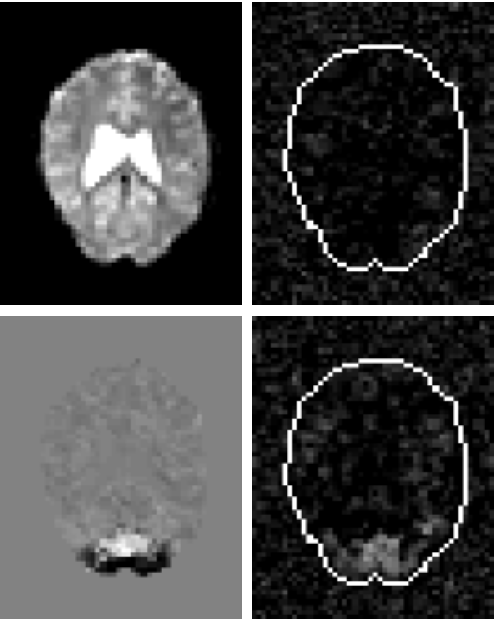

Bullseye-reversal
image intensity
1st order response
0 gap
A
B
C
D
t-score
(block paradigm)
2nd order response
0 gap
Notes:
The results of correlation analysis are shown here for a normal subject using the bullseye-reversal paradigm.
As predicted, there is no 1st order response using the bullseye reversal paradigm indicating that the bipolar contrast signal is subject to a full-wave rectification or squaring.
The 2nd order response is stronger in the peripheral than foveal region.

Slide 20


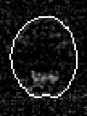
Uniform disk
image intensity
1st order response
0 gap
A
B
C
D
t-score
(block paradigm)
2nd order response
0 gap
Notes:
The results of correlation analysis are shown here for a normal subject using the black & white uniform disk paradigm.
In this case there is just temporal contrast but no spatial contrast.
As with the bipolar bullseye-reversals, there is no 1st order response.
Unlike the previous paradigms which had constant mean luminance, the optical scatter from the projection screen has the same m-sequence temporal modulation.
The scatter which illuminates the magnet bore stimulates the far peripheral region which is evident from the 2nd order response map.
The far periphery is highly sensitive to temporal contrast even without spatial contrast.

Slide 21
Example raw correlation plot uniform disk paradigm
periphery
raw correlation for inverse repeat
1st order response (difference)
correlation
2nd order response (sum)
lag delay
Notes:
Raw correlation waveforms are shown for a single pixel in the periphery.
The 2nd order response is clearly detectable, while there is no 1st order response.

Slide 22
conclusion
Can BOLD* fMRI be used to measure non-linear neuronal responses? YES
New method to explore non-linear response and interactions
  M-sequence probe & correlation analysis
  2nd order response maps
  fMRI paradigms using inter-stimulus gap as “control”
Non-linear systems analysis based on Volterra-Wiener Models
Preliminary Findings
  consistent with reported electrical activity
  consistent with visual system models
Notes:
In conclusion, we have demonstrated that BOLD fMRI may indeed be used to probe neuronal non-linearities despite the seconds long hemodynamic response.
This new method uses a m-sequence probe with and without a small decorrelating delay to discriminate the effects of fast and slow responses.
The preliminary experiments with visual activation are consistent with electrical activity measured using a variety of methods.
The increased temporal contrast sensitivity in the periphery has also been reported.

Slide 23
acknowledgement
We acknowledge helpful discussions with
Dr. Jonathan D. Victor
Department of Neurology and Neuroscience,
Weill Medical College of Cornell University
Notes:
I would like to acknowledge helpful discussions with Dr. Jonathan Victor of Cornell

