Slide 1

SENSE Coefficient Calculation using Adaptive Regularization
Peter Kellman and Elliot R. McVeigh
Laboratory for Cardiac Energetics
National Heart, Lung, and Blood Institute
National Institutes for Health

Slide 2
Regularization
…. a method to improve conditioning of inverse
Regularization may be applied to improve conditioning
    - tolerance to errors in B1-map estimates is increased
- solution becomes biased
    (i.e., ghost artifact suppression is degraded)
    - noise amplification (G-factor) is reduced
Adaptive regularization uses a priori
- does not penalize regions with low ghosts

Slide 3
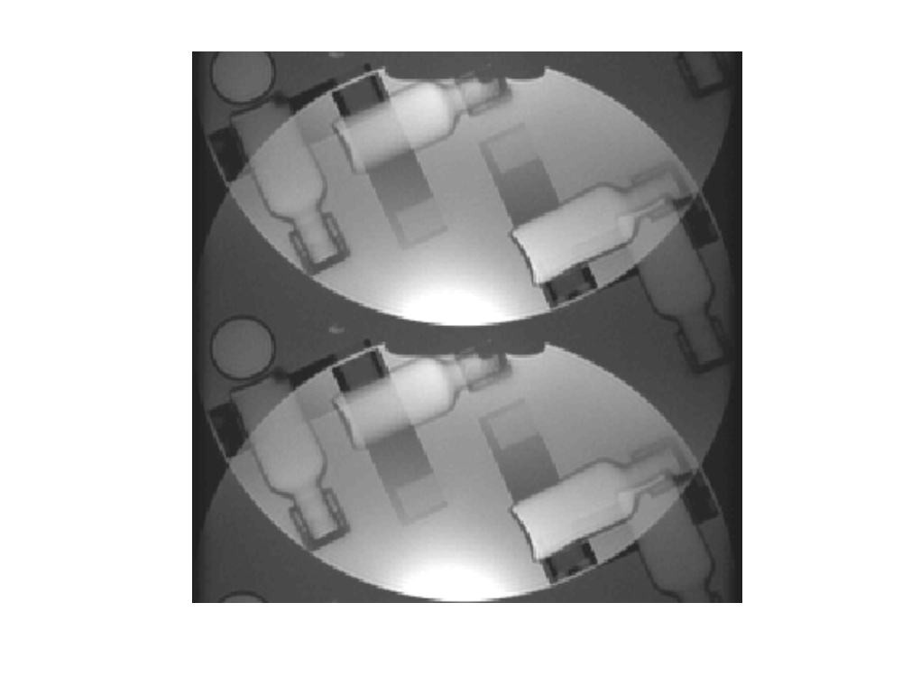
Illustration
R = 2 example
Weak artifact
Strong artifact
No artifact

Slide 4
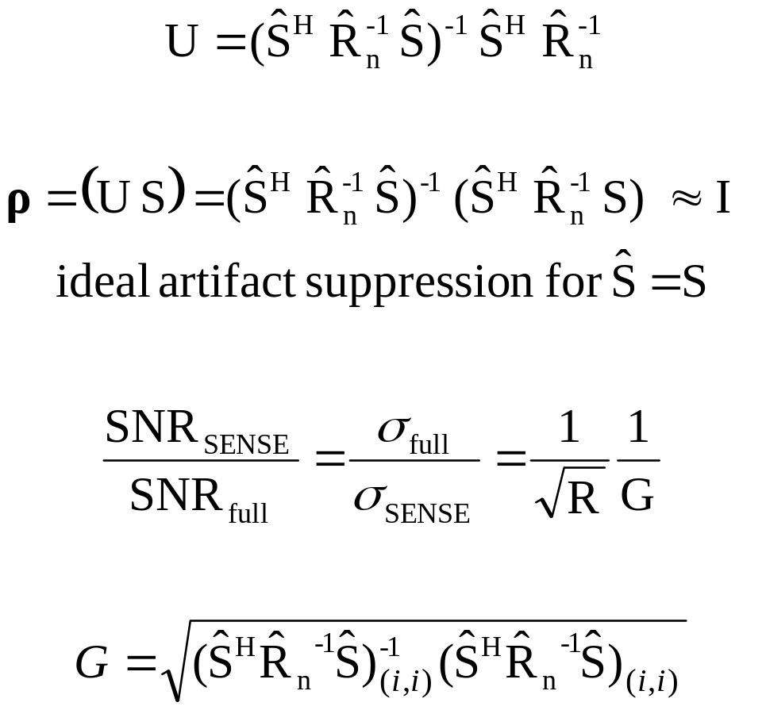
SENSE Solution without regularization
SENSE unmixing coefficients:
Alias artifact suppression:
SNR loss:
Noise inflation factor:

Slide 5
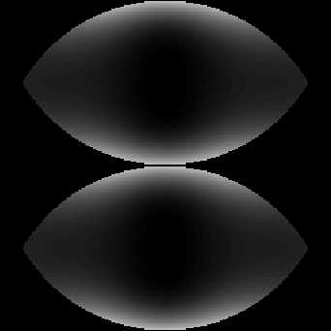
Example G-factor
R=2 using 4-coil Cardiac Array
1.25
1.2
1.15
1.1
1.05
1

Slide 6
Regularization using diagonal loading with fixed parameter
λ
large
λ = 0
Optimum B1-weighted phased array combining subject to perfect nulling constraint:
(normal SENSE solution)
Optimum B1-weighted phased array combining without any alias artifact suppression

Slide 7
Adaptive Regularization
R = 2 example

Slide 8
Adaptive Regularization
(simplified diagram)
compute desired
artifact suppression, ρ_{d}
compute
regularization parameter, Λ(x,y)
estimate
actual artifact
suppression, ρ
multi-coil
unaliased
images
estimate
coil
sensitivities, S
compute
SENSE
coefficients, U
output
SENSE
coefficients
(at last iteration)

Slide 9
G-Factor Validation
(SNR Measurement Method)
100
3
4
1
2
•
(x,y)

Slide 10
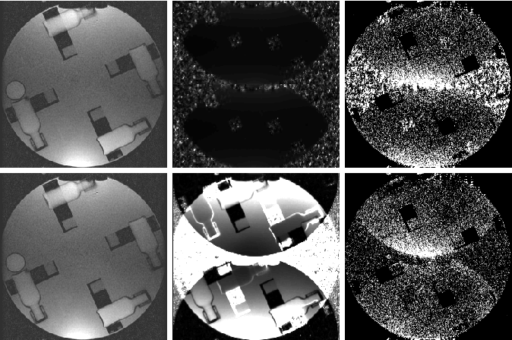
Preliminary results
artifact
suppression
ρ(x,y)
noise
amplification factor
G(x,y)
reconstructed
phantom image
fixed
regularization
adaptive
regularization

Slide 11
Conclusion
Benefits of adaptive regularization
  improved signal-to-noise ratio in certain regions
  alleviates need for thresholding the raw sensitivity maps
  (thresholding is often problematic)
Further Work
  experimental evaluation for several applications
  extension to higher acceleration factors
  performance characterization and parameter optimization

